Slide 1
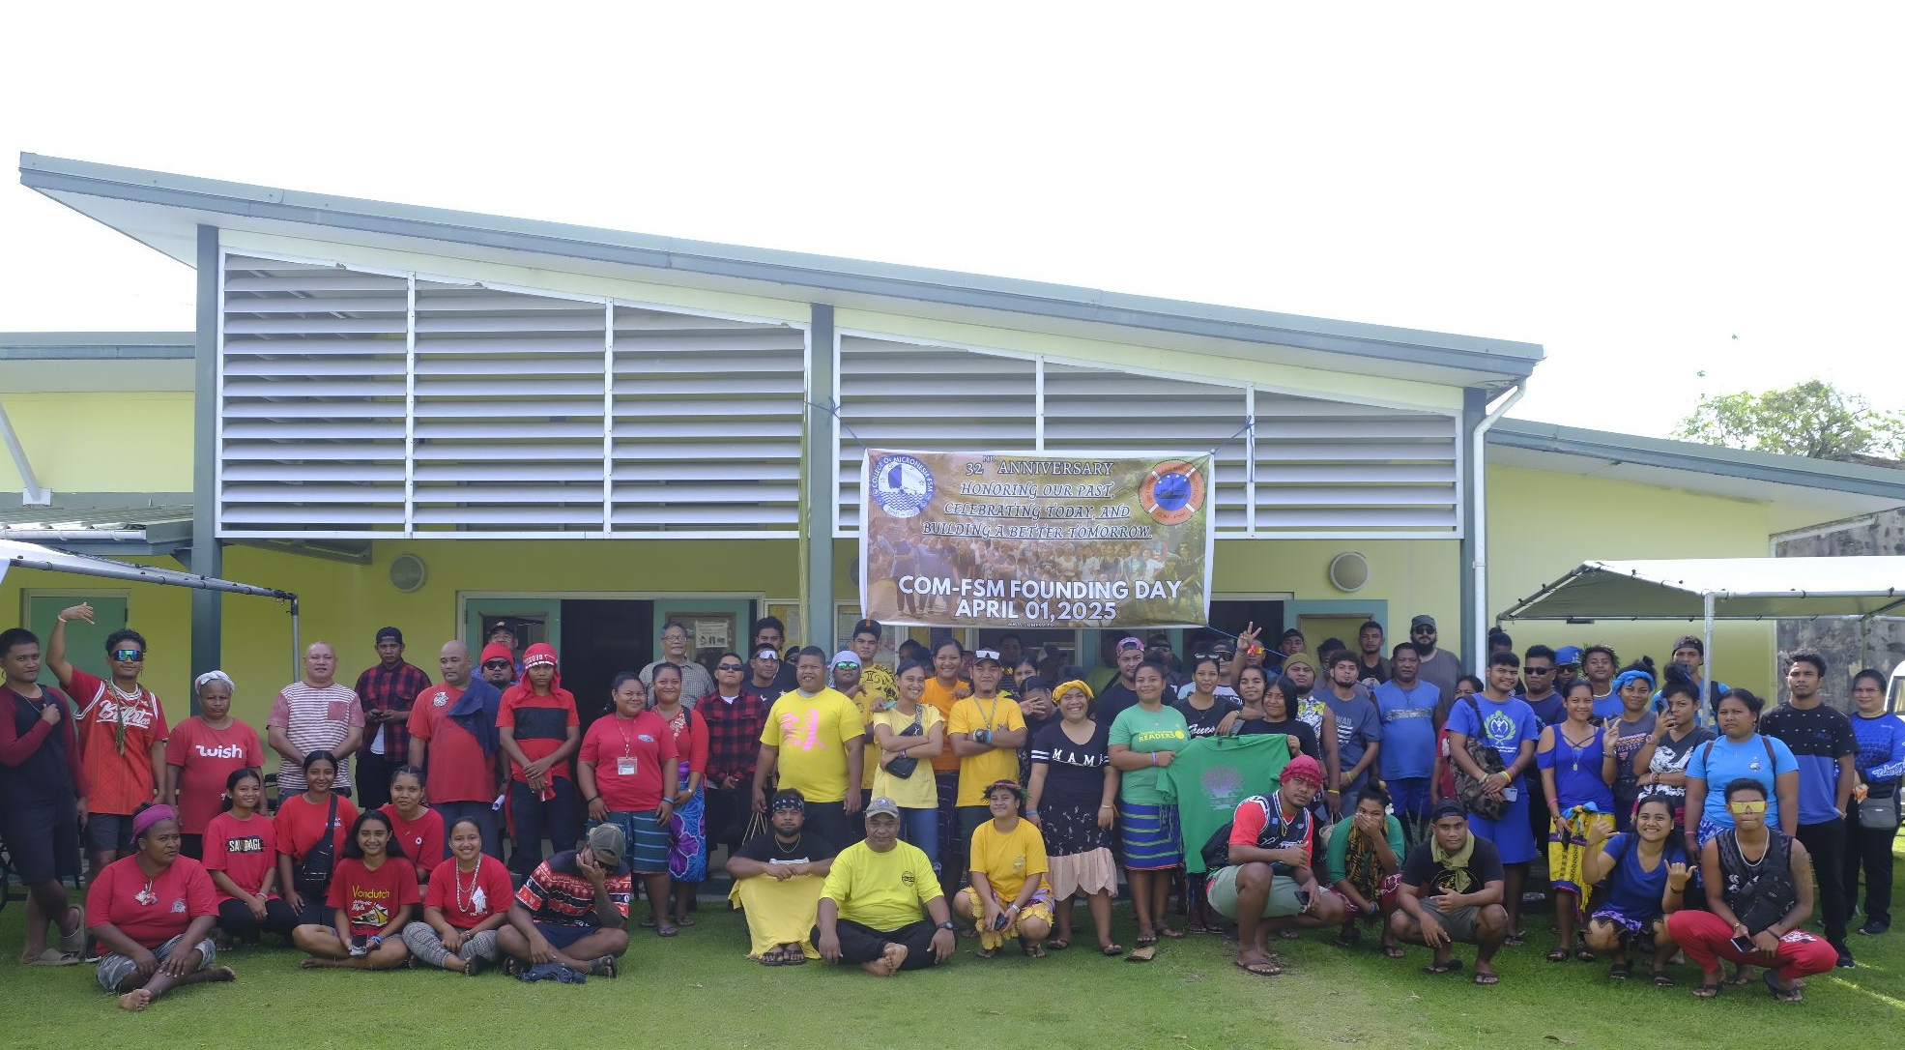
Board of Regents: SBA Report
COM-FSM
Mogethin
Rananim
Kaselehlie
Lenwo
DATE: September.02,2026

Slide 2
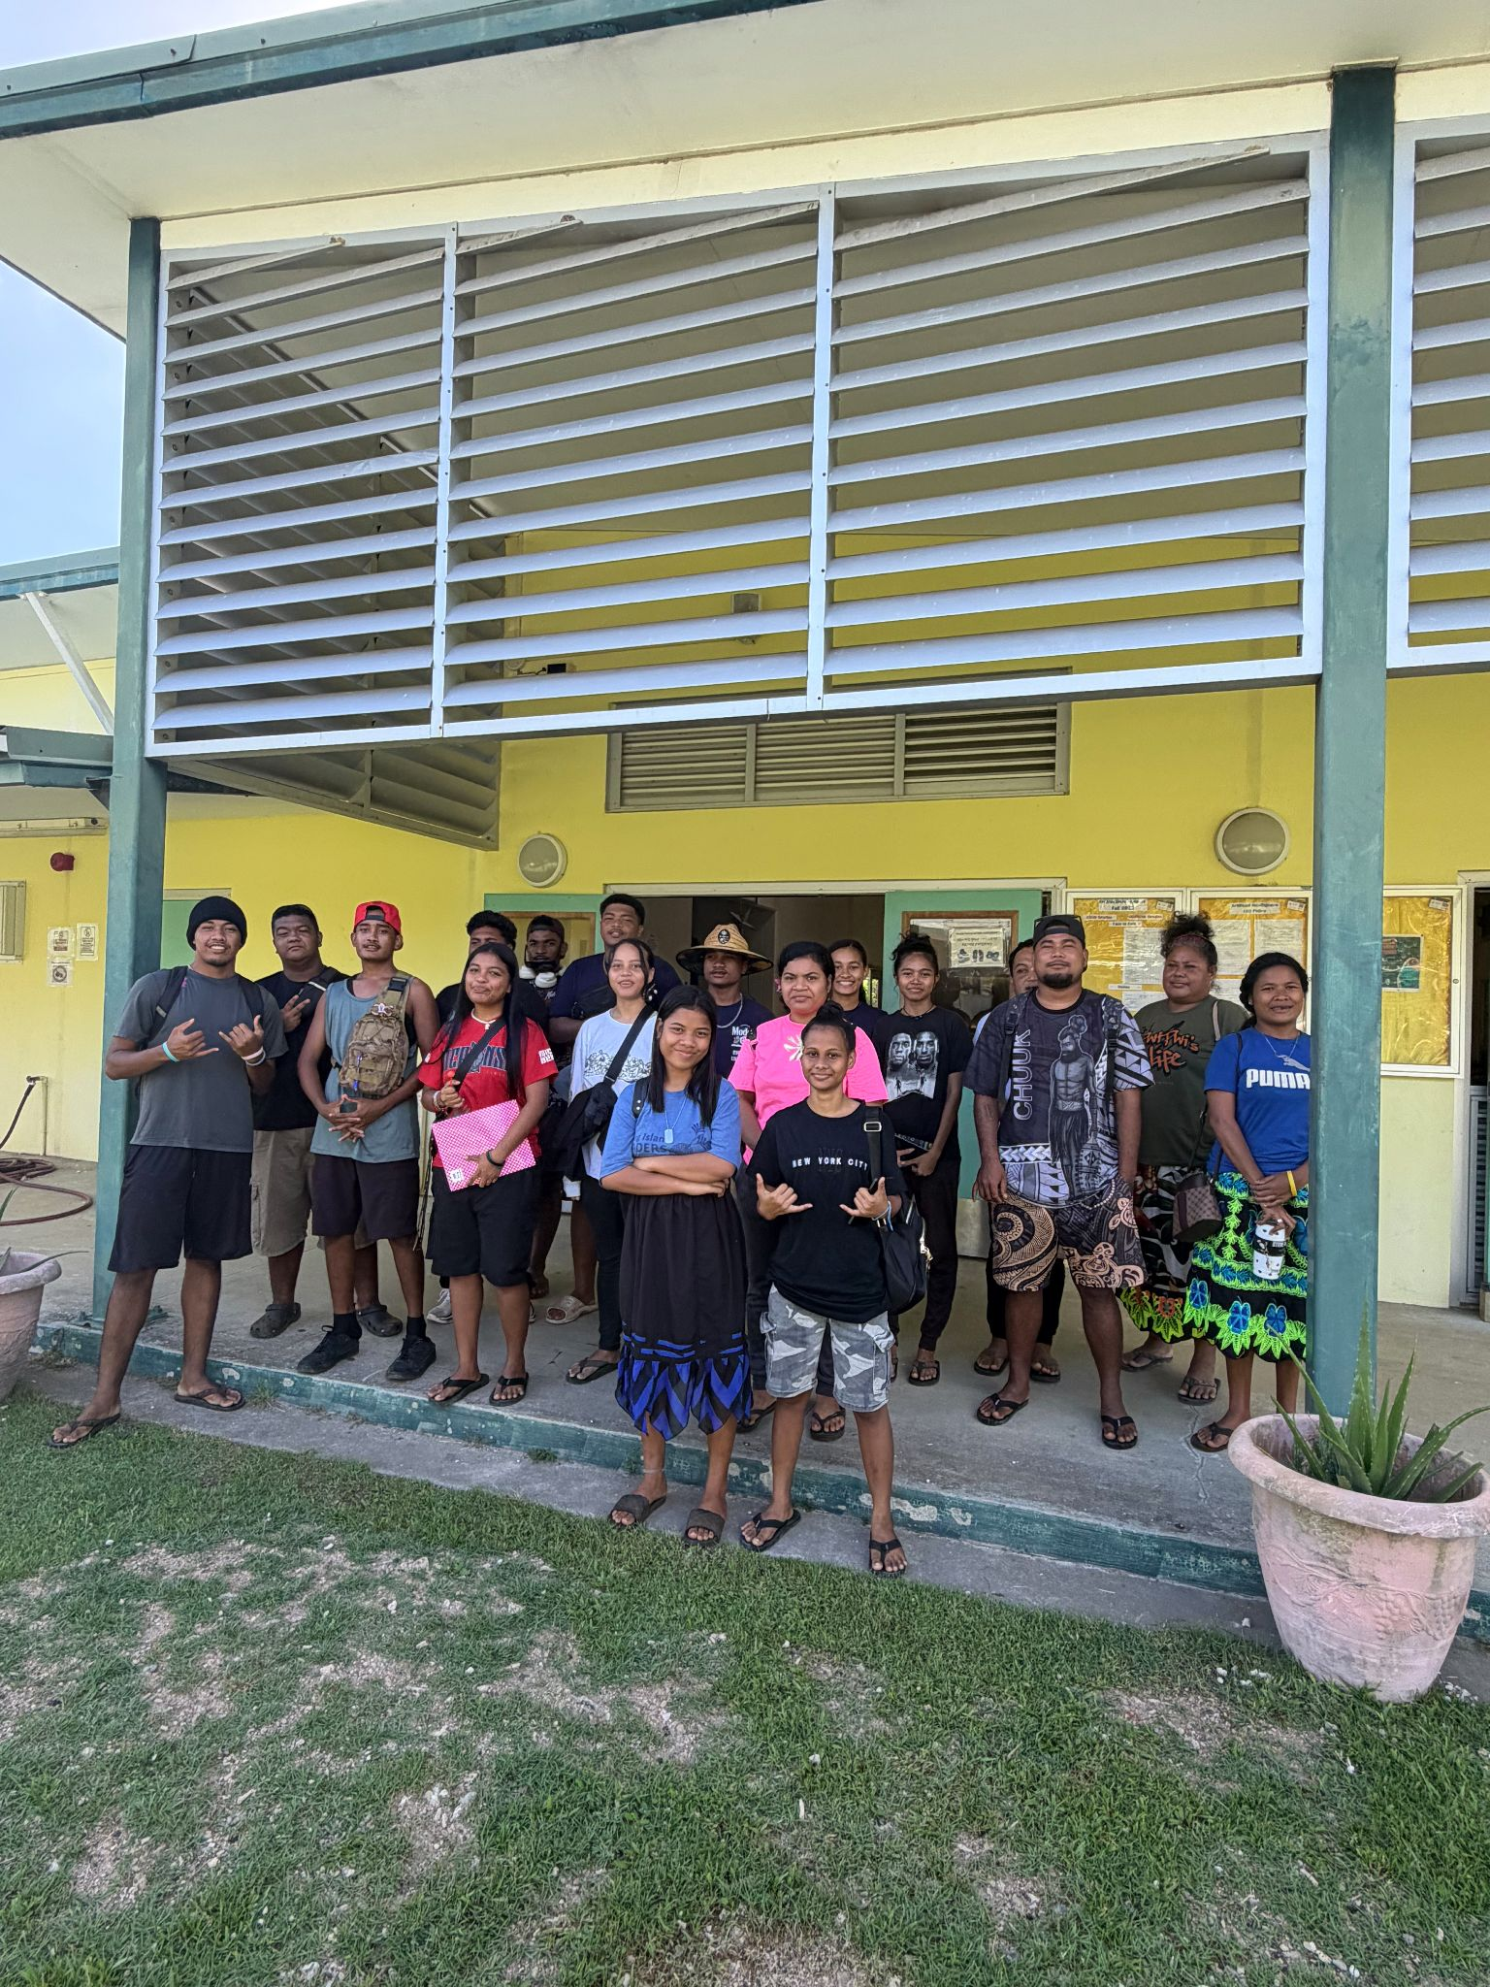
COM-FSM Mission Statement
The College of Micronesia -FSM is a learner-centered institution of higher education that is committed to the success of the Federated States of Micronesia by providing academic and career & technical educational programs characterized by continuous improvement and best practices.

Slide 3
COM-FSM Campus Activities
COM-FSM, Yap Campus
FSM-Fisheries and Maritime Institution
COM-FSM, Chuuk Campus
COM-FSM, Pohnpei Campus/CTEC
COM-FSM, National Campus
COM-FSM, Kosrae Campus

Slide 4
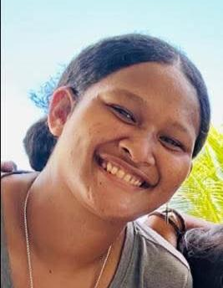
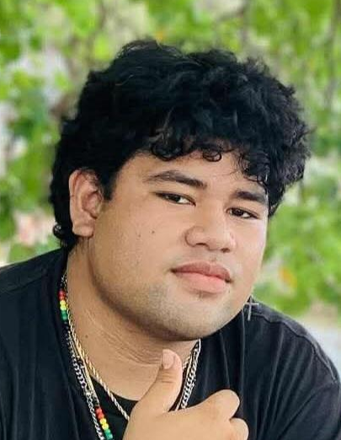
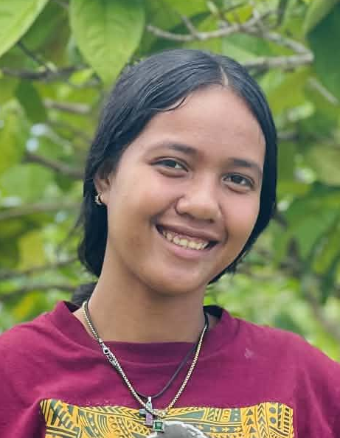
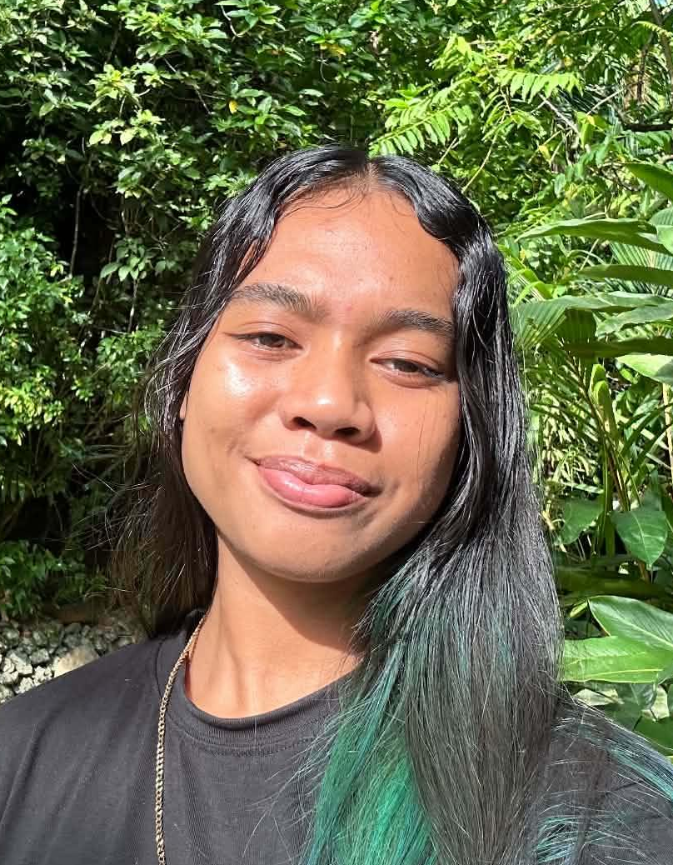
YAP CAMPUS SBA
Zinaida Hazel Yolomoch
Martinus Tinus Alokoa
Alpha Leyangerwel
Joannista Berngun
President
Vice President
Secretary
Treasurer

Slide 5
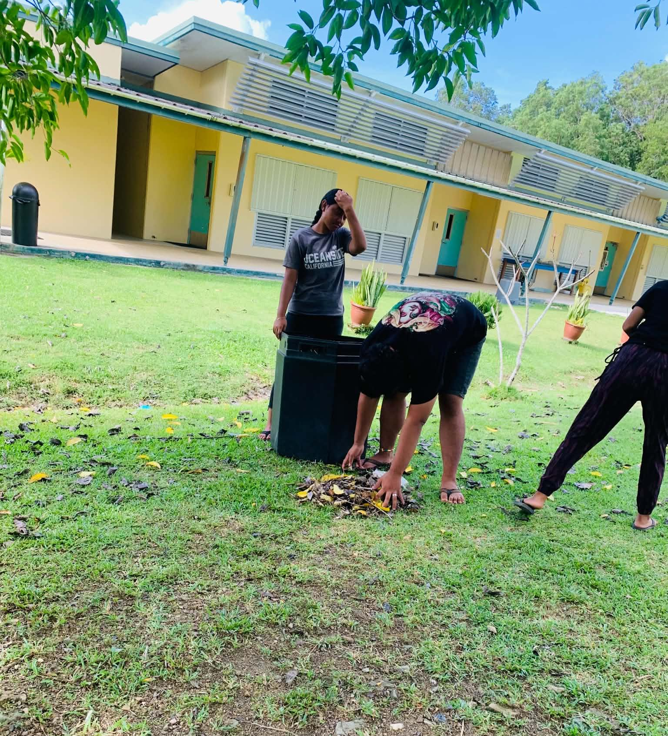
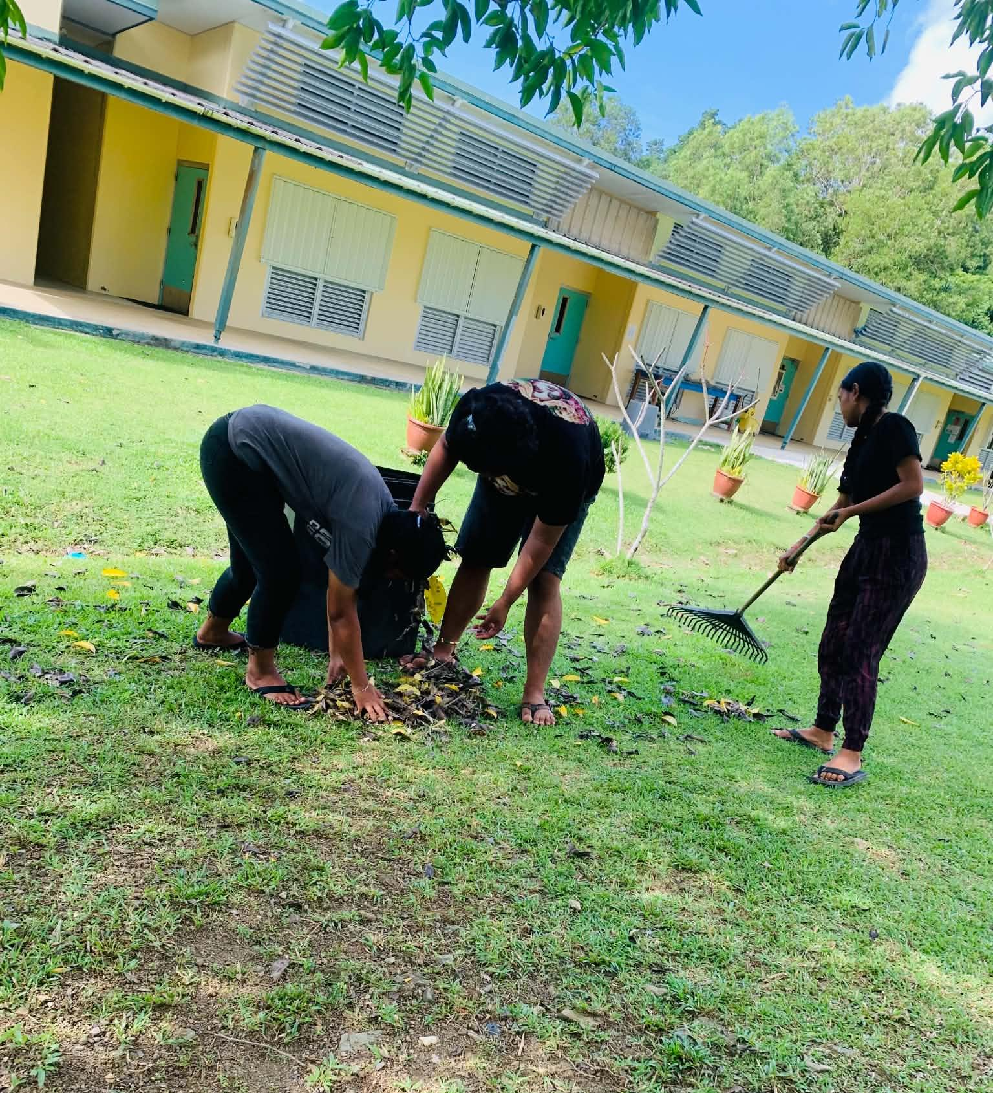
Yap Campus Activities (Friday Clean-up)
Every other friday we do clean up to help keep our campus clean and inviting.

Slide 6
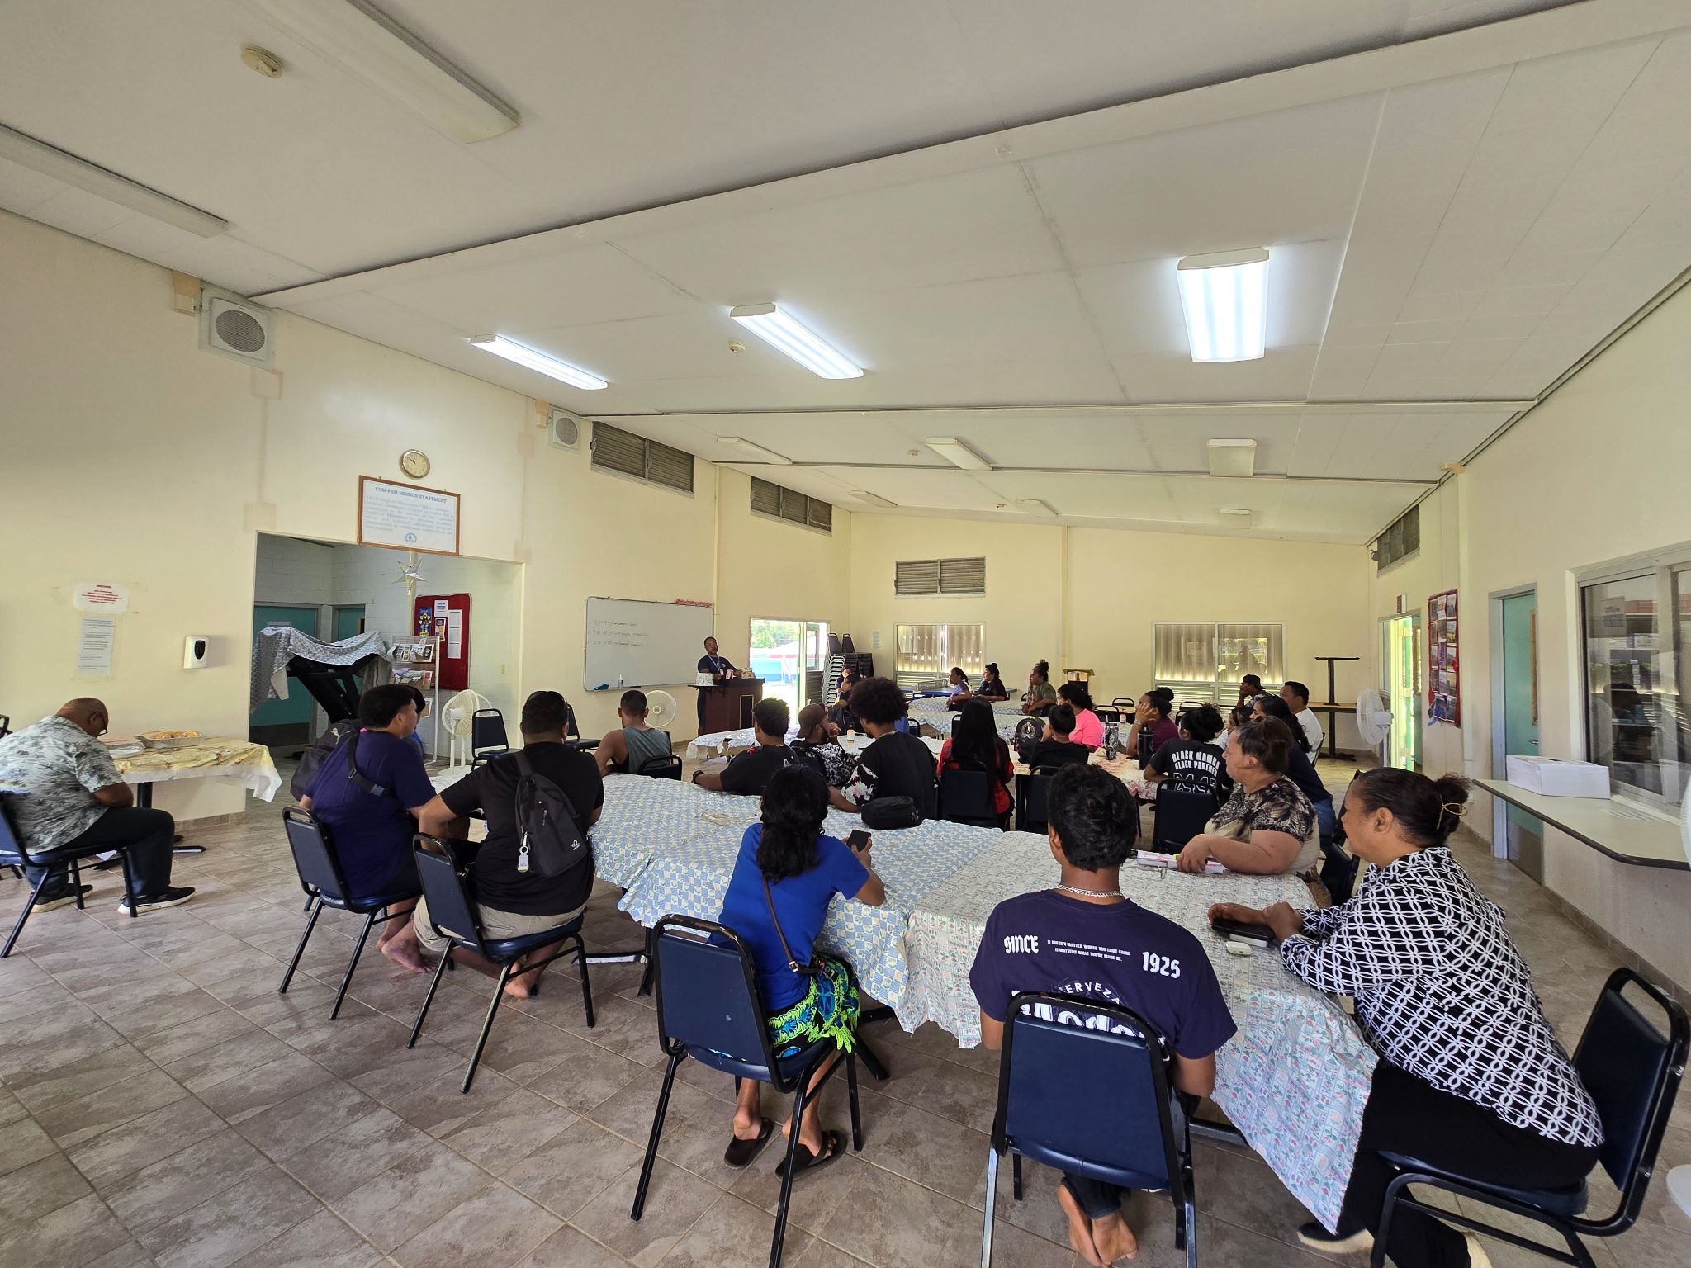
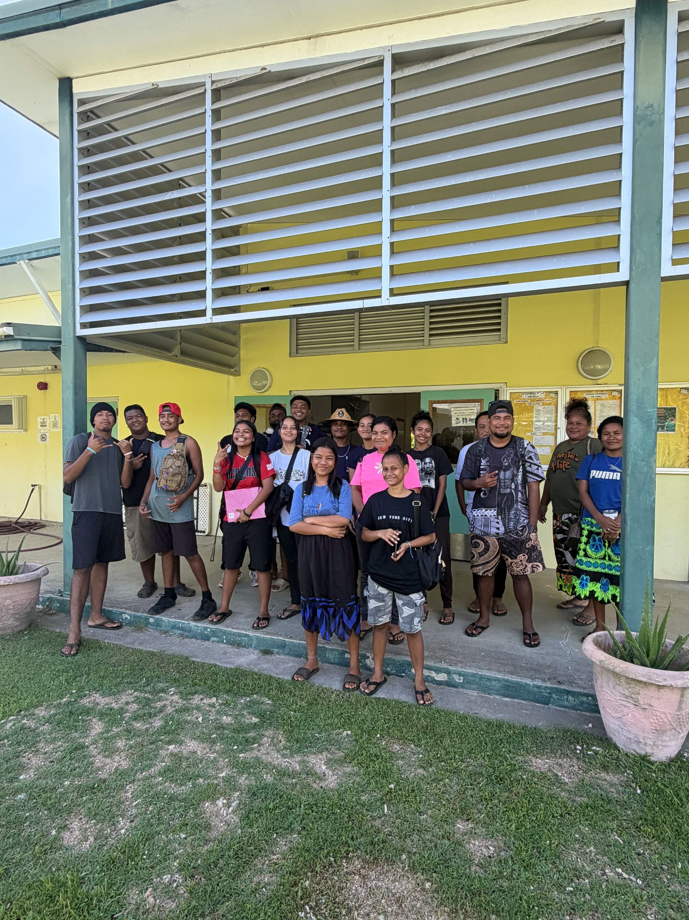
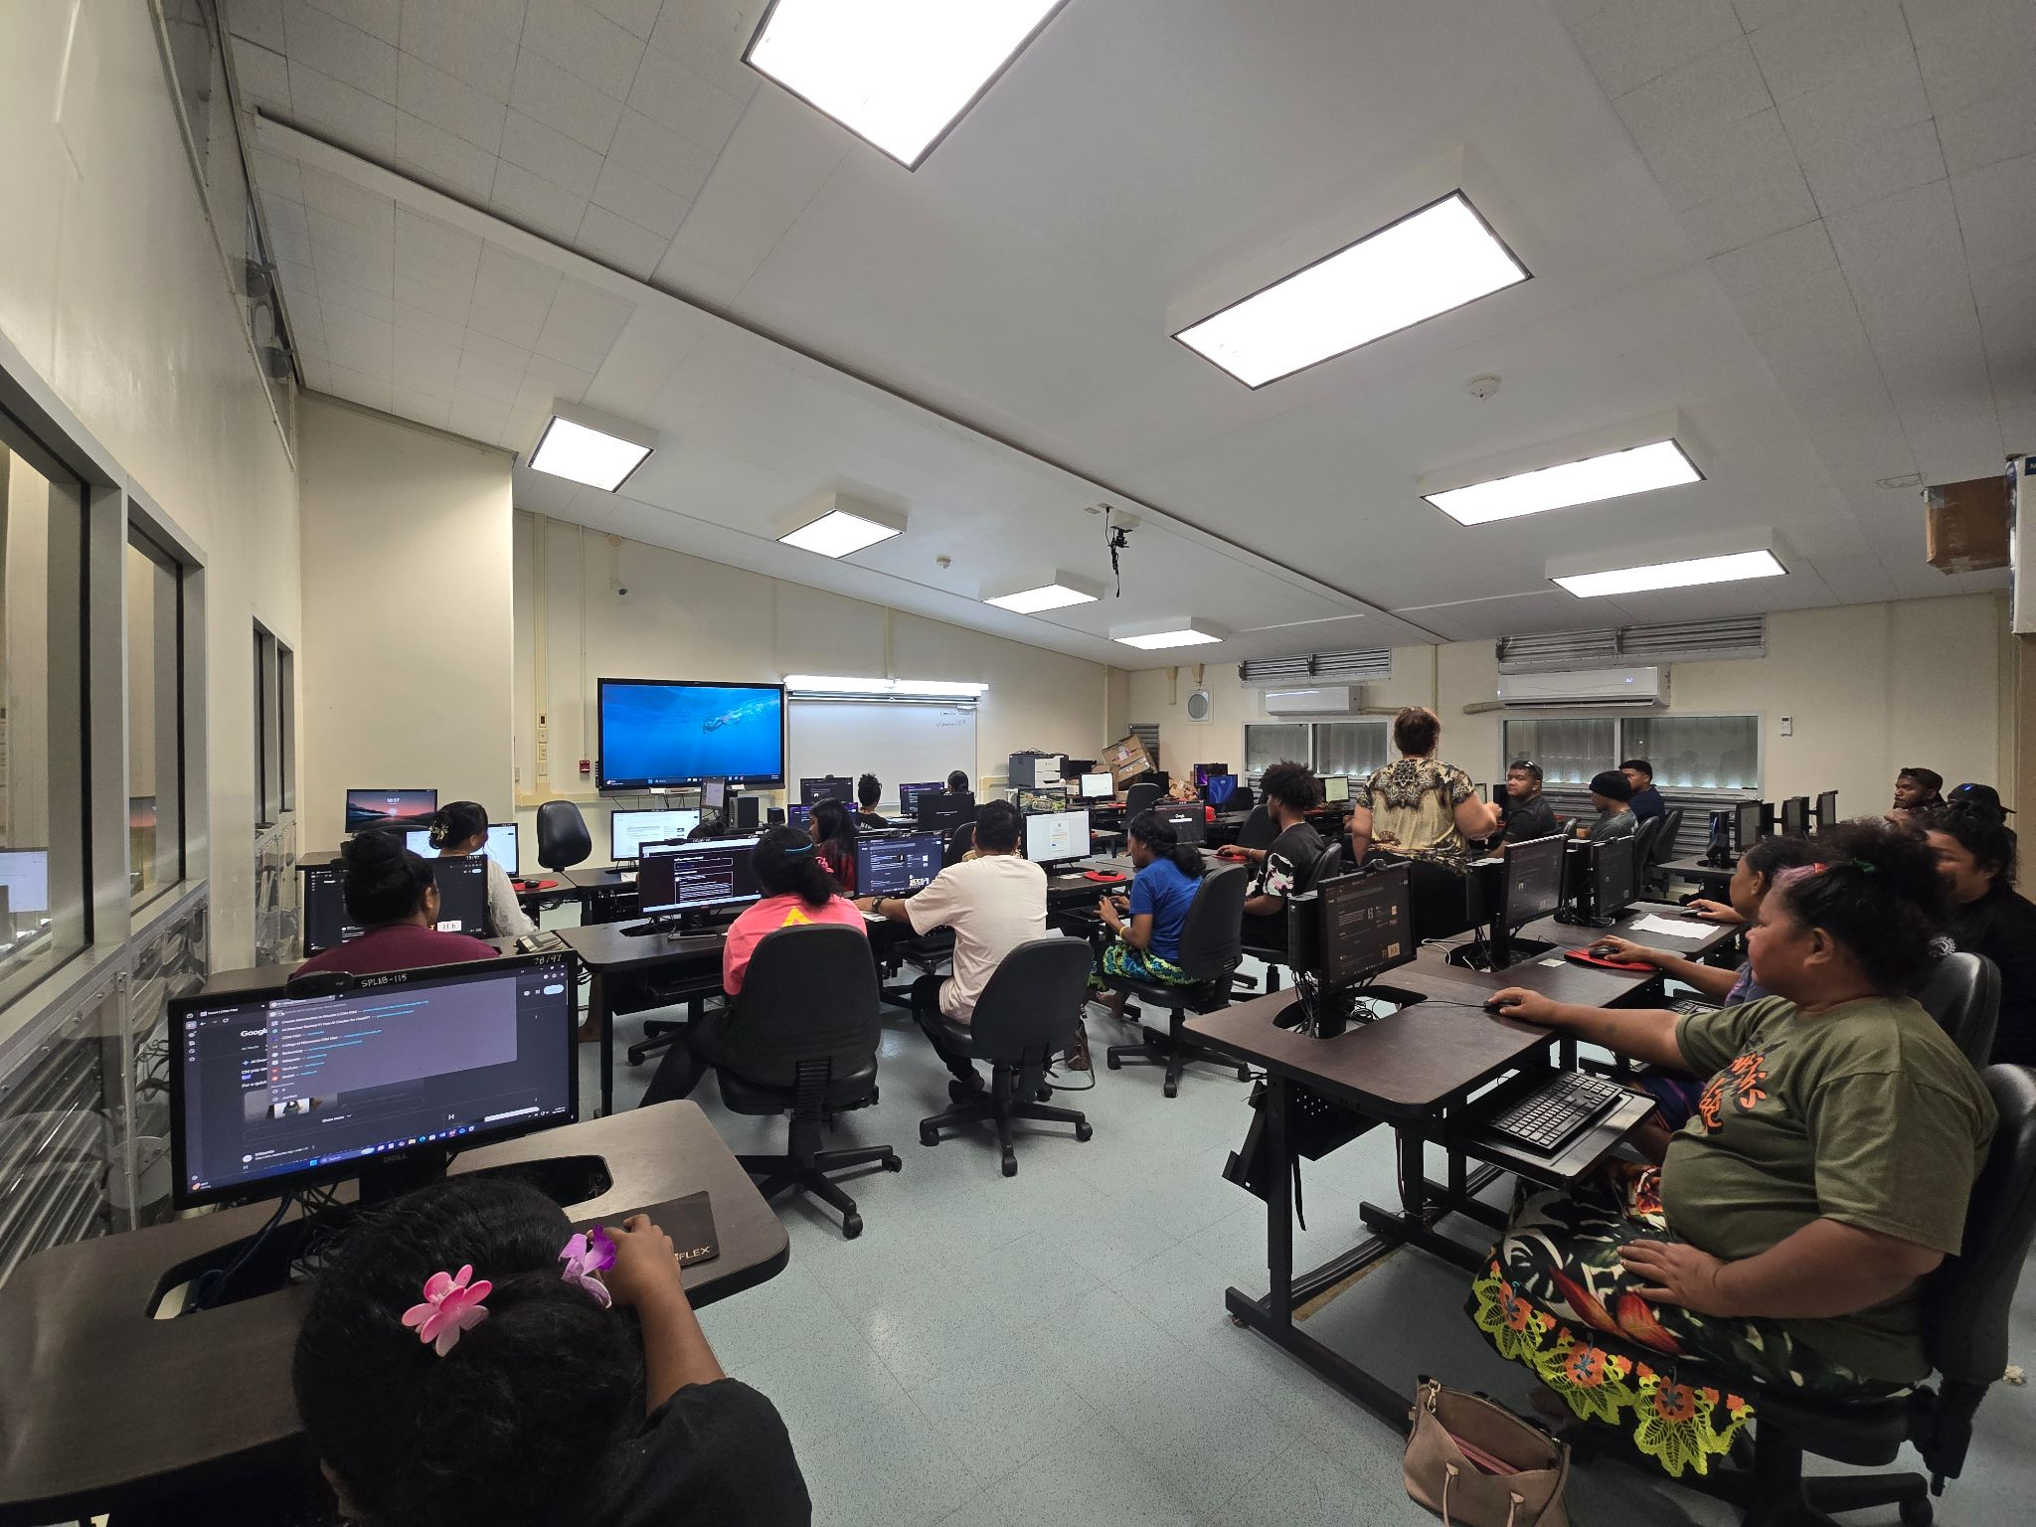
Yap Campus Activities (NEW Student Orientation)
New Student Orientation:
June 04, 2026 for Summer 2026 Semester
August 06, 2026 for Fall 2026 Semester
Hands-on Moodle Training
Welcome New Students
Orientation Meetings
Notes:
New Student Orientation:
June 04, 2026 for Summer 2026 Semester
August 06, 2026 for Fall 2026 Semester
This orientation helps students promote their learnings and continue to their education.
It also helps students get to know their buildings and know more about their environment.
Welcome New Students
Orientation Meetings
So as a student it is really helpful that we are being welcomed by staffs and faculty at the campus because we feel like it is pushing to the point where we are more interested to focus on school and try our best to do good in school.
As a student, orientation meetings is really a good thing that will be continuing every semester. Students were able to have time to know about school policy and more activity that will be happening throughout the semester.
Hands-on Moodle Training
Building connections to foster confidence
For the students, moodle training really do help because it really made the students know where to login into moodle and turn in their works.

Slide 7
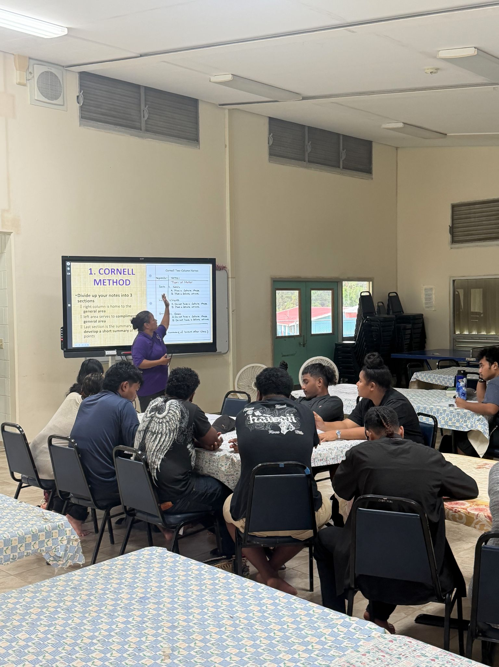
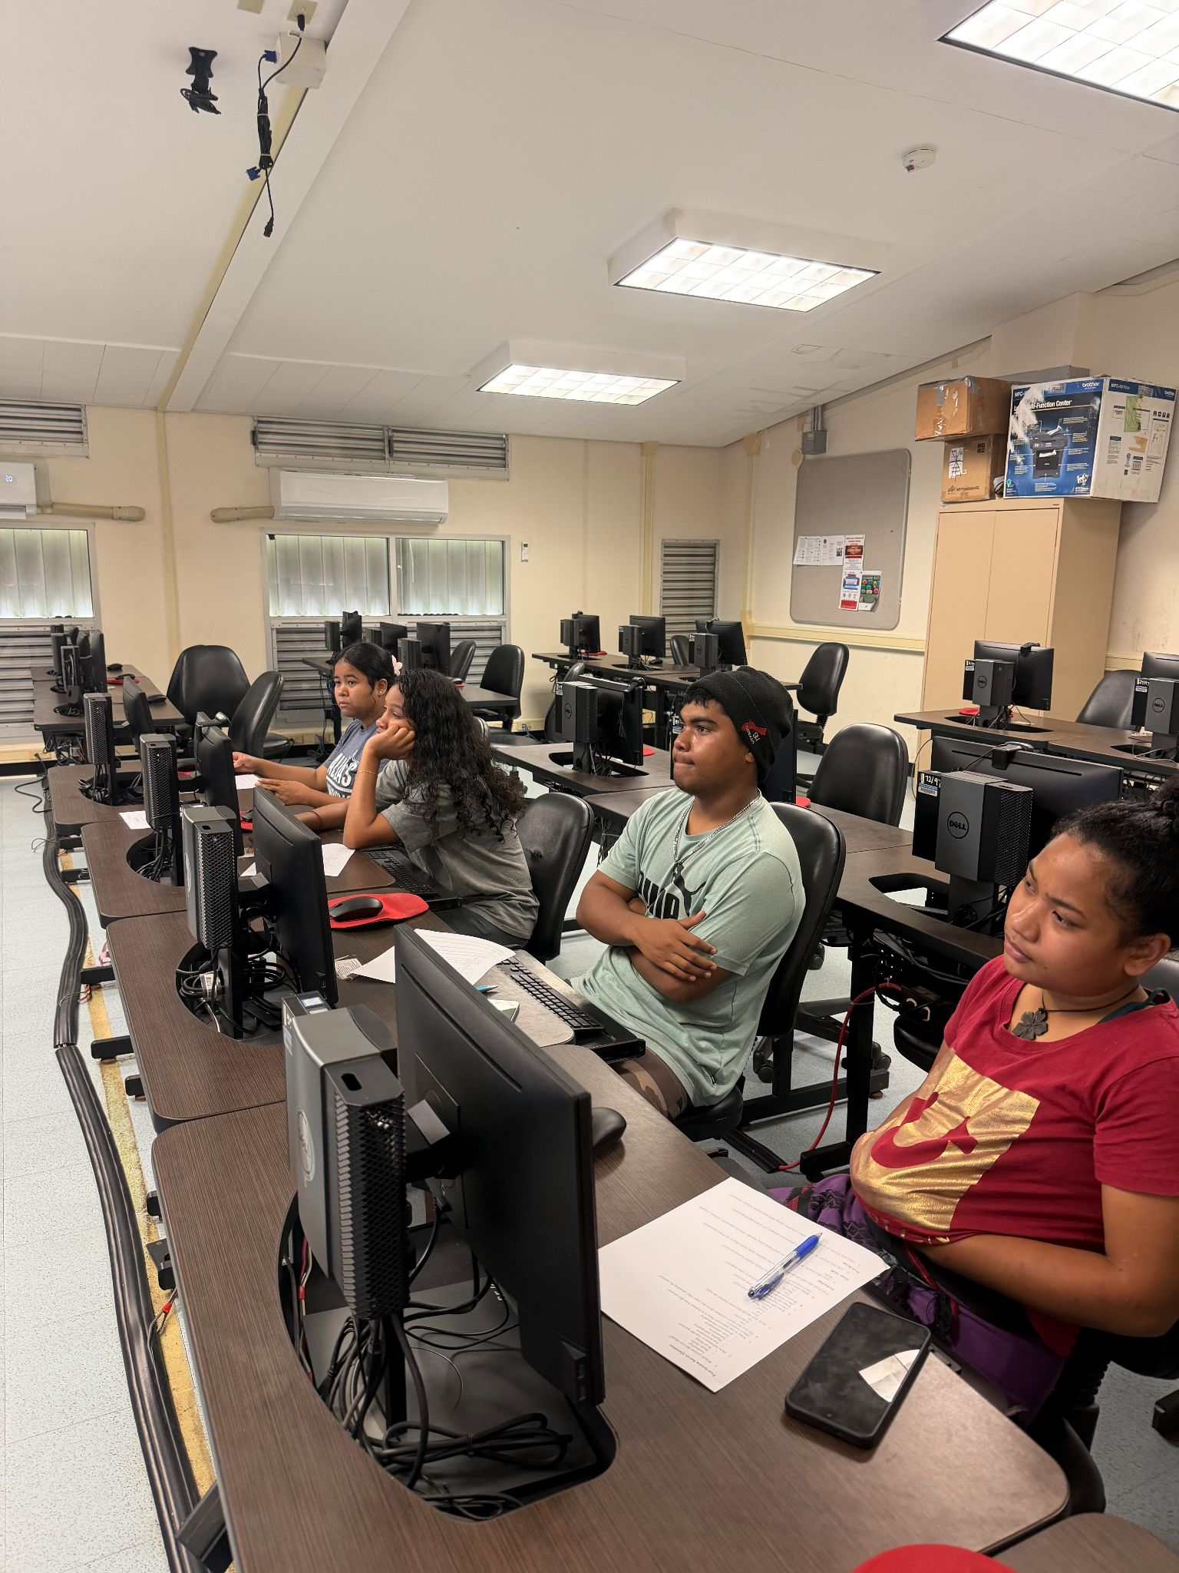
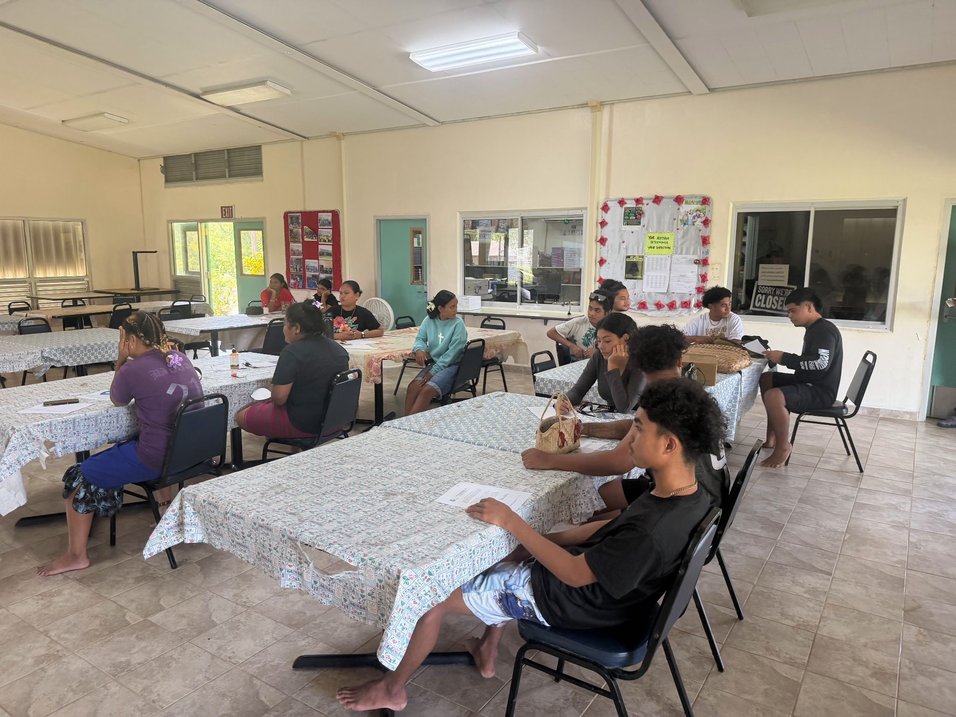
Yap Campus Activities (Summer Mini-Sessions)
Mini-Support Sessions for Student Success
Short focused workshops (30-60 minutes per session) throughout the summer semester & will continue this Fall 2026 semester. Topics include:
Moodle session
Computer Literacy
Study Skills
  Time Management/Setting Goals
  Note-taking skills
  Test-taking skills
Proper use of AI
Notes:
Mini-Support Sessions for Student Success
Short focused workshops (30-60 minutes per session) throughout the summer semester & will continue this semester
Topics include;
Moodle session
Computer Literacy
Study skills:
Time Management/Goal setting
Note taking skills
Test taking skills
Proper use of AI

Slide 8
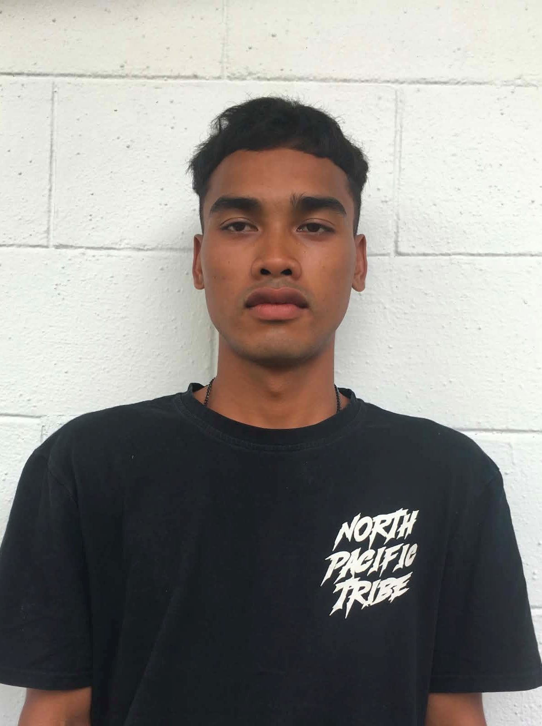
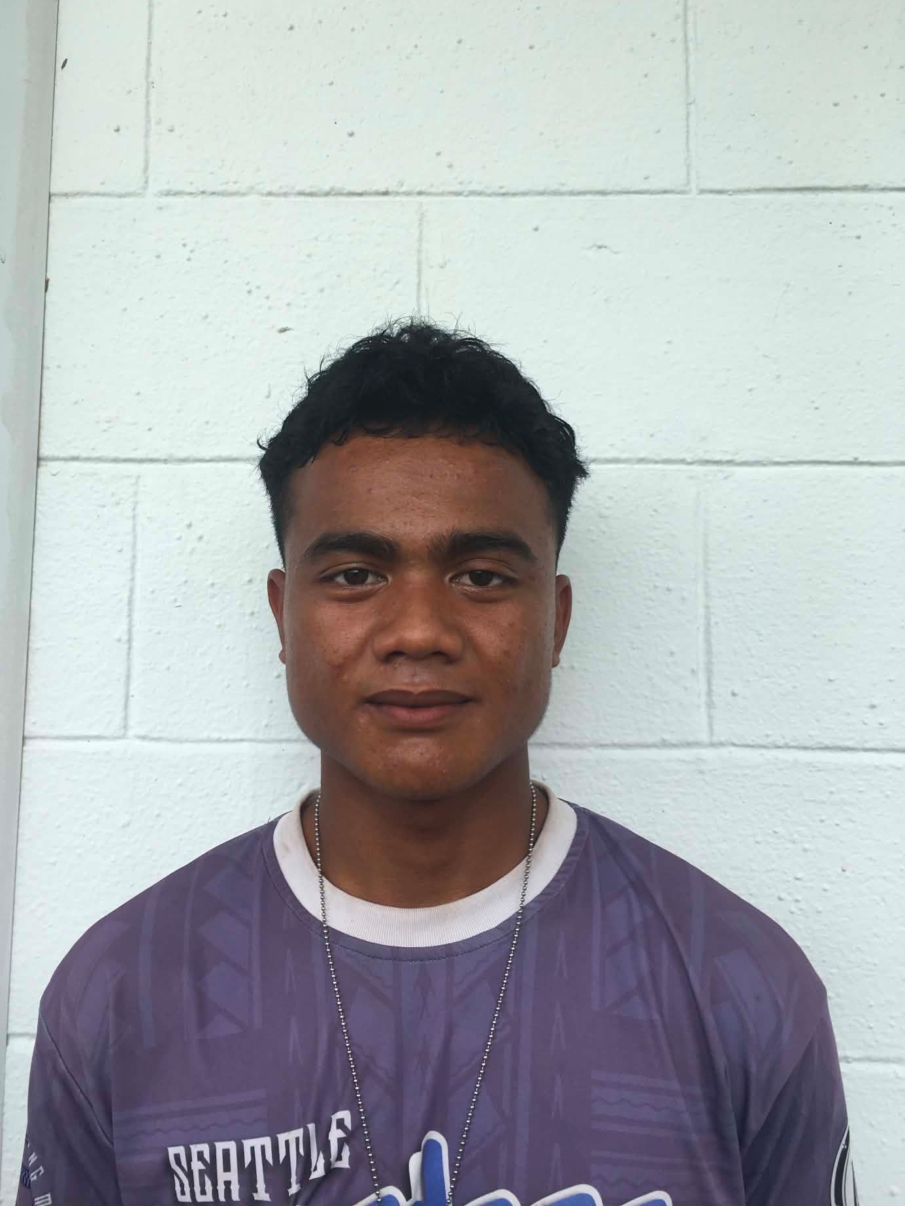
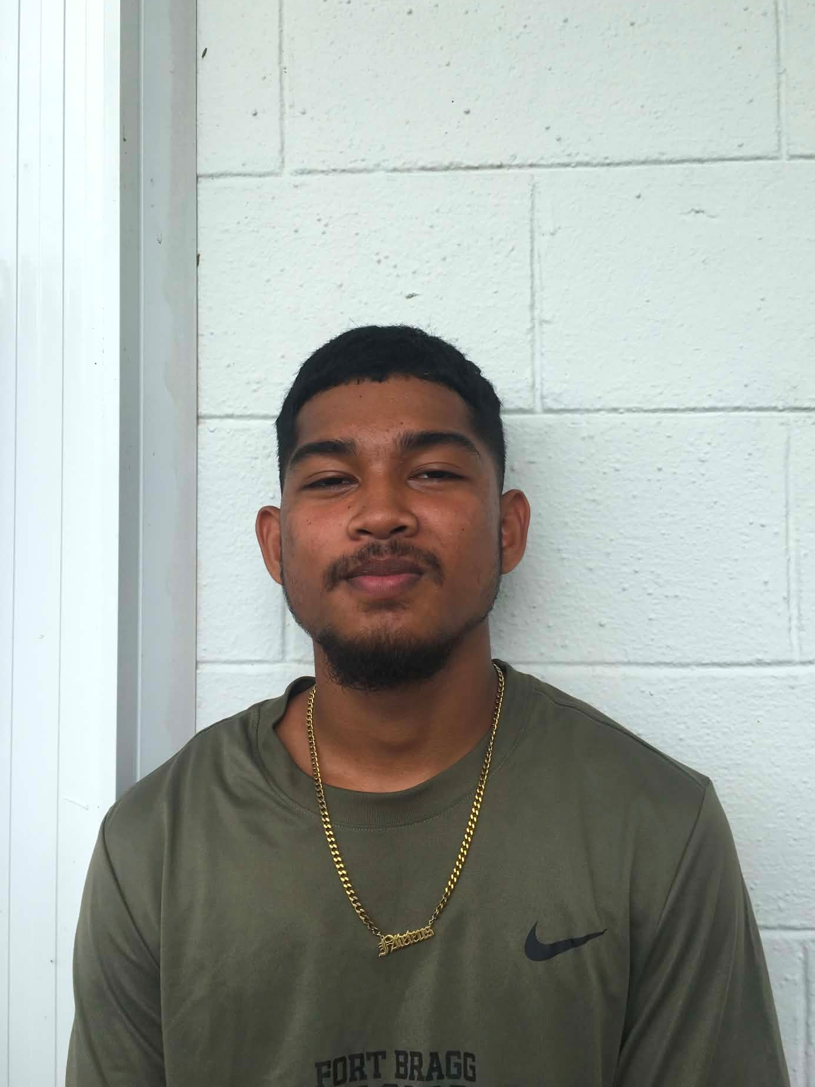
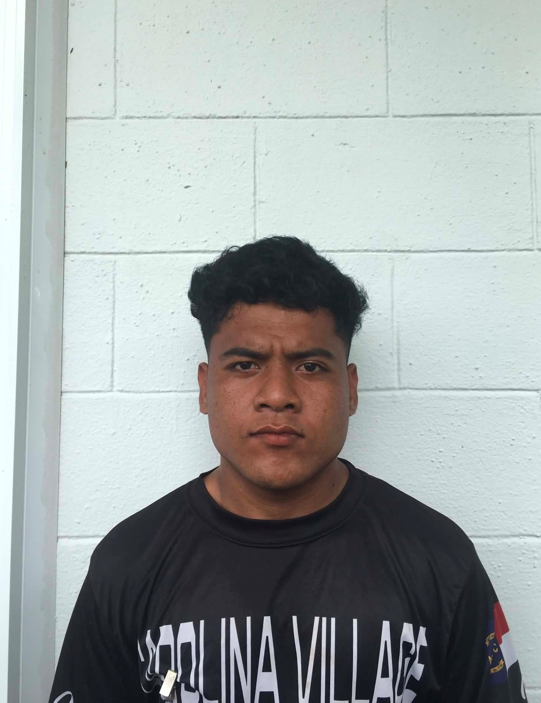
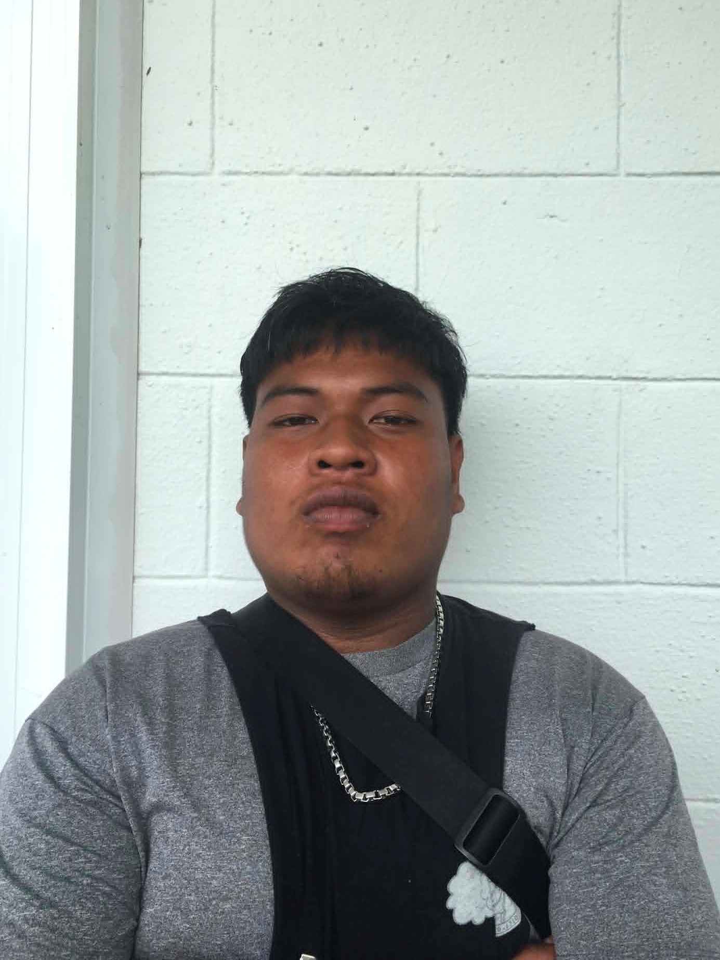
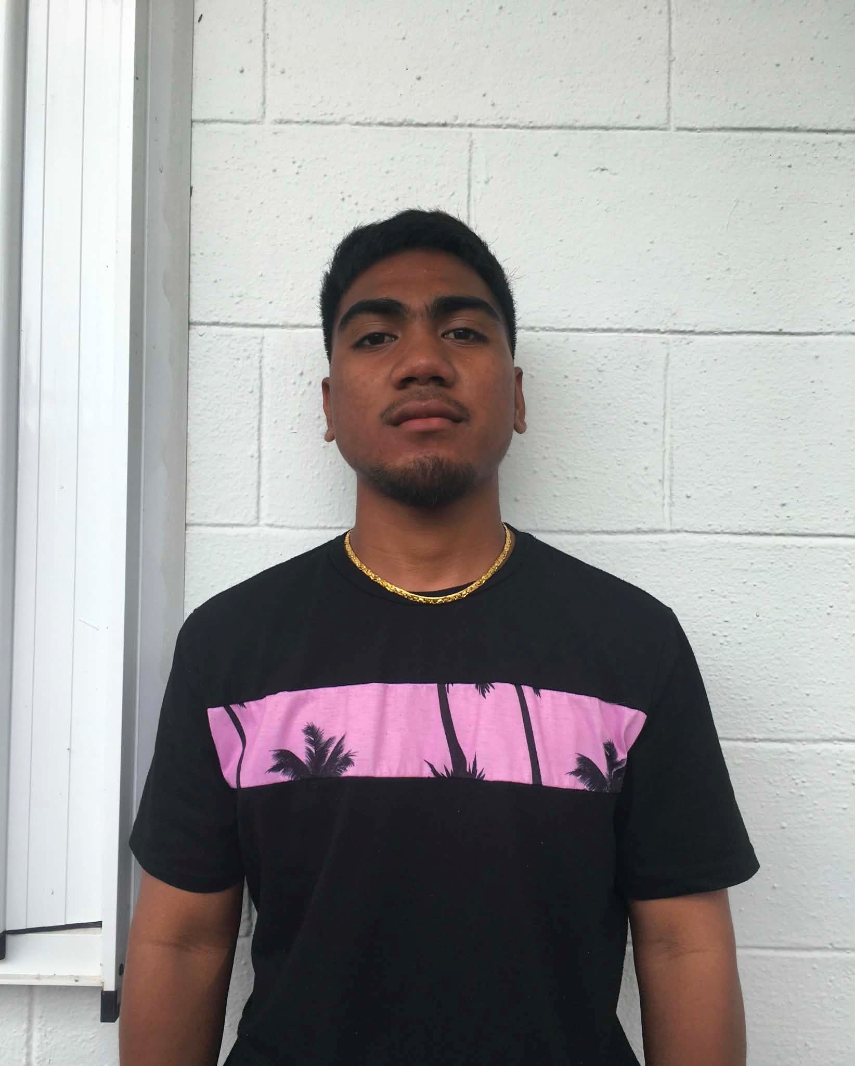
FSM-FMI CORP OFFICERS
Myles Mailing
Bert Jim
Jeroshi Mori
Danny Dose
Linson Ramson
Charles Ned
Corp. Commander
Executive Officer
Intelligence Officer
Logistic Officer
Alpha Squad Leader
Bravo Squad Leader

Slide 9
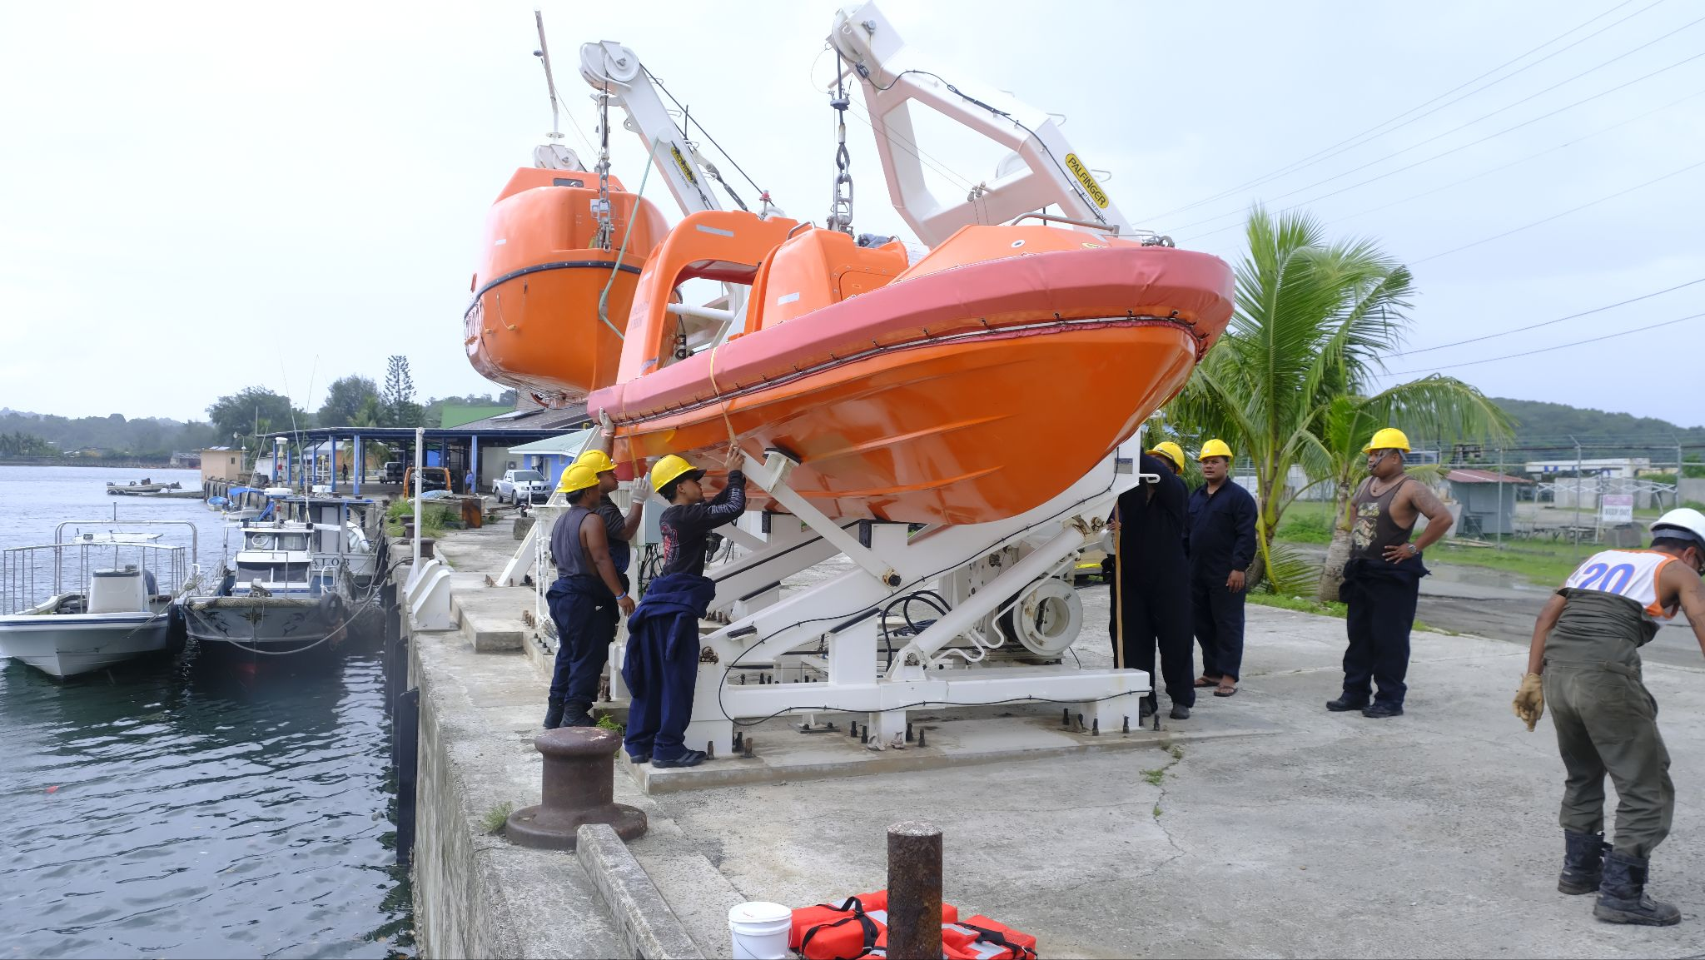
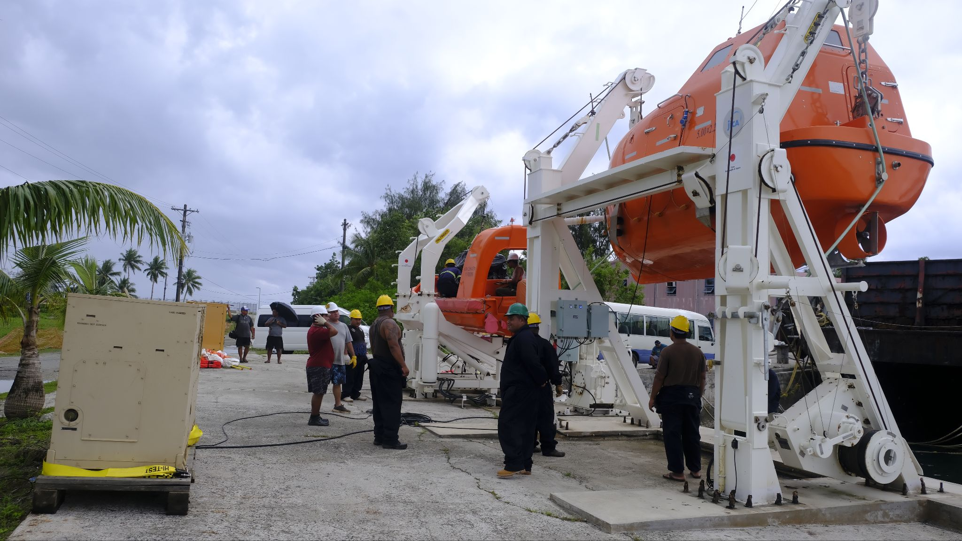
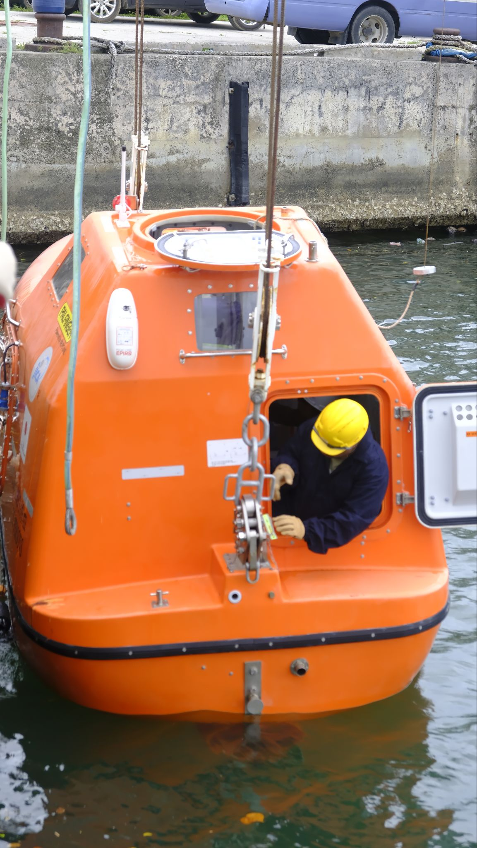
FSM-FMI Campus (YFA/Lifeboat & Rescue Boat)
Maintenance of Lifeboat and Rescue Boat
Regular inspection and servicing of safety equipment
Ensuring boats meet operational and safety standards
Hands on practice with maintenance procedures
Training on Launching Boats
Step-by-step instruction
Building confidence in real-life maritime scenarios
Notes:
Maintenance of Lifeboat and Rescue Boat
Regular inspection and servicing of safety equipment
Checking equipment routinely to make sure it is working properly, safe to use, and ready for an emergency, and repairing or maintaining it when needed.
Ensuring boats meet operational and safety standards
Making sure a boat is safe, properly equipped, and in good working condition before and during use.
Hands on practice with maintenance procedures
Doing maintenance tasks yourself under supervision or instruction.
Training on Launching Boats
Step-by-step instruction
To be taught each stage of launching a boat into the water and get it ready for operation.
Building confidence in real-life maritime scenarios
Developing the skills and confidence needed to handle actual situations that may happen when working on or around boats and in the marine environment.

Slide 10
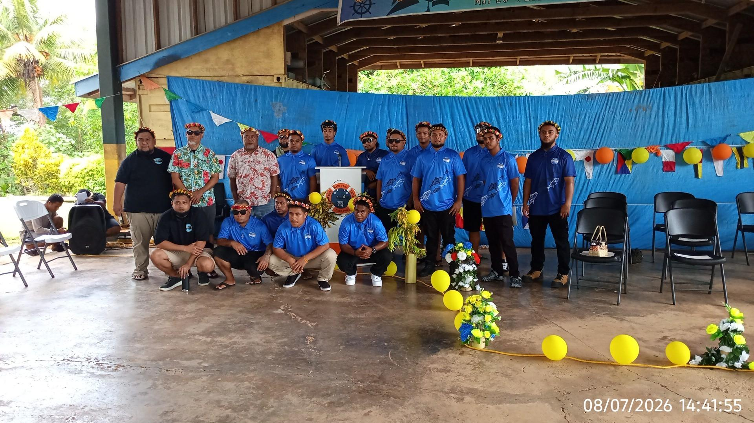
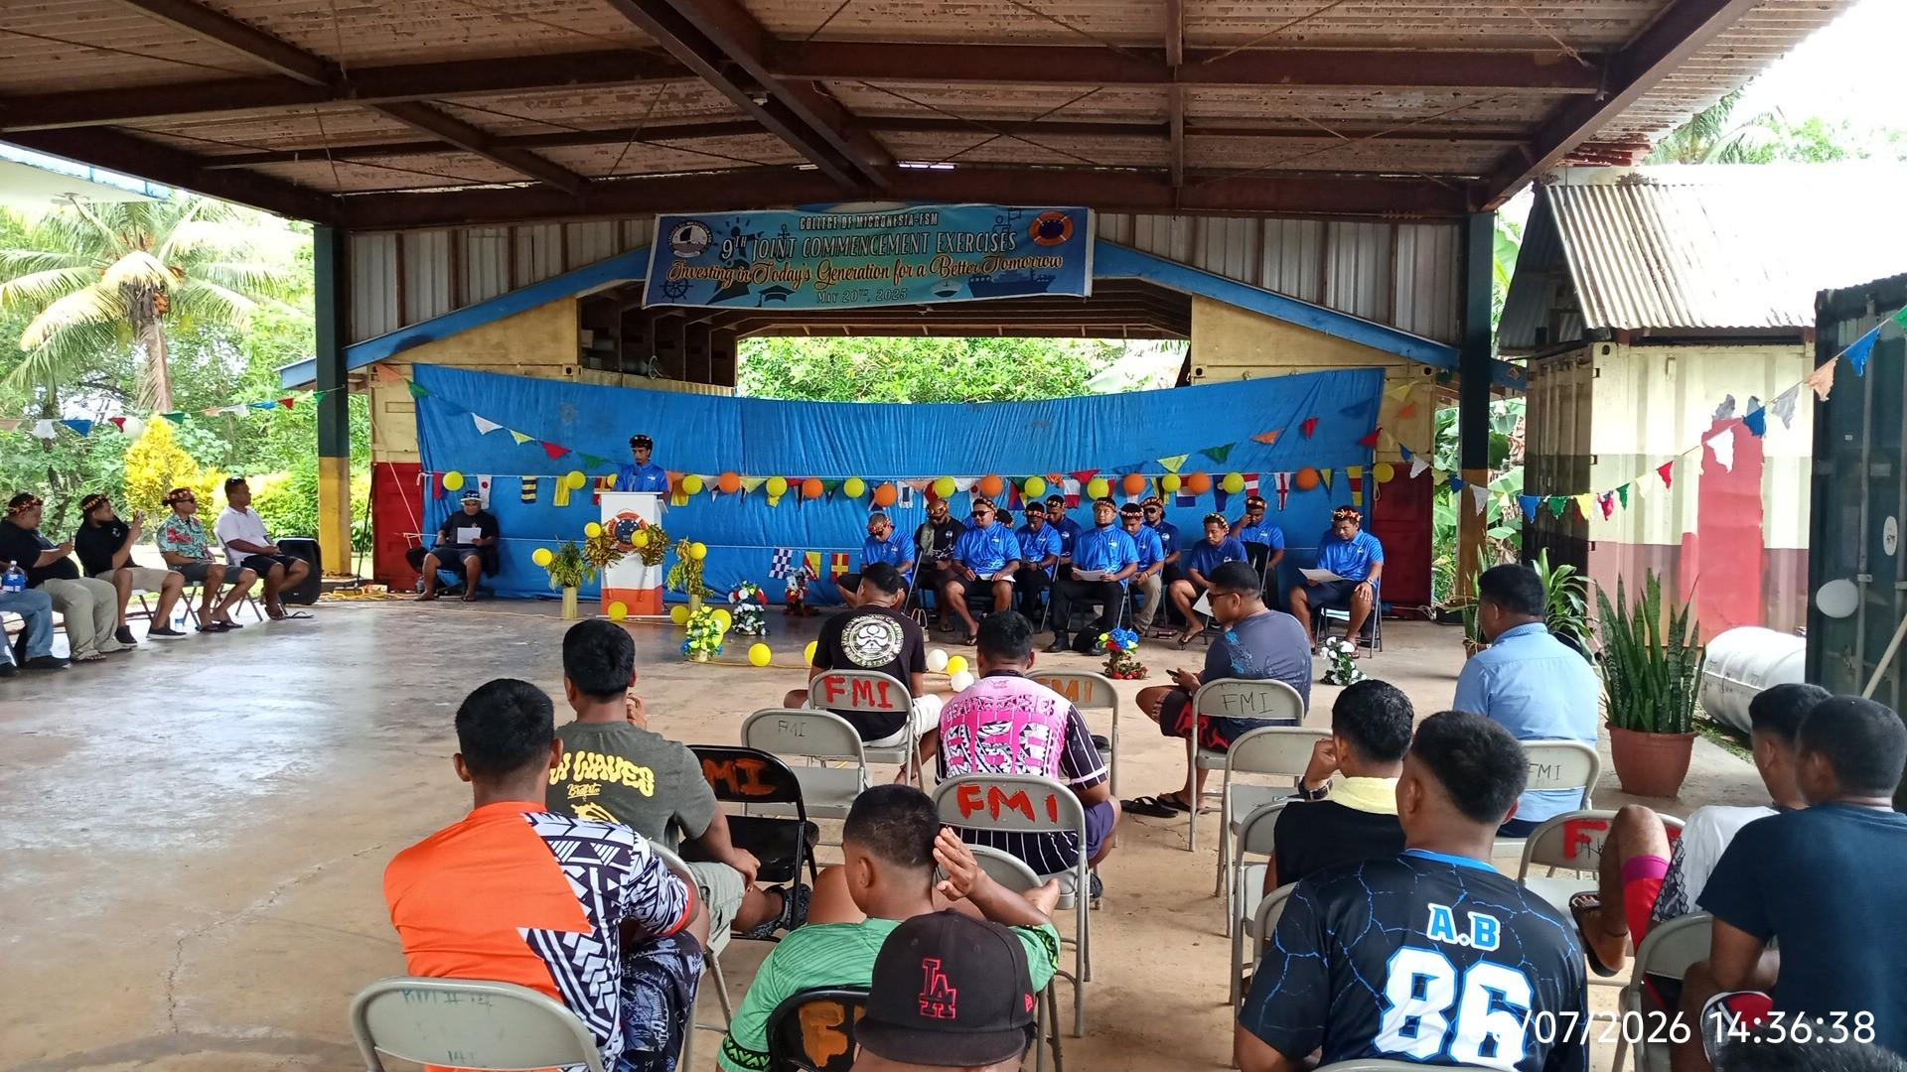
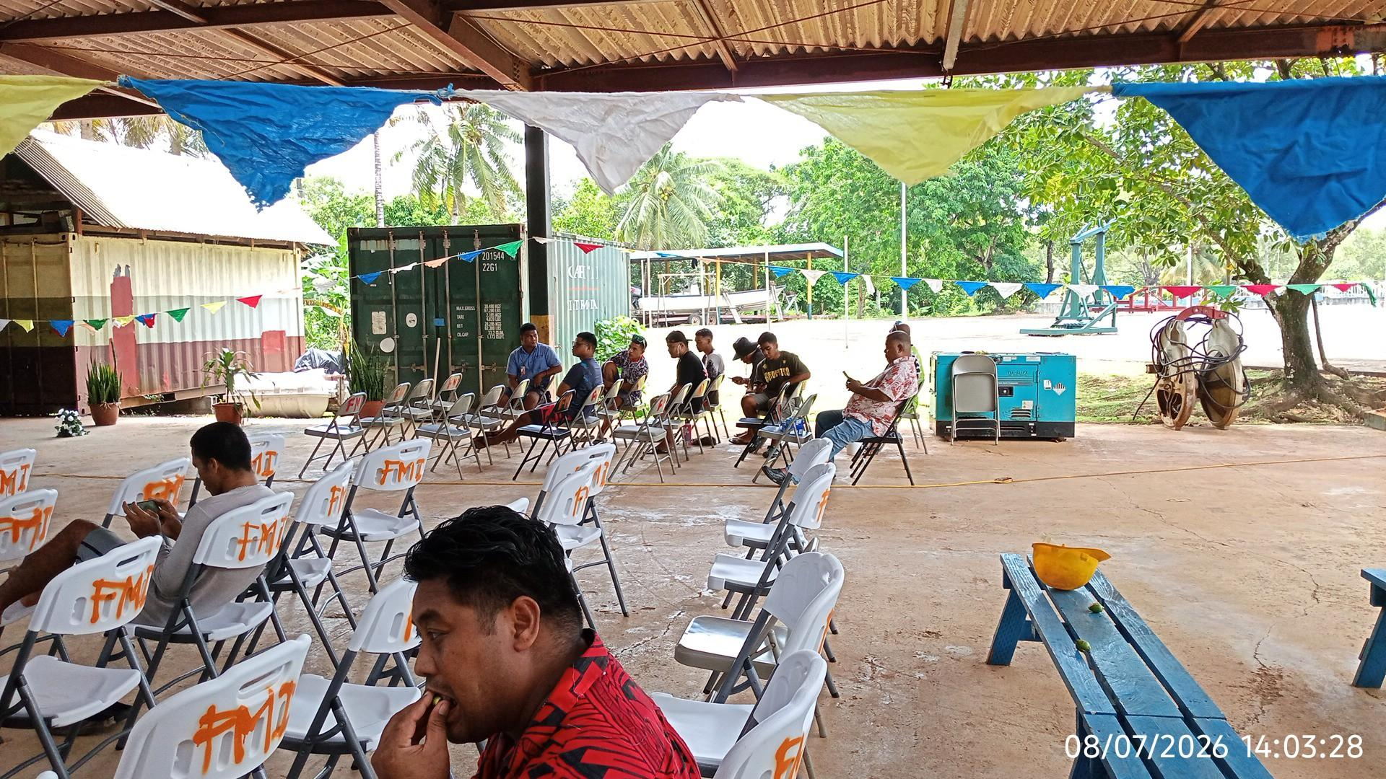
FSM-FMI Campus (NORMA-Closing Ceremony)
FSM-FMI Cadets Participation
Witnessed a milestone ceremony hosted by NORMA
Event held at FSM-FMI campus highlighting maritime achievements.
Cadets exposure to professional standards.
Strengthened awareness of career pathways in maritime fields.
Notes:
FSM FMI Cadets Participation
Witnessed a milestone ceremony hosted by NORMA
An event that people attend and observes an important event or ceremony organized by NORMA to mark a significant achievement or stage of progress.
Event held at FSM FMI campus highlighting maritime achievements
When they held the event at FMI campus and they do showcase and recognizing the event.
Cadets exposure to professional standards
Giving cadets the opportunities to learn about and experience the standards, behavior, skills, and expectations required in their future profession.
Strengthened awareness of career pathways in maritime fields.
Having a better understanding of the different career options available in the maritime industry and how to pursue them.
Example: learning about:
Ship captain or deck officer
Marine engineer
Port or harbor operations
Maritime safety and security
Security and marine resource management
Shipping and logistics
Maritime administration

Slide 11
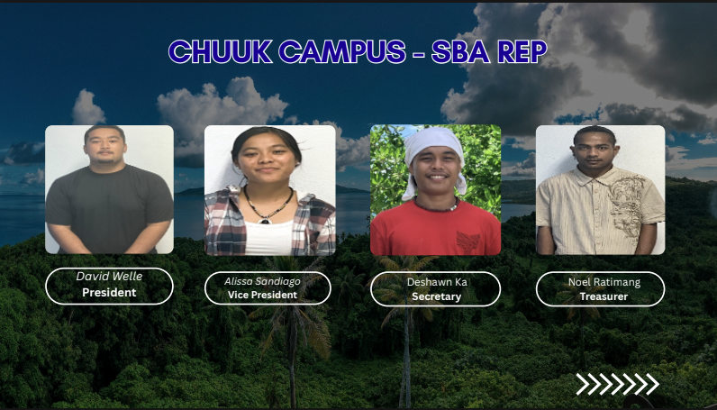
CHUUK CAMPUS SBA
David Walle
Alissa Sandiago
Deshawn Ka
Noel Ratimang
President
Vice President
Secretary
Treasurer

Slide 12
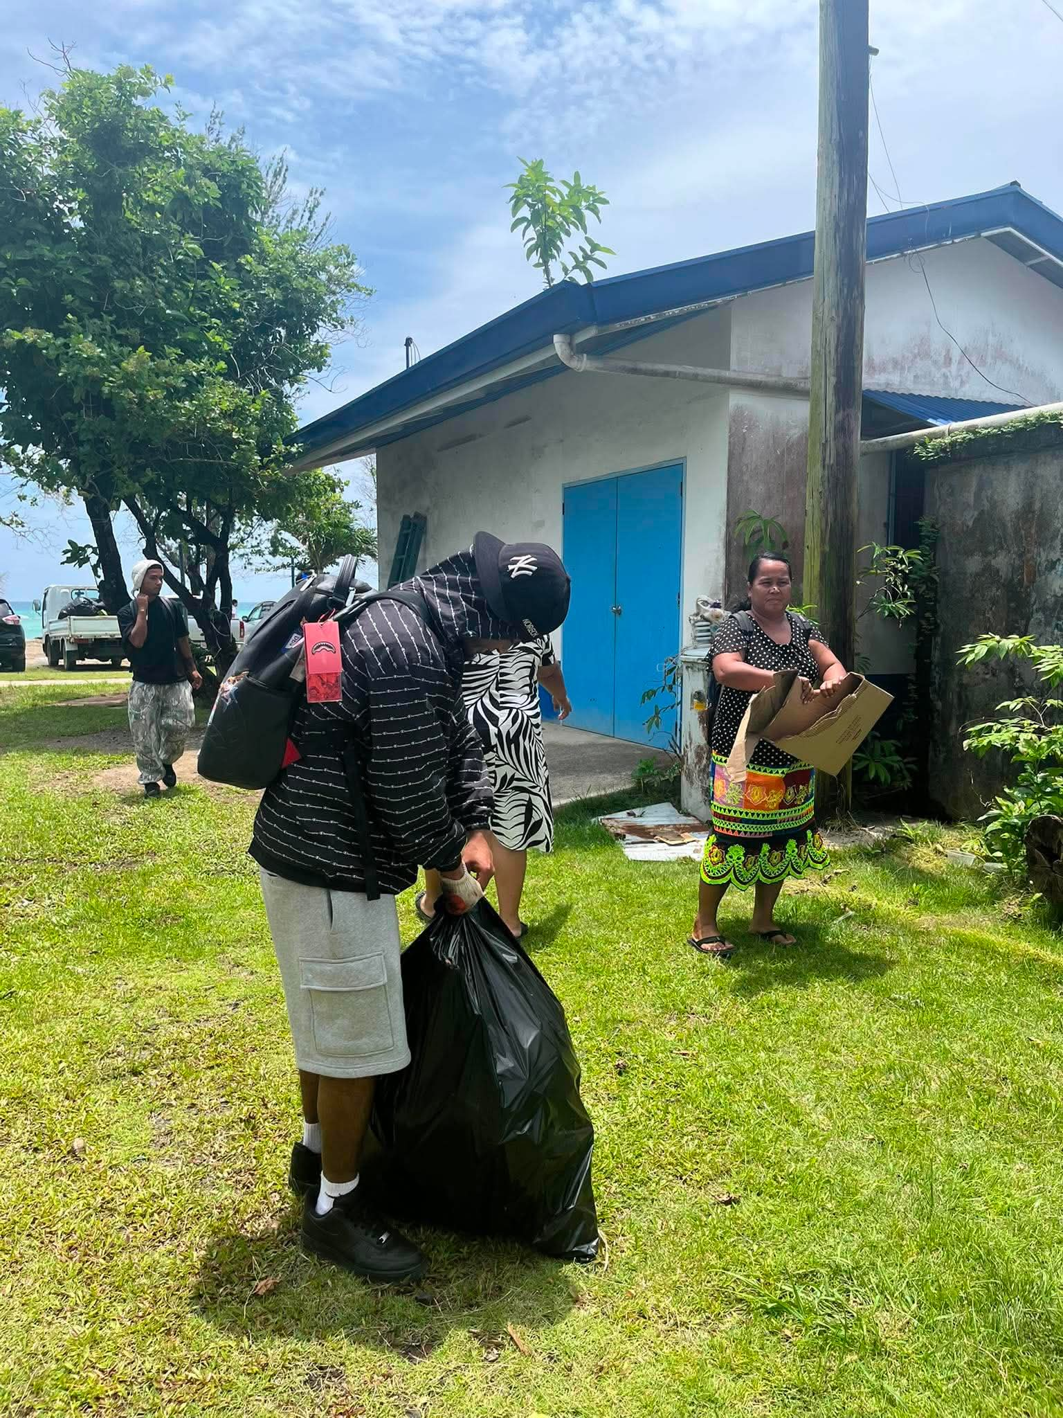
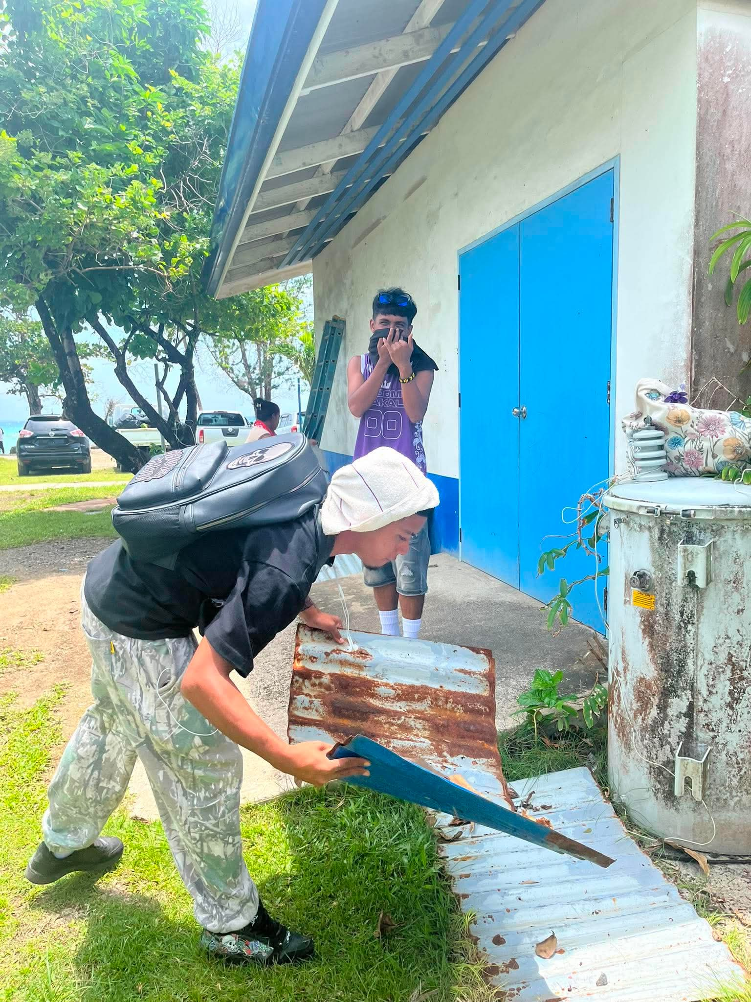
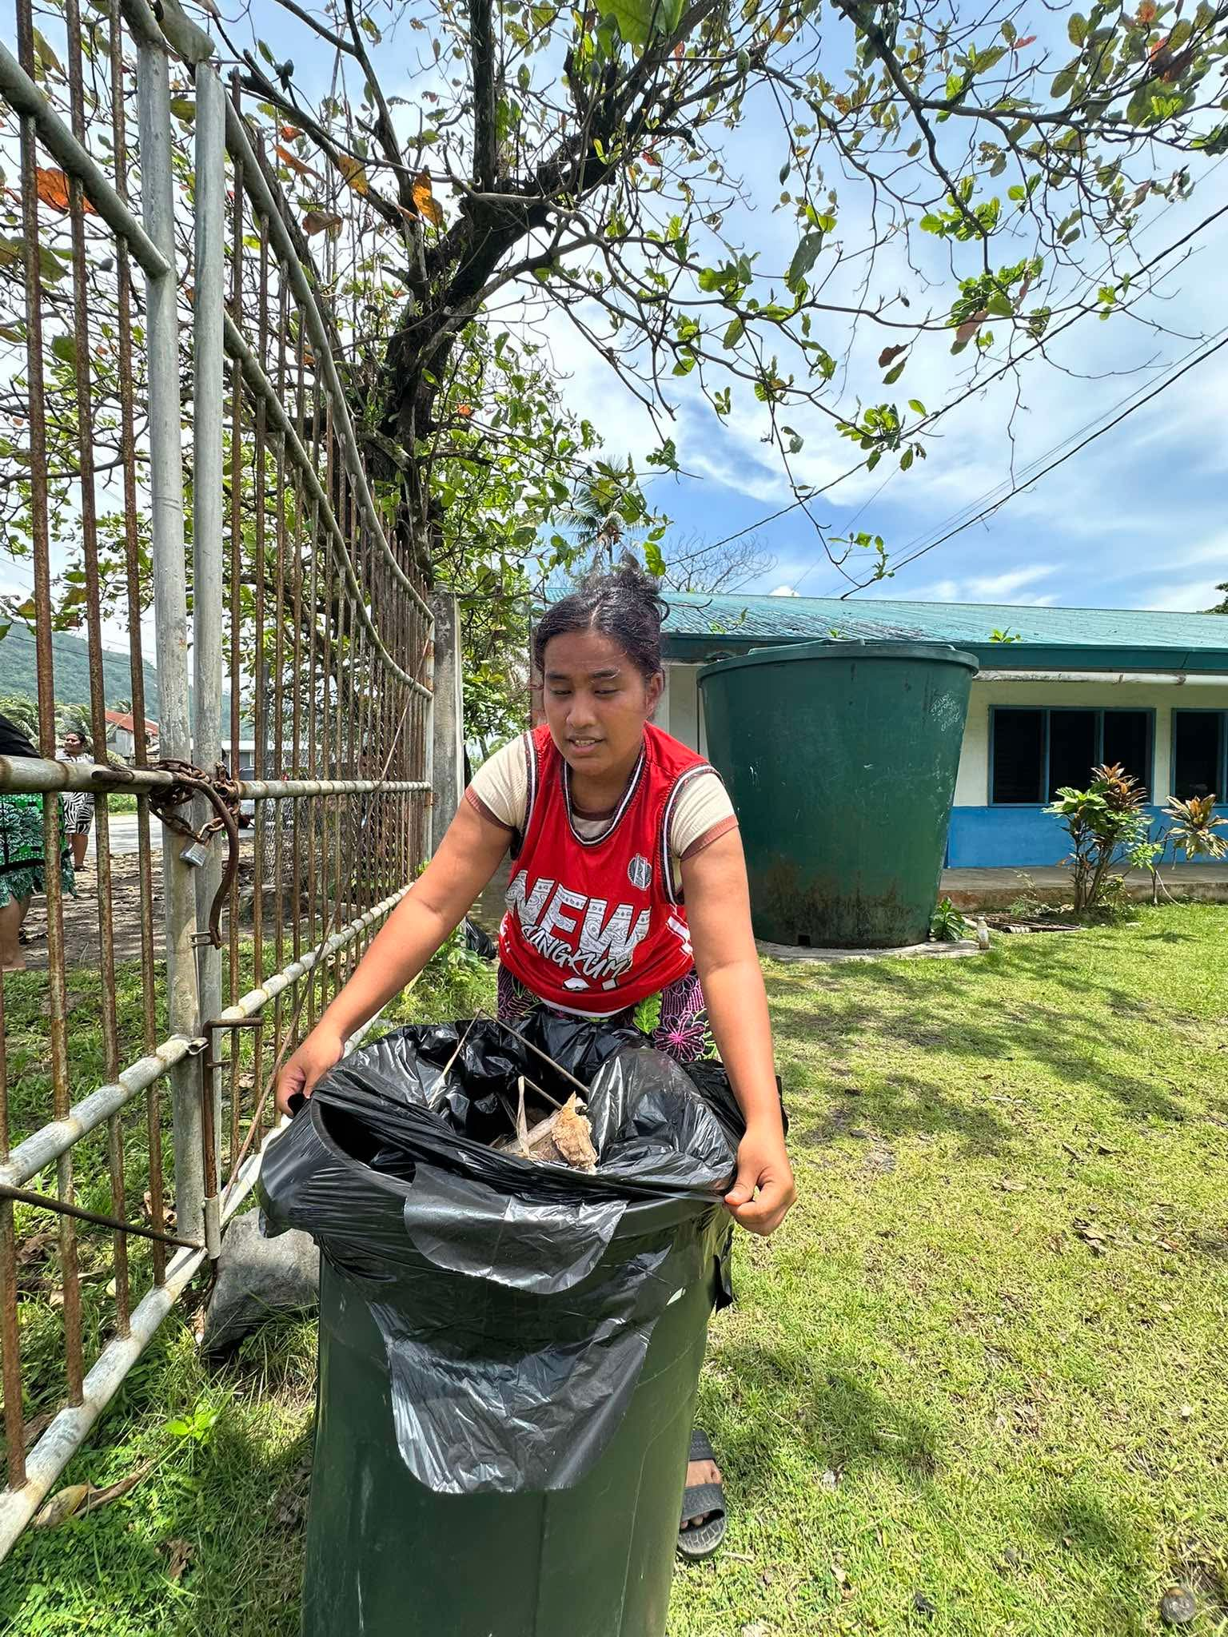
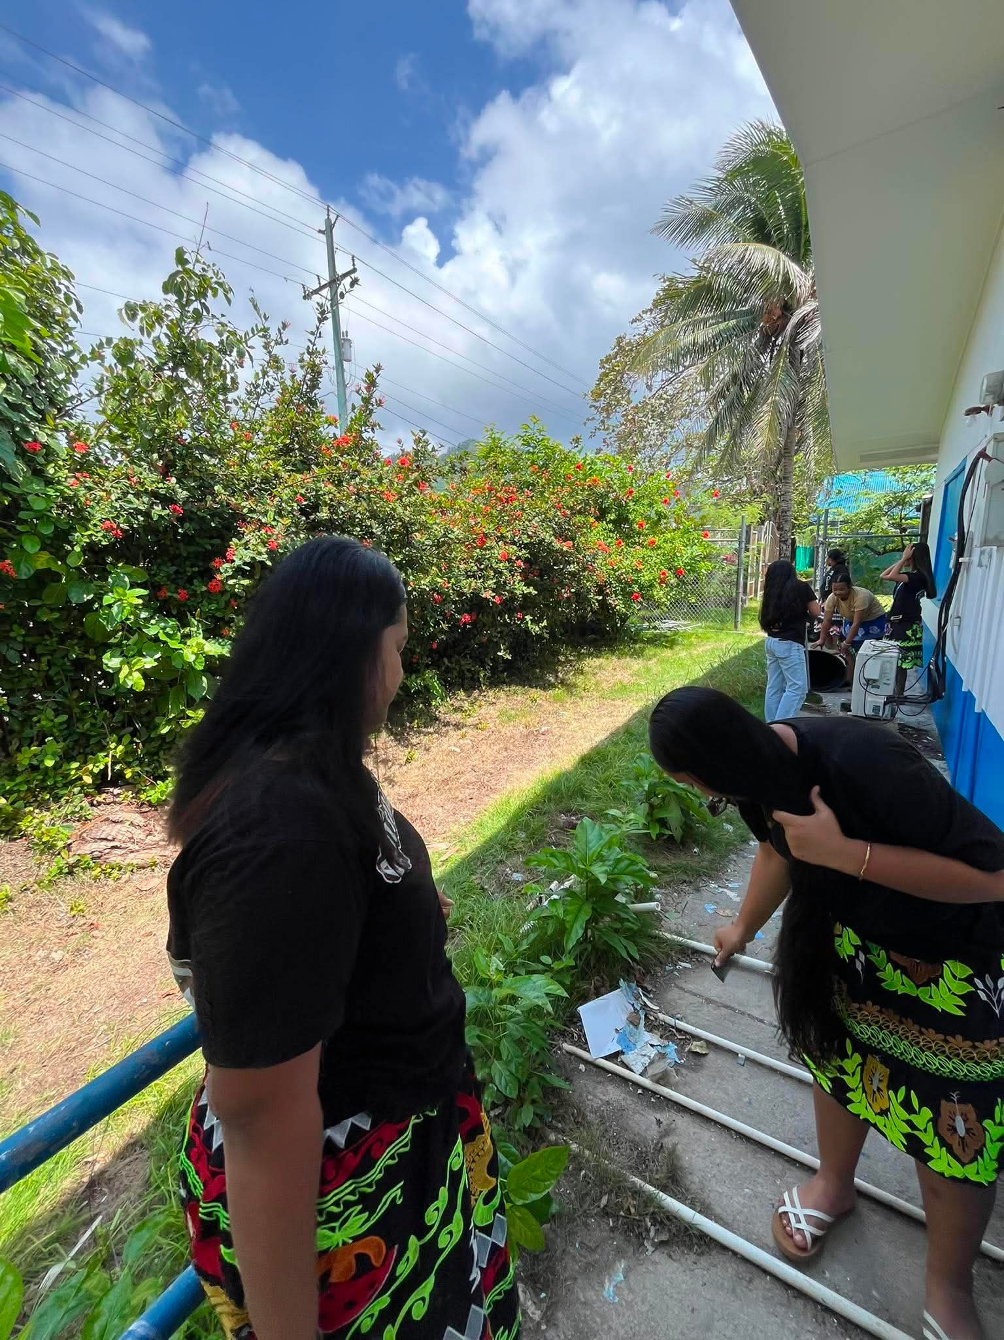
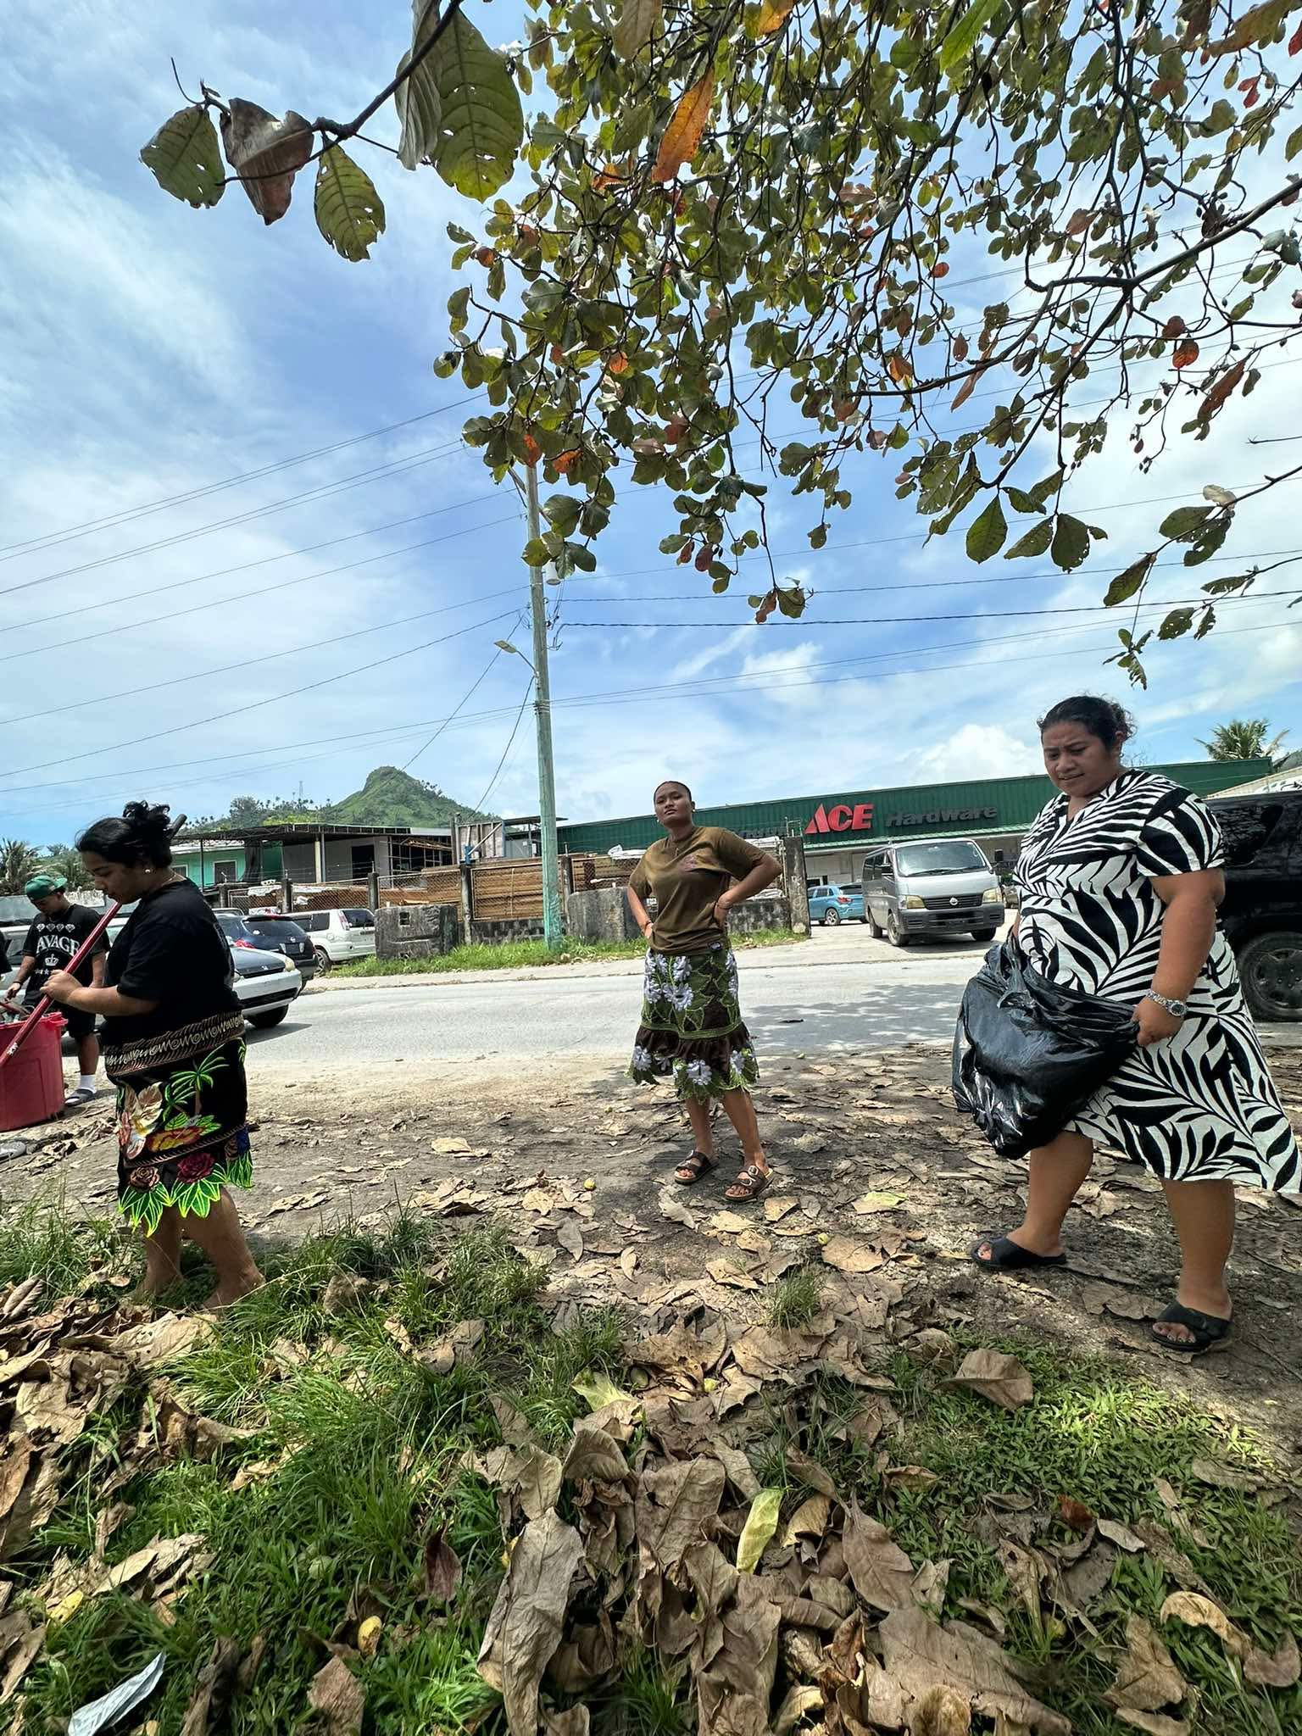
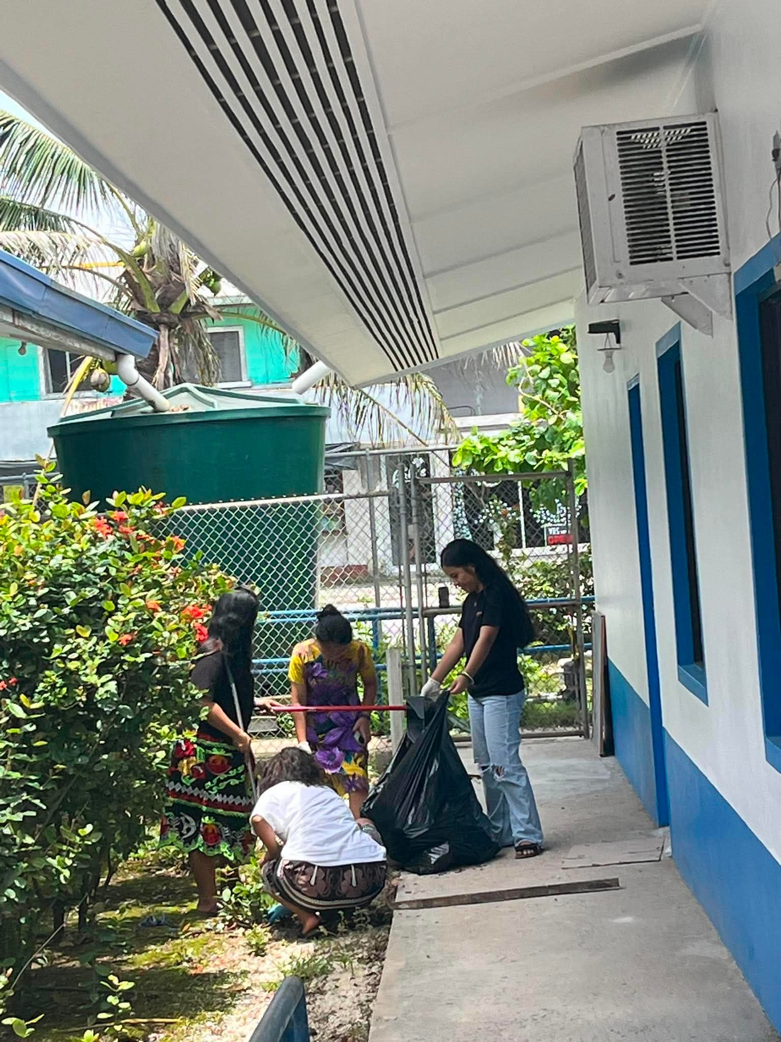
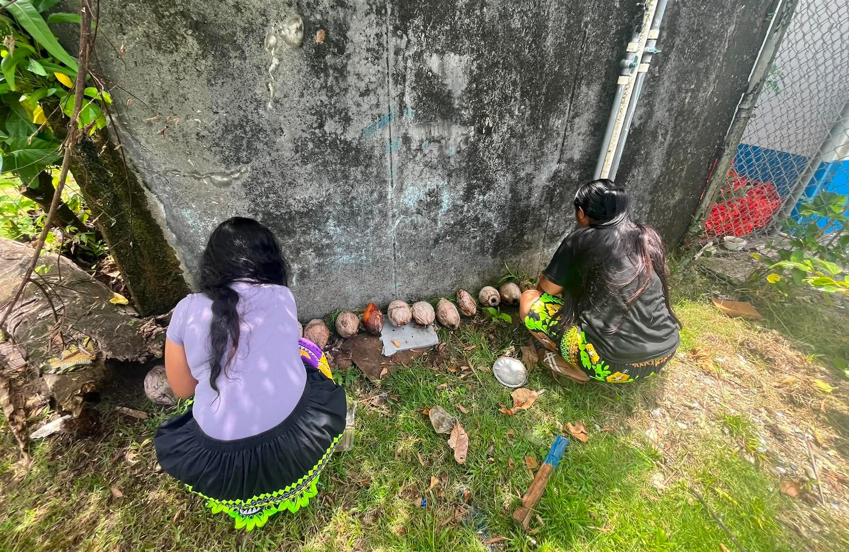
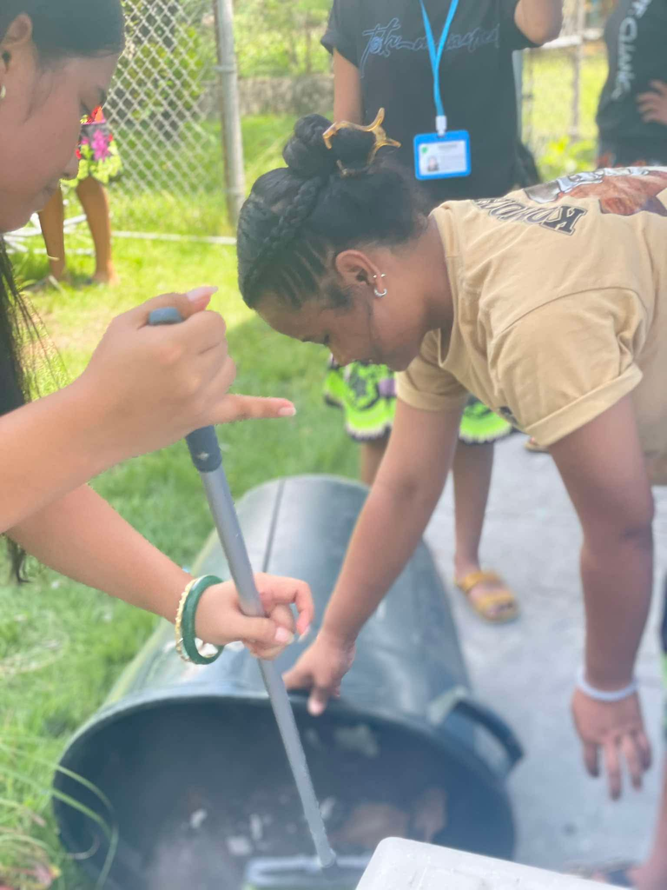
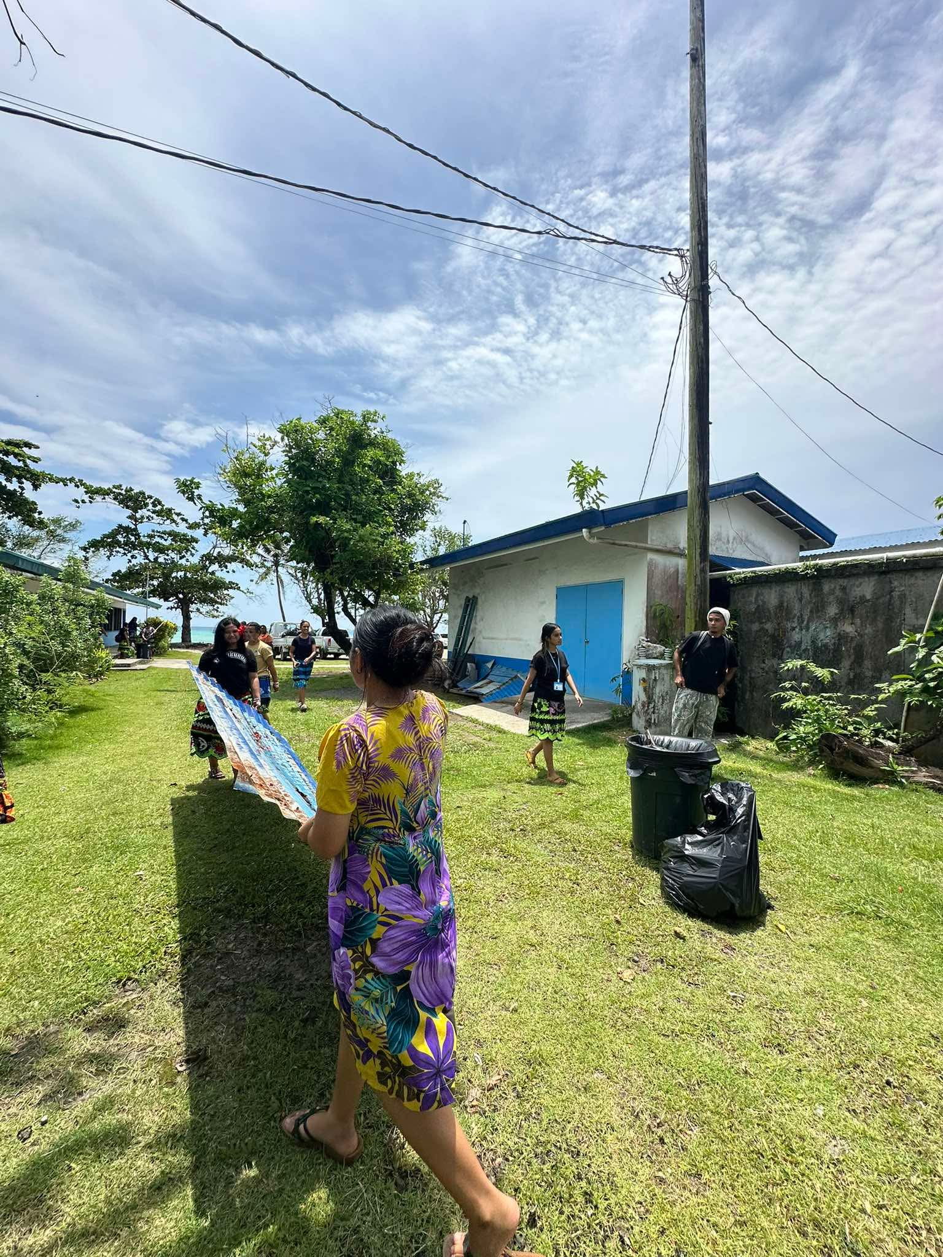
Chuuk Campus Activities (General Clean-Up)
After the typhoon, the students at the Chuuk campus help the community to clean around the campus.
Notes:
Due to Typhoon Sinlaku, no activities were planned during the summer semester.
However, the first General Clean-Up took place on Wednesday, August 26, 2026, led by Student Services and students on campus.

Slide 13
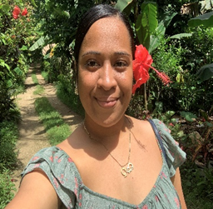
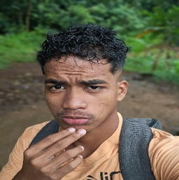
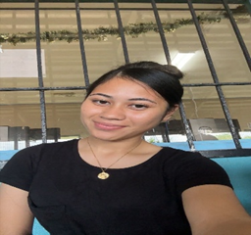
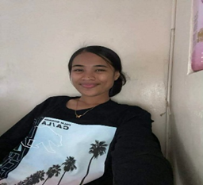
POHNPEI CAMPUS/CTEC SBA
Amayalynn Shoniber
Iberson Barnabas
Hafsha Edward
Lillyjean Alex
President
Vice President
Secretary
Treasurer

Slide 14
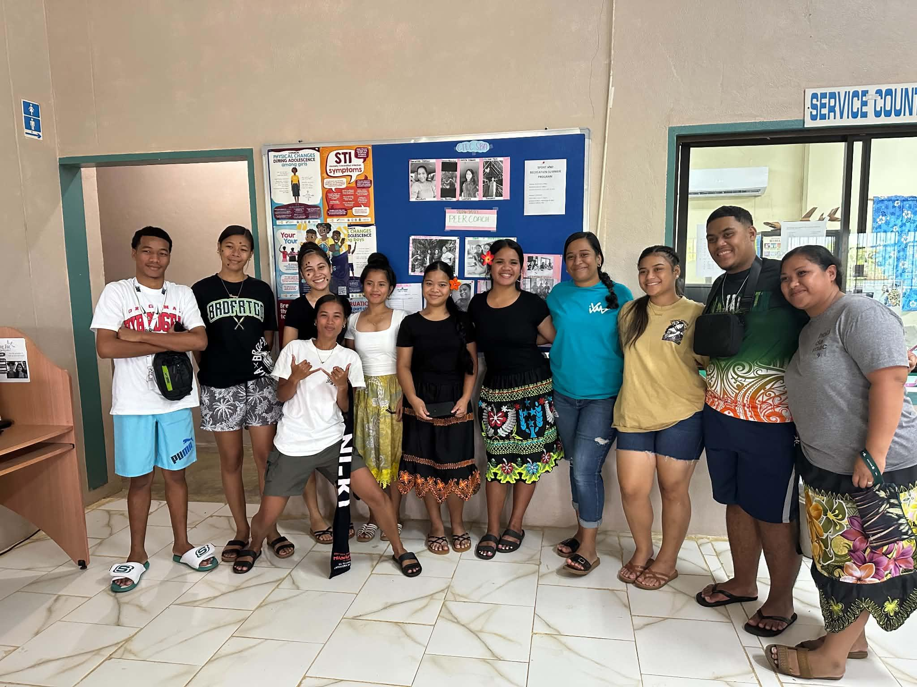
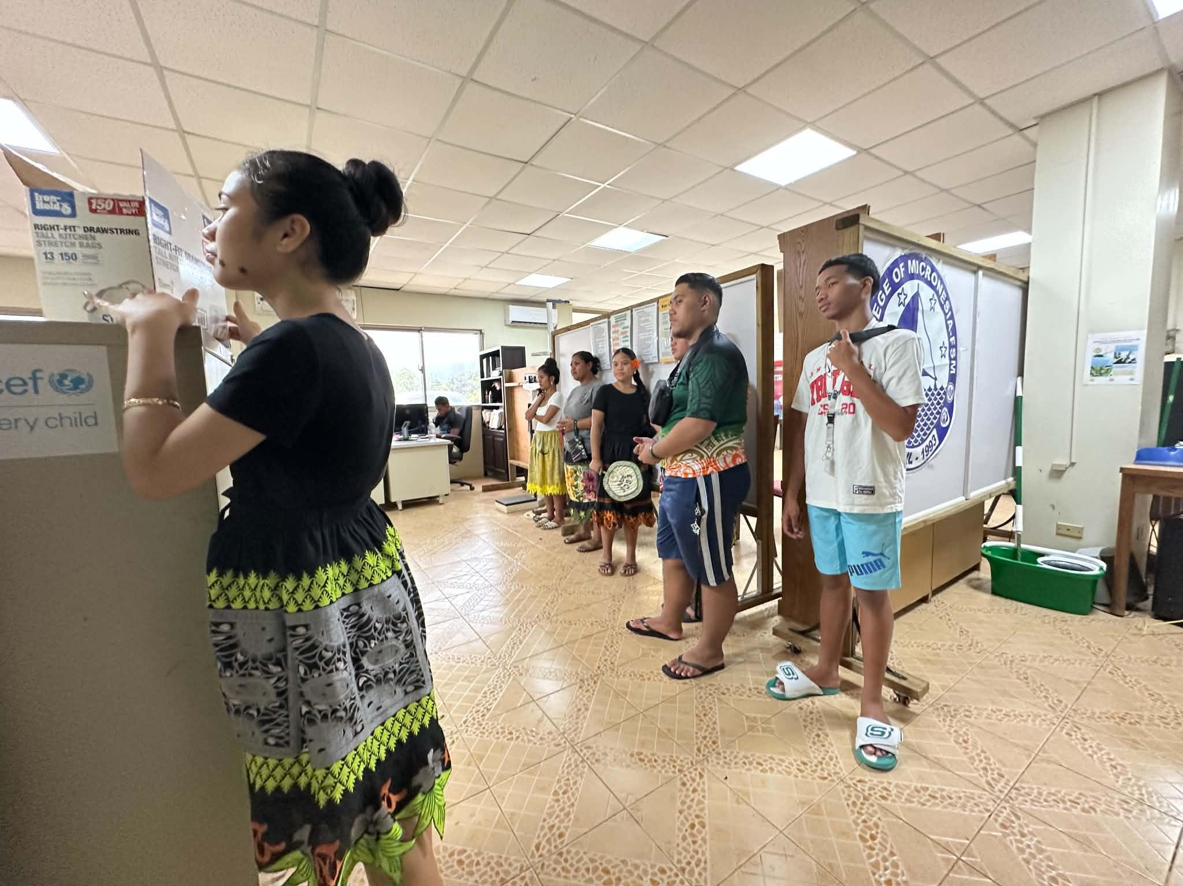
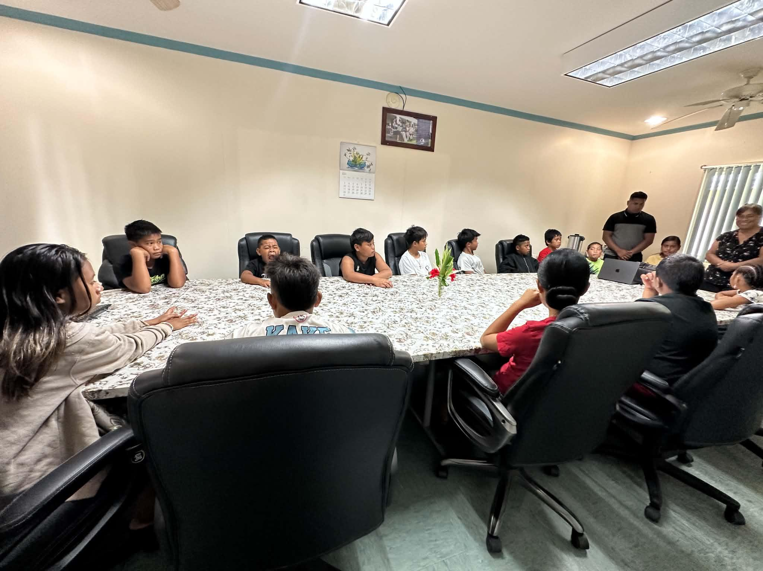
CTEC Activities
Campus Tour led by SBA officers
June 26, 2026 - GEM students from Ebeye, RMI toured CTEC campus.
  Introduced to offices and student services
  Learned about academic programs and student life
July 3, 2026 - Kitti Junior Police visited CTEC campus.
  Shared information on facilities, programs, and student organizations
  Encouraged continuing education after after high school
Tour promoted COM-FSM, build confidence, and inspired youth to pursue higher education
Notes:
Campus Tour led by SBA officers
June 26, 2026 - GEM students from Ebeye, RMI(Republic of the Marshall Island) toured CTEC campus.
Introduced to offices and student services
When the RMI were shown or familiarized with the different offices, departments, and support services available to students.
Learned about academic programs and student life
The students were given information about the course/programs and subjects the school offers.
July 3, 2026 - Kitti Junior Police visited CTEC campus.
Shared information on facilities, programs, and student organizations
They provided students with information about the school’s resources, academic opportunities, and groups they can join.
Encouraged continuing education after high school
Students were encouraged to keep studying after graduating from high school.
Tour promoted COM-FSM, build confidence, and inspired youth to pursue higher education

Slide 15
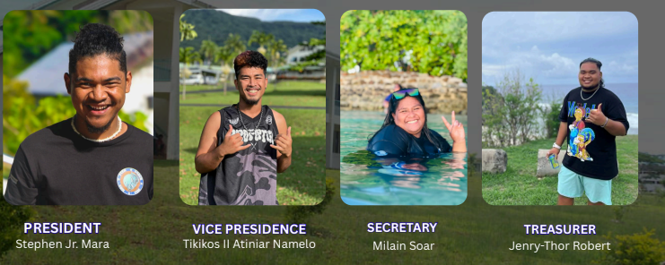
NATIONAL CAMPUS SBA
Stephen Jr. Mara
Tikikos II Atiniar Namelo
Milain Soar
Jenry- Thor Robert
President
Vice President
Secretary
Treasurer

Slide 16
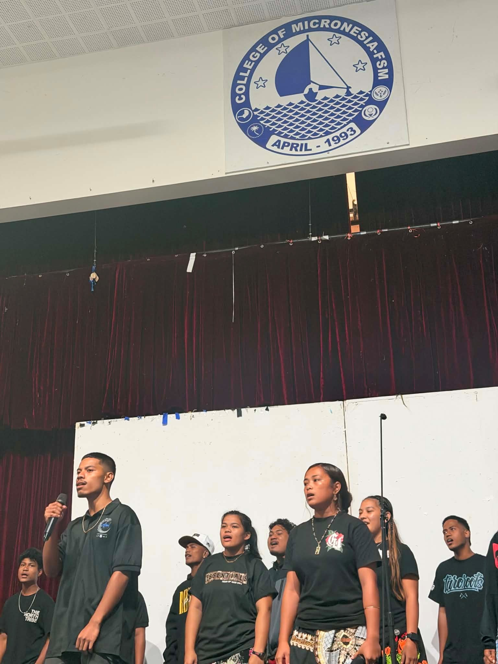
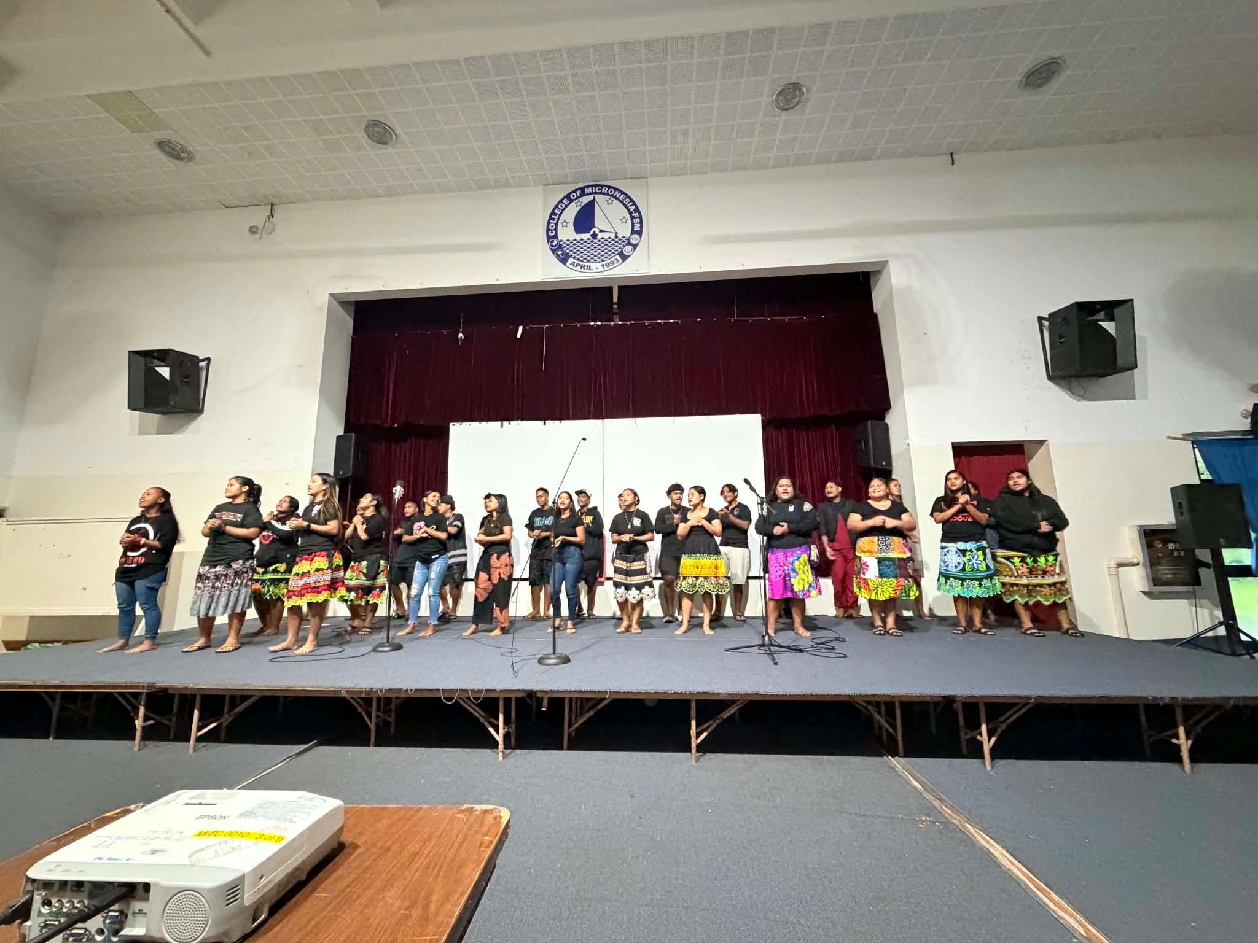
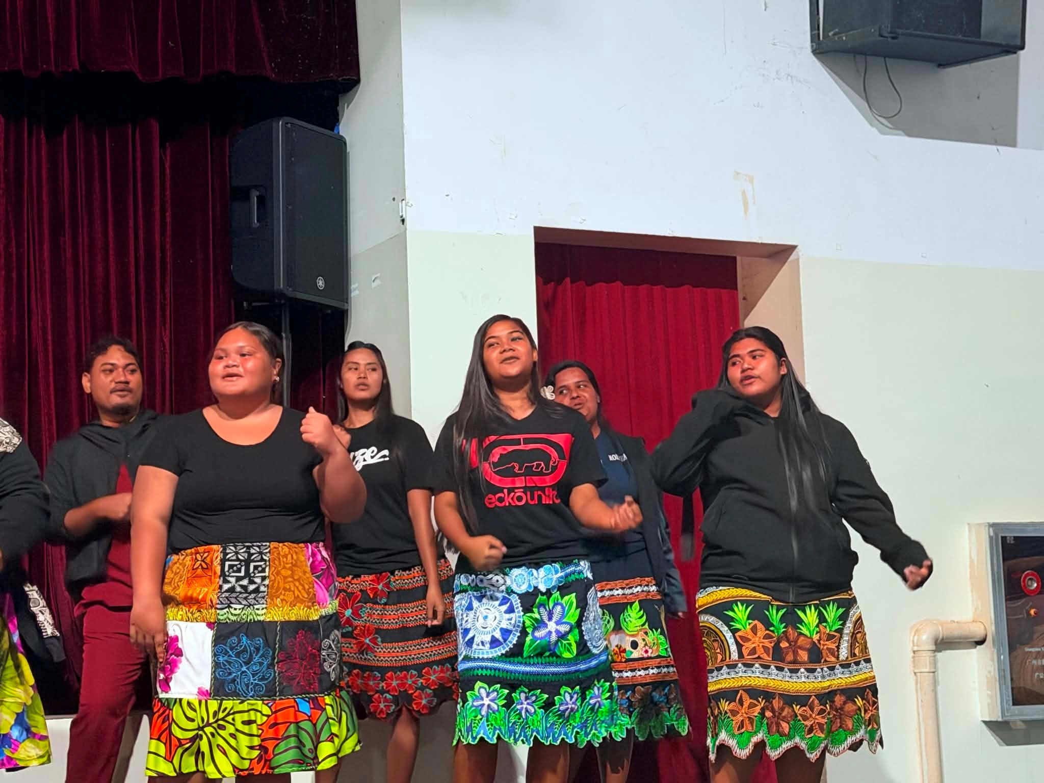
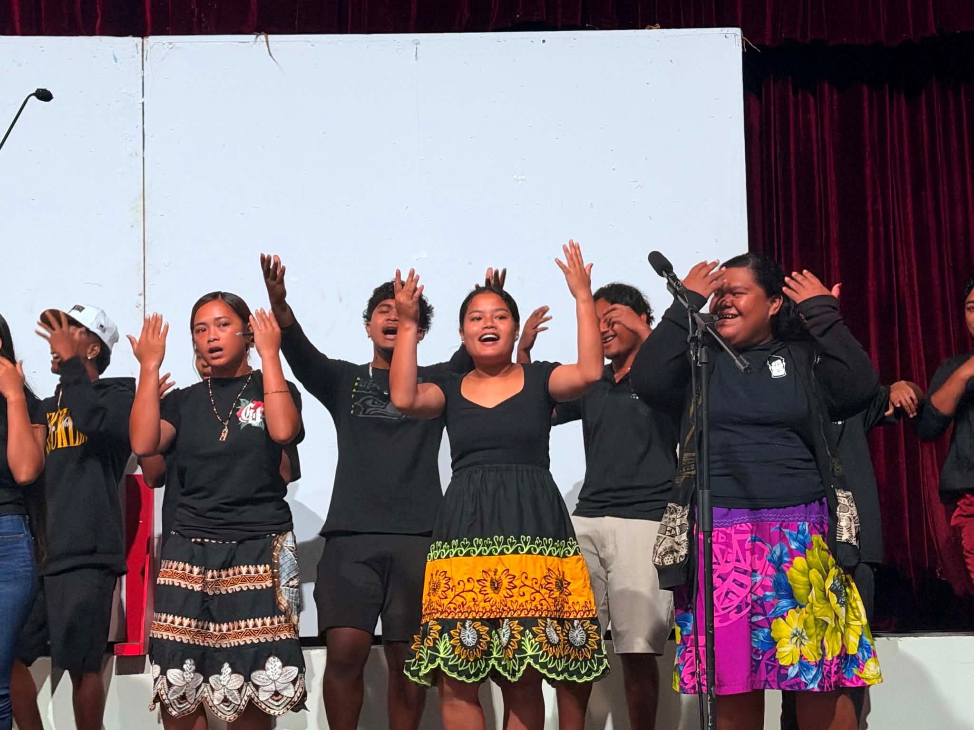
National Campus Choir
Fall 2026 orientation – 08-11-26:
National Campus Gym, COM Choir Participated in the orientation bringing live music into the event keeping everyone alive and focus on the presentations from the college departments and offices.
Instead of one presentation after another, the choir uses the break hours to keep the event more alive and fun.
Notes:
National Campus Gym, COM Choir Participated in the orientation bringing live music into the event keeping everyone alive and focus on the presentations from the college departments and offices.
Instead of one presentation after another, the choir uses the break hours to keep the event more alive and fun.

Slide 17
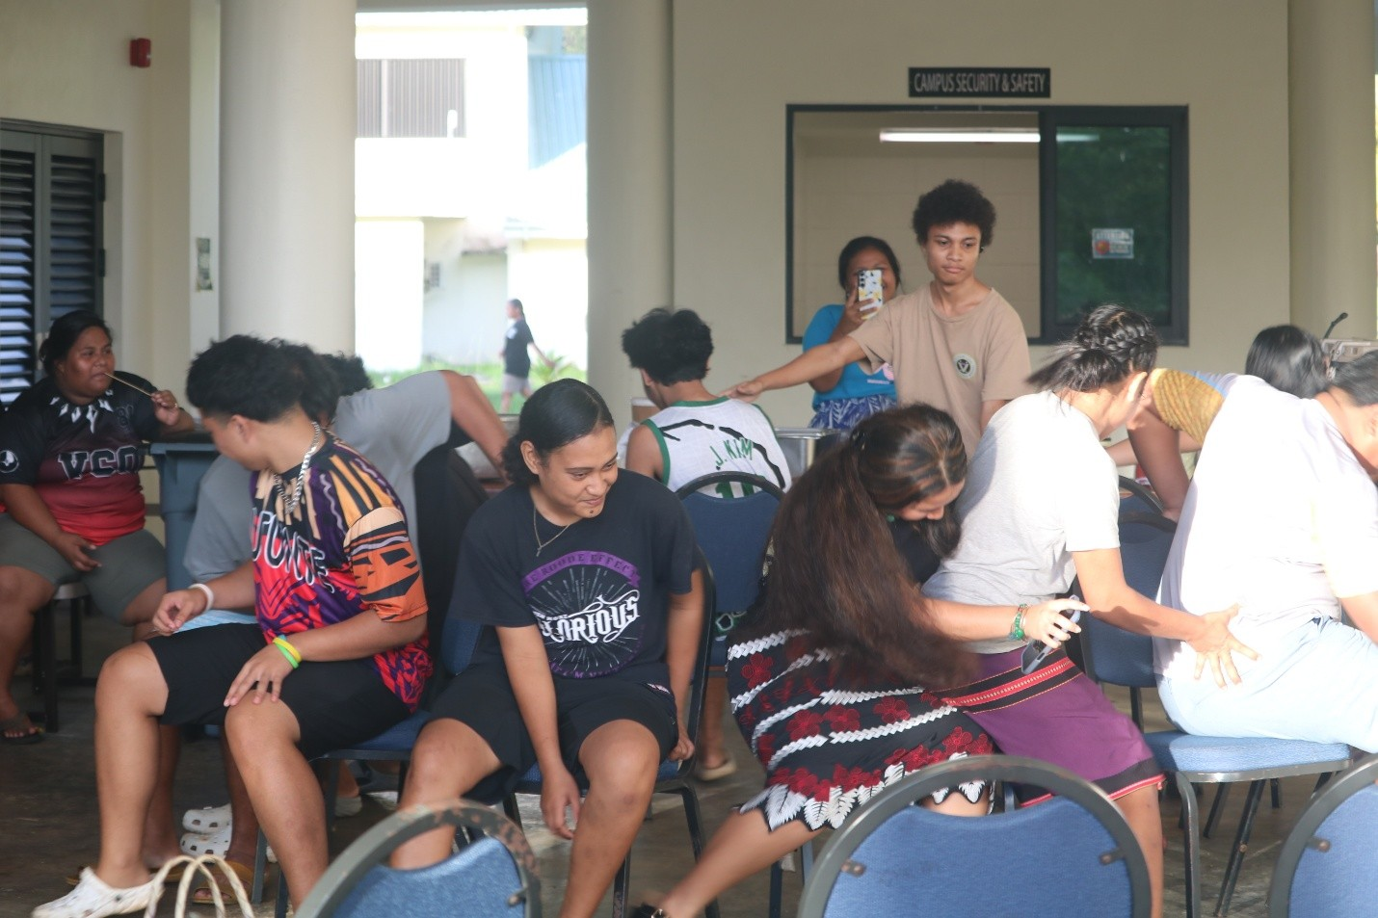
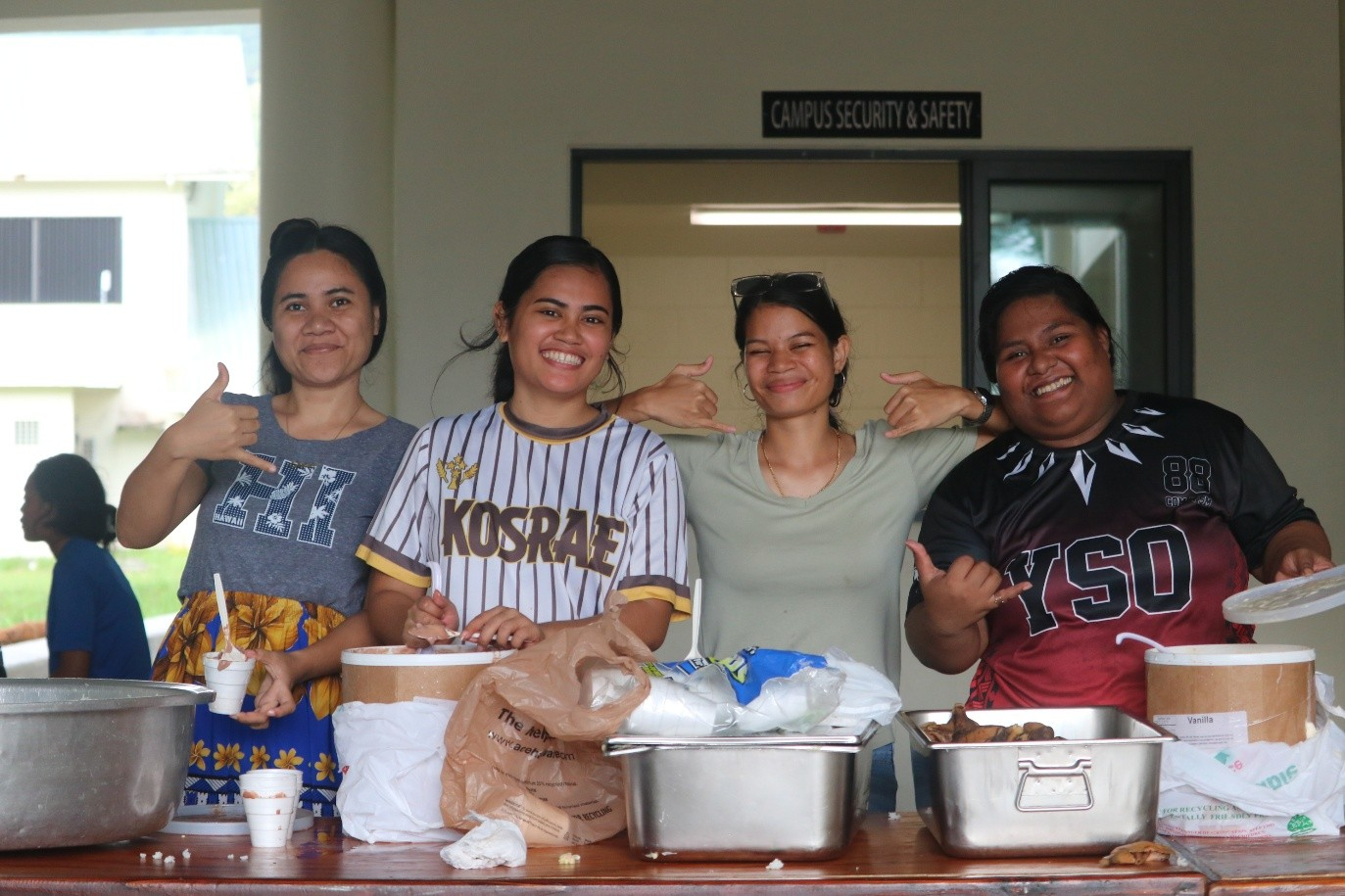


Nation Campus Activities
Saturday, August 15, 2026
Student Center – Residence Hall
Fall 2026 Welcome Party Welcomes Students Back to the Residence Hall
Notes:
Today, Saturday, August 15, 2026, Residence Hall students gathered at the Student Center for the Fall 2026 Welcome Party, welcoming all new, transfer, and continuing students back to school and to the dormitory.
The event focused on bringing students together, creating opportunities to meet and connect with one another, and building a strong sense of community and friendship among all Residence Hall students.
The Welcome Party provided a fun and welcoming environment for students to reconnect with returning friends, meet new classmates, and begin the Fall 2026 semester together. The event also emphasized the importance of unity, respect, and building strong relationships within the Residence Hall community.
As the new semester begins, the Residence Hall looks forward to creating more opportunities for students to connect, participate, and make meaningful memories throughout Fall 2026.
Welcome back, students, and best wishes for a successful Fall 2026 semester!
After the serving of food, there was few games that was held for the students to bond such as the musical chair and passing of the ring.

Slide 18


National Campus Activities (Round-the-Island Trip)
Residence Hall Students Round-the-Island Trip
Learned more about the island and its communities
Built teamwork and friendship
Gained new experiences outside the residence hall
Notes:
Residence Hall Students Round-the-Island Trip
Learned more about the island and its communities
The trip helped students see different places and learn about the local environment and culture.
Built teamwork and friendship
Students had the opportunity to spend time together, cooperate, and strengthen relationship.
Gained new experiences outside the residence hall
The trip allowed students to explore, relax, and experience activities outside their usual school routine.

Slide 19


National Campus Activities
Peer Coach Training
Learned how to support others
Improved communication skills
Developed leadership skills
Learned problem solving skills
Notes:
Peer Coach Training
Learned how to support others
Peer coaching teaches students how to help and encourage their fellow students.
Improved communication skills
Students learn how to listen carefully, ask helpful questions, and communicate respectfully.
Developed leadership skills
Peer coaching helps students become more responsible, confident, and supportive leaders.
Learned problem solving skills
Students learn how to guide peers in finding solutions to challenges they may face.

Slide 20

KOSRAE CAMPUS SBA
Geovannie Melander
AJ Alokoa
Vilanyema Paulino
Andyna Shrew
President
Vice President
Secretary
Treasure

Slide 21




Kosrae Campus Activities
Student Engagement and Leadership
On June 04, 2026 SBA Community work for the campus were to fill up water dispensers bottle.
June 10, 2026, SBA 2nd community service for the summer is to wash both 2 vans for the college. SBA took the lead in carry out this activity.
Notes:
On June 04, 2026 SBA Community work for the campus were to fill up water dispensers bottle.
June 10, 2026, SBA 2nd community service for the summer is to wash both 2 vans for the college. SBA took the lead in carry out this activity.

Slide 22



Kosrae Campus Activities
On June 18, 2026, a welcoming BBQ to both the new students and continuing students here at the student lounge and there were 64 students attended. This number came from the number of students taking class during the morning until the afternoon.
Notes:
On June 18, 2026, a welcoming BBQ to both the new students and continuing students here at the student lounge and there were 64 students attended. This number came from the number of students taking class during the morning until the afternoon.

Slide 23



Kosrae Campus Activities
On July 18, 2026 the first ever Music/Karaoke was held at the COM-FSM Kosrae campus lounge sponsored by the Summer 26 music club with Instructor Dr. Muller, and SBA.
It was a fun filled night where all the contestants and the spectators enjoyed. Top three winners were awarded with monetary awards sponsored by music instructor Dr. Muller.
Notes:
On July 18, 2026 the first ever Music/Karaoke was held at the COM-FSM Kosrae campus lounge sponsored by the Summer 26 music club with Instructor Dr. Muller, and SBA.
It was a fun filled night where all the contestants and the spectators enjoyed. Top three winners were awarded with monetary awards sponsored by music instructor Dr. Muller.

Slide 24




Kosrae Campus Activities
August 07, 2026 is the COMFSM Orientation for all new students attending this Fall 2026. It was held at the LRC room with 24 students attended.
On Monday August 24, 2026, SBA members coordinate a welcoming get together to all students and faculty as an Advisor/Student meet. A list for each advisor with their advisee were posted at the student lounge where all students came check their names and find their advisors and get a check in with them. After the activity, a pizza with ice coffee were blessed and offer to everyone.
Notes:
August 07, 2026 is the COMFSM Orientation for all new students attending this Fall 2026. It was held at the LRC room with 24 students attended.
On Monday August 24, 2026, SBA members coordinate a welcoming get together to all students and faculty as an Advisor/Student meet. A list for each advisor with their advisee were posted at the student lounge where all students came check their names and find their advisors and get a check in with them. After the activity, a pizza with ice coffee were blessed and offer to everyone.

Slide 25
Student Challenges and Concerns
Refunds were not received on a timely basis, still experiencing delays despite complete filling up of FAFSA and submit needed documents on time.
SBA fund request for activities still delays at times.
No eating outlet on campus.
Need more available classes and instructors
Dorm room for students living afar.
Need more help from staff to plan & organize events along with students to encourage attendance and participation.
Offer more opportunities for students from state campuses to stay home to complete their degree.
Limited time for event planning – SBA officers balancing full-time studies with leadership duties
Notes:
[Note to Presenter: It may be effective to provide some details/examples of how these points may be true for you as an SBA officer & student or from other SBA officers from the other campuses.]
Finish list after speaking to all campus reps.

