Slide 1
Financial Report
As of August 31, 2026

Slide 2
I. Overview
This report summarizes the overall financial health of the College of Micronesia-FSM.
Statement of Projected Revenue and Actual Expenditure
FY2027 Projected Revenue
Cash Balance
Receivable Balance
Business Office Operation
Auxiliary Services Operation

Slide 3
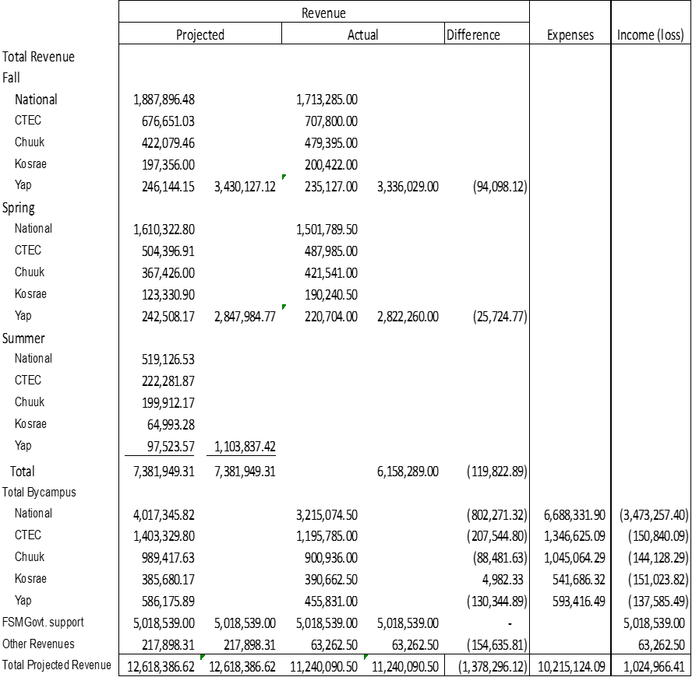
II. Statement of Projected Revenue and Actual Expenditures as of July 31, 2026 (Unrestricted)

Slide 4
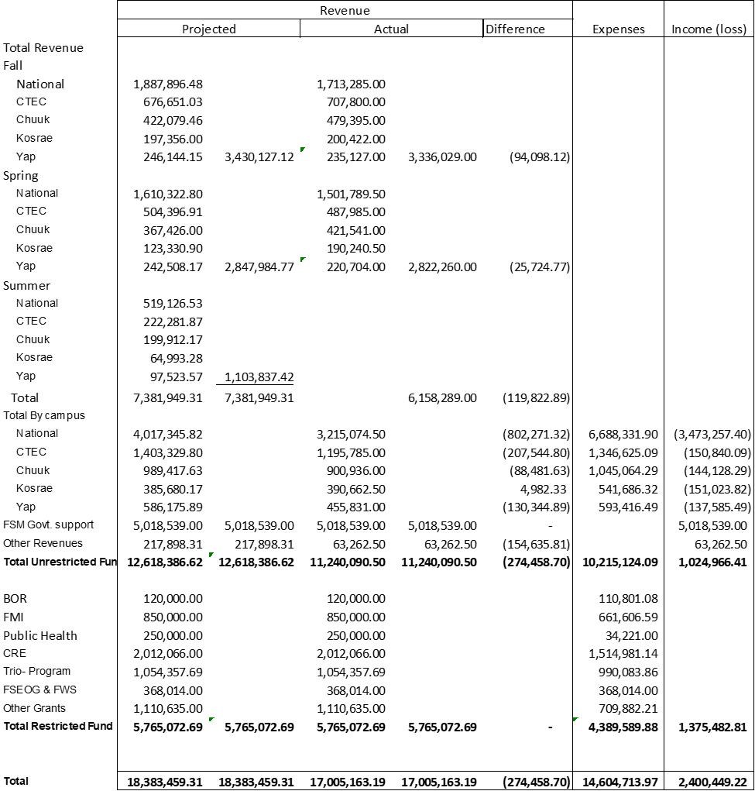
III. Statement of Projected Revenue and Actual Expenditures as of July 31, 2026 (Unrestricted and restricted)

Slide 5
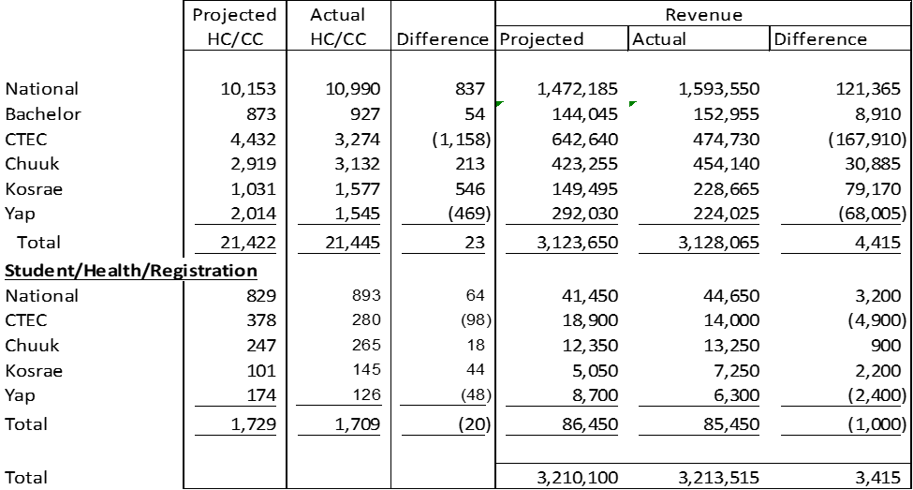
IV. FY2027 Projected Revenue (Fall)

Slide 6
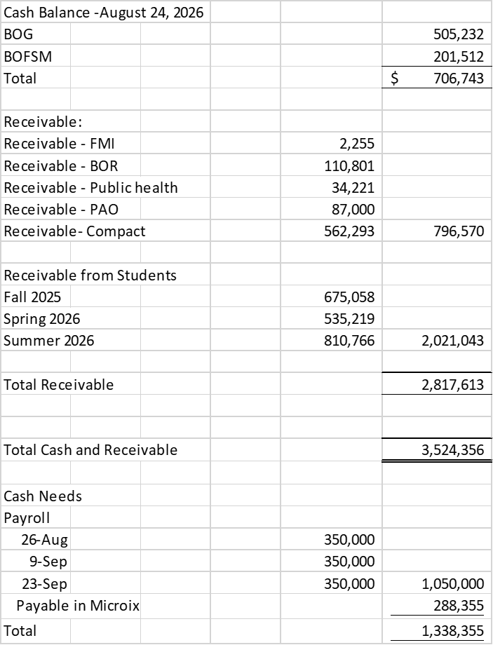
V. Cash Balance

Slide 7
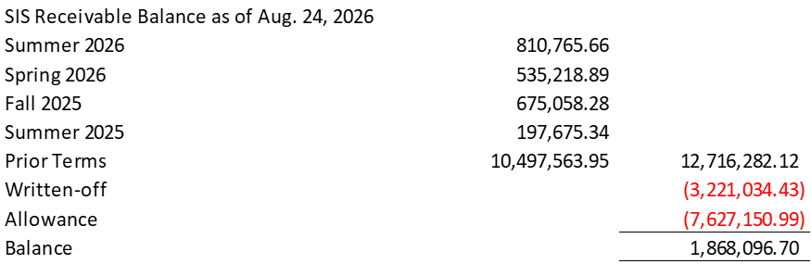
VI. Account Receivable Balance

Slide 8
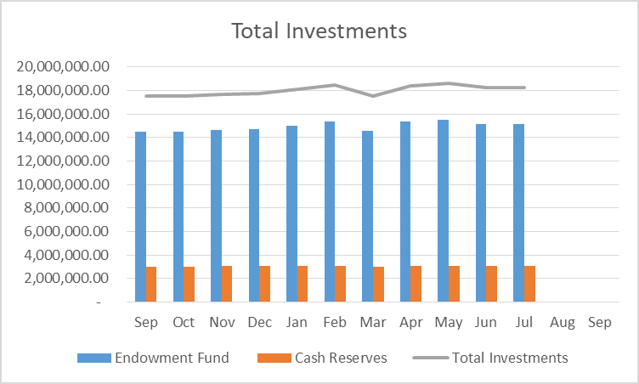
VII. Investment Balance
Endowment Fund - $15,160,019.61
Cash Reserves- $3,079,293
Total Investments -$18,239,312.61

Slide 9
VIII. Business Office
A. Staff shortfall – 3 special contracts (1 student)
B. Digital Timekeeping grant- ongoing
C. Cloud migration of MIP Accounting System- completed
D. Relocation to the ground floor of the Admin Building
E. Staff Development – 3 staff will attend the APIPA in Pohnpei

Slide 10
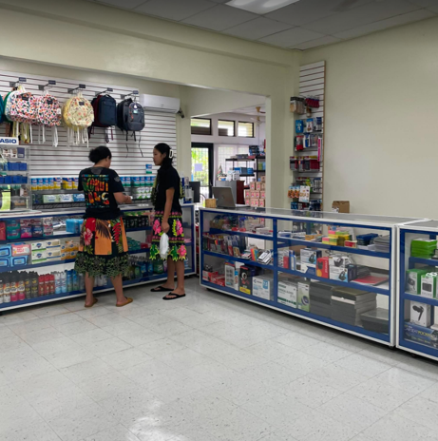
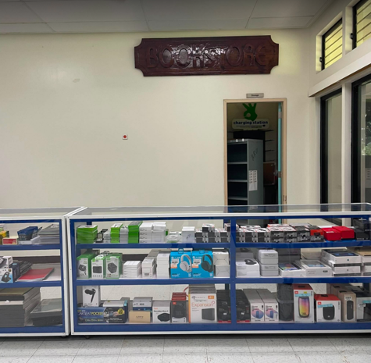
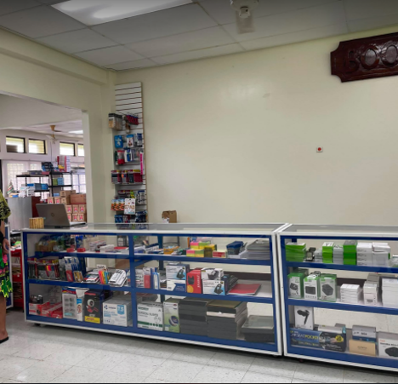
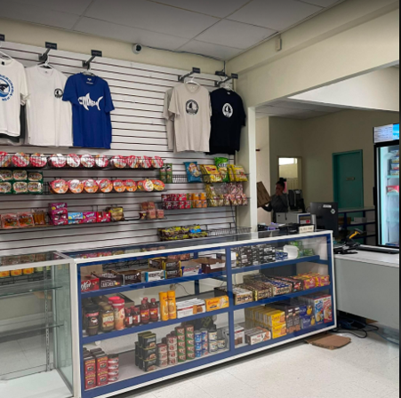
IX. Auxiliary Services
Bookstore Expansion and System Upgrade

Slide 11

X. Auxiliary Services
Dining Hall and Student Cafe
-Serving 86 students from RH
-emergency light

