Slide 1
Financial Report
As of April 30, 2025

Slide 2
I. Overview
This report summarizes the overall financial health of the College of Micronesia-FSM.
Investments Status Report
FY 2024 and 2025 Audit Status
Cash Balance
Statement of Projected Revenue and Actual Expenditure
Business Office Operation

Slide 3
II. Budget
A. FY2026 Actual Expenses as of April 30, 2026
Campus | Requested Budget | Approved Budget | Actual Expenses | Encumbered Expenses | Actual & Encumbered | Budget Balance | %
National | 12,000,823 | 8,031,483 | 4,160,985 | 406,582 | 4,567,567 | 3,463,915 | 43%
Pohnpei | 1,779,717 | 1,779,717 | 922,044 | 43,779 | 965,823 | 813,894 | 46%
Chuuk | 1,297,173 | 1,297,173 | 714,042 | 52,317 | 766,359 | 530,814 | 41%
Kosrae | 806,605 | 806,605 | 365,058 | 47,446 | 412,504 | 394,101 | 49%
Yap | 703,408 | 703,408 | 408,428 | 23,566 | 431,994 | 271,414 | 39%
Total | 16,587,727 | 12,618,386 | 6,570,558 | 573,690 | 7,144,248 | 5,474,138 | 43%
 |  | 76% | 52% | 5% | 57% | 43%

Slide 4
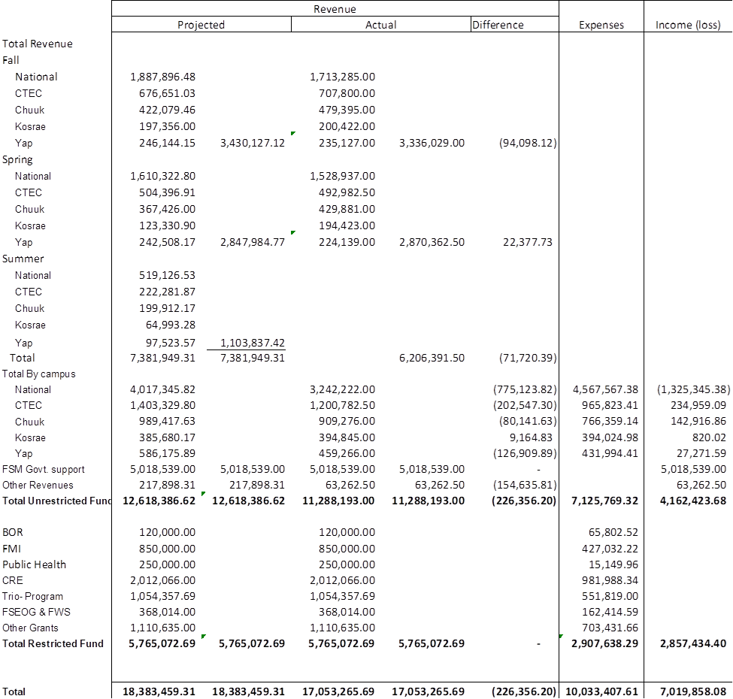
B. Statement of Projected Revenue and Actual Expenditures as of April 30 , 2026

Slide 5
III. BOR Budget

Slide 6
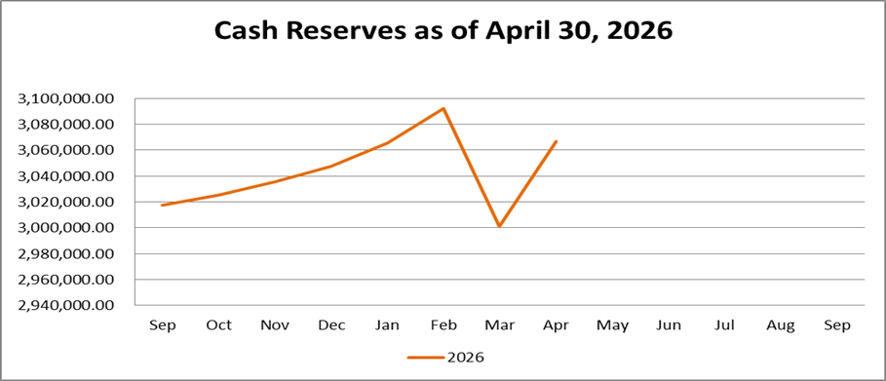
IV. Investment Balance as of April 30, 2026
A. Cash Reserves Fund
Balance as of April 30, 2026 - $3,066,943.11
Unrealized gain for FY2026 - $49,291.20

Slide 7
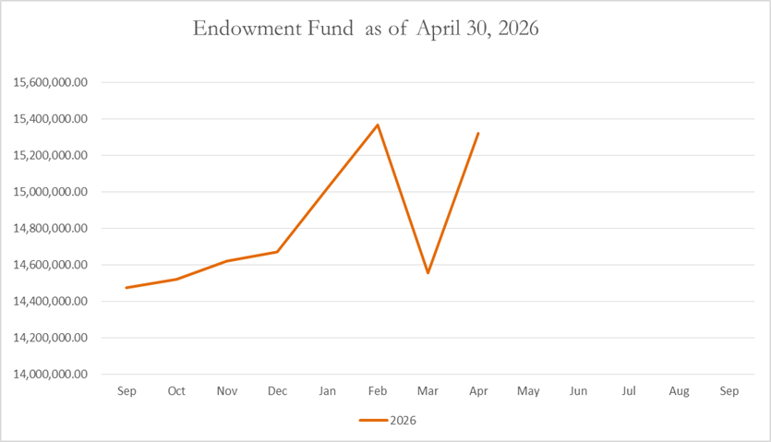
B. Endowment Fund
Balance as of April 30, 2026- $15,321,866.93
Unrealized gain for FY2026 - $849,006.95

Slide 8
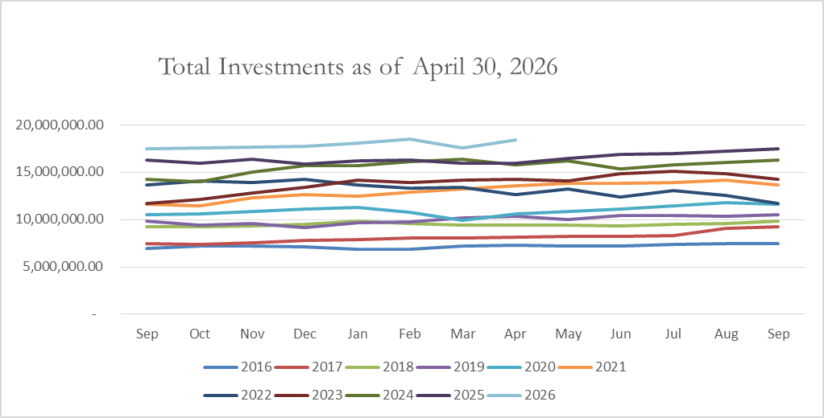
C. Total Investment Fund
Balance as of April 30, 2026-$18,388,810.04
Unrealized gain for FY2026 - $898,298.15

Slide 9
V- 2025 Audit Status
On-going and expected to be finished by June 30, 2026

Slide 10
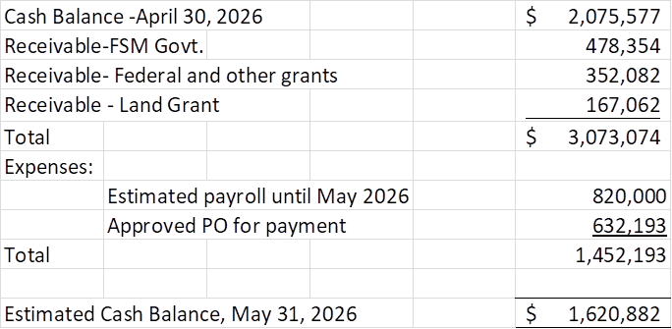
VI. Cash Status

Slide 11
VII. Business Office
A. Staff shortfall – 4 special contracts (3 students)
B. Digital Timekeeping grant- ongoing
C. Cloud migration of MIP Accounting System- ongoing

