Slide 1


Slide 2
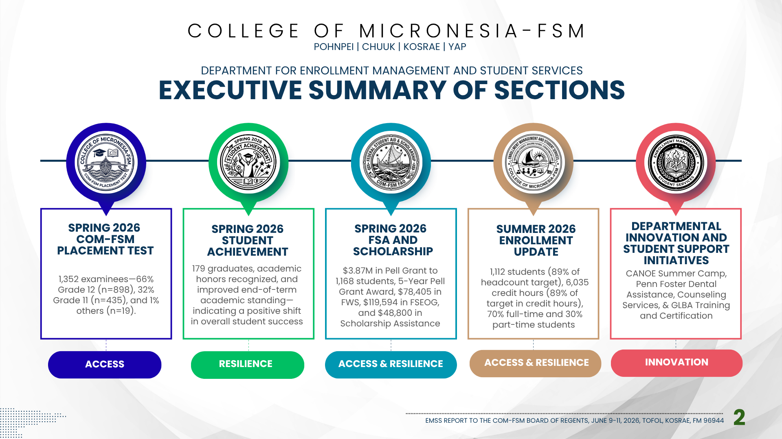

Slide 3
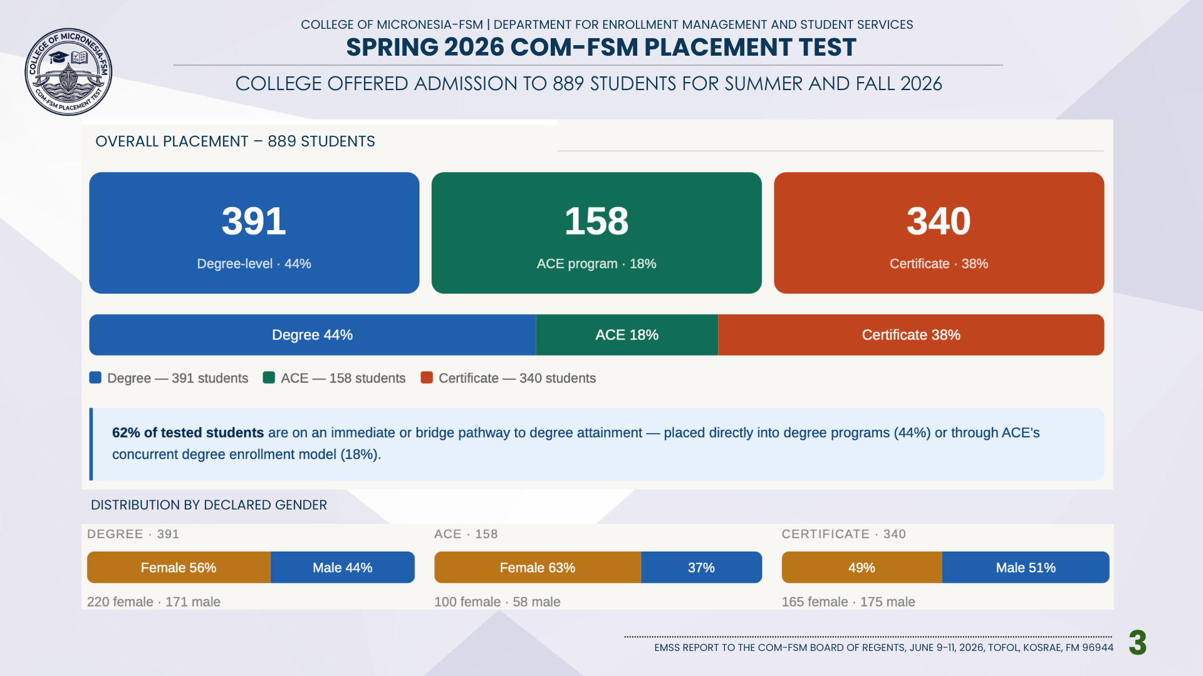

Slide 4
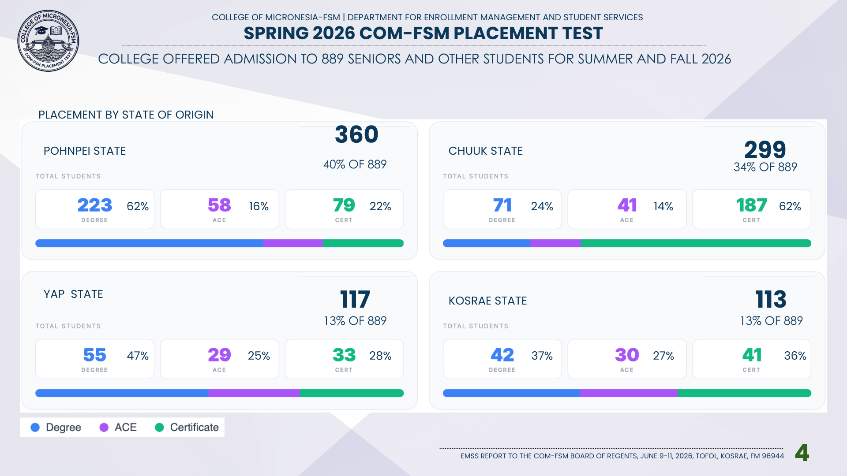

Slide 5
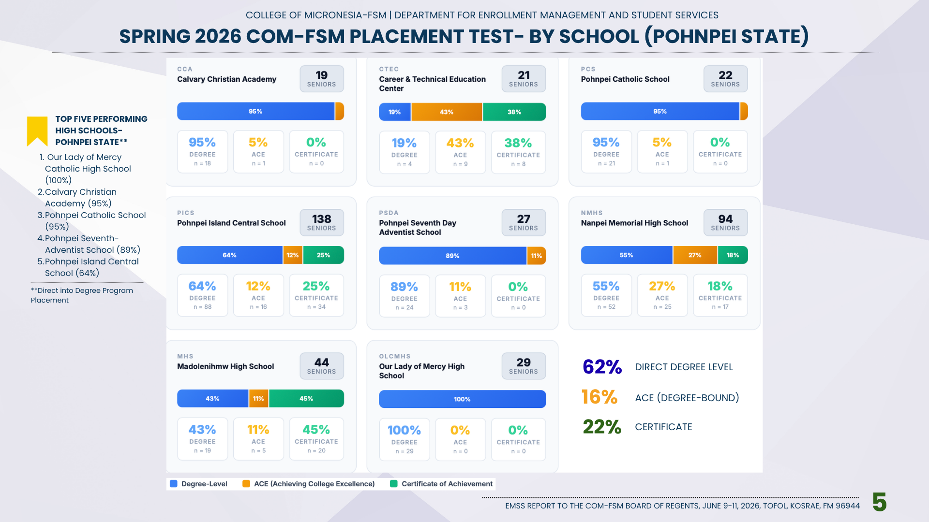

Slide 6
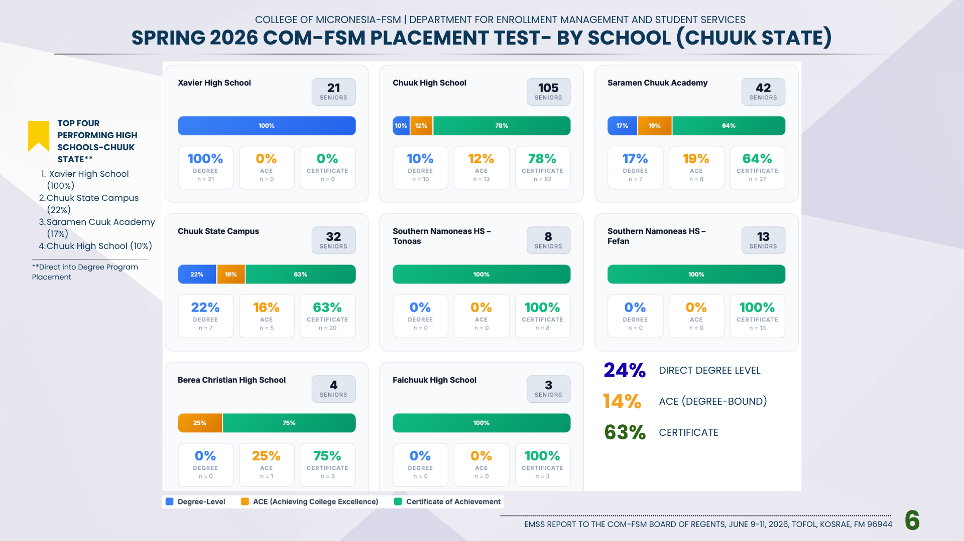

Slide 7


Slide 8
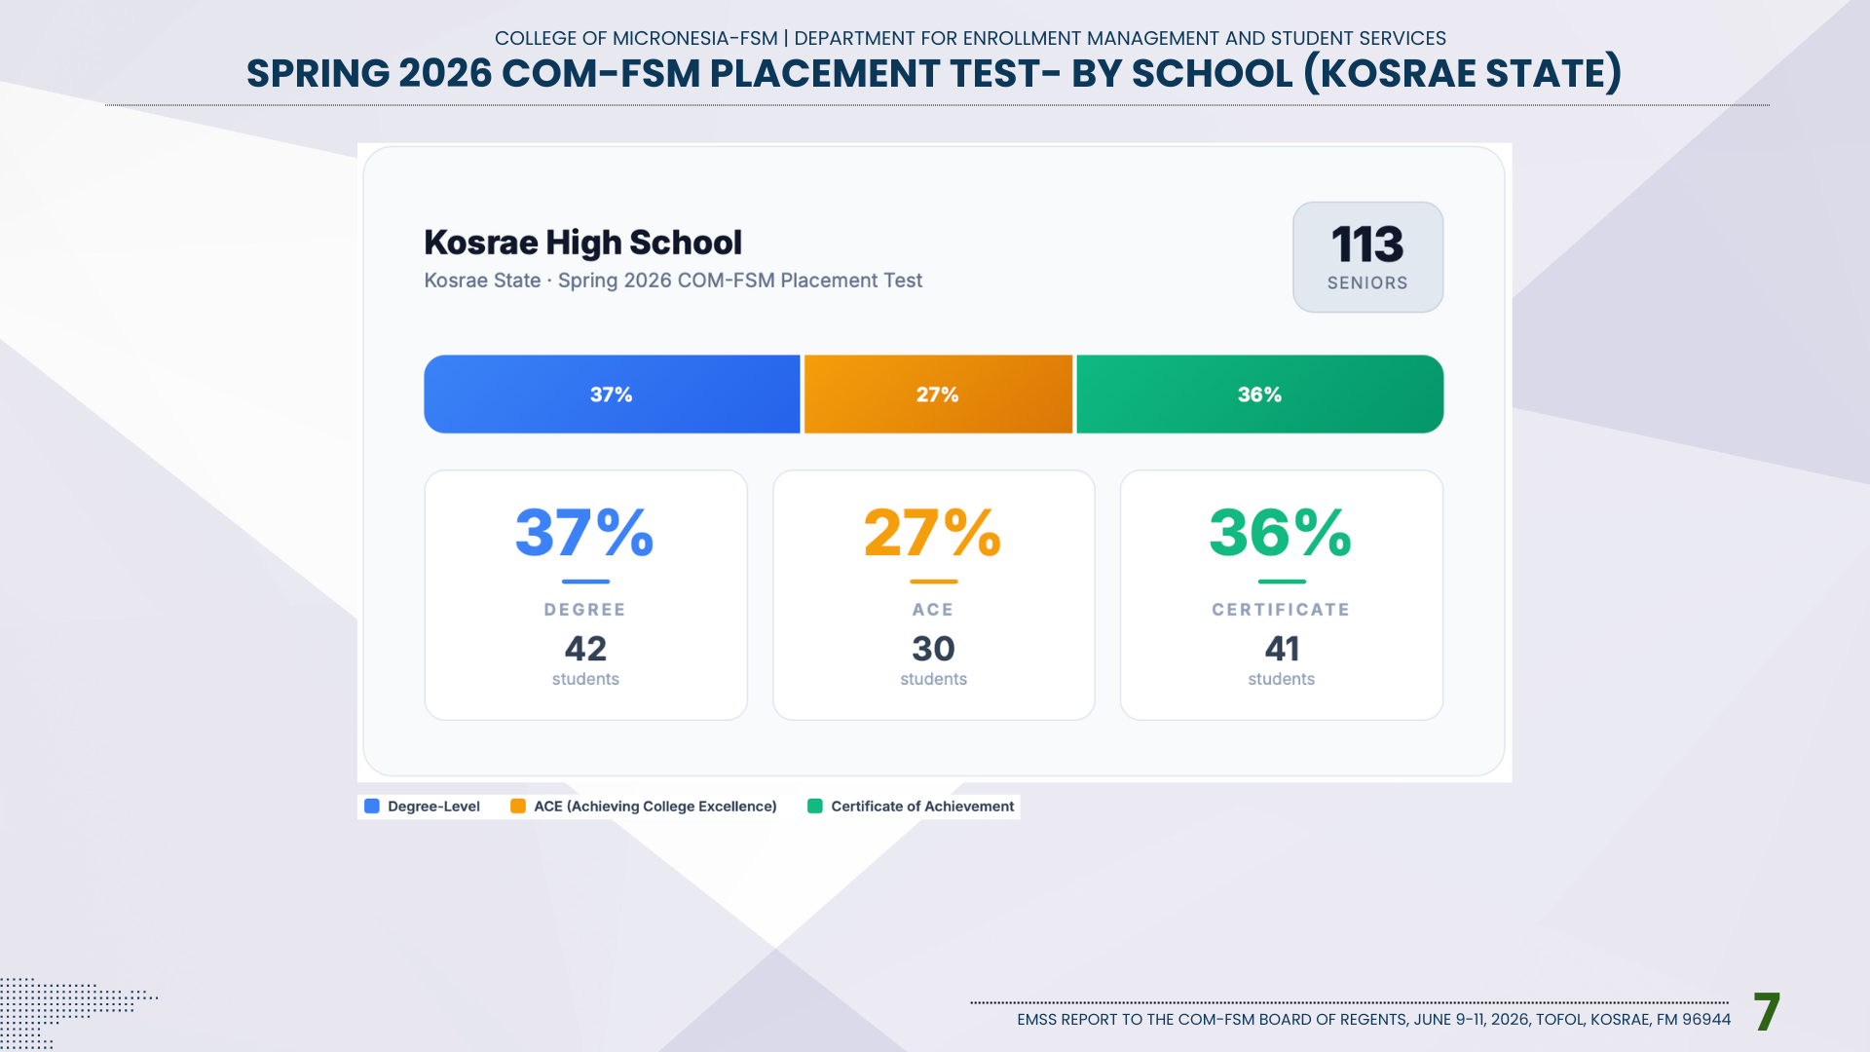

Slide 9
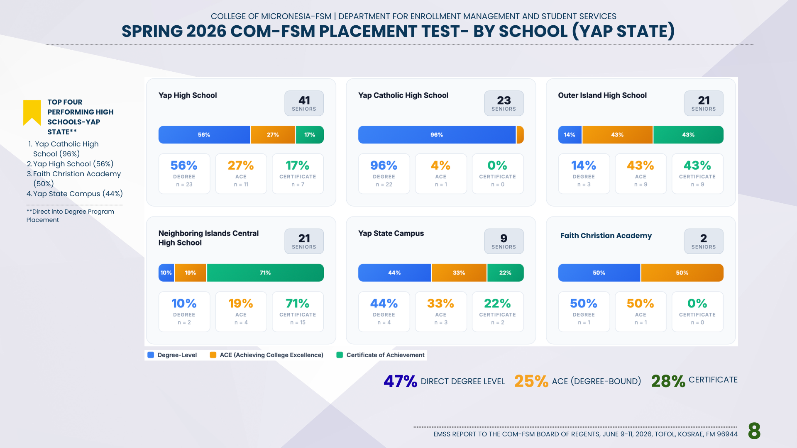

Slide 10
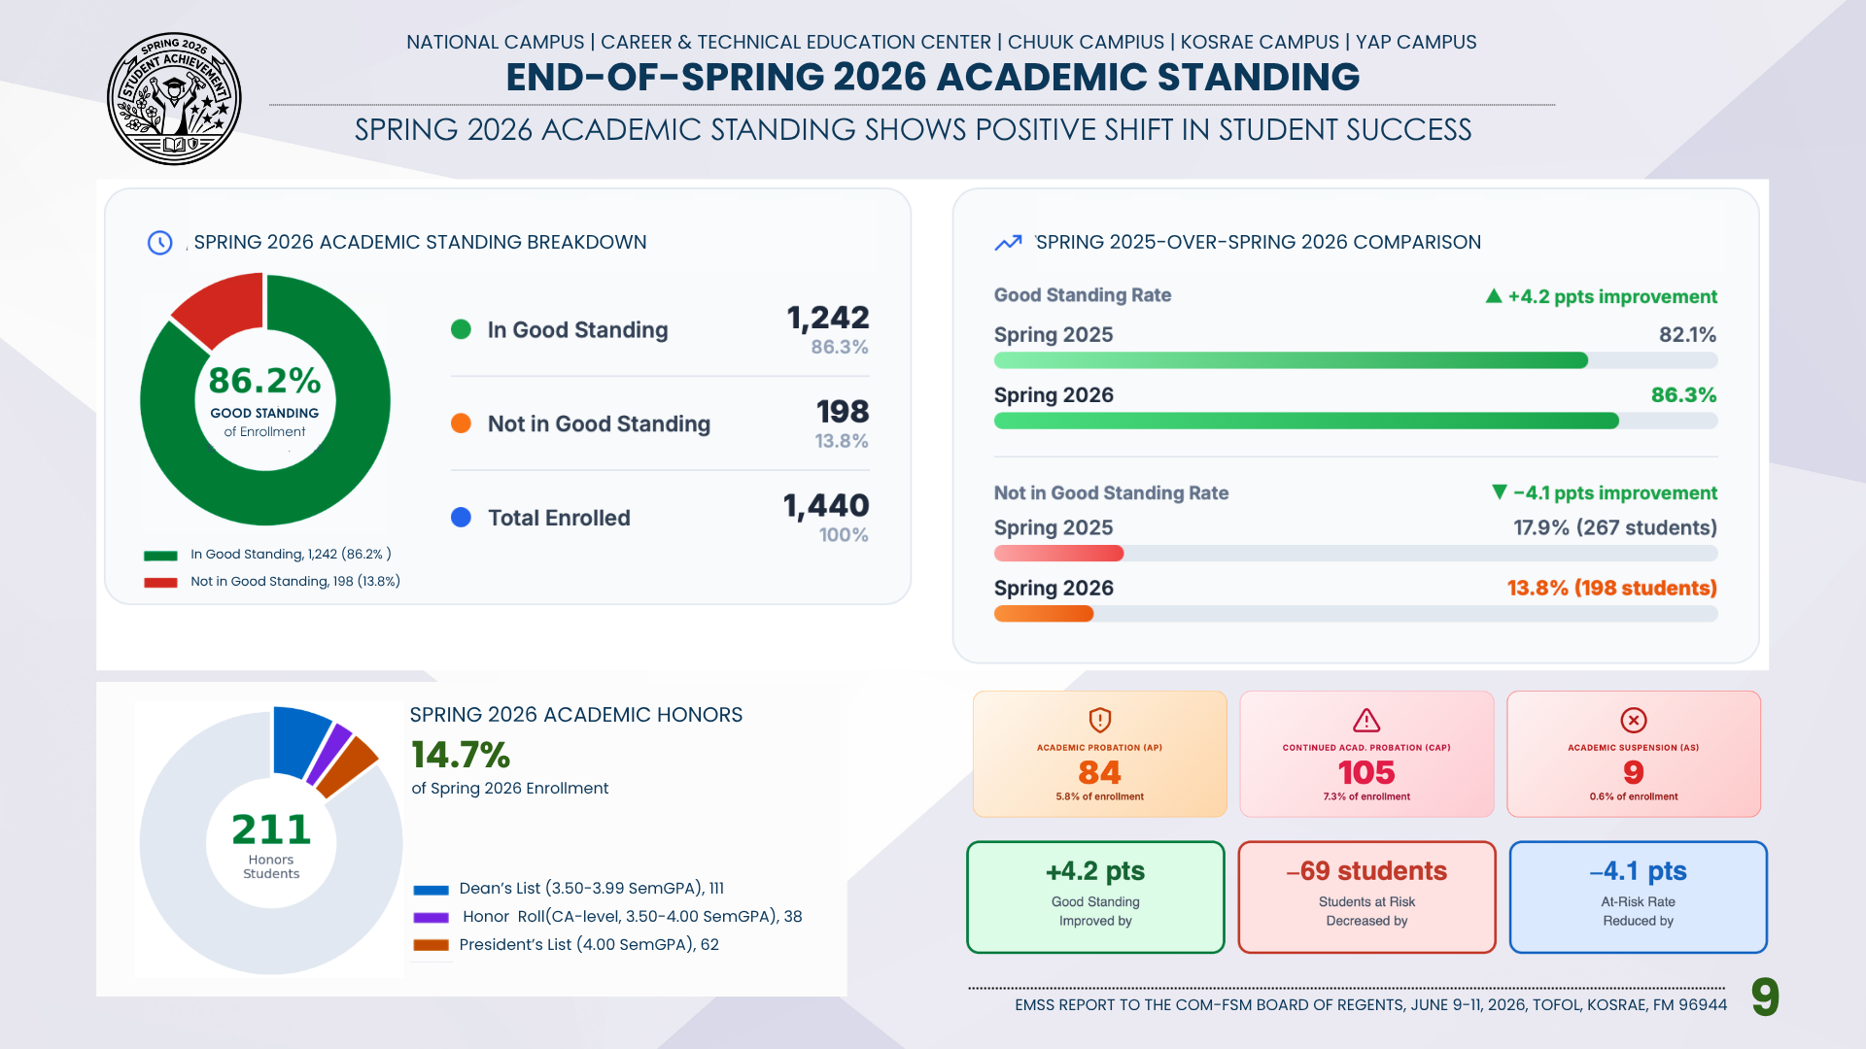

Slide 11
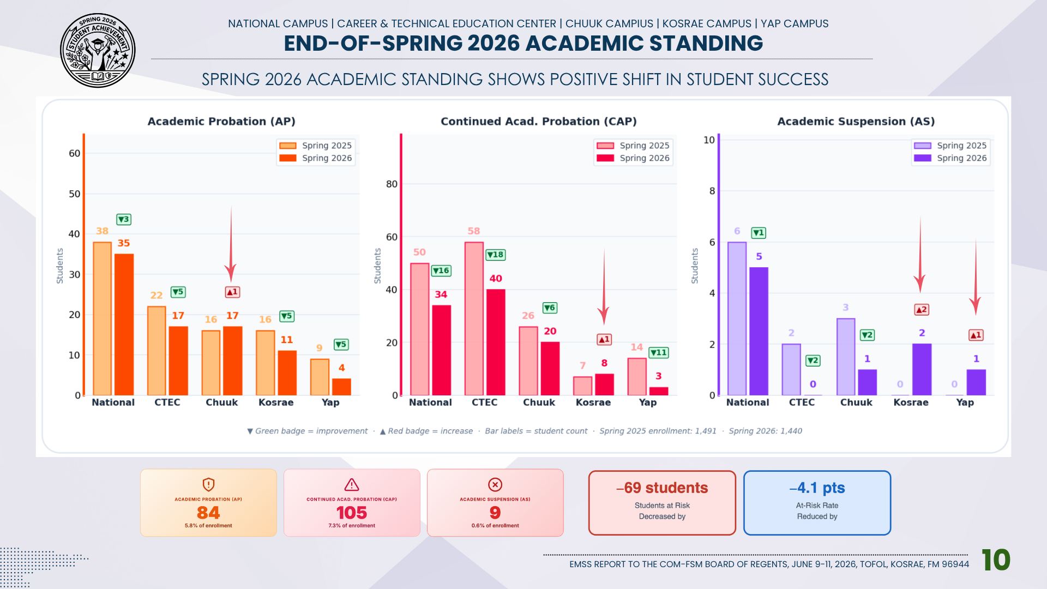

Slide 12
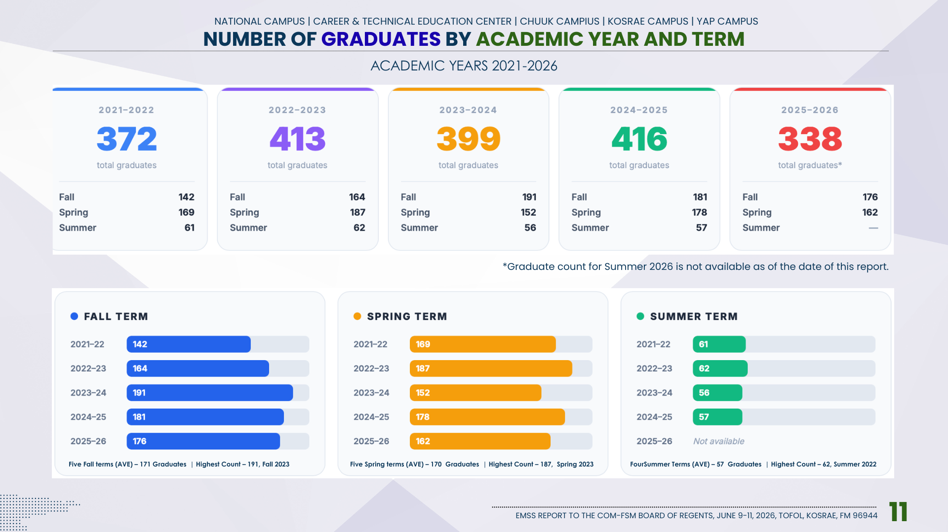

Slide 13
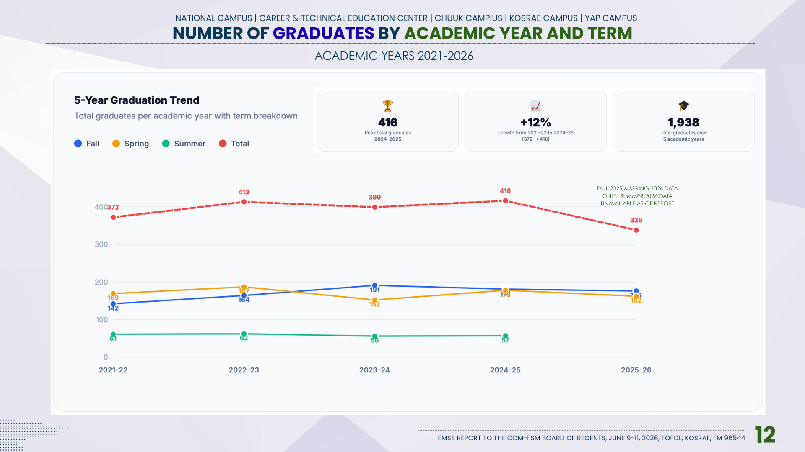

Slide 14


Slide 15
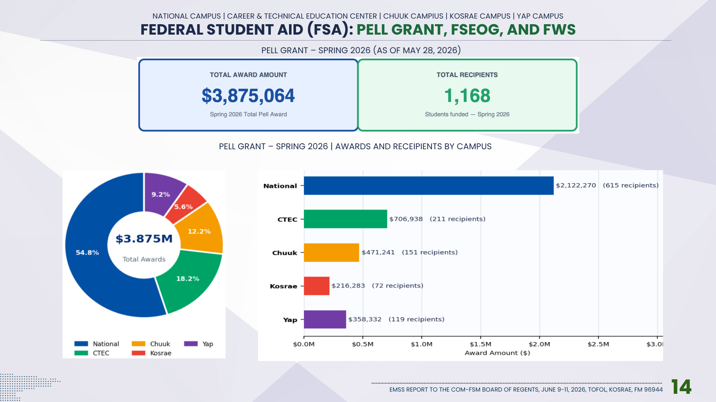

Slide 16
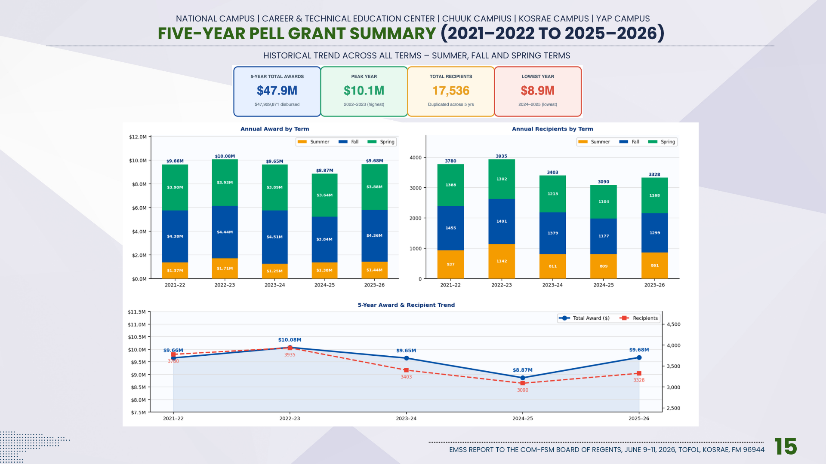

Slide 17
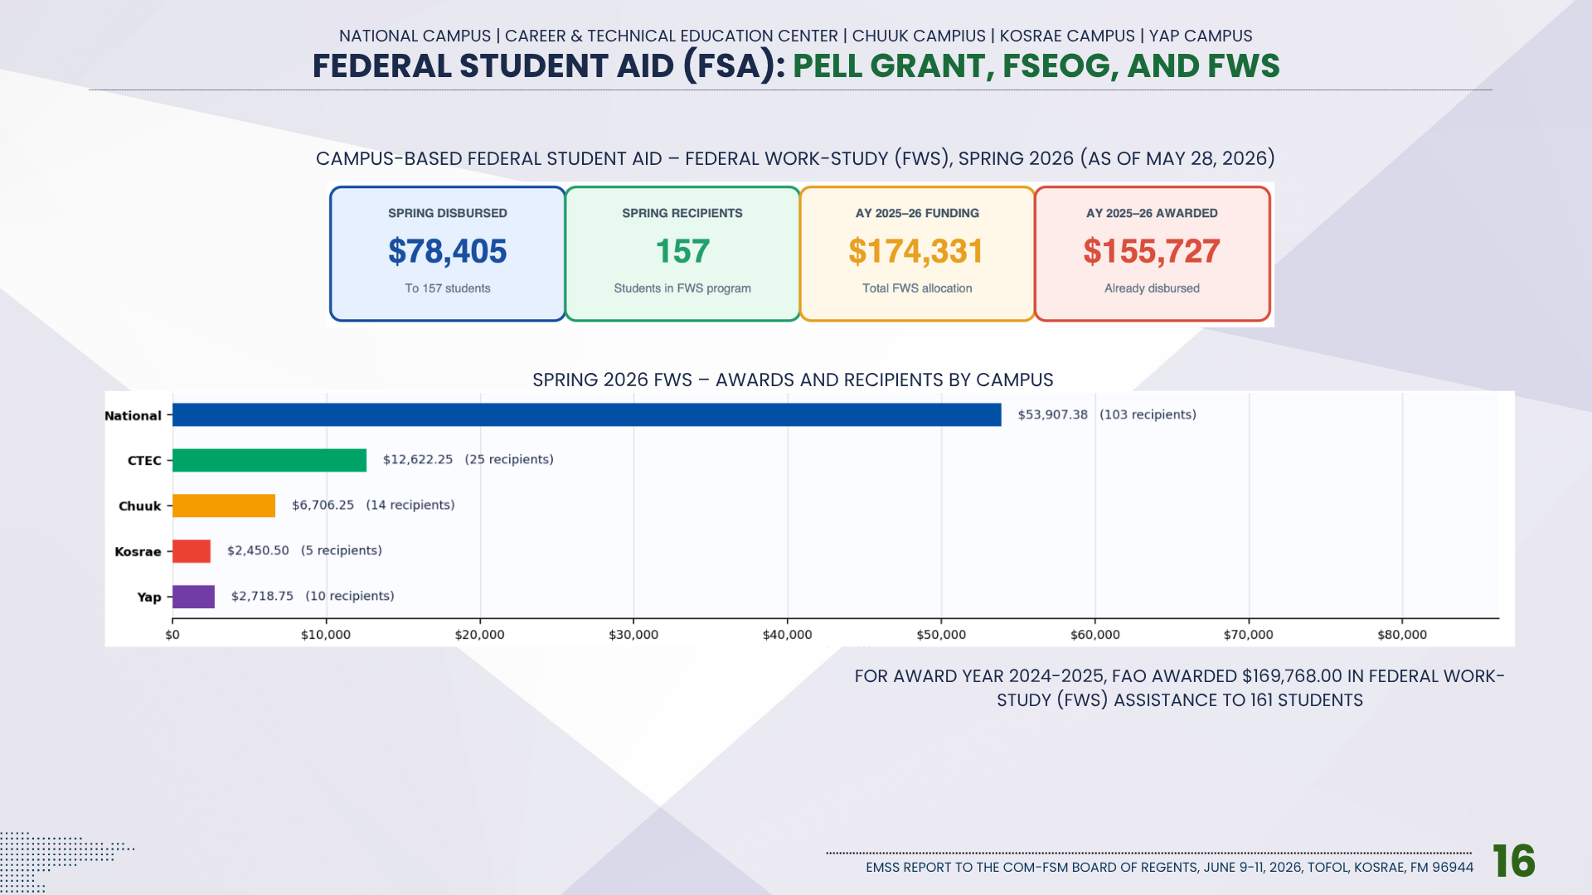

Slide 18
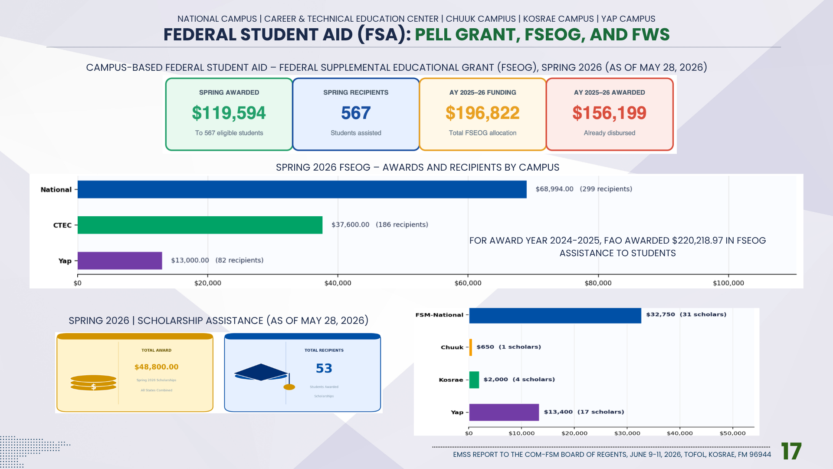

Slide 19
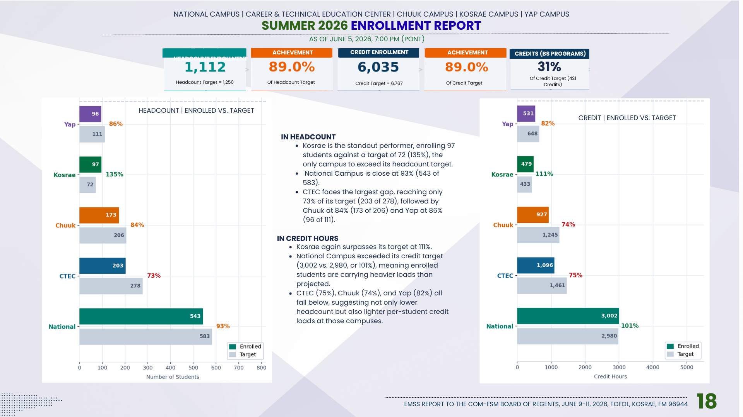

Slide 20
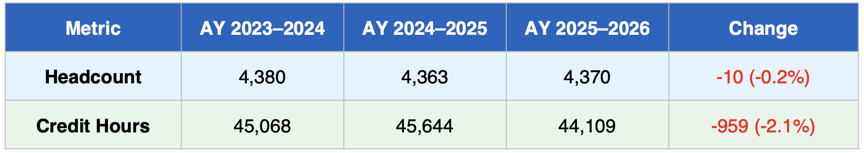
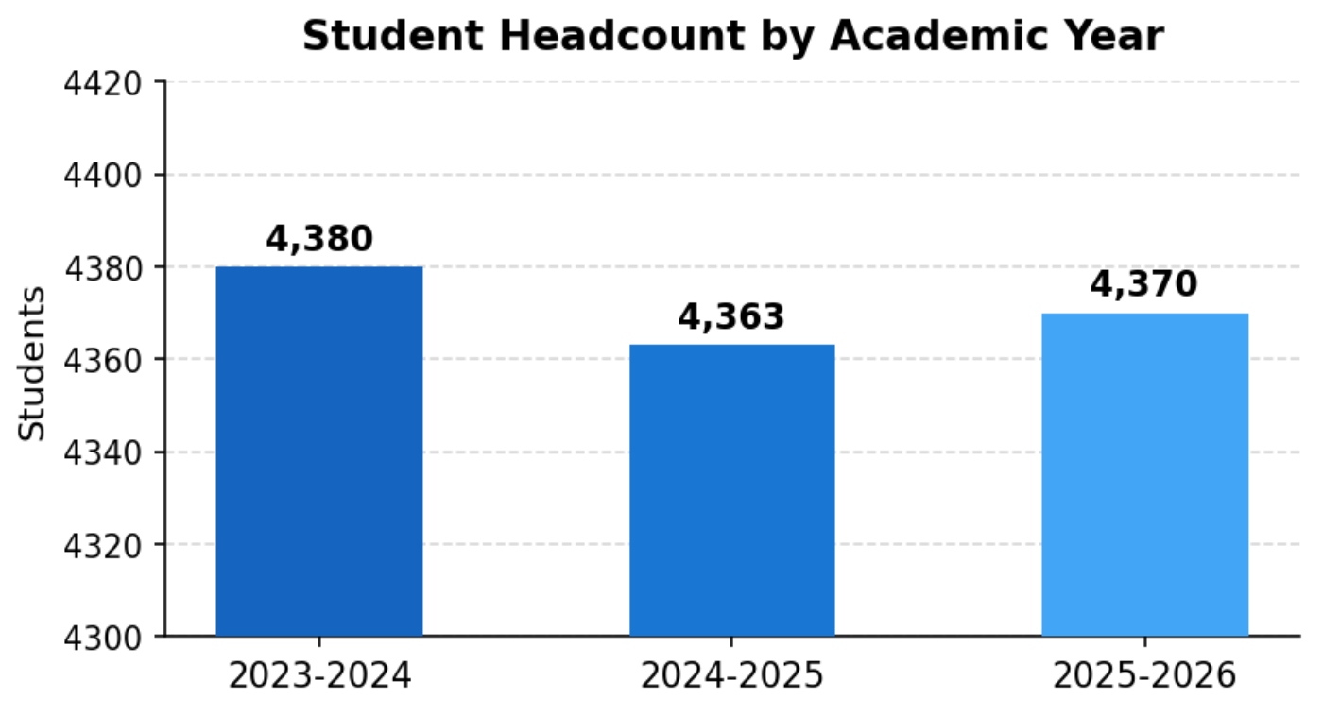
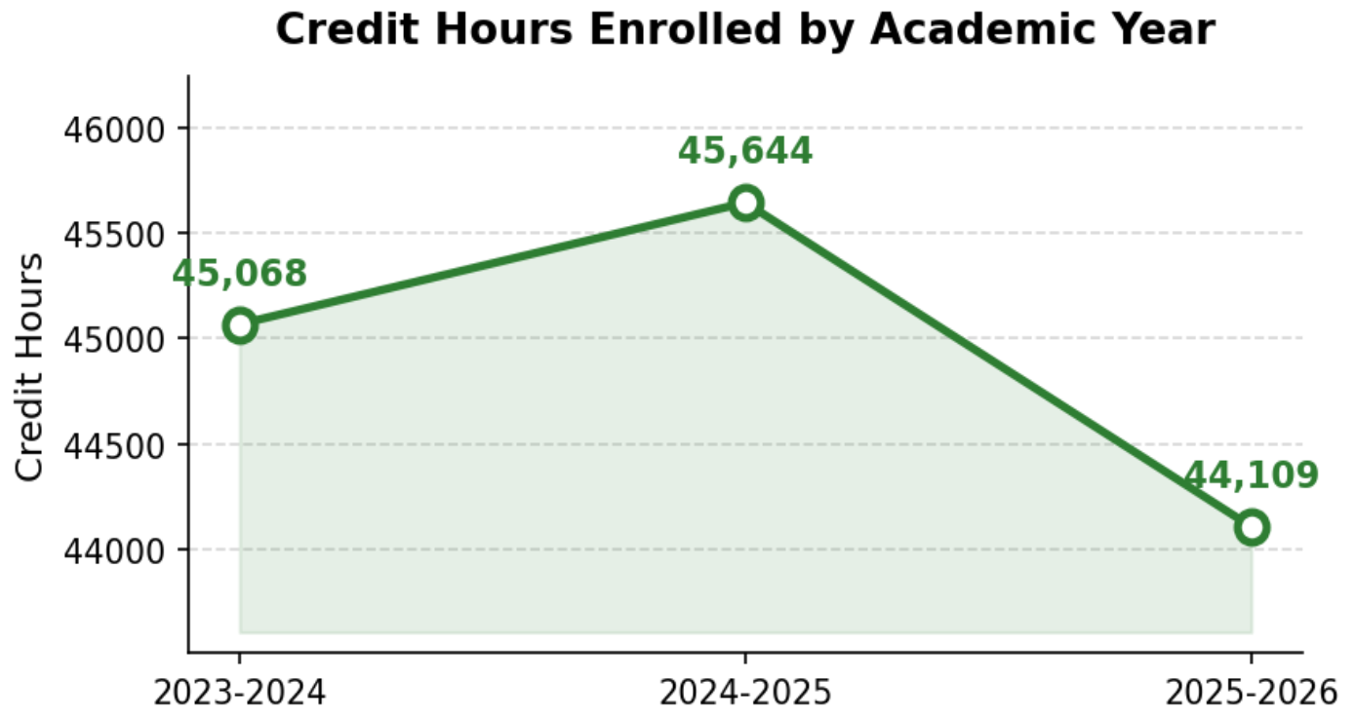
ENROLLMENT IN HEADCOUNT AND CREDIT HOURS | AY 2023-2024 TO AY 2025-2026
-17 OR -0.39%
7 OR 0.16%
576 OR 1.28%
-1535 OR -3.62%
Headcount dipped slightly from 4,380 (2023–24) to 4,363 (2024–25), then partially recovered to 4,370 in
2025–26, a net change of -10 students (-0.2%) over the period.
Credit hours peaked at 45,644 in 2024–25 (+576 from baseline), before declining to 44,109 in 2025–26,
ending -959 credit hours (-2.1%) below the 2023–24 level.

Slide 21
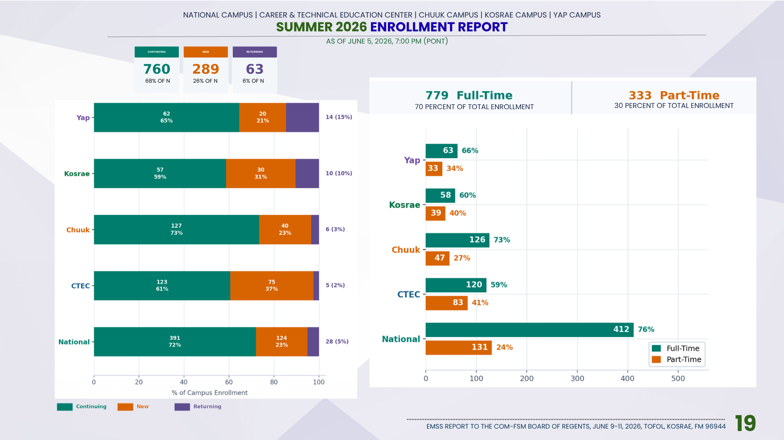

Slide 22
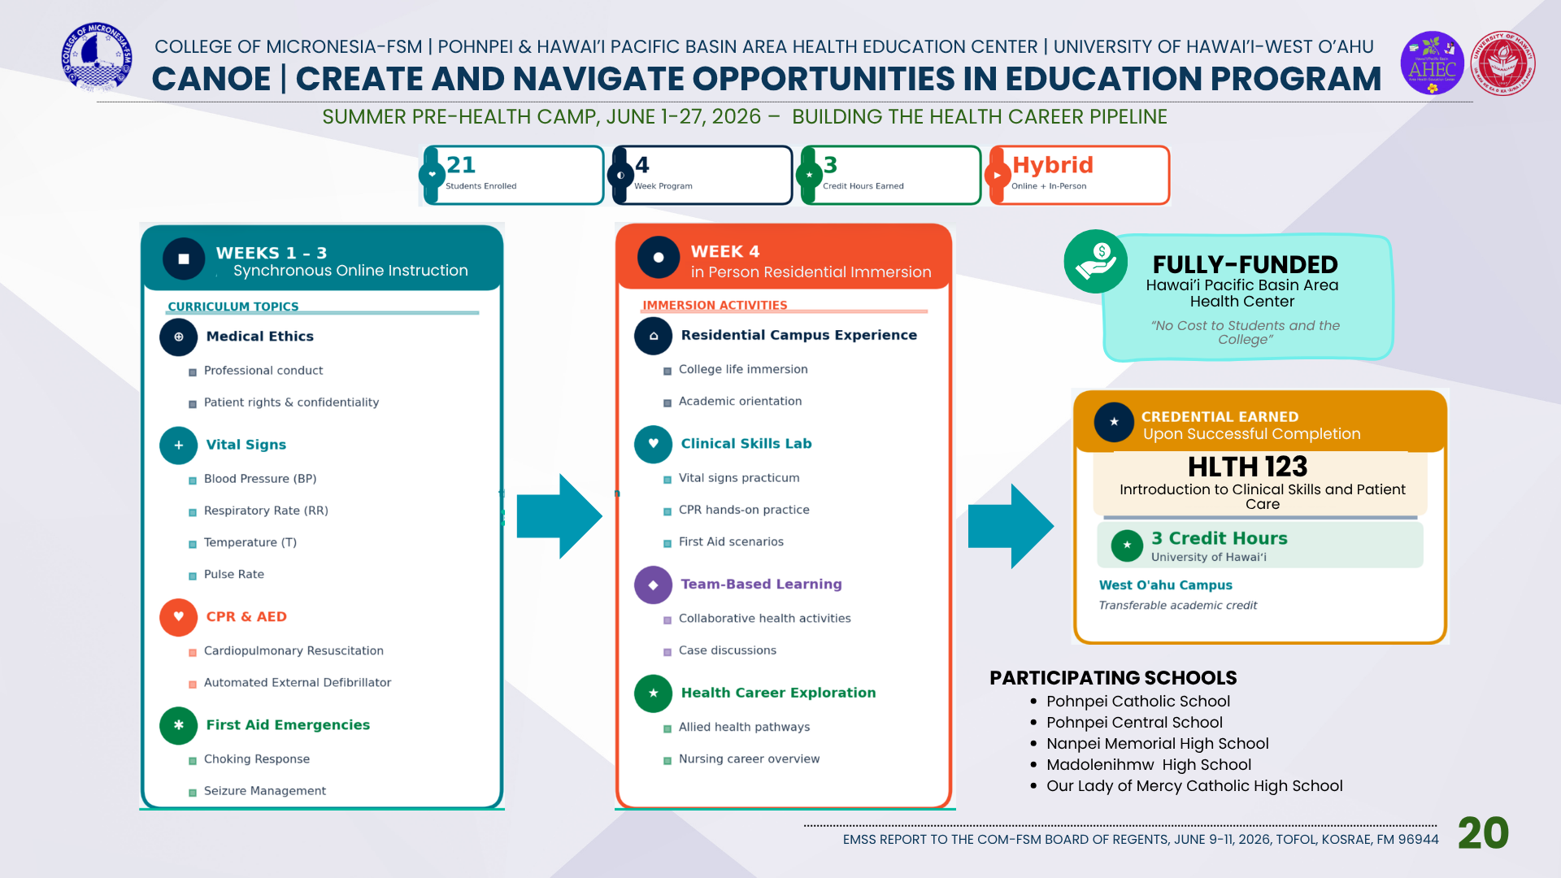

Slide 23
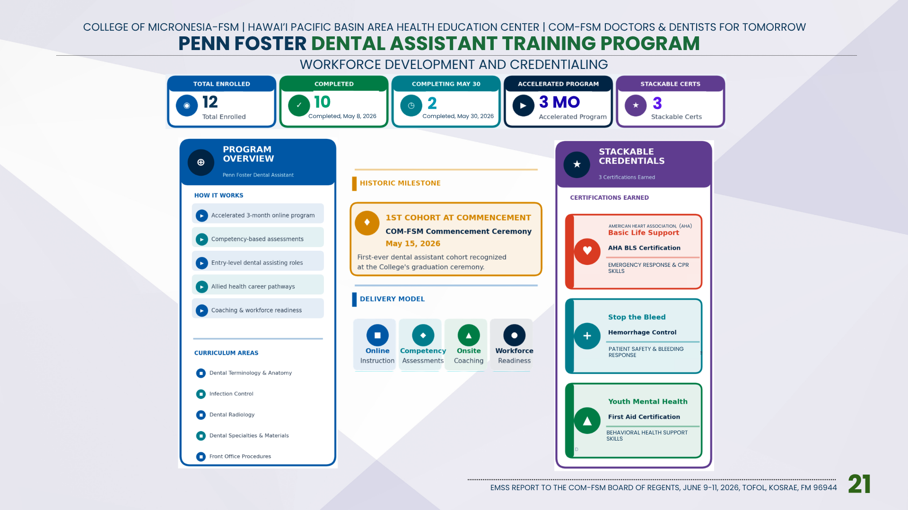

Slide 24
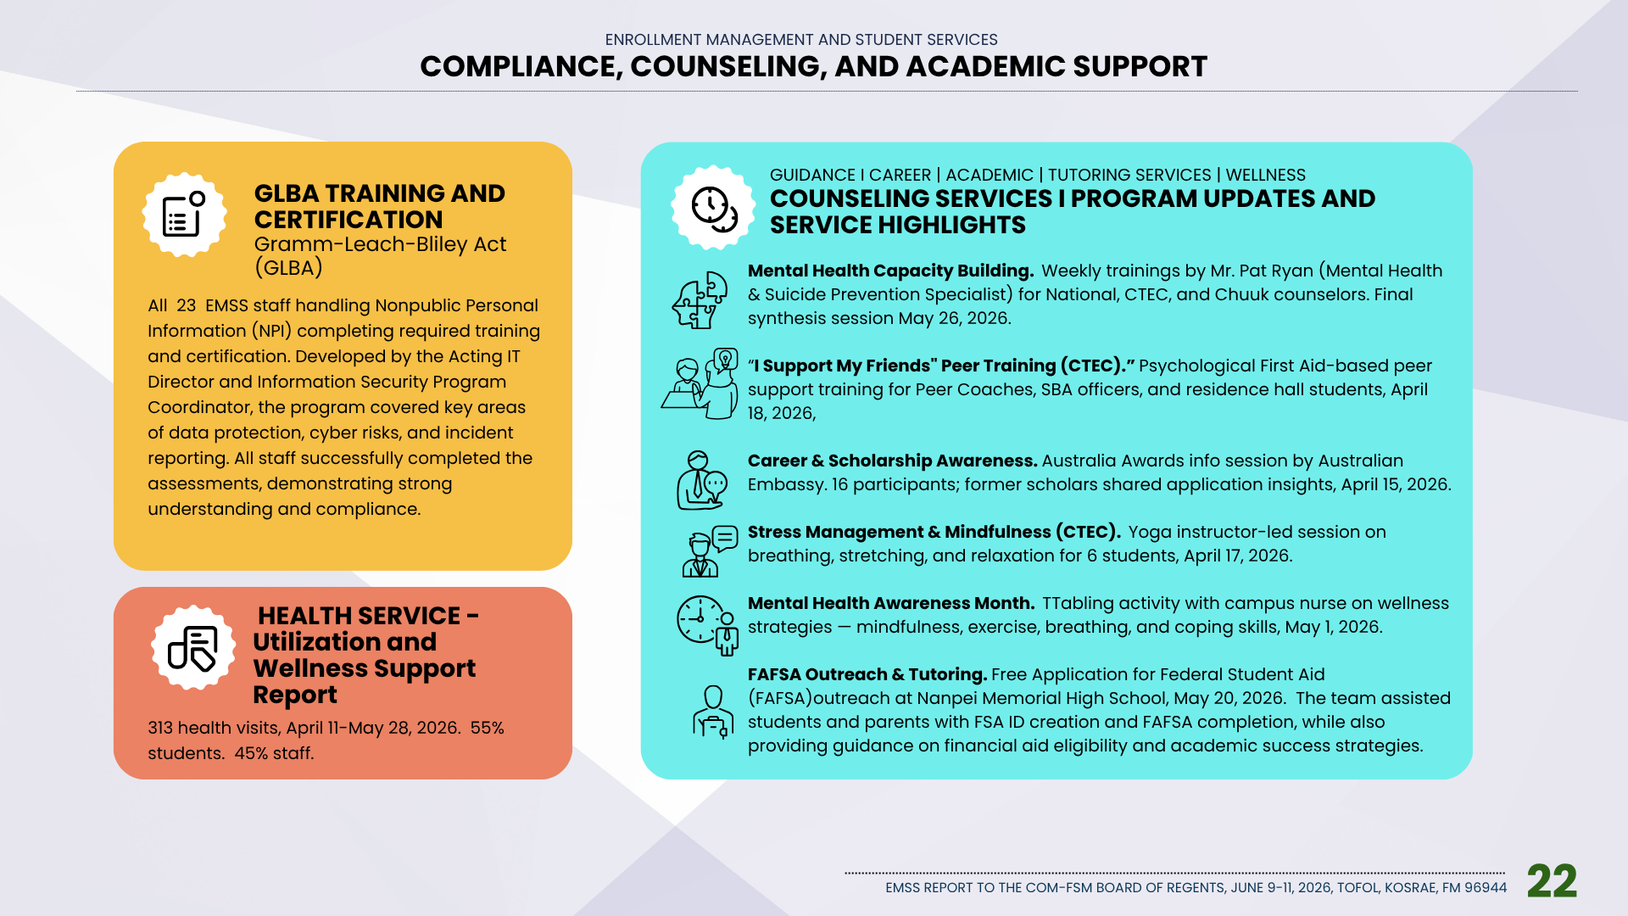

Slide 25


Slide 26
