Slide 1

College of Micronesia-FSM
Yap | Chuuk | Pohnpei | Kosrae
College of Micronesia-FSM is accredited by the Accrediting Commission for Community and Junior Colleges
Office of the President
Intentional transformational journeys at COMFSM
Board of Regents Meeting
June 9-11, 2026
Kosrae Campus
Kosrae
BOR Meeting Presentation by President Theresa Koroivulaono (Ph. D): December 3-6, 2025

Slide 2




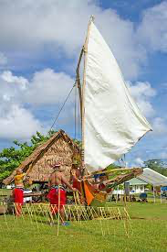

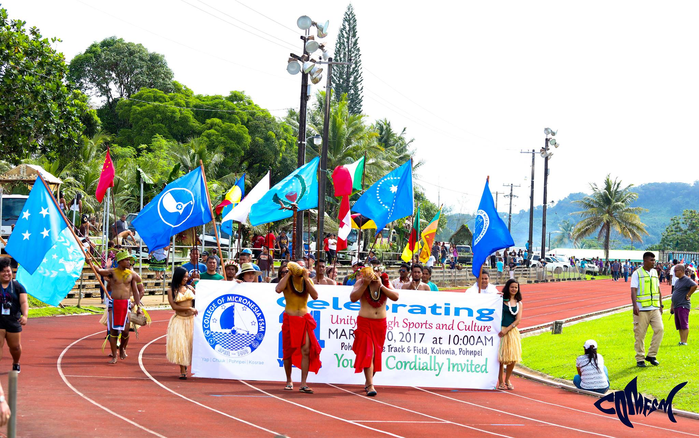



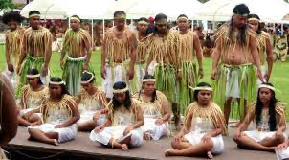
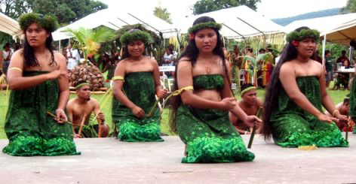

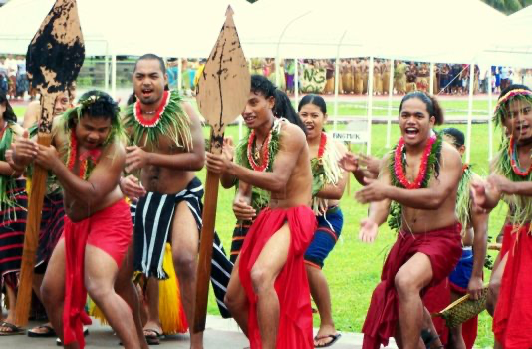


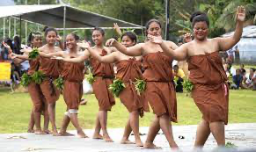
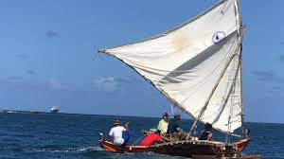



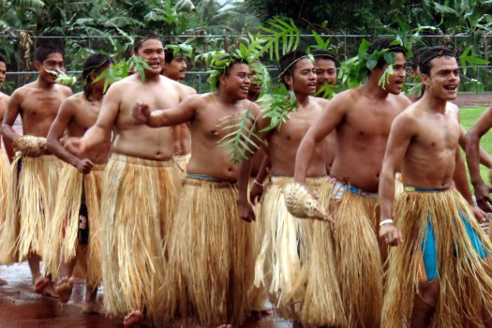
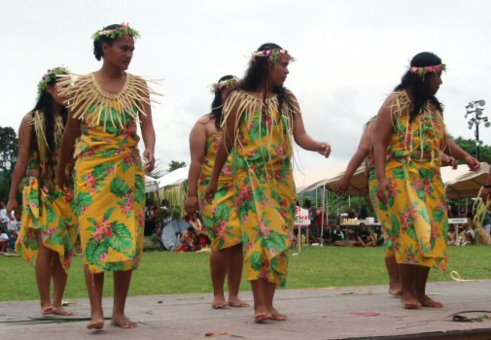
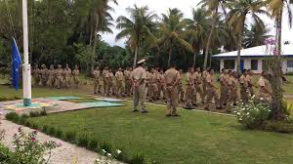
Office of the President
EDUCATIONAL MISSION
Office of the
President
The College of Micronesia-FSM is a learner-centered institution of higher education that is committed to the success of the Federated States of Micronesia by providing academic and career & technical educational programs characterized by continuous improvement and best practices.
INSTITUTIONAL VISION
We provide quality education today for a successful tomorrow.
INSTITUTIONAL CORE VALUES
Commitment
Excellence
Learner-Centeredness
Professionalism
Teamwork
Respect
Students Today
Leaders Tomorrow

Slide 3


4 States, 6 Campuses, 1,000,000+ sq. miles of ocean
National Campus
P.O. Box 159, Palikir, Pohnpei FM 96941
Phone: (691) 320-2480 | Fax: (691) 320-2479 | E-Mail: national@comfsm.fm
Career & Technical Education Center
P.O. Box 614, Kolonia, Pohnpei FM 96941
Phone: (691) 320-3795 | Fax: (691) 320-3799 | E-Mail: pnisite@comfsm.fm
Chuuk Campus
P.O. Box 879, Went, Chuuk FM 96942
Phone: (691) 330-3689 | Fax: (691) 330-2740 | E-Mail: chksite@comfsm.fm
Yap Campus
P.O. Box 286, Colonia, Yap FM 96943
Phone: (691) 350-2296 | Fax: (691) 350-5150 | E-Mail: yapsite@comfsm.fm
Kosrae Campus
P.O. Box 37, Tofol, Kosrae FM 96944
Phone: (691) 370-3191| Fax: (691) 370-3193 | E-Mail: ksasite@comfsm.fm
FSM Fisheries & Maritime Institute
P.O. Box 1056, Colonia, Yap FM 96943
Phone: (691) 350-3544 | Fax: (691) 350-3545 | E-Mail: fmi@comfsm.fm
College of Micronesia-FSM is accredited by the Accrediting Commission for Community and Junior Colleges, Western Association of Schools and Colleges, 331 J Street Suite 200 Sacramento, CA 95814,(415) 506-0234, an institutional accrediting body recognized by the Council for Higher Education Accreditation and the U.S. Department of Education.

Slide 4
MISSION
Office of the
President
The College of Micronesia-FSM is a learner-centered
institution of higher education that is committed to the
success of the Federated States of Micronesia by providing
academic and career & technical educational programs
characterized by continuous improvement and best practices.
Students Today
Leaders Tomorrow

Slide 5
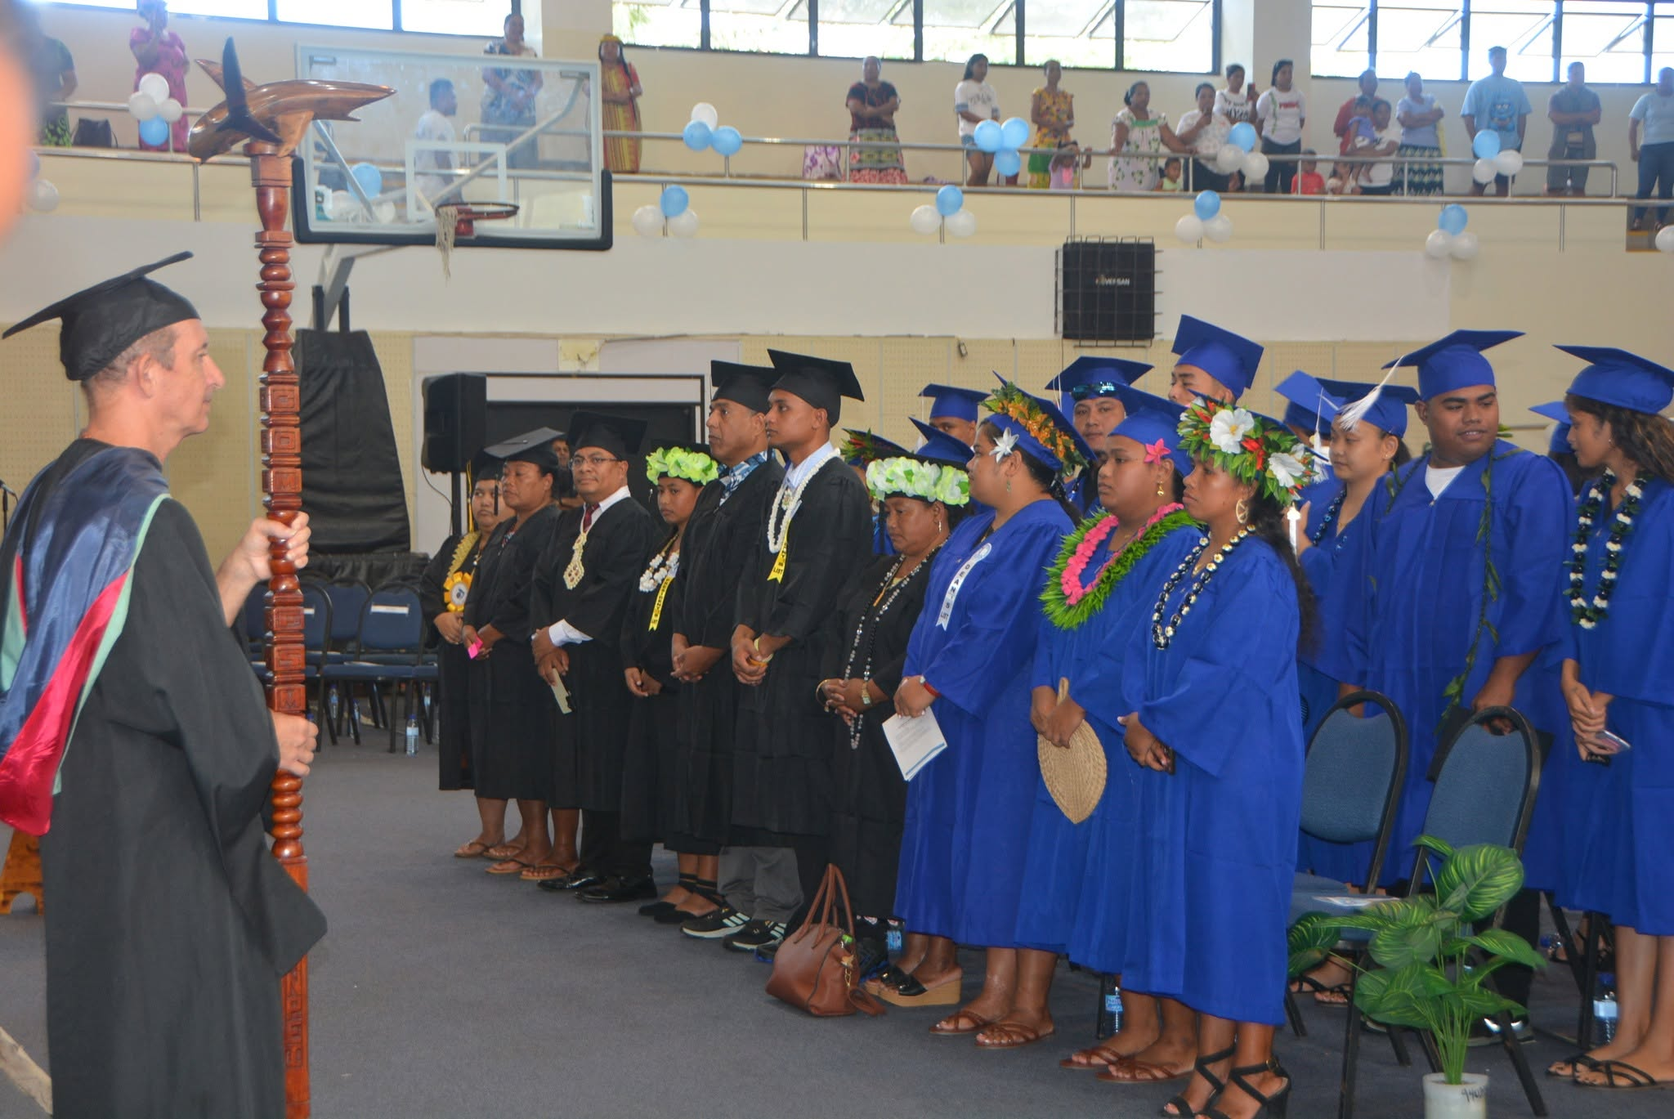
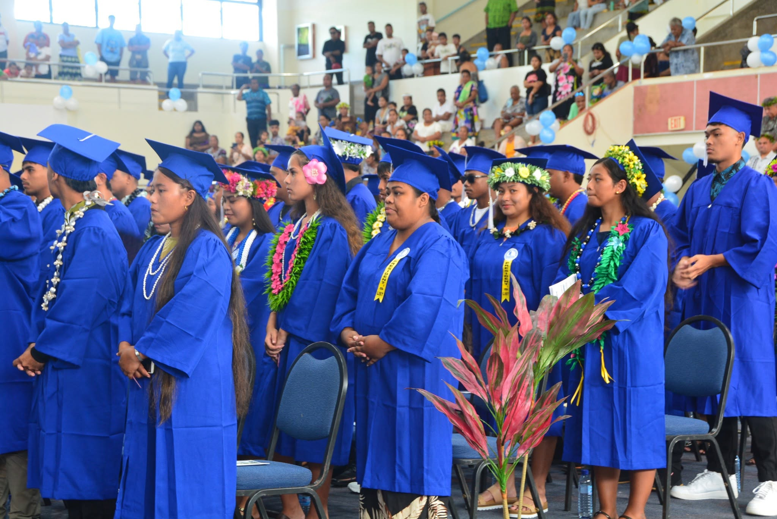
OVERVIEW
Office of the
President
Workforce Needs Assessment
Curriculum Review
European Union (EU) Micronesia Project
Summer 2026 Pilot Training Programs
Direct Reports
Budget Hearings
Navigating the Headwinds of Change
Re-establishing Connections & Partnerships
Students Today
Leaders Tomorrow

Slide 6
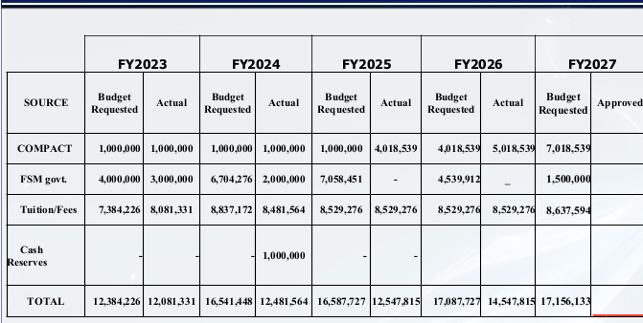
BUDGET HEARING
EDUCATION COMMITTEE
Office of the
President
Requested budgets: increase of 28%; Actual budgets: increase of just 17%.
Cumulative inflation 2023-2026: 15.2%
Students Today
Leaders Tomorrow

Slide 7
MAINTAINING QUALITY EDUCATION
Office of the
President
Operational Cost Adjustments: Factor in a ≈ 15.2% to 18% price increase across utilities, insurance, technology licensing, and campus maintenance to avoid deferred upkeep and service disruptions.
Competitive Compensation: Allocate funds to adjust faculty and staff salaries to prevent a decline in instructional quality.
Strategic Enrollment Management: Budget for targeted marketing; outreach to adult learners and displaced workers; community college enrollments frequently fluctuates e. g. out-migration.
Flexible Modality Offerings: Optimize course scheduling by expanding hybrid and online programs; maximizes classroom utilization, reduces physical campus overhead costs.
Students Today
Leaders Tomorrow

Slide 8
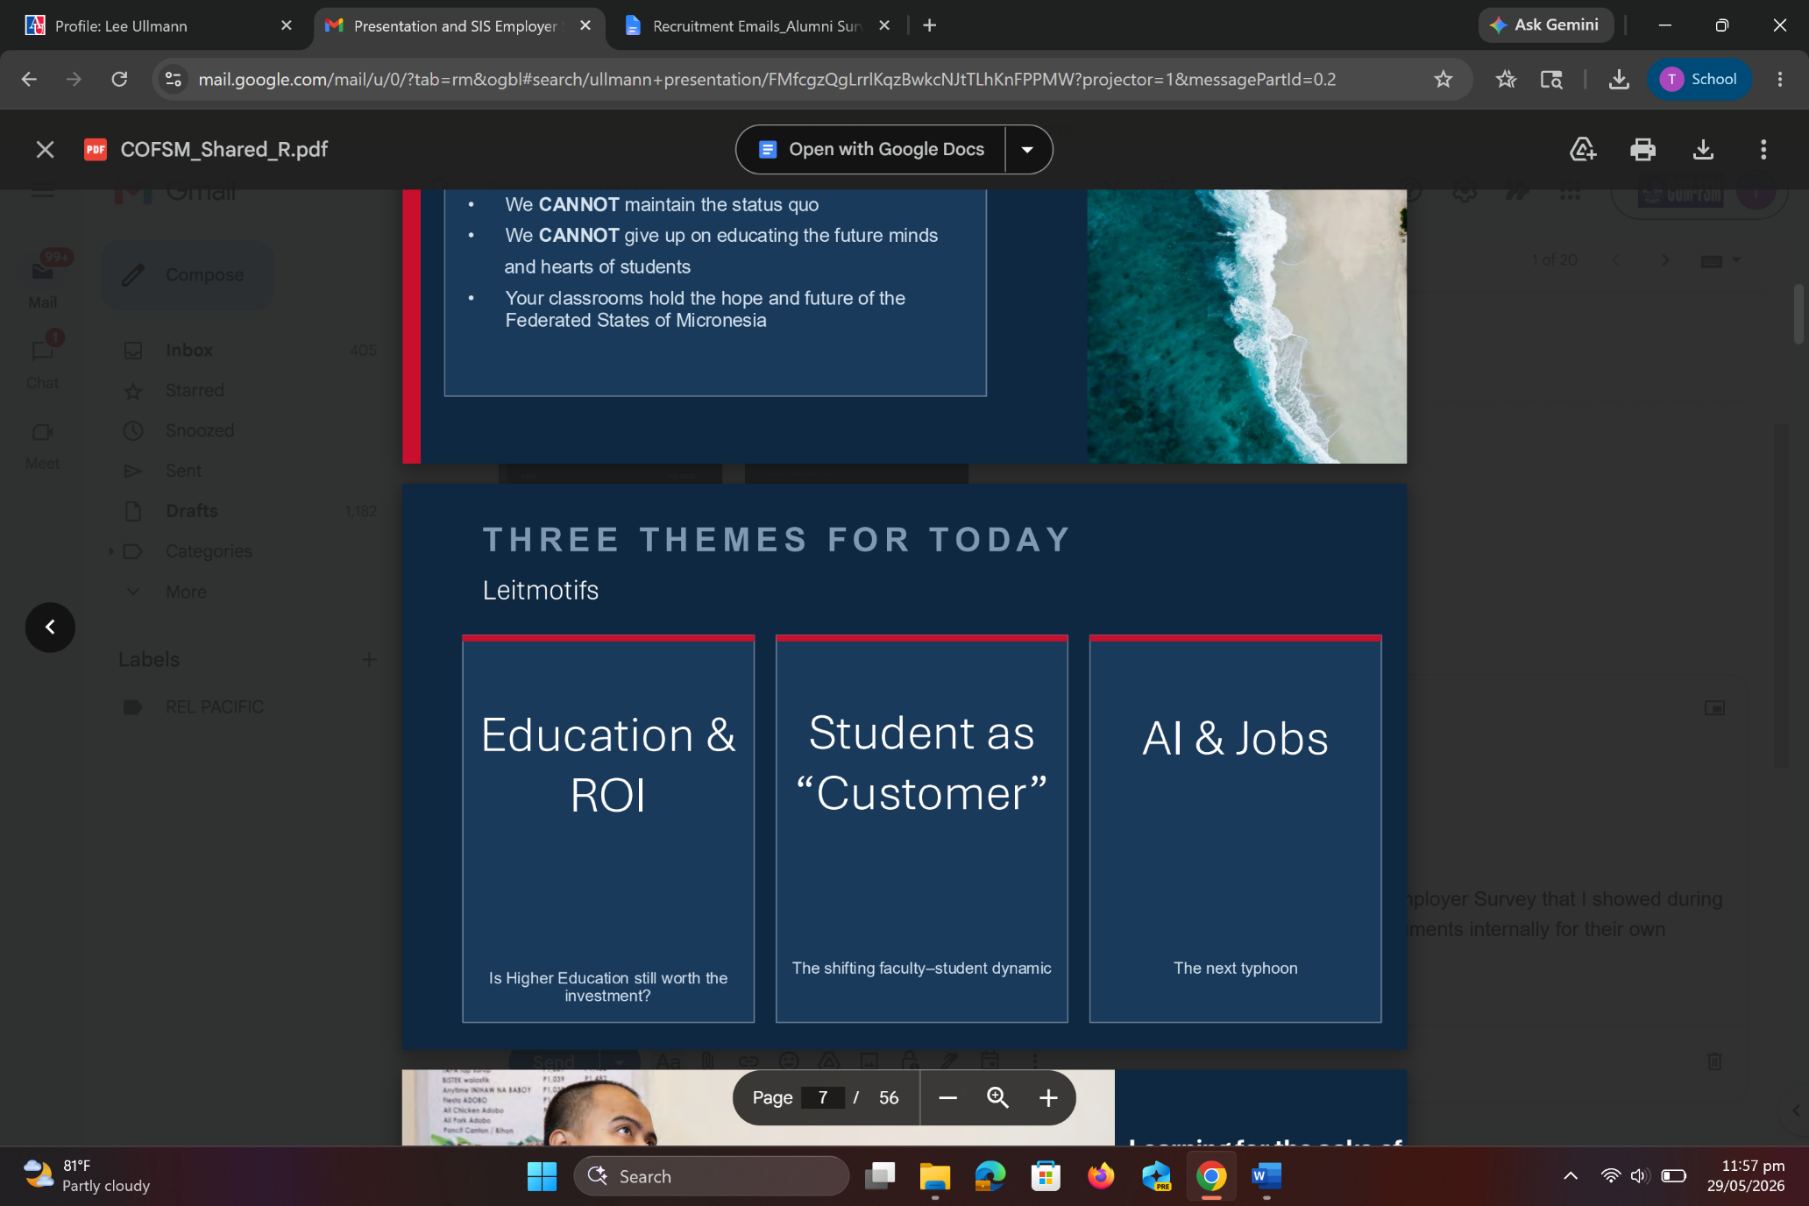
NAVIGATING THE HEADWINDS FACING
HIGHER EDUCATION
Office of the
President
Students Today
Leaders Tomorrow

Slide 9

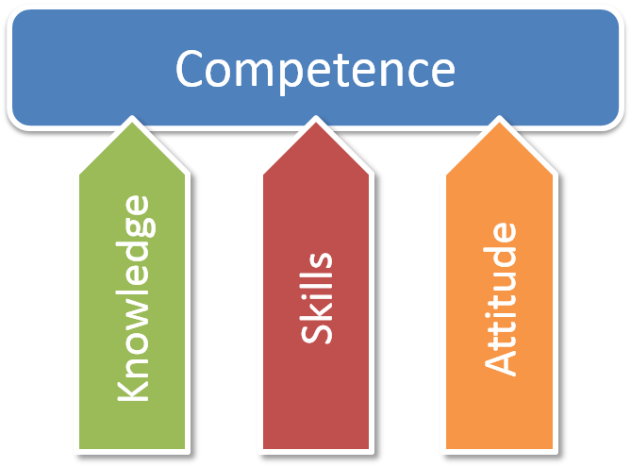

REVIEW – REVISE - REALIGN
Office of the
President
Students Today
Leaders Tomorrow

Slide 10
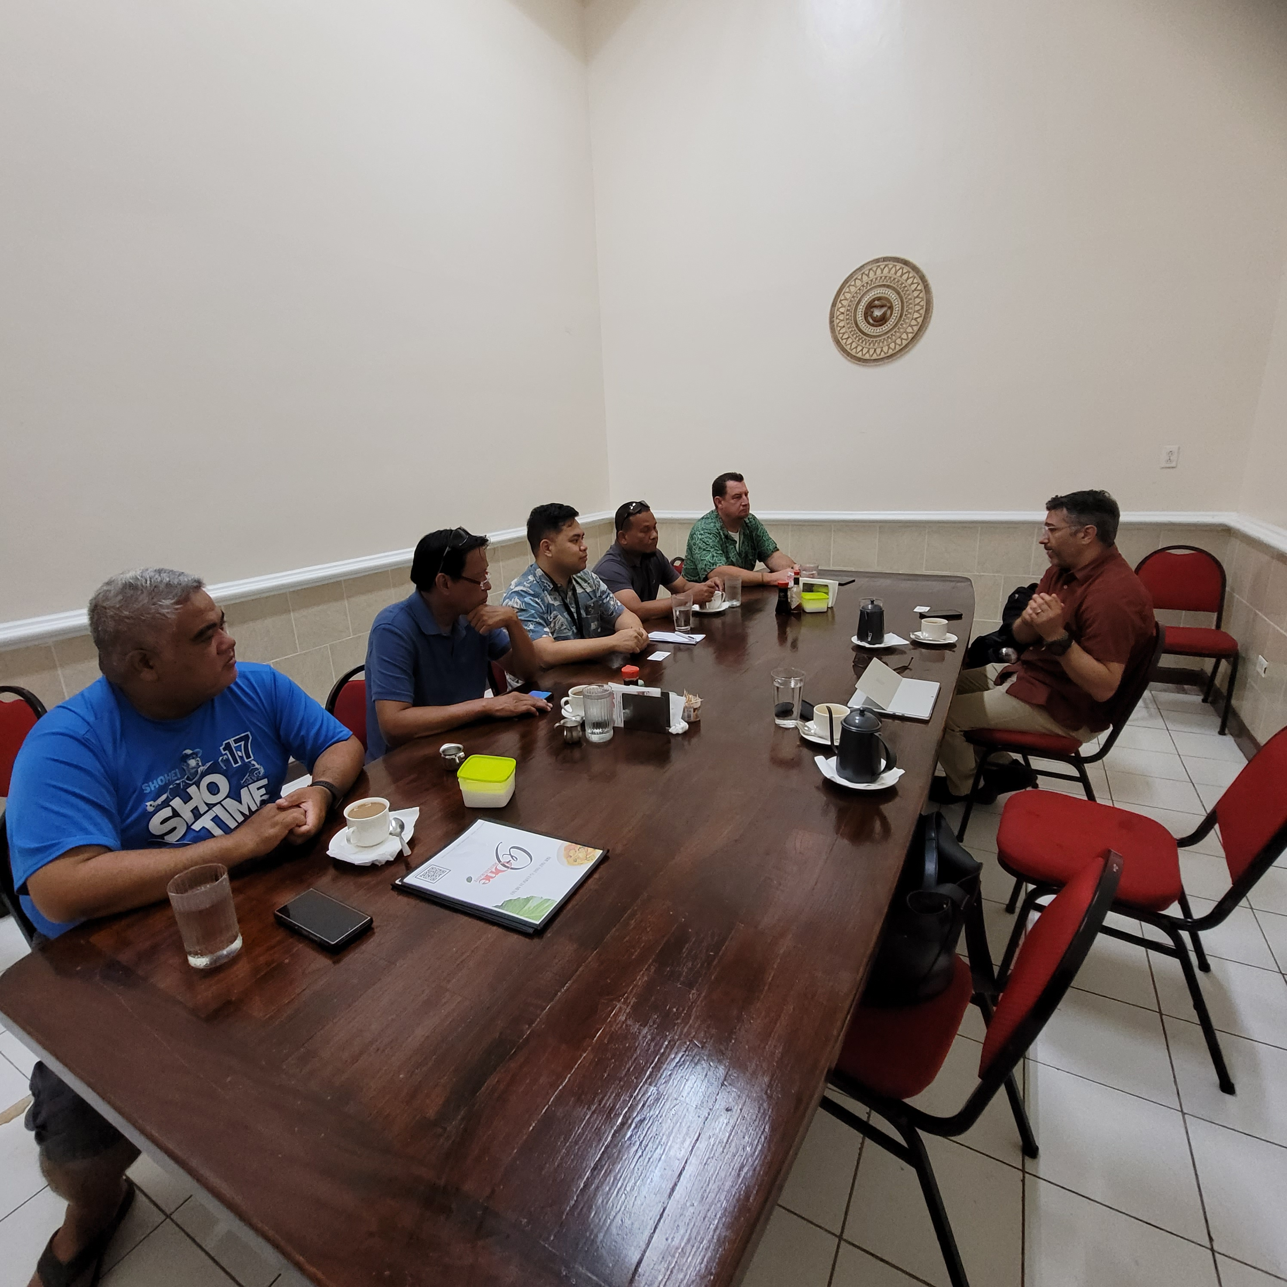
TRIANGULATE PUBLIC, PRIVATE &
EDUCATION SECTORS
Office of the
President
Advisory Councils, Business Liaison and other Inclusive Practices
Direct private sector involvement with National, State governments and education providers is vital for growing the economy through employment-generation and incentivized initiatives.
Students Today
Leaders Tomorrow

Slide 11
DATA-INFORMED TRANSFORMATION
Office of the
President
Workforce Needs Assessment
Stage 1: Report published
Stage 2: Subnational surveys (State level)
Curriculum Review
Phases 1 & 2 complete; Report published
Phase 3: Implementation of recommendations
Students Today
Leaders Tomorrow
https://www.comfsm.edu.fm/wp-content/uploads/2026/05/FSM-Workforce-Needs-Assessment-Stage-1-Report.pdf
https://www.comfsm.edu.fm/wp-content/uploads/2026/06/21st-Century-Curriculum-Project-Final-Report.pdf

Slide 12
EU MICRONESIA PROJECT
Office of the
President
EU-MICRONESIA
Modernizing teachers and students trainings for the motivations towards blue and green careers in the Federated States of Micronesia
The main Deliverable of WP2 (Work Package 2) is the Train the Trainer Toolkit integrating the full Manual for Trainers, 6 Educational Materials…a dedicated micro-credentials model for teachers’ initial education. 4 Audiovisuals materials and 4 Presentation materials adopted during the Capaciy Building in Micronesia (min. 8 hours of recordings). Validation among the National Authorities and inclusion of the train the training in the official procedures of induction, initial and continuous training and internship of teachers, its legislative Framework and educational reform, including the new training model for teachers operating with secondary school students and the proposition of recognition of micro-credentials and validation from National Authorities. Integration of the content in the existing Higher Education Degrees in Education by the COM-FSM. [20 teachers, 20 College Interns, 20 Science Students]
Students Today
Leaders Tomorrow
COMFSM BUDGET: 169,218,36 euro/$195,278 USD

Slide 13
IAEA SUMMARY
Office of the
President
Institutional Advancement & External Affairs
Explore incentives for businesses, graduates, and locally trained workers to reduce workforce migration abroad.
Finalize written descriptions of Endowment Fund programs, including scholarships, vocational training, internships, local employment incentives, and entrepreneurship support.
Enhance donor engagement and recognition, including acknowledgment of major donors at commencement ceremonies.
Visit state campuses to strengthen Endowment Fund fundraising efforts.
Continue discussions between the College and national leaders on workforce retention strategies. Requested $50,000 from the National Government.
Students Today
Leaders Tomorrow

Slide 14
HRO SUMMARY
Office of the
President
Human Resources Office
Peer Review Recommendation: March 2023
Recommendation 2:
To improve effectiveness, the team recommends that the College strengthen its practices and systems for personnel evaluation and management as stated in the President’s Workplan. (III.A.3, III.A.5).
Update: Continued training and refreshers for Classified, Professional, Management and Faculty members.
By Fiscal Year (Oct-Sept) | FY2026 | FY2025 | FY2024 | FY2023 | TOTAL
CTEC |  | CTEC | CTEC | CTEC | CTEC
Faculty | 1 | 1 | 2 | 2 | 6
Staff | 4 | 6 | 3 | 9 | 22
National |  | National | National | National | National
Faculty | 0 | 4 | 1 | 6 | 11
Staff | 6 | 11 | 10 | 11 | 38
FMI |  | FMI | FMI | FMI | FMI
Faculty | 0 | 0 | 0 | 0 | 0
Staff | 0 | 4 | 2 | 4 | 10
Kosrae |  | Kosrae | Kosrae | Kosrae | Kosrae
Faculty | 0 | 1 | 1 | 1 | 3
Staff | 0 | 13 | 4 | 4 | 21
Yap |  | Yap | Yap | Yap | Yap
Faculty | 0 | 0 | 0 | 1 | 1
Staff | 3 | 1 | 2 | 4 | 10
Chuuk |  | Chuuk | Chuuk | Chuuk | Chuuk
Faculty | 0 | 0 | 0 | 0 | 0
Staff | 0 | 2 | 3 | 5 | 10
Total Faculty | 1 | 6 | 4 | 10 | 21
Total Staff | 13 | 37 | 24 | 37 | 111
Total Vacancies | 14 | 43 | 28 | 47 | 132
Students Today
Leaders Tomorrow

Slide 15

VISION FROM THE OTP
Office of the
President
COM-FSM: Pacific Island region higher education leader in Marine Science and Fisheries & Maritime Studies focusing on 'blue' and 'green' careers and climate-resilient agriculture and aquaculture best practices.
Students Today
Leaders Tomorrow

Slide 16
End of Presentation
Thank you!
College of Micronesia-FSM
Yap | Chuuk | Pohnpei | Kosrae
College of Micronesia-FSM is accredited by the Accrediting Commission for Community and Junior Colleges

Slide 17
ACKNOWLEDGEMENTS
Office of the
President
Images used in this presentation have been sourced through author-created graphics, COM-FSM image repositories, internet searches and the EU Micronesia presentation by Dr. Igor Vitale delivered virtually on February 20, 2026.
Students Today
Leaders Tomorrow

