Slide 1
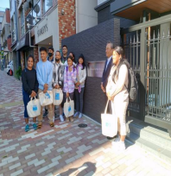

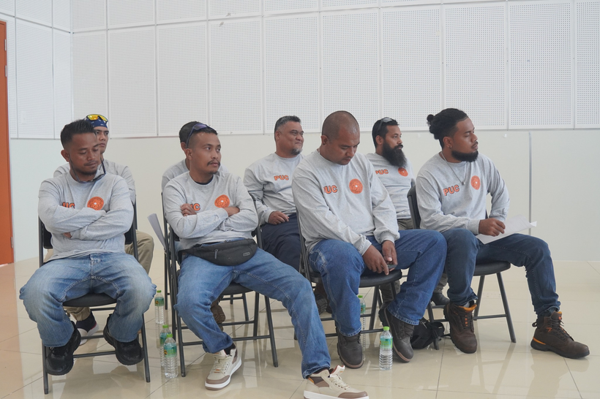
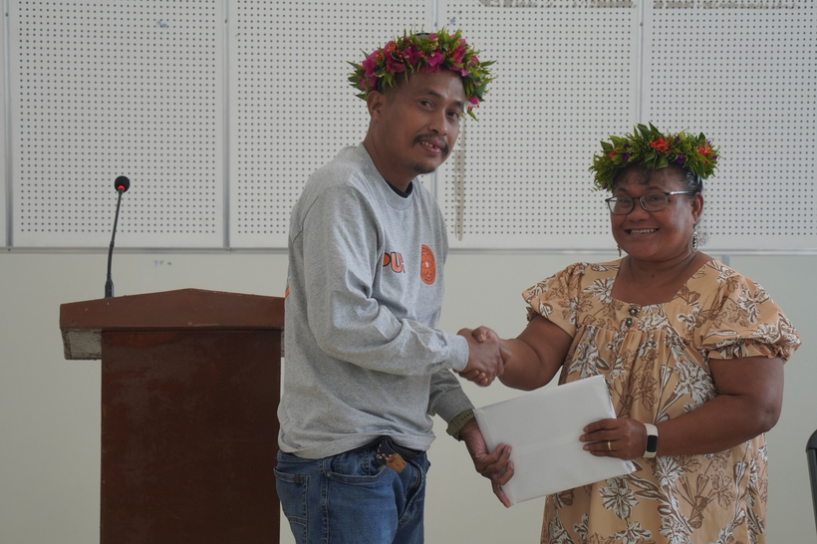
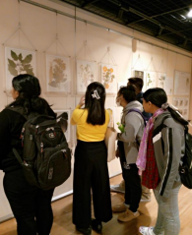
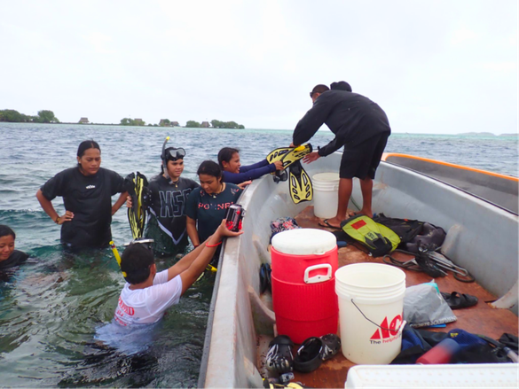
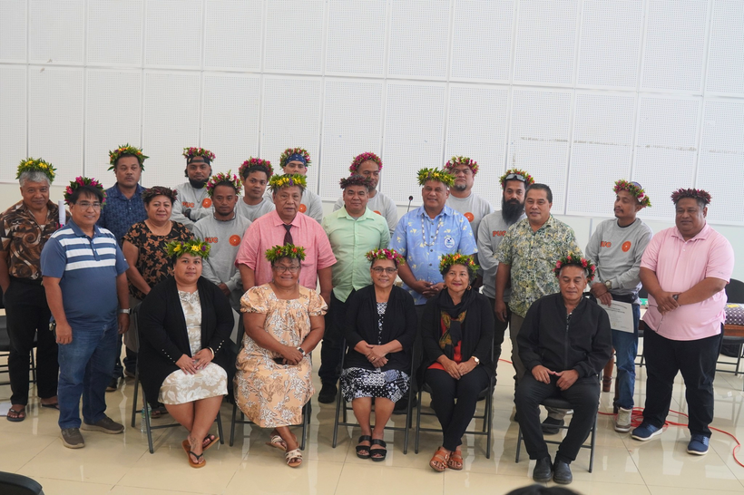
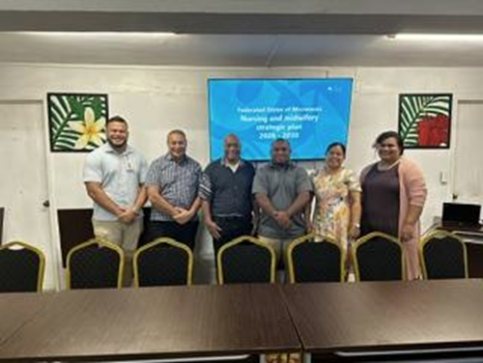
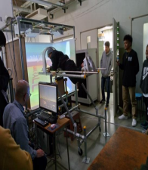
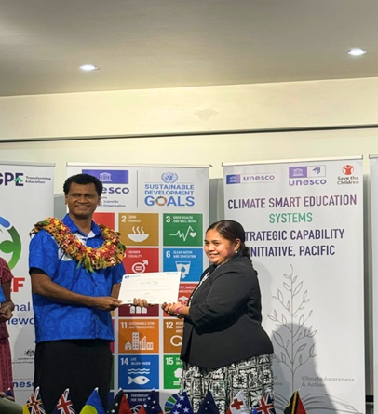
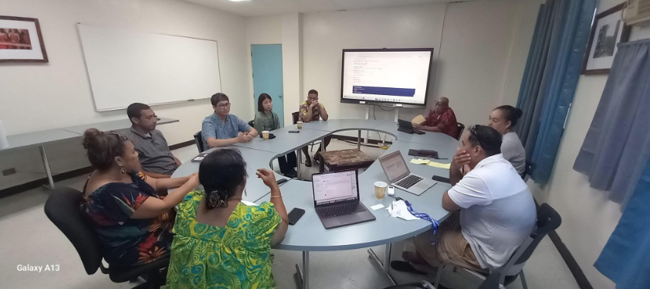
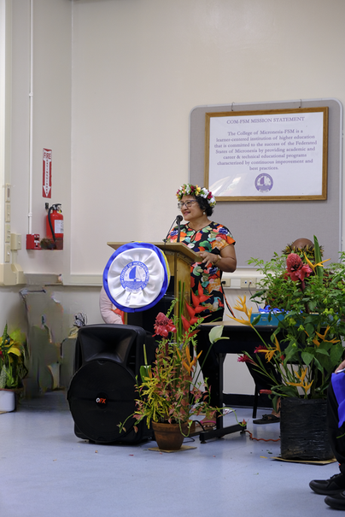
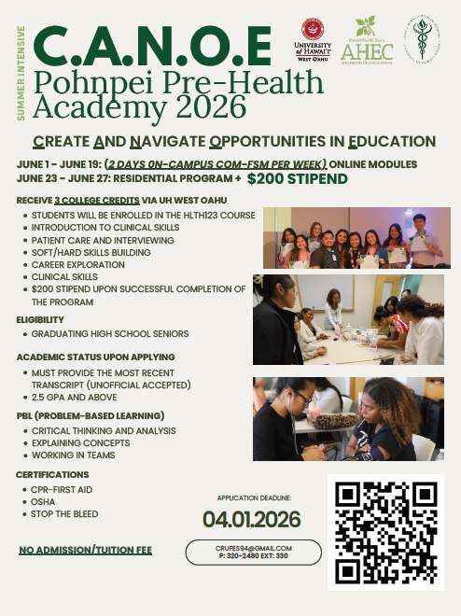
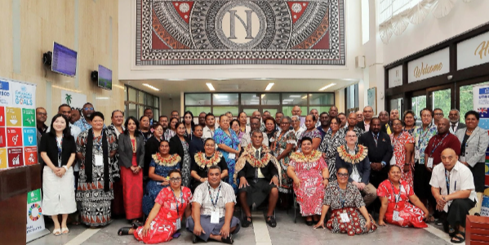
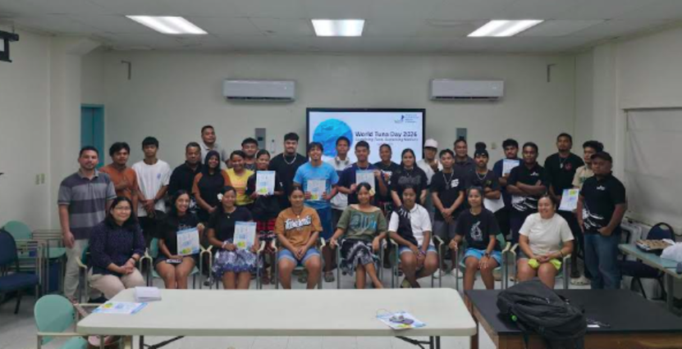
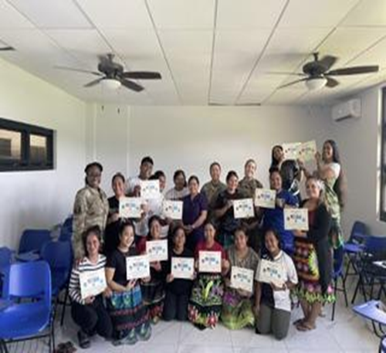
Department for Instructional Affairs
Report to the Board of Regents
2026 3RD QUARTER REPORT
Delihna Ehmes - VPIA
Office of the Campus Dean
Office of the Academic Affairs
Learning Resource Center
Instructional Coordinator

Slide 2




IA Inside Reports
Office of the Campus Dean
Office of the Academic Affairs
Learning Resource Center
Instructional Coordinator
IA_AUO_1. Provide guidance to development, delivery, and enhance quality of all instructional programs to meet high standards of quality and relevance.
IA_AUO_2. Provide support for the efficient management and development of all library resources and collections across state campus libraries to meet diverse user needs.
IA_AUO_3. Provide support for ongoing professional development to enhance instructional effectiveness and learning support services.
Strengthening Faculty
IA_AUO_4. Establish a new or strengthen existing internal and external stakeholder collaboration to enhance educational opportunities and outcomes
IA_AUO_5. Implement systematic assessment protocols in support of equitable student achievement.

Slide 3
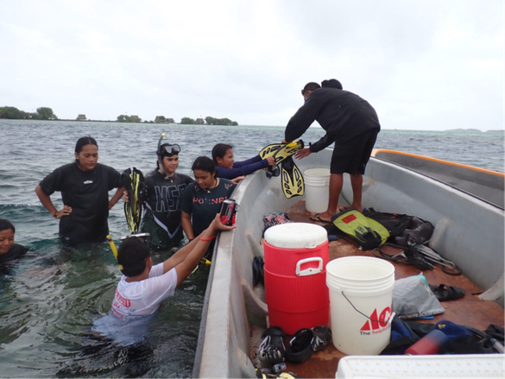
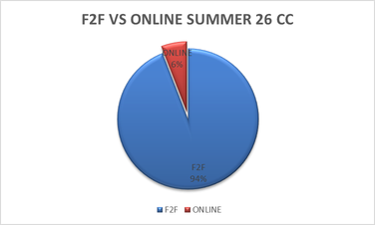
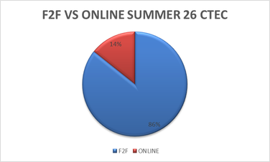
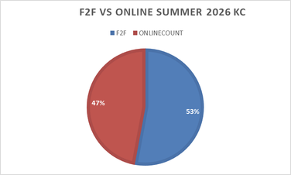
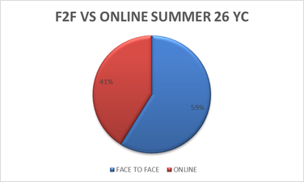
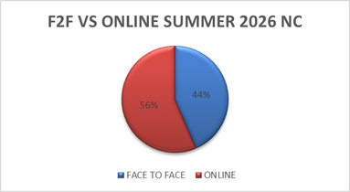
IA_AUO_1. Provide guidance to development, delivery, and enhance quality of all instructional programs to meet high standards of quality and relevance.
  Pre-Health Pathway Review : The AHEC Pre-Health Academy provided healthcare training, career exploration, and academic preparation opportunities for participating students.
  Experience Marine Field Studies : Students gained hands-on marine science experience through reef studies, environmental observation, and sustainable aquaculture field activities.
  COM-FSM 21st Century Curriculum Project Survey Results : Survey findings highlighted strong satisfaction, career readiness, enrollment growth, and challenges in curriculum modernization and technology integration.
  National Campus — Computer Lab Utilization Spring 2026 : Business Lab recorded the highest student usage, while Networking Lab showed the lowest computer lab utilization during Spring 2026.
  Summer Course 2026 Face-to-Face vs Online Offerings : Summer 2026 course offerings showed low enrollment across campuses, with face-to-face classes dominating overall student participation.
Office of the Campus Dean
Office of the Academic Affairs
Learning Resource Center
Instructional Coordinator

Slide 4
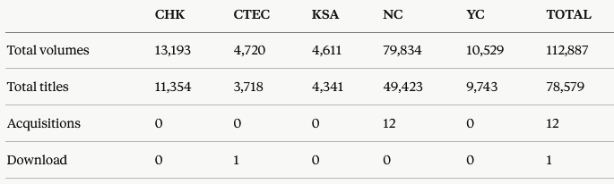
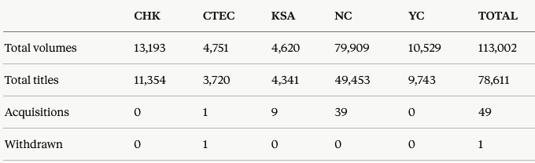
IA_AUO_2. Provide support for the efficient management and development of all library resources and collections across state campus libraries to meet diverse user needs.
Highlights
  The LRC strengthened library services through collection recovery, facility improvements, student outreach, regional partnerships, and staff recognition initiatives.
Collection Development
  Library acquisitions and inventory recovery efforts expanded educational resources and improved access to updated learning materials system-wide.
Office of the Campus Dean
Office of the Academic Affairs
Learning Resource Center
Instructional Coordinator

Slide 5
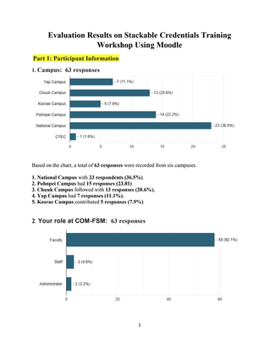
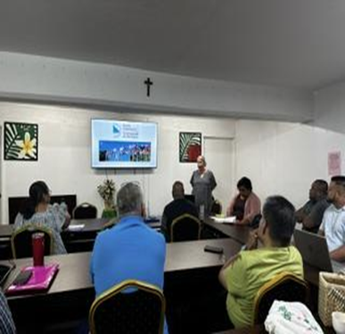
IA_AUO_3. Provide support for ongoing professional development to enhance instructional effectiveness and learning support services.
  1. Stackable Credentials Workshop and Evaluation: Four Modules - The workshop covered foundations, introduction, benefits and industry alignment, and implementation strategies for stackable credentials at COM-FSM.
  Evaluation: Participants reported strong satisfaction, improved understanding, and increased confidence applying stackable credential concepts within institutional practices.
  2. Nursing and Midwifery Strategic Planning Workshop - Nursing faculty participated in regional discussions focused on strengthening healthcare workforce development and nursing education strategies.
  Key Recommendations and Outputs - Discussions emphasized workforce planning, curriculum updates, internship programs, standardized training, and long-term healthcare sustainability initiatives.
  Collaboration and Leadership - The workshop strengthened collaboration among healthcare institutions, government agencies, educators, and nursing leaders across the Federated States of Micronesia.
Office of the Campus Dean
Office of the Academic Affairs
Learning Resource Center
Instructional Coordinator

Slide 6
IA_AUO_4. Establish a new or strengthen existing internal and external stakeholder collaboration to enhance educational opportunities and outcomes
  U.S. Air Force Maternal and Child Health Training: Nursing students strengthened maternal and child healthcare skills through simulations, clinical training, and emergency response education.
  Mental Wellness and Professional Development: Training discussions emphasized emotional wellbeing, resilience, and strategies supporting nursing students’ professional and personal development.
  Korea Institute of Ocean Science and Technology (KIOST): COM-FSM collaborated with KIOST representatives to strengthen marine science partnerships and expand educational opportunities for students.
  PETALS: Pacific educators and leaders explored climate-smart learning, life skills integration, and regional collaboration during the UNESCO consultation in Fiji.
  World Tuna Day 2026:Students gained real-world fisheries management experience through presentations, case studies, and collaborative industry-focused learning activities.
Office of the Campus Dean
Office of the Academic Affairs
Learning Resource Center
Instructional Coordinator

Slide 7
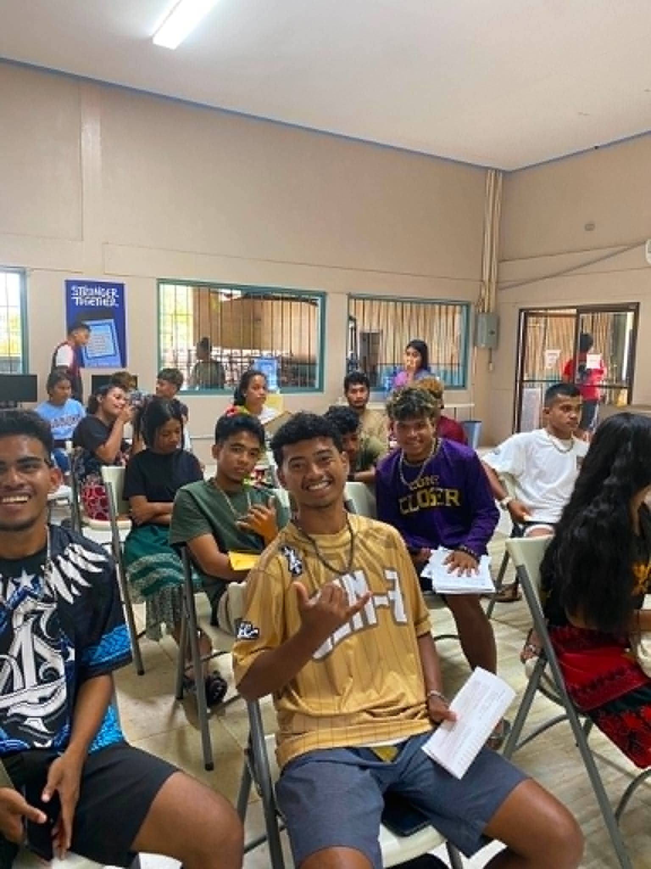
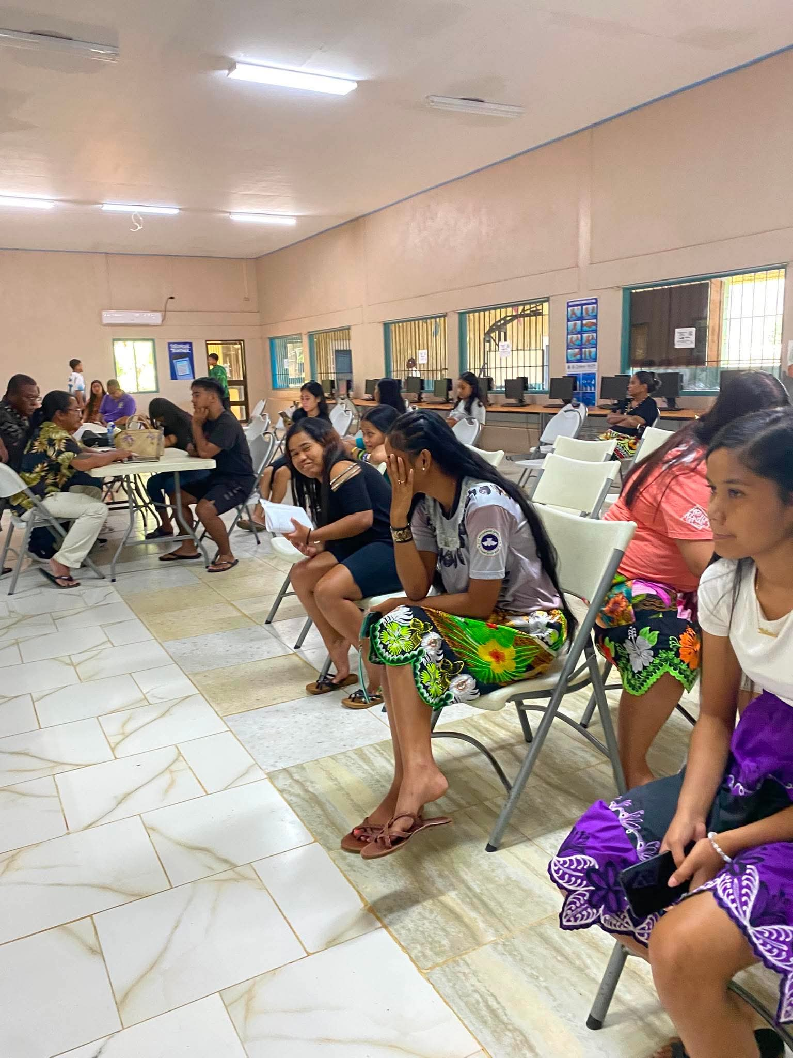
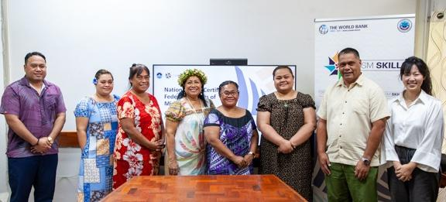
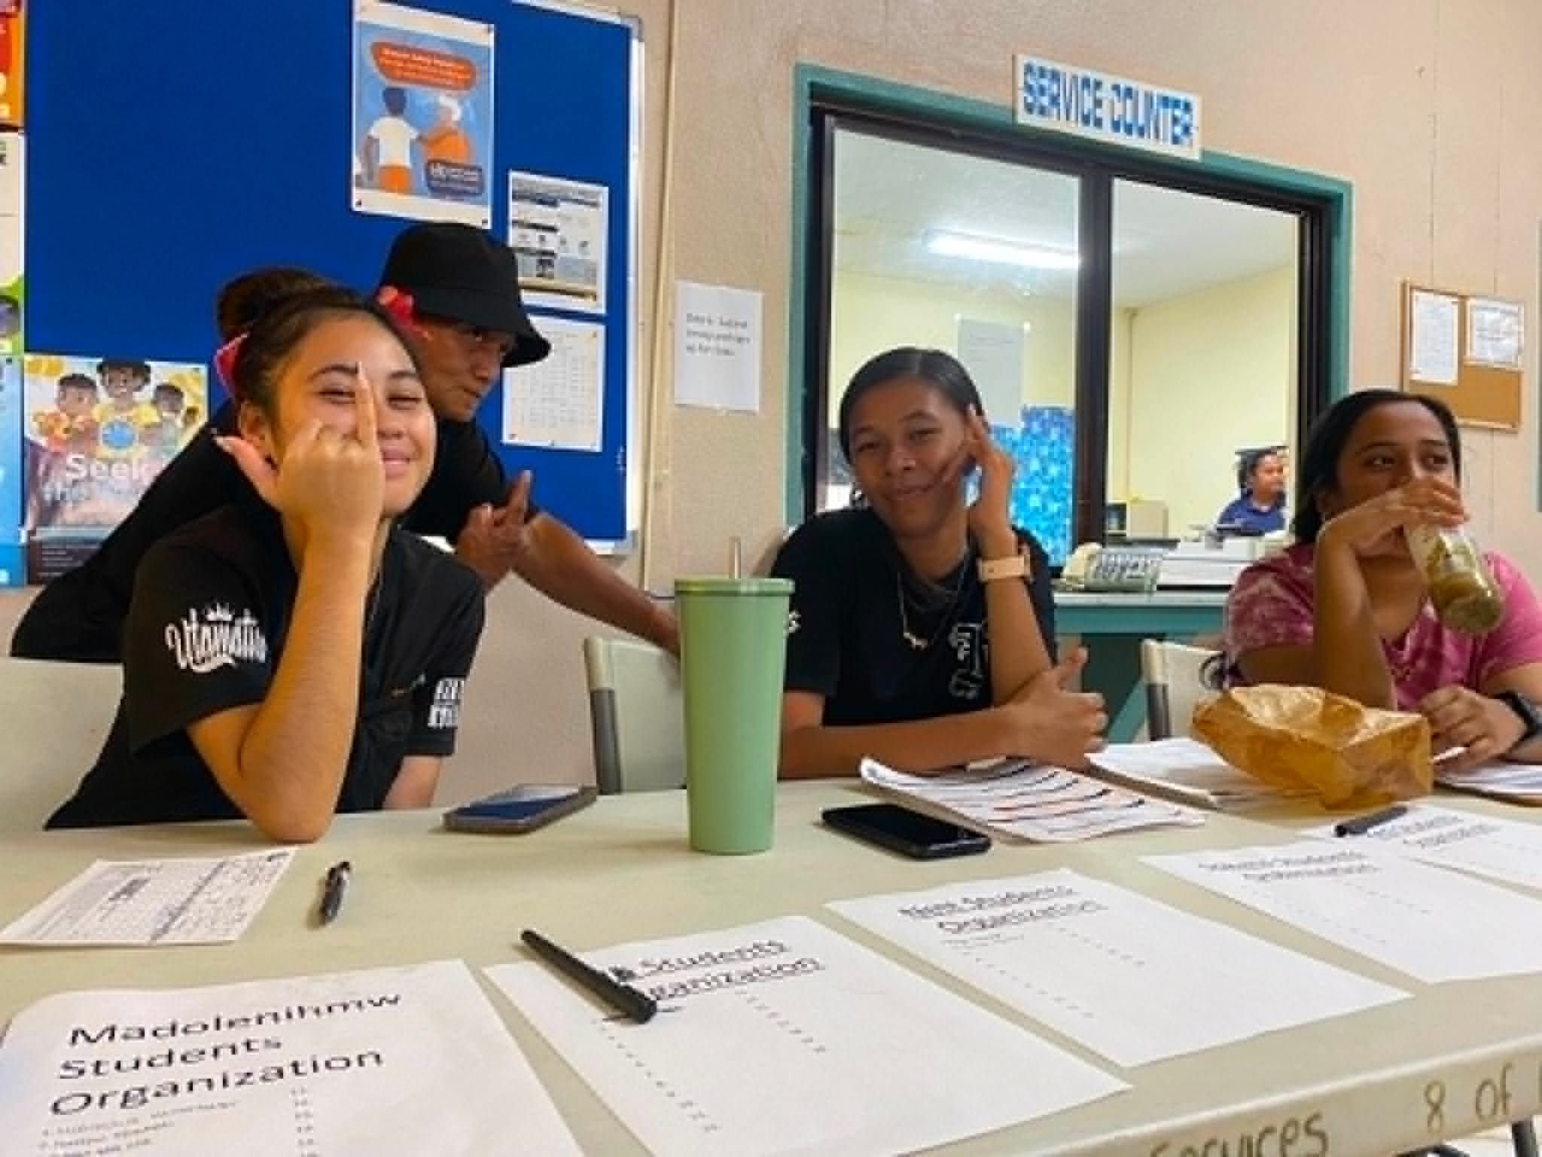
CTEC Update
  Spring 2026
  Regular Programs
Staff Incentive Day May 14, 2026
100% UB (19) and eTSP (25) - completed FSA & FAFSA
19 UB Students in Degree and 20 eTSP students in degree and 5 in certificate
  Summer 2026
  25 F2F courses, 4 online courses, 12 full-time faculty, 6 part-time faculty, total contracts $56,994.78 (projected as of April 2026)
  Electronics/Telecommunications Training
  Continue AT Certification
  UB Summer 2026 Bridge and College Visit in August
Years of Services (Monetary Award)
 | 5 Years | 6 | $50.00 | $ 300.00
 | 20 Years | 2 | $200.00 | $ 400.00
Awards
 | Award of Recognition | $ 250.00 |  | $ 250.00
 | Faculty of the Year | $ 250.00 |  | $ 250.00
 | Students Choice | $ 50.00 |  | $ 50.00
 | Good Health (Monetary Award) | $ 50.00 | 2 | $ 100.00
 | Community (Gift Certificate) | $ 50.00 |  | $ 50.00
Other Stakeholders
    Launched Skills Certification Unit with NDOE/R&D and WB
    Graduated 17/30 AT with DOFA and WB grant
    Graduated 8/10 Electricians for PUC Apprenticeship
    6/14 On tract for Law Enforcement Apprenticeship
Challenges:
Increasing maintenance and fuel cost
Continue to find UXOs
Continued vacancies
Office of the Campus Dean
Office of the Academic Affairs
Learning Resource Center
Instructional Coordinator

Slide 8
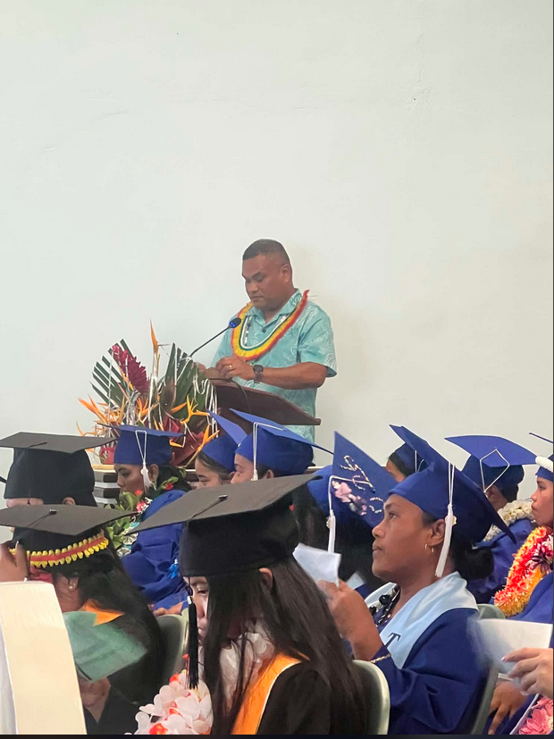
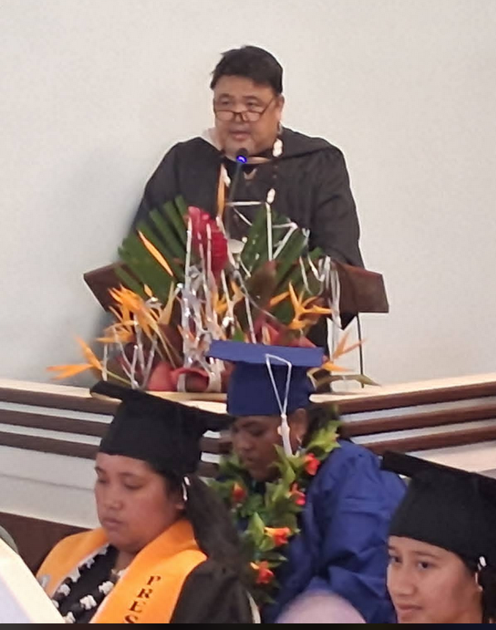
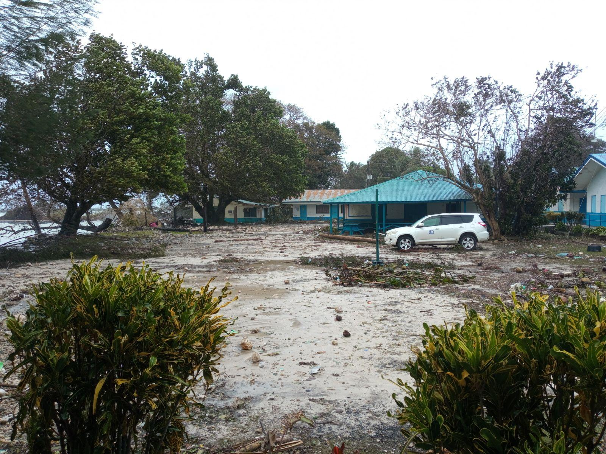
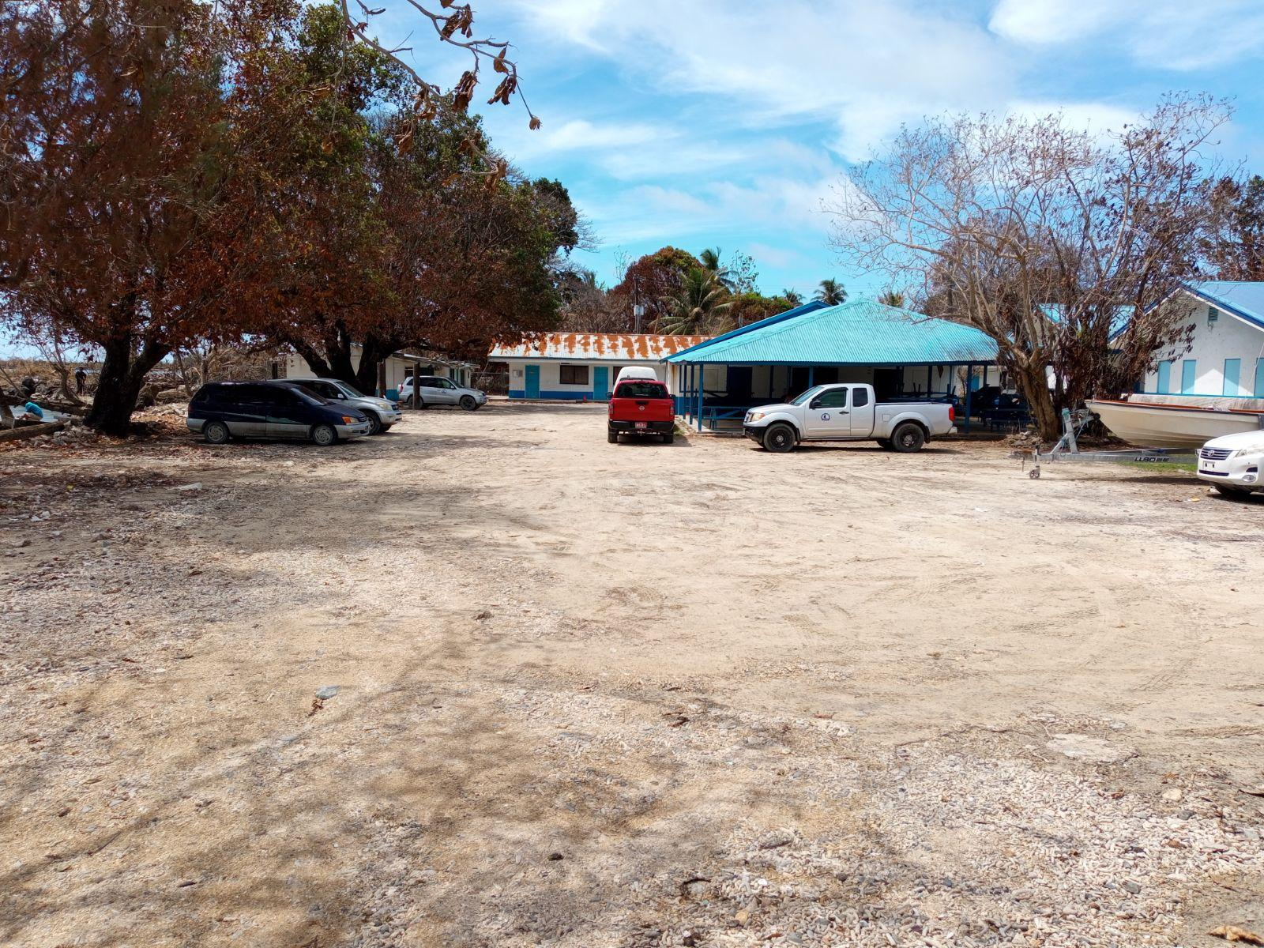
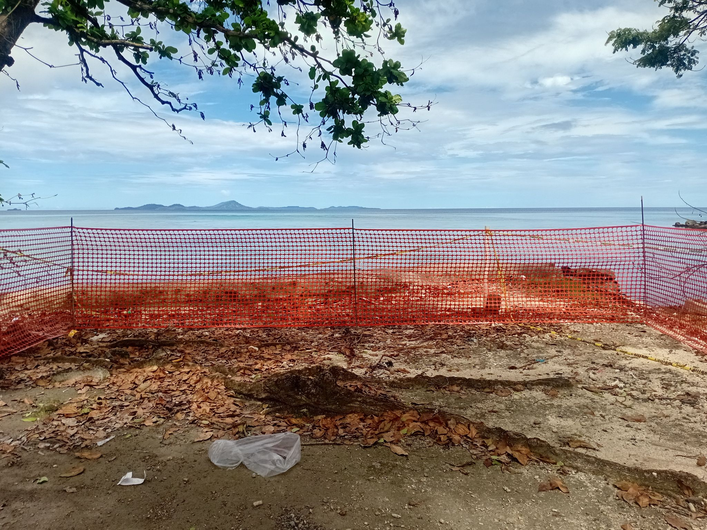
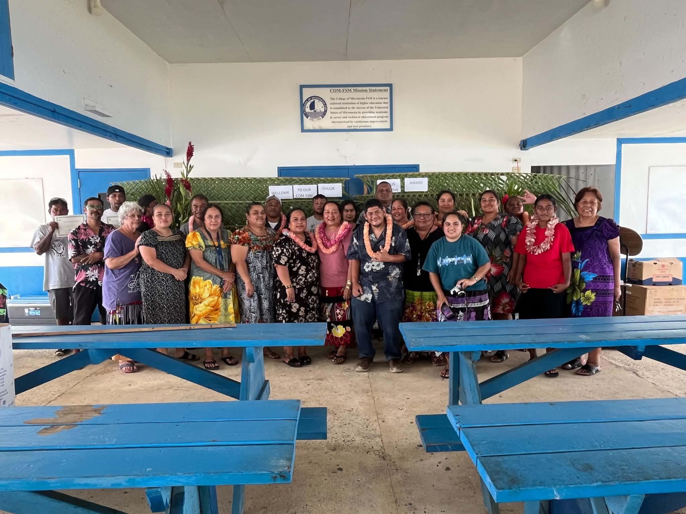
f
CHUUK CAMPUS UPDATE
  Spring 2026
  Following Sinlaku, the Chuuk Campus remained shut for 13 days, with classes resuming April 28, pausing again on April 30 for Chuuk Political Status, and finally reopening May 4th.
  May 26, 2026 COM-FSM Chuuk Campus Commencement Exercises- Spring 2026-25 Graduates, Fall 2025- 23 & Summer 2025- 6
Keynote Speaker Regent Arnold
  After Sinlaku Cleanup operations Protective measures
  Strategy for Sustaining Instruction – Chuuk Campus (Recovery Following the Typhoon)
  Out of 13 Chuuk instructors, 6 have submitted plans to recover missed instructional days through Holiday and Saturday Classes
2) Chuuk Campus Incentive Award May 27, 2026
Office of the Campus Dean
Office of the Academic Affairs
Learning Resource Center
Instructional Coordinator

Slide 9
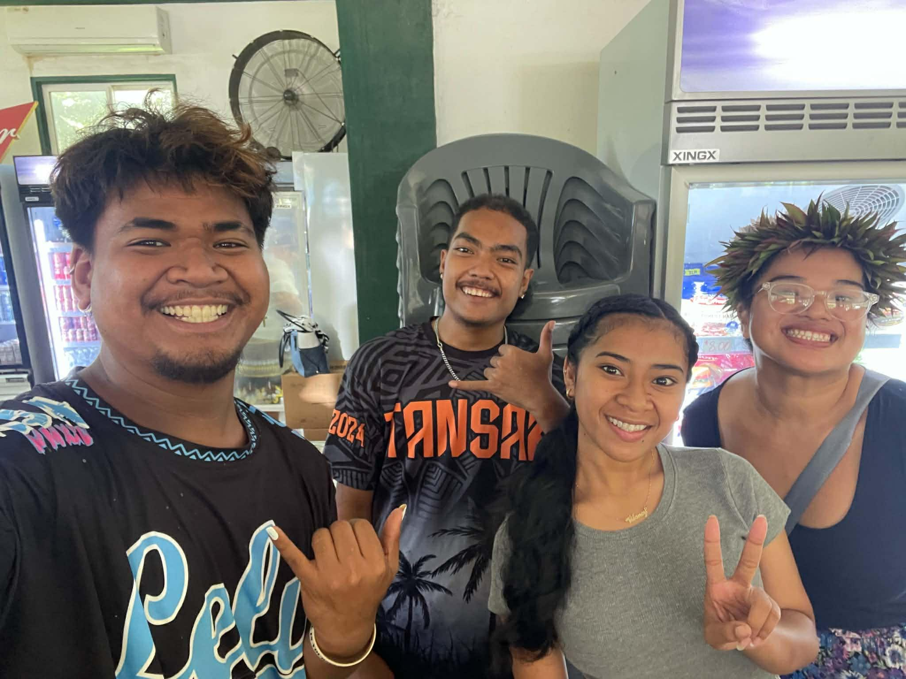
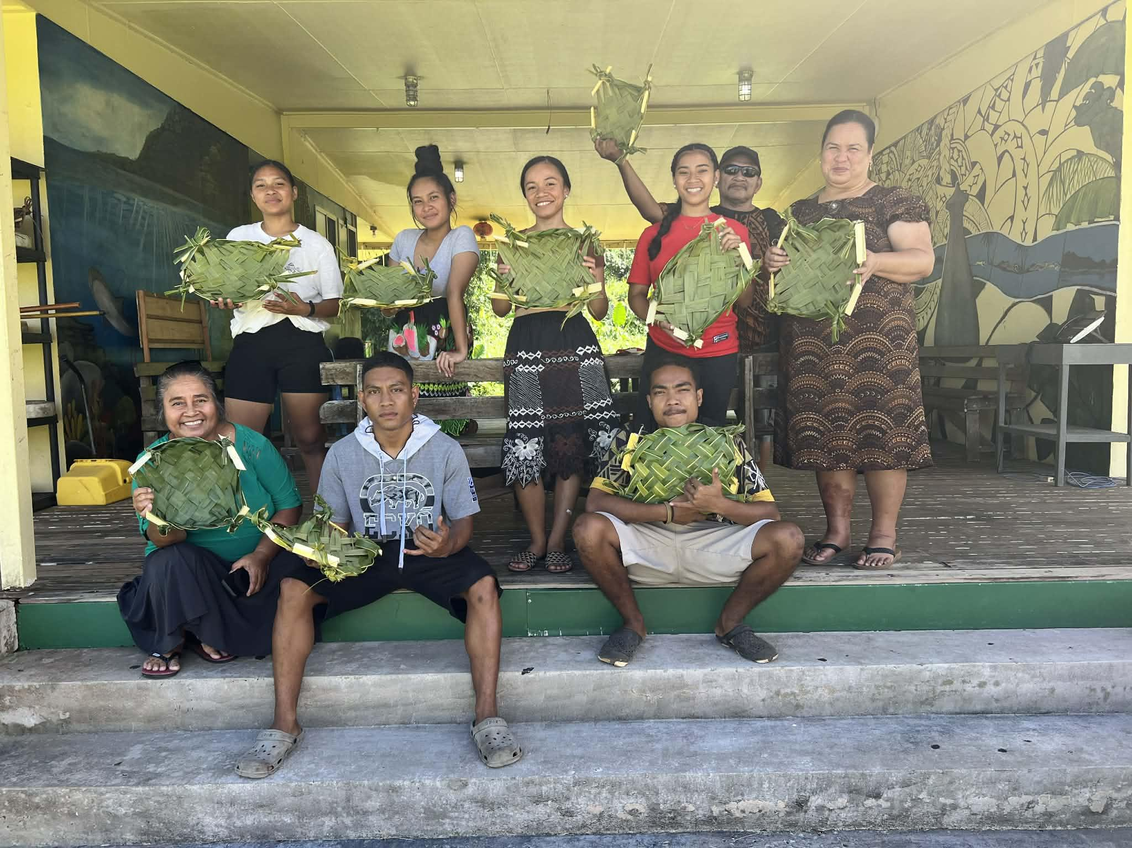
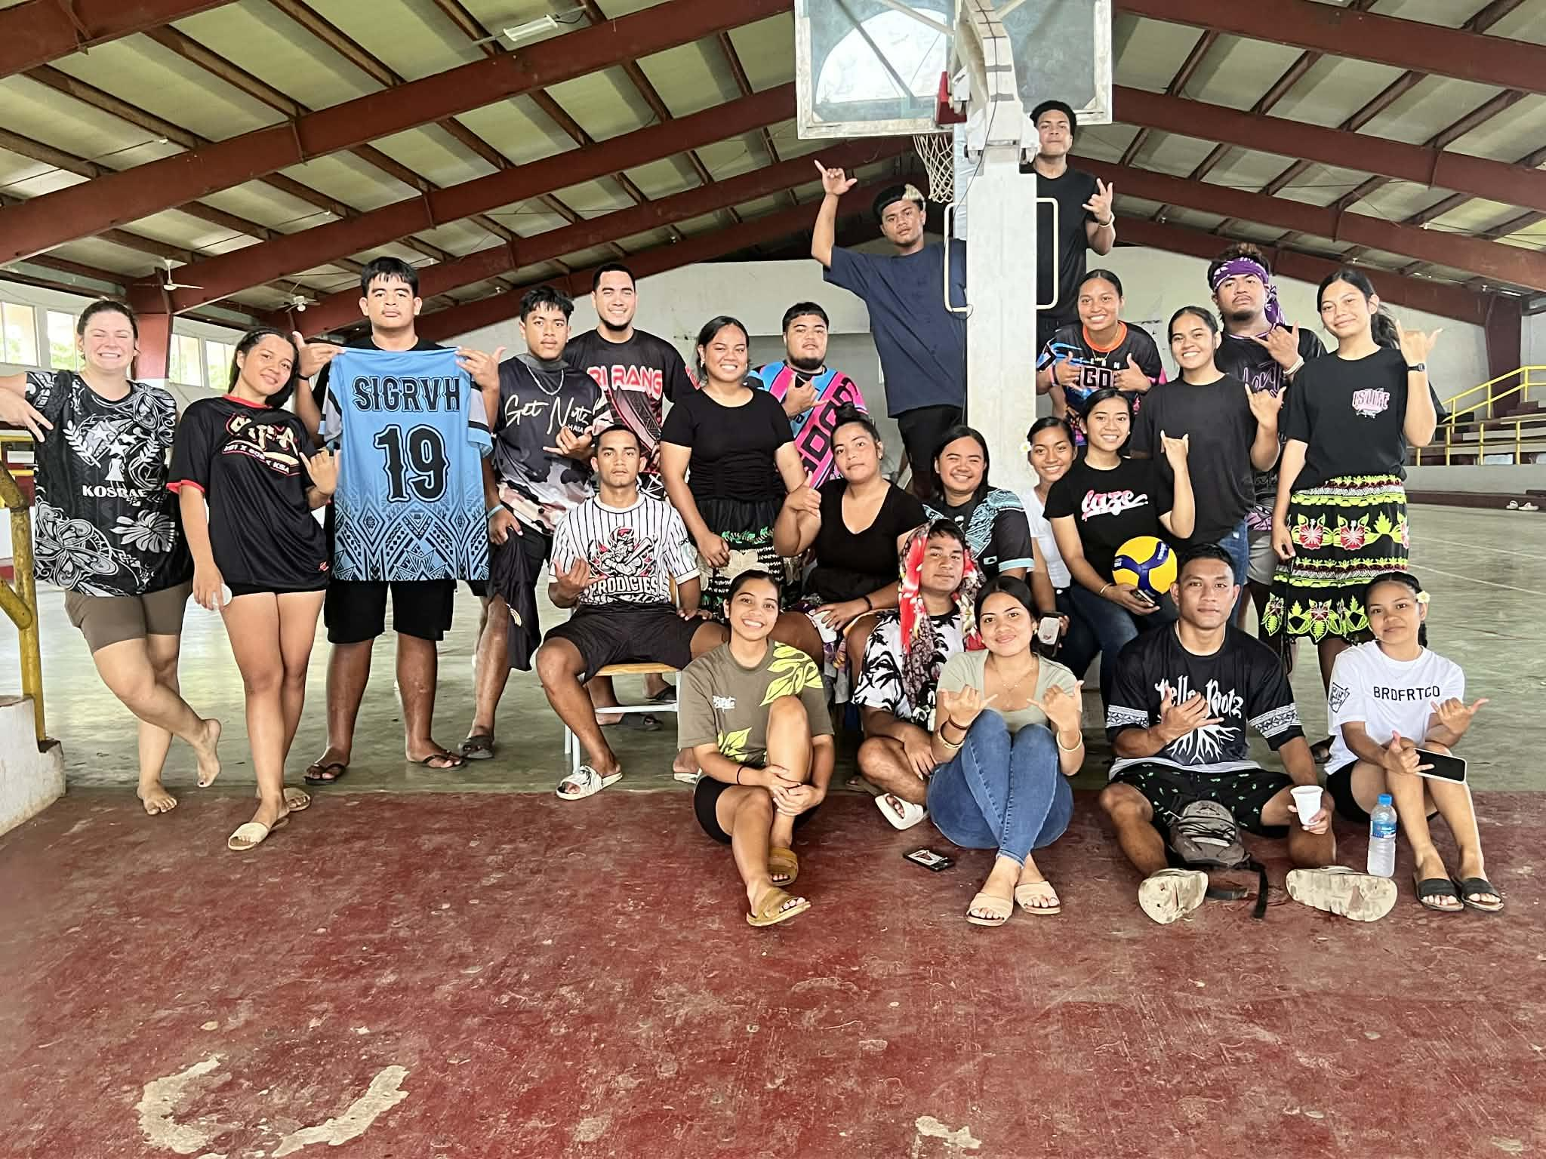
Kosrae Update
  Spring 2026
  Regular Programs
Enrolled 125 students and 68.95% passed courses
Graduated 16 students Spring 2026
Awarded Pell to 60% ( 76) of the enrollment received their Pell Award for Spring 2026. 15% of them are dual students and 25% (31) have not been awarded.
Patrons' usage of LRC programs and services April - 253, May - 103
  Other Stakeholders
    Dual-enrolled 19 students from Kosrae High school (One of our students was the Valedictorian.)
    Partner with Kosrae state gym for sports club usage 1x per week
    Graduated 6 teachers from KDOE with a BS in Elementary Ed.
  Summer 2026
  9 face to face classes offered and 6 online a total of 10 faculty members teaching
  107 enrolled
Culture Club
SBA and Club leaders with SBA Rep
Sports club
Office of the Campus Dean
Office of the Academic Affairs
Learning Resource Center
Instructional Coordinator

Slide 10
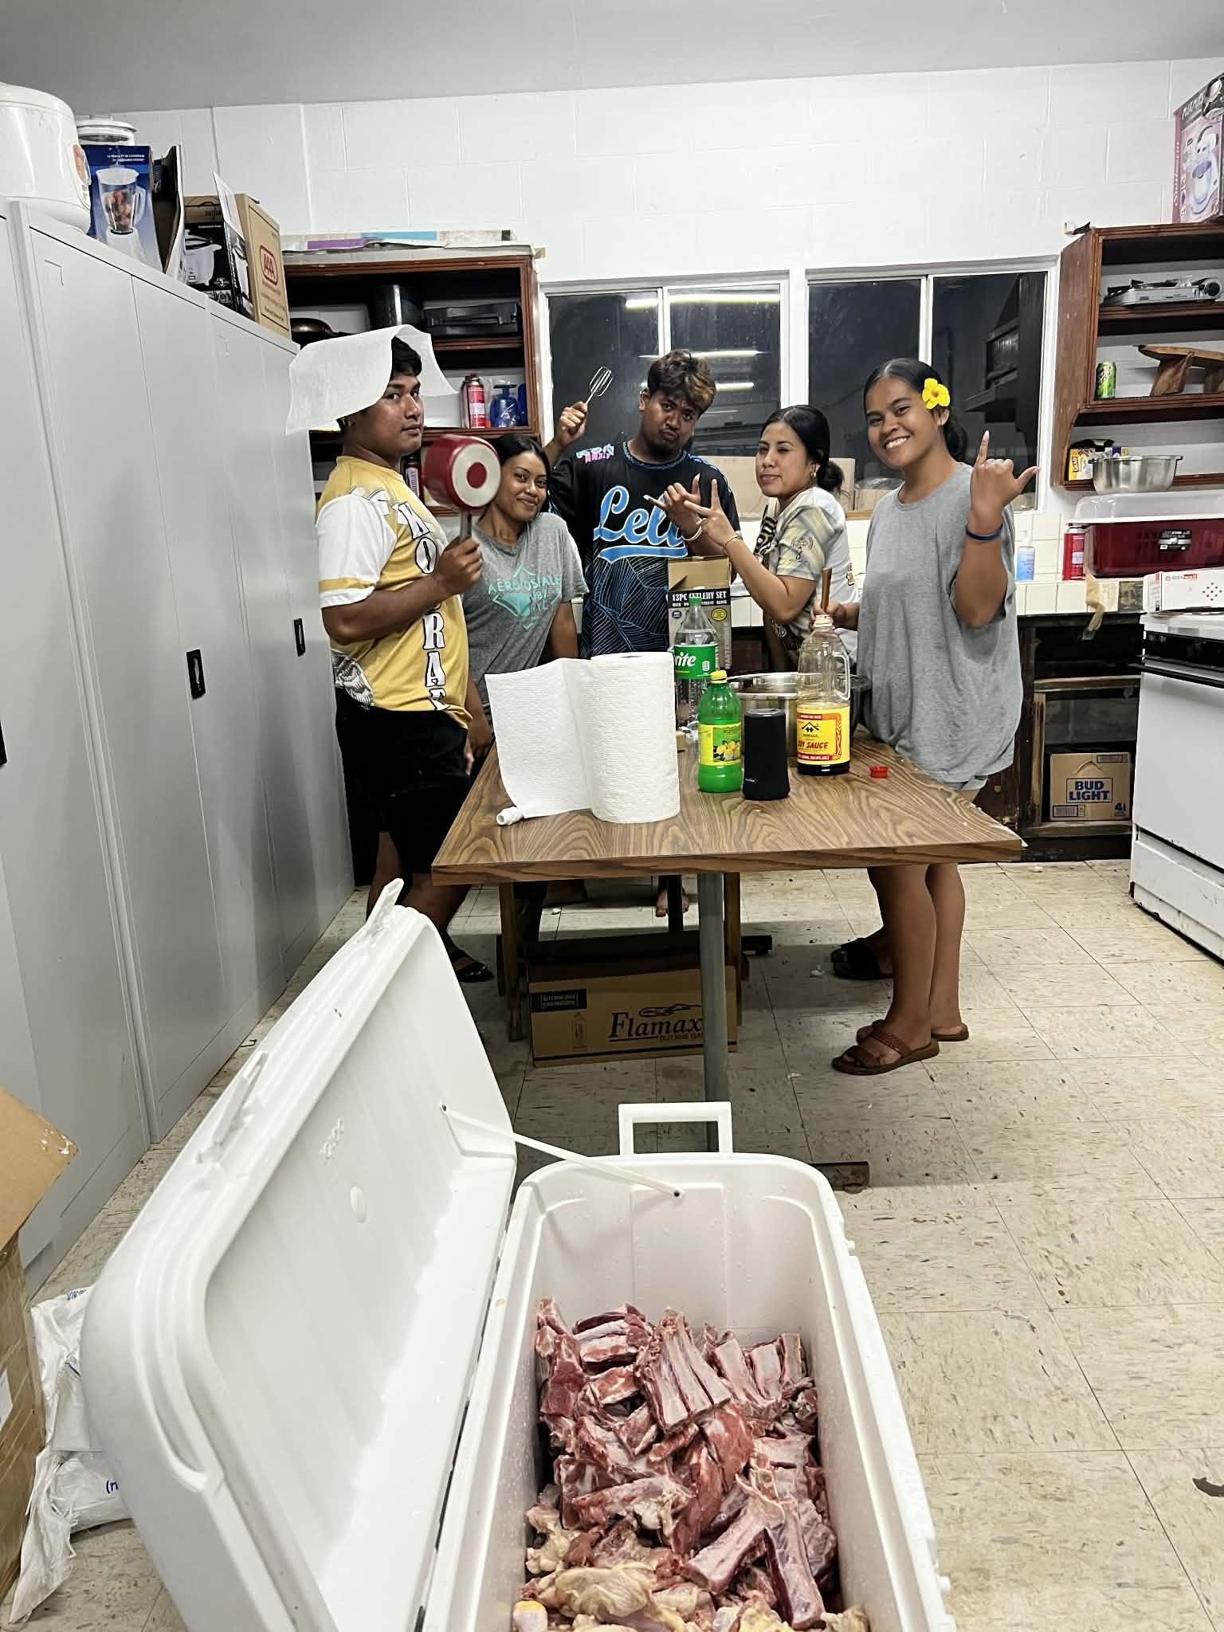
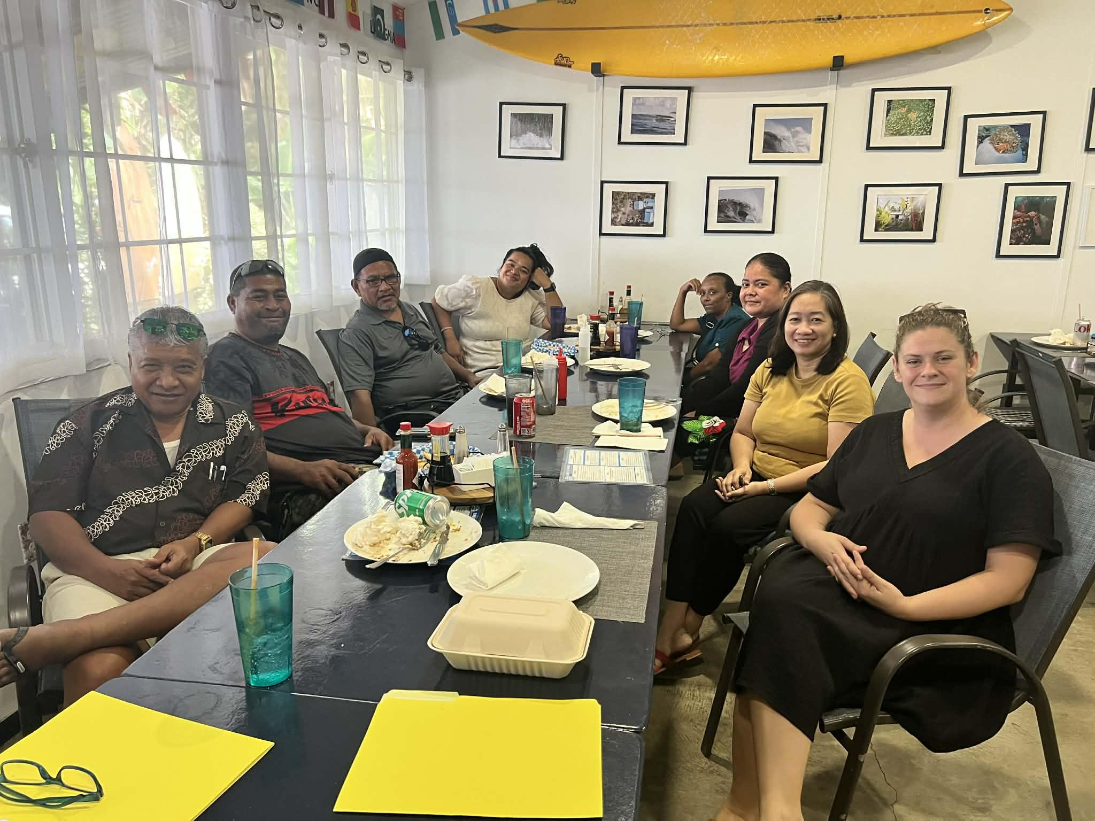
Kosrae Update
  Highlights:
  High level of students’ engagement in sports club
  SBA very active with campus and community events
  Much staff teambuilding by planning and executing Founding day, Incentive day, Graduation, and a Staff retreat.
SBA and club leaders help prep for Founding day
  Challenges:
  Filling empty staffing positions
  Finding qualified mechanics to service vehicles
  Limited funds to build student activity infrastructure
  Finding and securing contractors for construction projects
Faculty lunch outing
Office of the Campus Dean
Office of the Academic Affairs
Learning Resource Center
Instructional Coordinator

Slide 11
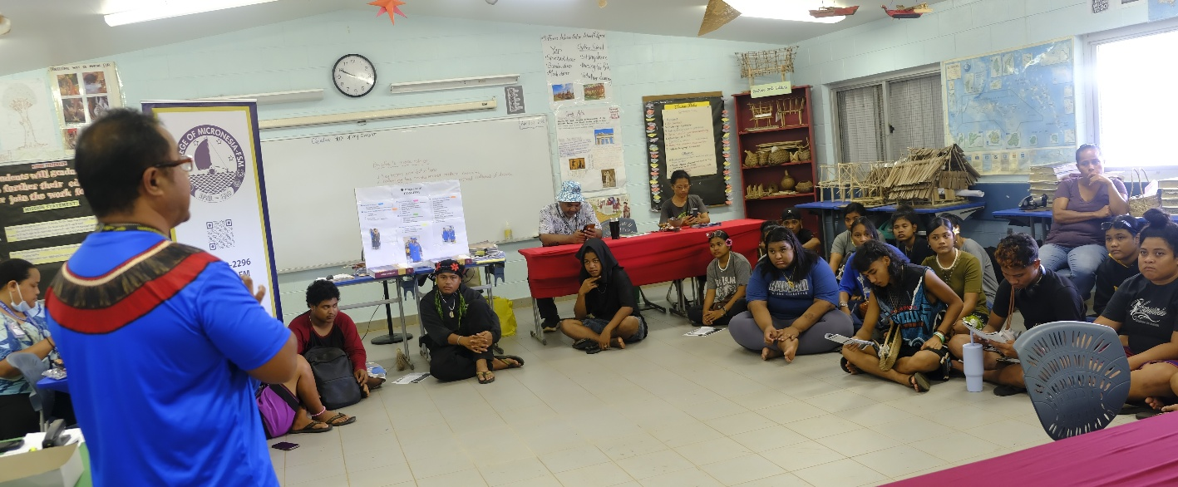
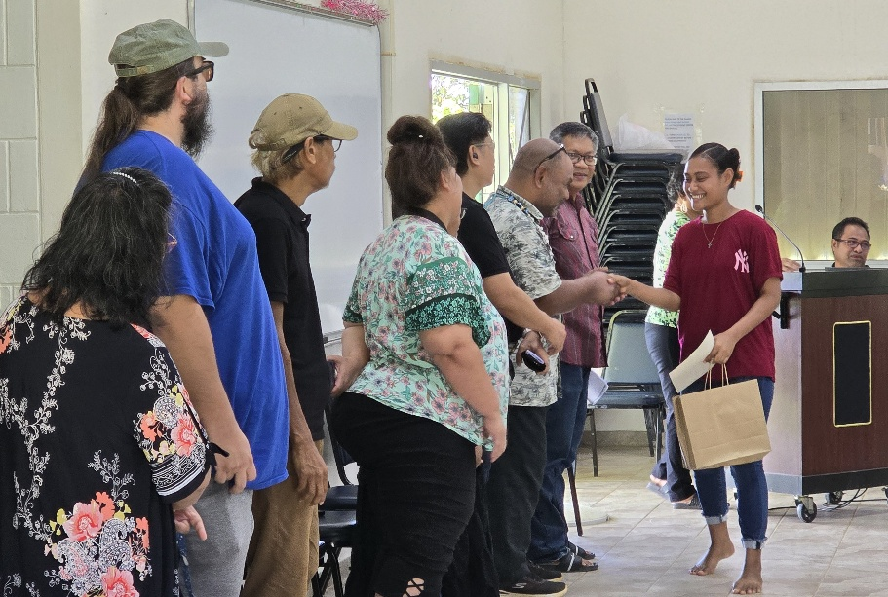
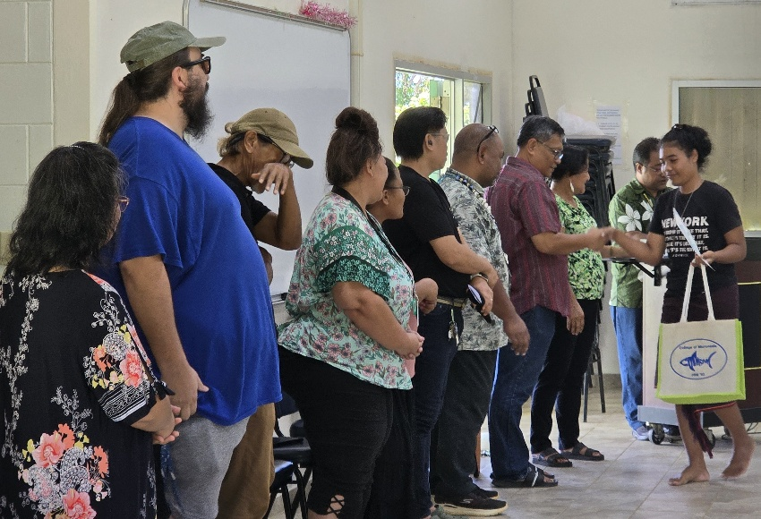
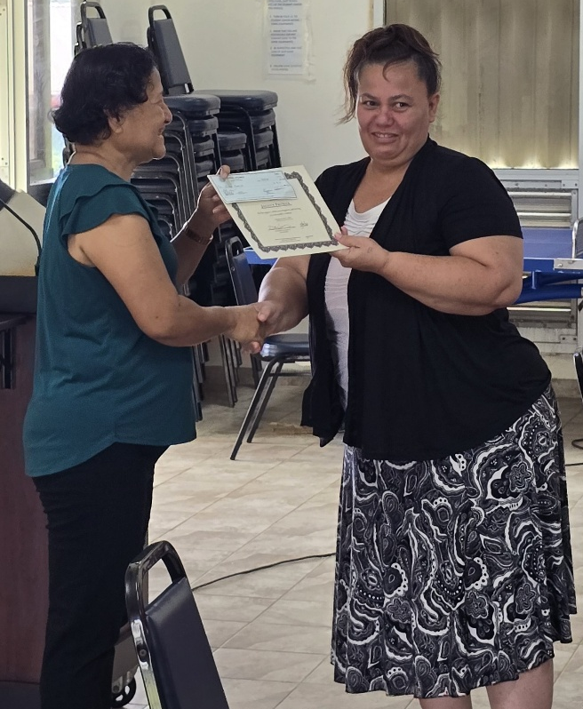
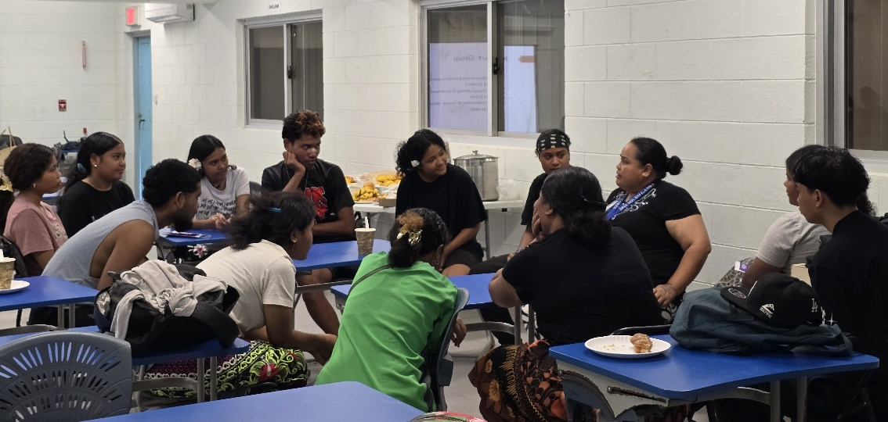
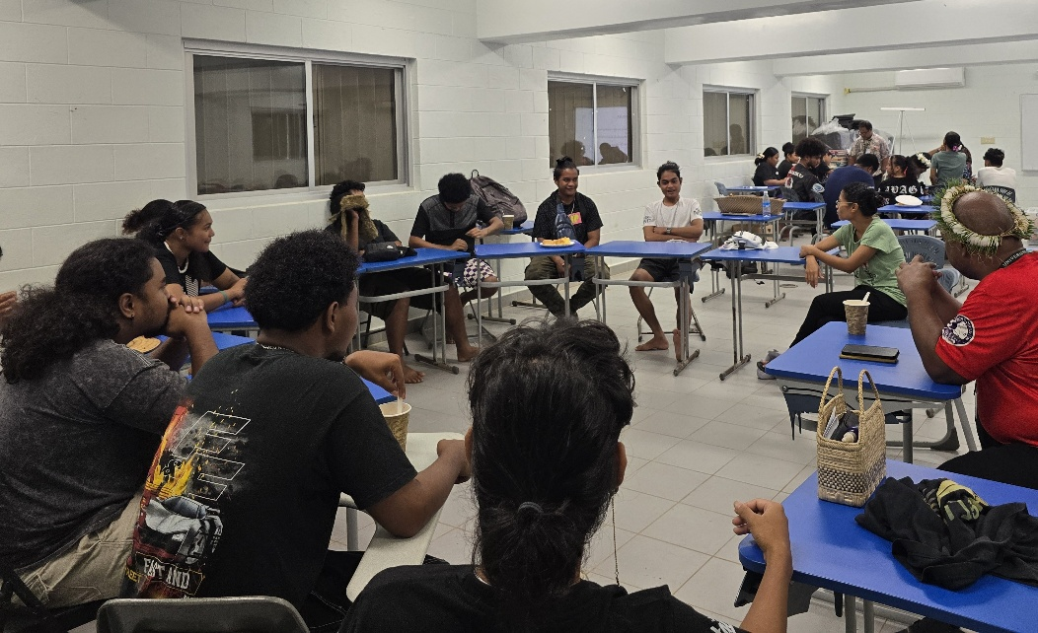
Yap Campus Update
**Spring 2026:**- Total number of students: 131
22 students (22/64) received tutoring. 14/22 ended semester with grade of C or better.
Student Award Day, May 12 [choir members won]
4 Academic Excellence
1 Perfect Attendance F2F
25 Active Participation in online classes
19 Most Improved
1 Dean’s Award for Leadership & Good Academic Standing
Incentive Award, May 19th
10th Commencement Exercises, May 22nd. 14 graduates
3 BS-Elem Ed., 4 AA-LA, 4 AA-Pre TP, 1 CA-TCP, & 2 CA-AFT
** Outreach & promo activities**
College & Career Fair, April 10th
Total student participants=333 (16 schools)
23 agencies (government & private)-62 agents
11 parents, guardians, & school officials
Outcome: partnerships, networking, & collaborations
YHS Job Fair, April 30^{th -------}strengthened relationship with YHS
Summer work with YHS – SY 2026-2027 Academic Year COA
YCHS & YHS visits – Admissions applications & FAFSA (YHS-all; YCHS-7)
Yap Health Services – Community Health Training Program starts Summer 2026
Yap DOE – teacher training (Elem. Teachers on main island)
Electrical System Installation Training (13)-Award Ceremony, June 17th, YC Student Lounge (Yap R&D, DPW&T)
Summer 2026 – 39 attended Student Orientation June 4th

Slide 12
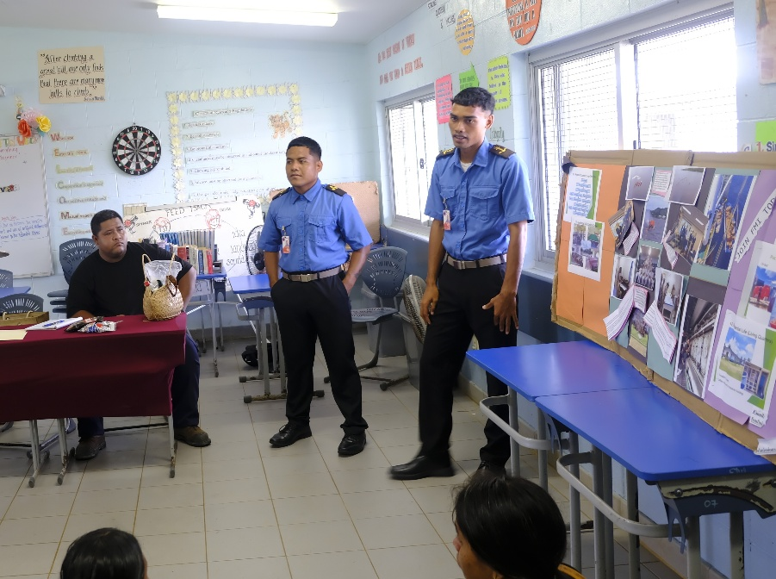
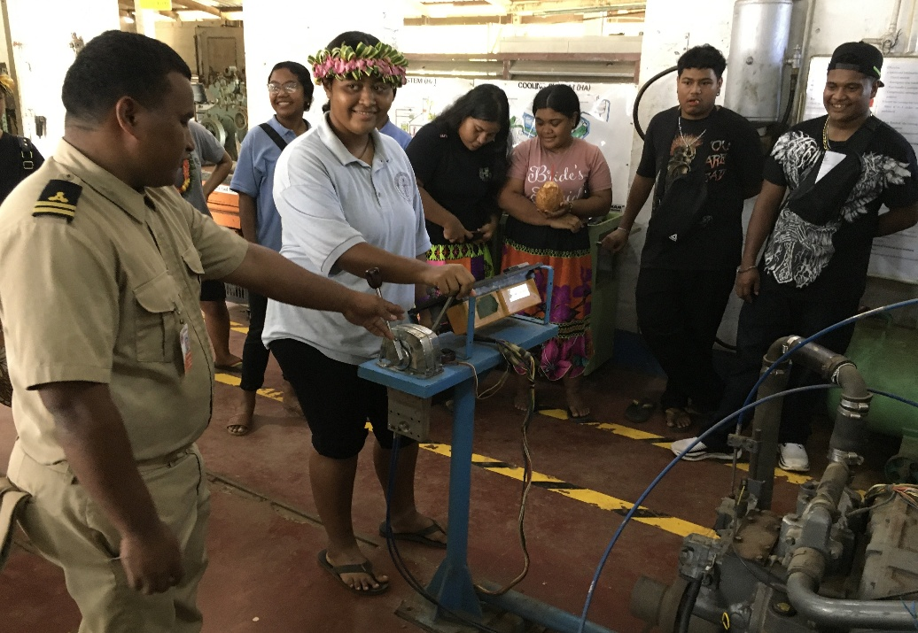
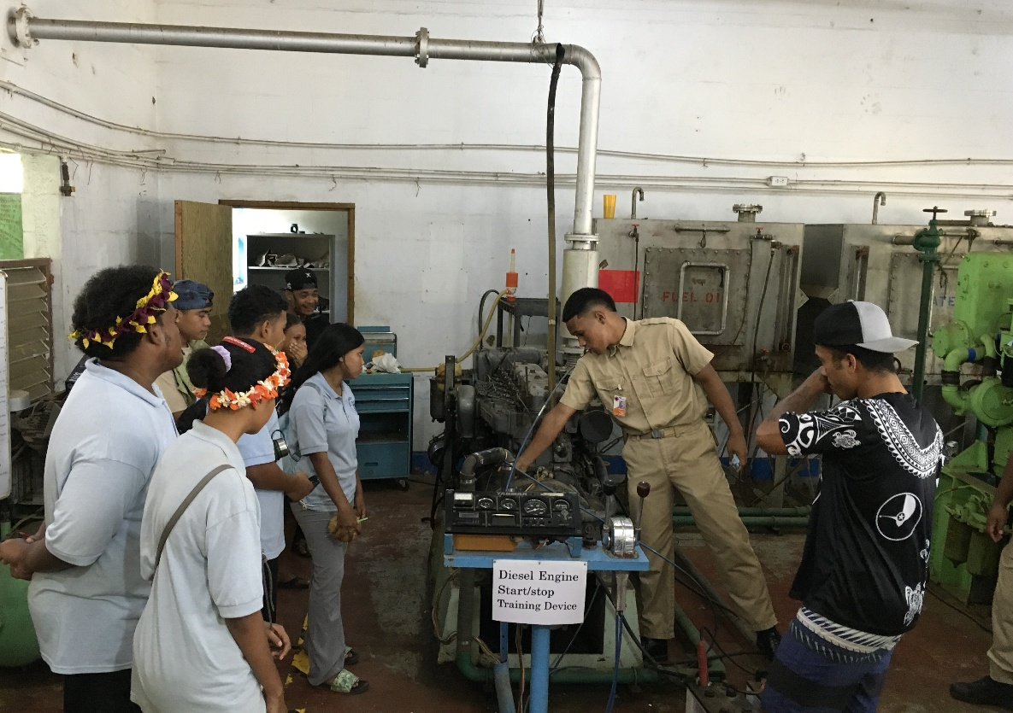
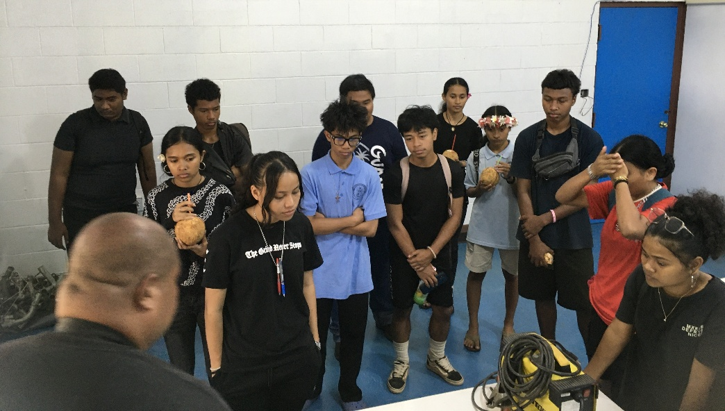

FSM FMI Update
**SPRING 2026**
2nd Yr Cadets – shipboard training, March 21-April 8
Student Mental Health Awareness & Suicide Prevention Workshop, April 20
FMI Exhibition Day, April 21
  Students (juniors & seniors)- YHS, YCHS, YSDA, & FCA
  Event featured 8 stations & a firefighting demo
  YHS Job Fair – recruitment by cadets
  Incentive Award & Farewell to 2nd Year Cadets, May 20
    Student Choice Award – Capt. Pine Timoteo
    Innovative Award – Joseph Falmed, Engineer
    Recognition Award – Valerio Ken
    Staff of the Year – Dorinda Laayow
    Farewell speeches – new CO Myles Mailing & President Theresa
    10th Joint Commencement Exercises, May 22
      17 graduates – 10 navigation, 7 marine engineering (Class 6 & 5)
      Welcoming Remarks – President Theresa
      Keynote Speaker – Thomas Kostka, FSM TC&I
      SUMMER 2026 ACTIVITIES:
        8 weeks of shipboard training for Class 5 cadets (MV H2) June 8-Aug 1
        Class 4 cadets continue with classes until August/September
    Firefighting equipment & Radar simulator – to be installed during the summer (July or August ??)
    Class 4 recruitment – 2nd cohort
    Program Review & Modification
    Port Pilot Training Development
    2 day Retreat – Vision, Mission, Goals & Outcomes

Slide 13
IA Sub-Units
Office of the Campus Dean
Office of the Academic Affairs
Learning Resource Center
Instructional Coordinator

Slide 14
Department for Instructional Affairs
Thank You!
2026 3RD QUARTER REPORT
Delihna Ehmes - VPIA
Office of the Campus Dean
Office of the Academic Affairs
Learning Resource Center
Instructional Coordinator

