Slide 1
Financial Report
As of February 28, 2025

Slide 2
I. Overview
This report summarizes the overall financial health of the College of Micronesia-FSM.
Investments Status Report
FY 2024 and 2025 Audit Status
Cash Balance
Statement of Projected Revenue and Actual Expenditure
Auxiliary Operation
Business Office Operation

Slide 3
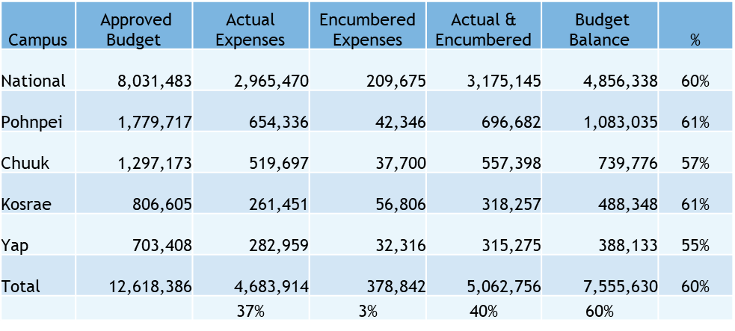
II. Budget A. FY2026 Actual Expenses as of February 28, 2026

Slide 4
B. BOR Budget
BOR | Approved Budget | Actual Expenses | Encumbered Expenses | Actual & Encumbered | Budget Balance | %
Travel | 60,000 | 14,363 | 27,616 | 41,979 | 18,021 | 30%
Contractual Services | 30,000 | 6,026 | - | 6,026 | 23,975 | 80%
Miscellaneous | 15,000 | 772 | - | 772 | 14,228 | 95%
Fund Raising | 15,000 | - | - | - | 15,000 | 100%
Total | 120,000 | 21,161 | 27,616 | 48,777 | 71,223 | 59%
 |  | 18% | 23% | 41% | 59%

Slide 5
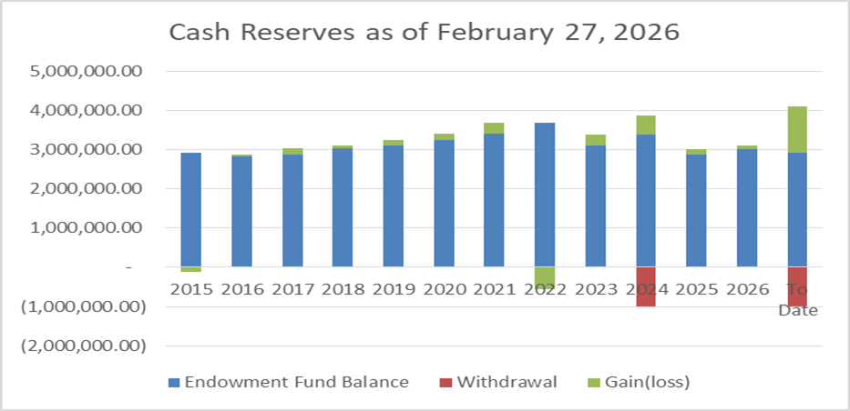
III. Investment Balance as of February 27, 2026 A. Cash Reserves Fund
Balance as of February 27, 2026 - $3,092,387.15
Unrealized gain for FY2026 - $74,735.24

Slide 6
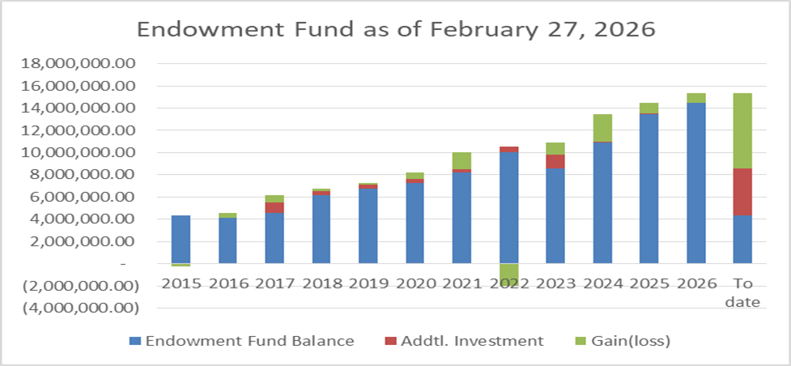
B. Endowment Fund
Balance as of February 27, 2026- $15,367,802.31
Unrealized gain for FY2026 - $894,942.33

Slide 7
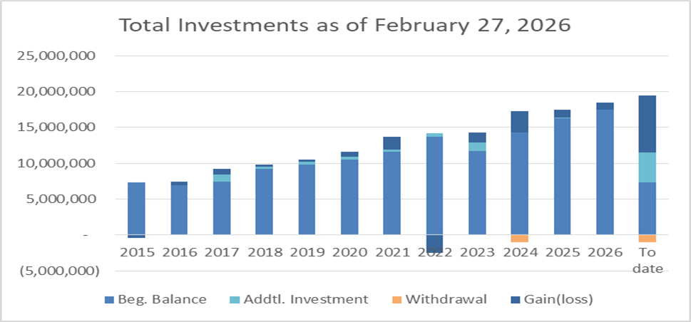
C. Total Investment Fund
Balance as of February 27, 2026-$18,460,189.46
Unrealized gain for FY2026 - $969,677.57

Slide 8
IV- FY 2024 and 2025 Audit Status
FY2024 Audit Status – Completed January 29, 2026
FY2025 Audit - will start April 2026

Slide 9
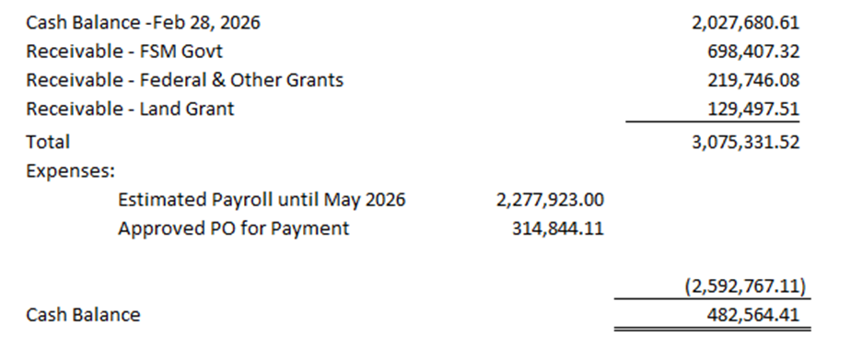
V. Cash Status

Slide 10
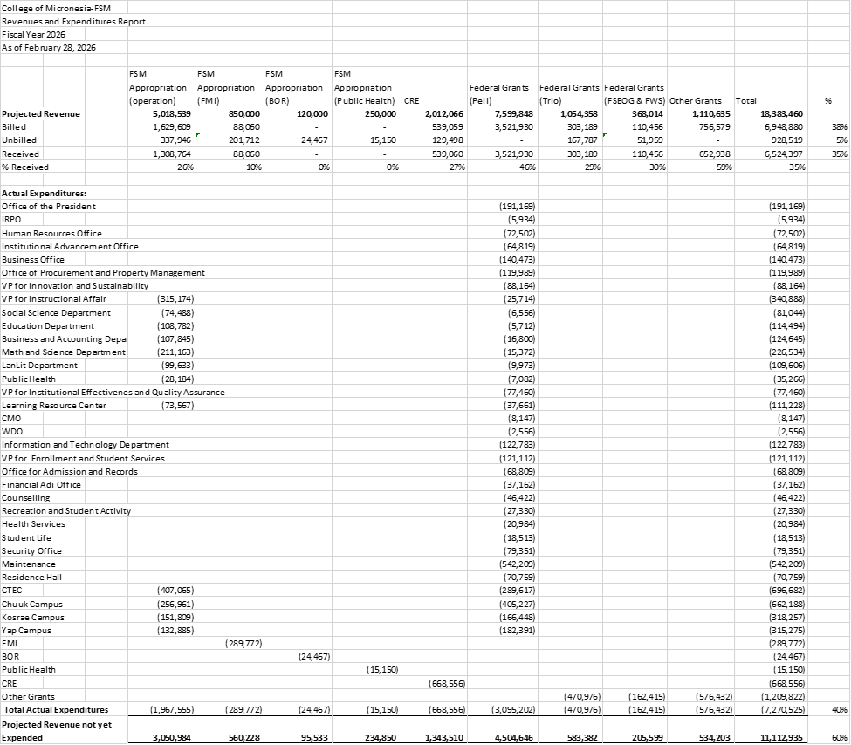
VI. Statement of Projected Revenue and Actual Expenditures as of February 28, 2026

Slide 11
VII. Auxiliary Services
A. Bookstore Operation
A.1 Bookstore Website and online payment system - https://store.comfsm.edu.fm/login
A.2 Transition to Digital Resources
A.3 Facilitate the transition to a unified college bookstore, encompassing both the range of items offered and the overall physical presentation.
A.4 The bookstore manager has been awarded a travel grant by the National Association of College Stores (NACS) Foundation to participate in the Campus Market Expo (CAMEX) 2026 Conference.
B. Dining Hall Operation
B.1 Assistance was received from CFE for the acquisition of an industrial chiller intended for the storage of locally produced goods.
B.2 Enhance operational strategies to address the rising operational costs and the declining number of students residing in the Residence Hall.
- Manpower training
- Stock monitoring to avoid losses
- Expand services by offering catering to college and non-college activities
- Menu improvement by using more locally produced vegetables

Slide 12
VIII. Business Office
A. Staff Training – CRE Accountant Zsannette Wichep attended NERAOC conference
- Accountant V Angelica Festijo attended the UNICEF training
- Comptroller Roselle Togonon together with VP Delihna Ehmes and Institution Researcher Malintha Perera attended the training for Compact Funding Reporting
B. To mitigate the staff shortage, the office hired Business Administration major students under special contracts.
- 4 special contracts
C. A total of 301 employees, equivalent to 87.5%, received the full adjustment of 10%.
D. As of February 28, 2026, a total of $2,326,721 in Pell Grant awards was processed. Additionally, a sum of $946,730.63 was disbursed to students in the form of refunds.

