Slide 1

College of Micronesia-FSM
Yap | Chuuk | Pohnpei | Kosrae
College of Micronesia-FSM is accredited by the Accrediting Commission for Community and Junior Colleges
Office of the President
Continuing transformational journeys at COMFSM
Board of Regents Meeting
April 6-10, 2026
National Campus
Pohnpei
BOR Meeting Presentation by President Theresa Koroivulaono (Ph. D): December 3-6, 2025

Slide 2




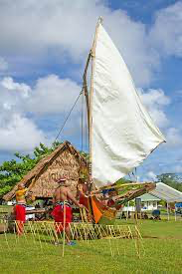
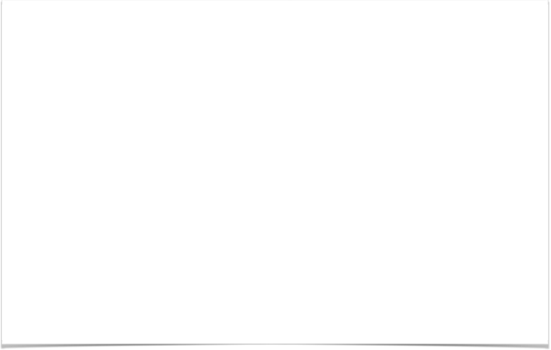
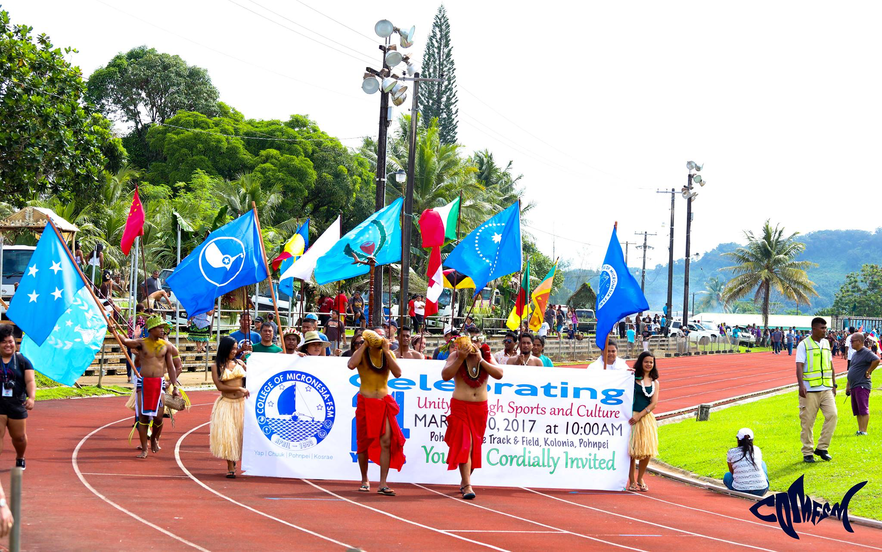



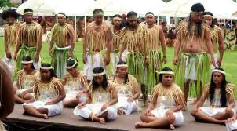
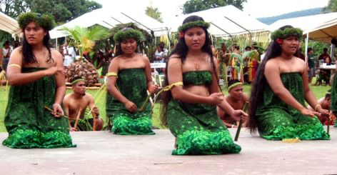

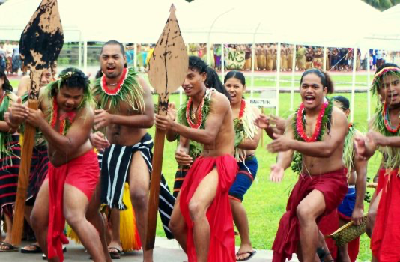


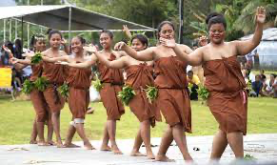
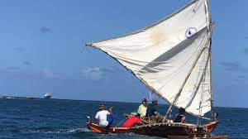



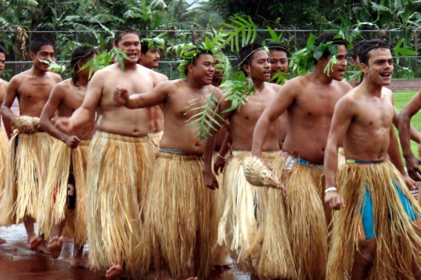
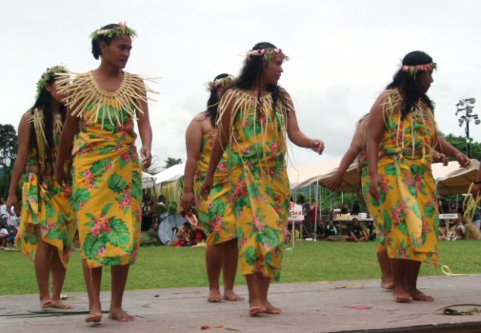
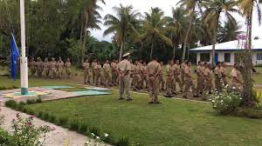
Office of the President
EDUCATIONAL MISSION
Office of the
President
The College of Micronesia-FSM is a learner-centered institution of higher education that is committed to the success of the Federated States of Micronesia by providing academic and career & technical educational programs characterized by continuous improvement and best practices.
INSTITUTIONAL VISION
We provide quality education today for a successful tomorrow.
INSTITUTIONAL CORE VALUES
Commitment
Excellence
Learner-Centeredness
Professionalism
Teamwork
Respect
Students Today
Leaders Tomorrow

Slide 3


4 States, 6 Campuses, 1,000,000+ sq. miles of ocean
National Campus
P.O. Box 159, Palikir, Pohnpei FM 96941
Phone: (691) 320-2480 | Fax: (691) 320-2479 | E-Mail: national@comfsm.fm
Career & Technical Education Center
P.O. Box 614, Kolonia, Pohnpei FM 96941
Phone: (691) 320-3795 | Fax: (691) 320-3799 | E-Mail: pnisite@comfsm.fm
Chuuk Campus
P.O. Box 879, Went, Chuuk FM 96942
Phone: (691) 330-3689 | Fax: (691) 330-2740 | E-Mail: chksite@comfsm.fm
Yap Campus
P.O. Box 286, Colonia, Yap FM 96943
Phone: (691) 350-2296 | Fax: (691) 350-5150 | E-Mail: yapsite@comfsm.fm
Kosrae Campus
P.O. Box 37, Tofol, Kosrae FM 96944
Phone: (691) 370-3191| Fax: (691) 370-3193 | E-Mail: ksasite@comfsm.fm
FSM Fisheries & Maritime Institute
P.O. Box 1056, Colonia, Yap FM 96943
Phone: (691) 350-3544 | Fax: (691) 350-3545 | E-Mail: fmi@comfsm.fm
College of Micronesia-FSM is accredited by the Accrediting Commission for Community and Junior Colleges, Western Association of Schools and Colleges, 331 J Street Suite 200 Sacramento, CA 95814,(415) 506-0234, an institutional accrediting body recognized by the Council for Higher Education Accreditation and the U.S. Department of Education.

Slide 4
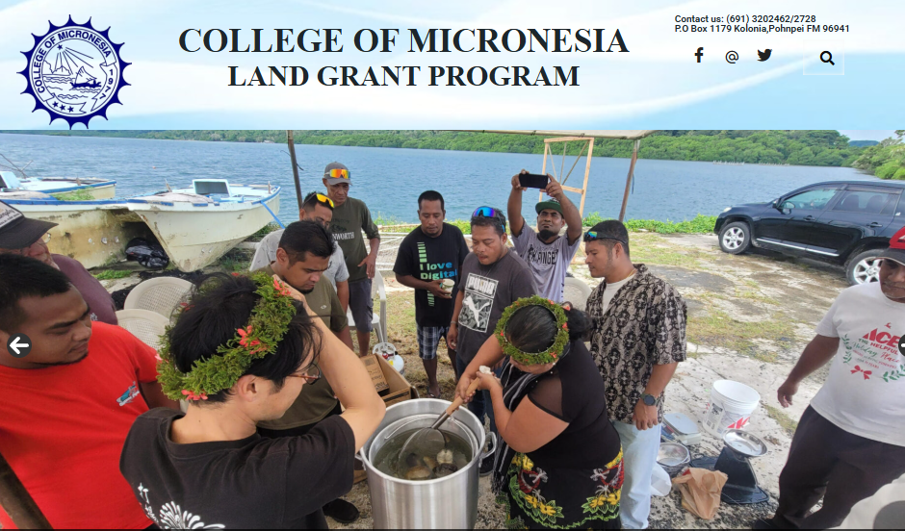

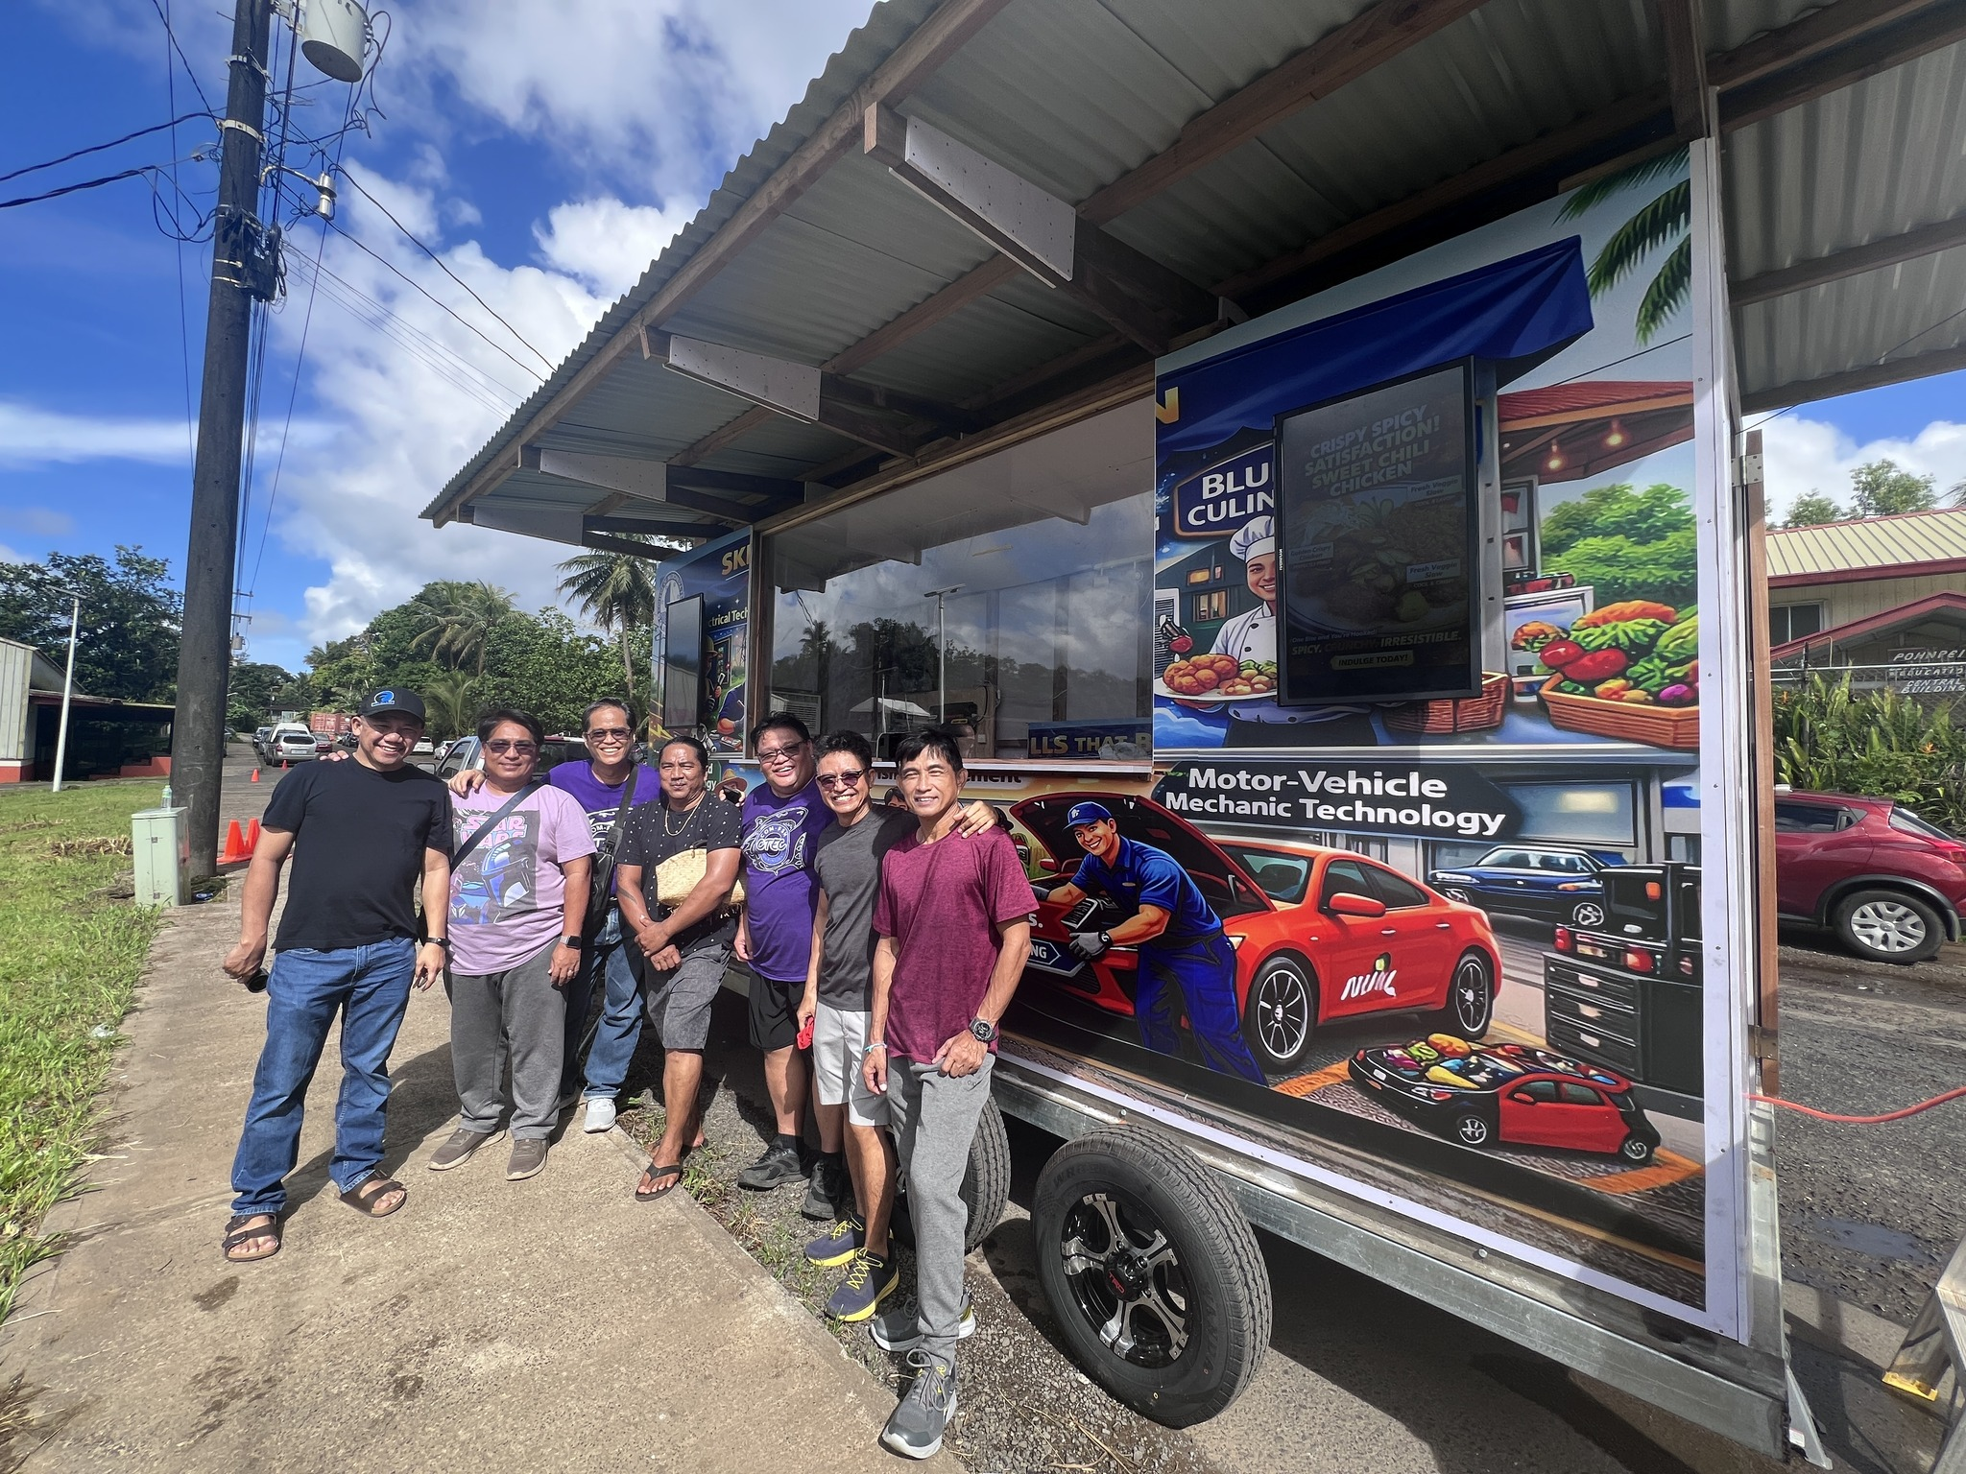
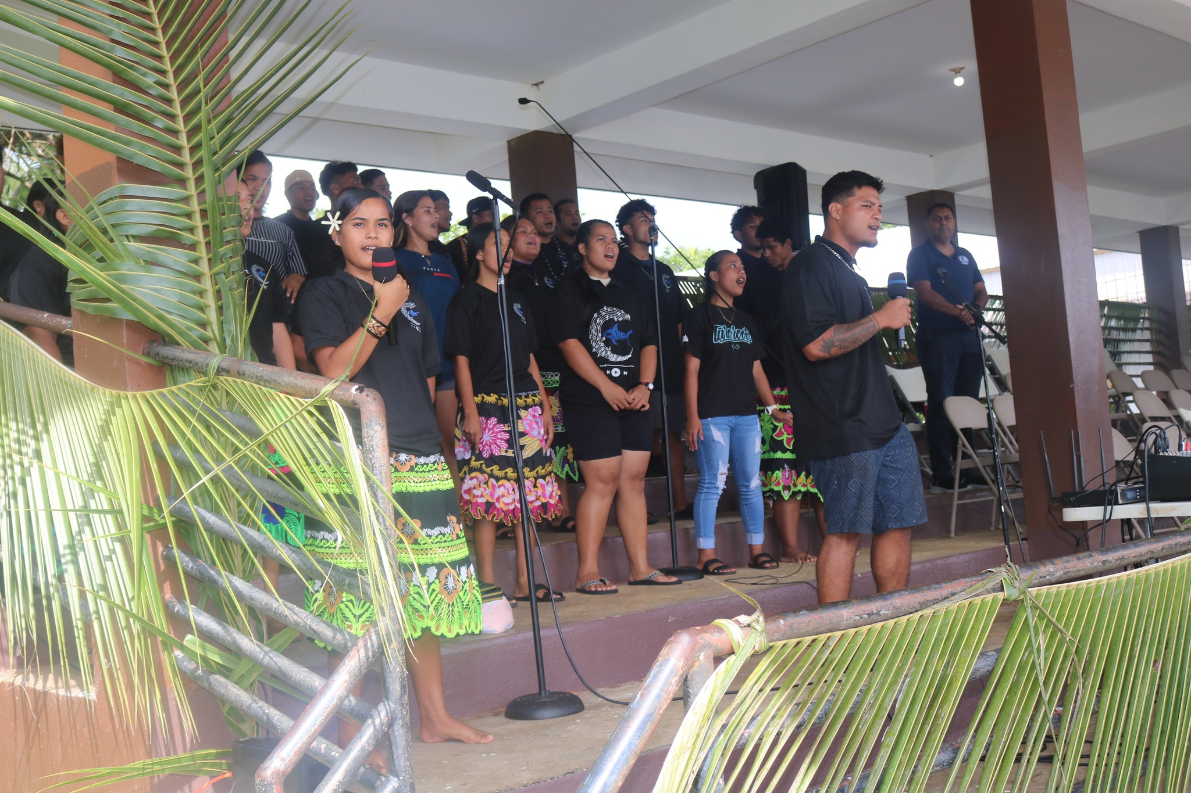
OVERVIEW
Office of the
President
Training for Transformation: ACCJC, Complete College America & ACCT
Updates:
Workforce Needs Assessment & the Curriculum Review
Strategic Plan KPIs & ISSs
OCM
HRO, IAEA
Students Today
Leaders Tomorrow

Slide 5
ACCJC
COMPLETE COLLEGE AMERICA
Office of the
President
THEMES: Transparency, Storytelling and Value Literacy.
Southwest Wisconsin Technical College (SWTC) showcased how ‘return on investment’ (ROI) data “can be embedded into planning and culture to ensure students graduate into living-wage careers”.
Case studies, guided planning and interactive ROI mapping provided the “blueprint for change”
SWTC teams turned accreditation challenges into award-winning college transformation.
Programs were revamped, stronger connections with the workforce were developed and accountability systems were embedded in college culture so that graduates could transition into “living wage opportunities”.
SWTC was the 2025 Aspen $1 million Prize Winner. The Aspen Prize is awarded to a community college that delivers “high and improving levels of student success”
Aspen Institute, 2025. College Excellence Program.
Stackable credentials are short-term, industry-aligned learning experiences that build toward larger credentials and meaningful employment outcomes
Identified two key components of career education and workforce pathways, namely curricular considerations and student support upon which to build stackable credential models for each institution.
Designed a stackable credential workshop for faculty and non-faculty members at COM-FSM.
The team employed the badge-to-pathway approach where "one completes the first module and earns a badge” and that badge opens the next module, and so forth.
This initiative has been very successful thus far with substantial ‘buy-in’ from the faculty. There is a very high percentage of participation and a very high percentage of completions despite other faculty responsibilities like midterm assessments, teaching and standing committee loads.
Faculty Professional Development Session: April 2, 2026: Stackable Credentials at COM-FSM
Students Today
Leaders Tomorrow

Slide 6
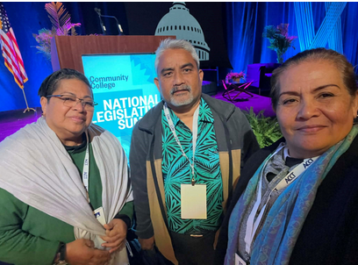
ASSOCIATION OF COMMUNITY COLLEGE TRUSTEES
(ACCT)
Office of the
President
1900 participants with the COM-FSM representation being the only one from the Pacific Islands’ region.
“New Trustees Academy”, February 8, 2026: The full-day program focused on “Governance, Consultation” and “Administration” as the guiding pillars on which a Community College Board can develop policies, procedures and practices for carrying out their responsibilities with integrity and transparency.
Scenario-based discussion groups.
A meeting between COM-FSM and selected ACCT partners, included discussions for a second Governance Leadership Institute (GLI) in the Micronesian region later this year.
COM-FSM has yet to hold a Board training retreat that was deferred from 2025.
Students Today
Leaders Tomorrow

Slide 7
CURRICULUM REVIEW UPDATE
Office of the
President
Phase 1: Creating a project logic model (completed)
Phase 2: Understanding current practices
Phase 2a: Document review and course audit (completed)
Phase 2b: Student, faculty, and alumni surveys (completed)
Phase 2c: Student, faculty, alumni, and community member interviews (completed)
Phase 2d: Final report (expected April 2026)
Phase 3: Planning for curriculum changes (starting May 2026)
Students Today
Leaders Tomorrow

Slide 8
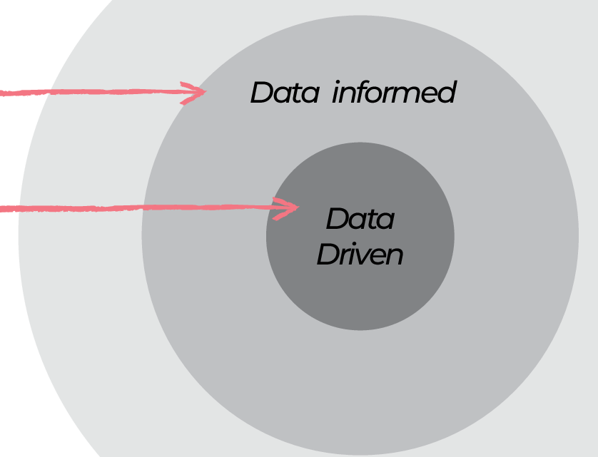
CURRICULUM REVIEW PROCESS
Office of the
President
Enrollment (programs)
Syllabi, Course & Program Reviews
Surveys & Focus Groups
Fluctuating Enrollment Trends
Basis for Transformation
Informed Transformation
Students Today
Leaders Tomorrow

Slide 9
STRATEGIC PLAN 2025-2030: UPDATES
Office of the
President
Since the implementation of the Strategic Plan 2025-2030 one year ago, the information in the following 8 tables provide the first evaluation results of the college’s performance under the new plan. Overall, there are 26 key performance indicators (KPIs) and 13 institutional set standards (ISSs). Each of the three strategic goals – “Access, Innovation” and “Resilience” – has outcomes. Each outcome has KPIs and some have ISSs. The KPI is the measure of success used by COM-FSM. Integrated with the KPIs are the required ACCJC ISSs.
Students Today
Leaders Tomorrow

Slide 10
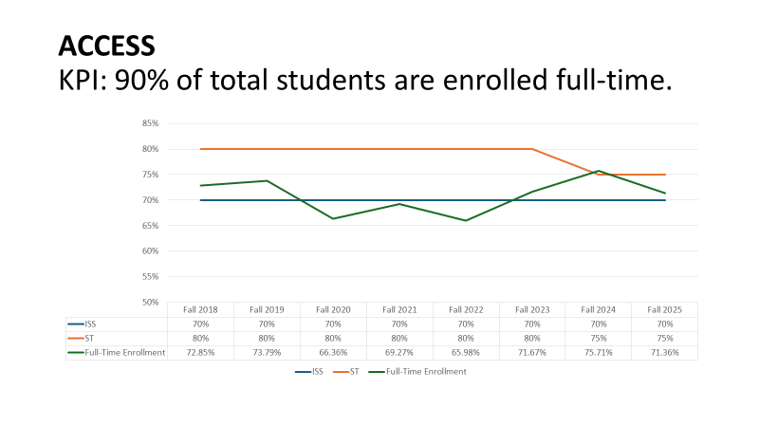
ISS FOR FALL 2025: 70% OF STUDENTS ENROLLED
FULL-TIME
Office of the
President
Students Today
Leaders Tomorrow

Slide 11
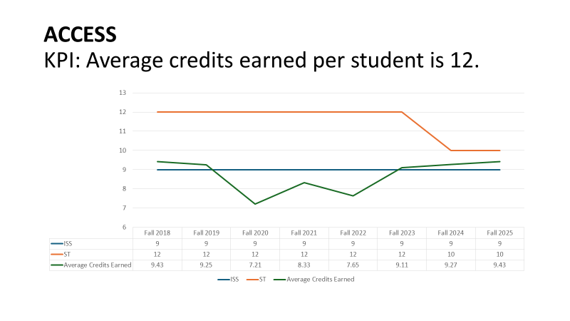
ISS FOR FALL 2025: AVERAGE CREDITS PER STUDENT: 9
Office of the
President
Students Today
Leaders Tomorrow

Slide 12
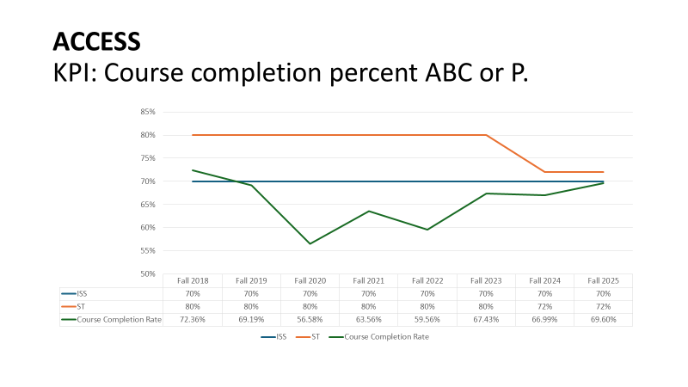
ISS FOR FALL 2025: 70% COURSE COMPLETION
Office of the
President
Students Today
Leaders Tomorrow

Slide 13
RESILIENCE KPI: Persistence/Retention rate for fall – spring is 95%
ISS FOR FALL 2025: 80% PERSISTENCE/RETENTION:
FALL-SPRING
Office of the
President
Students Today
Leaders Tomorrow

Slide 14
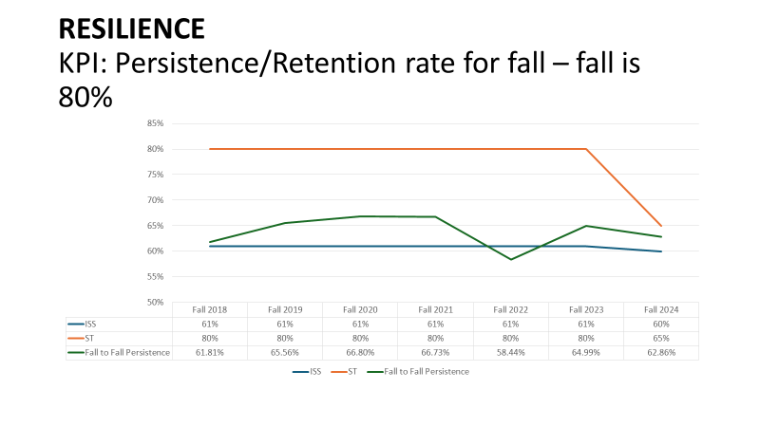
ISS FOR FALL 2025: 60% PERSISTENCE/RETENTION:
FALL-FALL
Office of the
President
Students Today
Leaders Tomorrow

Slide 15
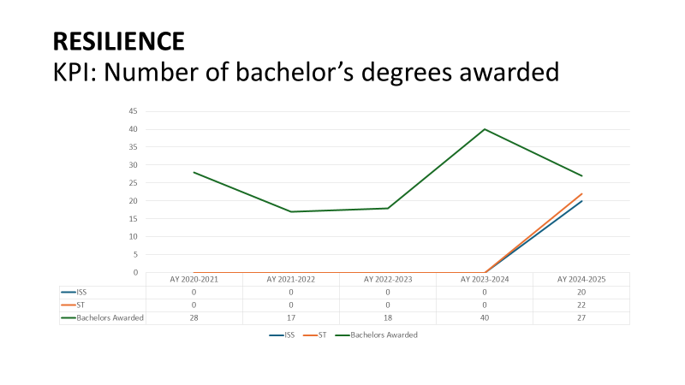
ISS FOR AY2024-2025: 20 BACHELOR’S DEGREES AWARDED
Office of the
President
Students Today
Leaders Tomorrow

Slide 16
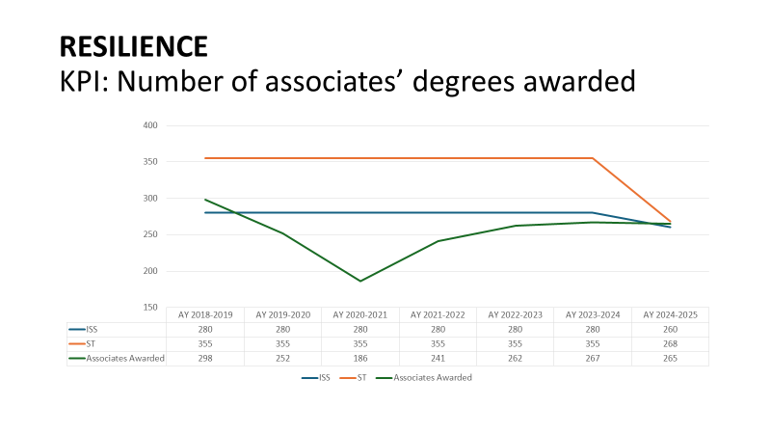
ISS FOR AY2024-2025: 260 ASSOCIATE DEGREES AWARDED
Office of the
President
Students Today
Leaders Tomorrow
Notes:
This increases to $1,037.37 in FY2025.

Slide 17
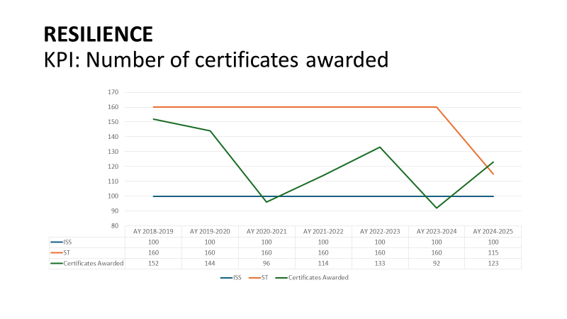
ISS FOR AY2024-2025: 100 CERTIFICATES AWARDED
Office of the
President
Students Today
Leaders Tomorrow

Slide 18

SUMMARY OF AY2024-2025 COM-FSM PERFORMANCE
Office of the
President
KPI/ISS | KPI/ISS IS MET/UNMET | ST IS MET/UNMET
ACCESS
KPI: 70% of total students are enrolled full-time |  | X
KPI: average credits earned per student: 9 |  | X
KPI: course completion percent ABC or P: 70% |  | X
RESILIENCE
KPI: Persistence/retention rate for fall-spring: 80% |  | X
KPI: Persistence/retention rate for fall-fall: 60% |  | X
KPI: number of bachelor’s degrees awarded: 20
KPI: number of associates’ degrees awarded: 260 |  | X
KPI: number of certificates awarded: 100
Students Today
Leaders Tomorrow

Slide 19
SUBMISSION TO THE BOARD OF REGENTS FOR APPROVAL
AMENDMENTS TO THE STRATEGIC PLAN 2025-2030
That numbers are inserted for each KPI because currently they are not numbered (there are 26 in total);
That KPI 1 is revised to read “percentage of time to degree completion for first-time, full-time enrollments”
That the following language is Inserted at the top of the section labelled “STRATEGIC PLAN 2025-2030: KEY PERFORMANCE INDICATORS & ISS”.
KPIs = Key Performance Indicators: COM-FSM’s quantifiable measures used to evaluate the college’s success in achieving the strategic goals listed in this strategic plan.
ISSs = Institutional Set Standards: are mandatory accreditation requirements.
Where there are both KPIs and ISSs showing in the same section, the results will be recorded as the same. The KPI is the chosen college term for measuring its achievements while the ISS is the required ACCJC measure.
That the following KPIs/ISSs are revised to read:
RESILIENCE: ISS 6/KPI: graduation rate of first-time, full-time students at 100%
ISS 7/KPI: graduation rate of first-time, full-time students at 150%
ISS 8/KPI: graduation rate of first-time, full-time students at 200%
Office of the
President
Students Today
Leaders Tomorrow

Slide 20
OFFICE OF COMPACT MANAGEMENT: AN UPDATE
March 5, 2026: the Office of Compact Management (OCM) reached out to COM-FSM requesting college input in relation to rescinding a resolution from 2011, effective FY2013 to reduce Compact sector funds (to the college) to $1 million.
In FY2025 the resolution was suspended which allowed an increase from $1 million to $5.018 million in FY2026 (to COM-FSM).
The OCM is currently preparing submissions to rescind five legacy resolutions including the $1 million cap for Compact funds to COM-FSM.
March 20, 2026: The college input was submitted to the OCM in draft form requesting (OCM) feedback.
April 2, 2026: More information was requested by the OCM.
April 10, 2026: COM-FSM will submit the requested information.
Office of the
President
April 23, 2026: Mid-year JEMCO meeting.
Students Today
Leaders Tomorrow

Slide 21
DIVERSITY AT COM-FSM
Office of the
President
Students Today
Leaders Tomorrow

Slide 22
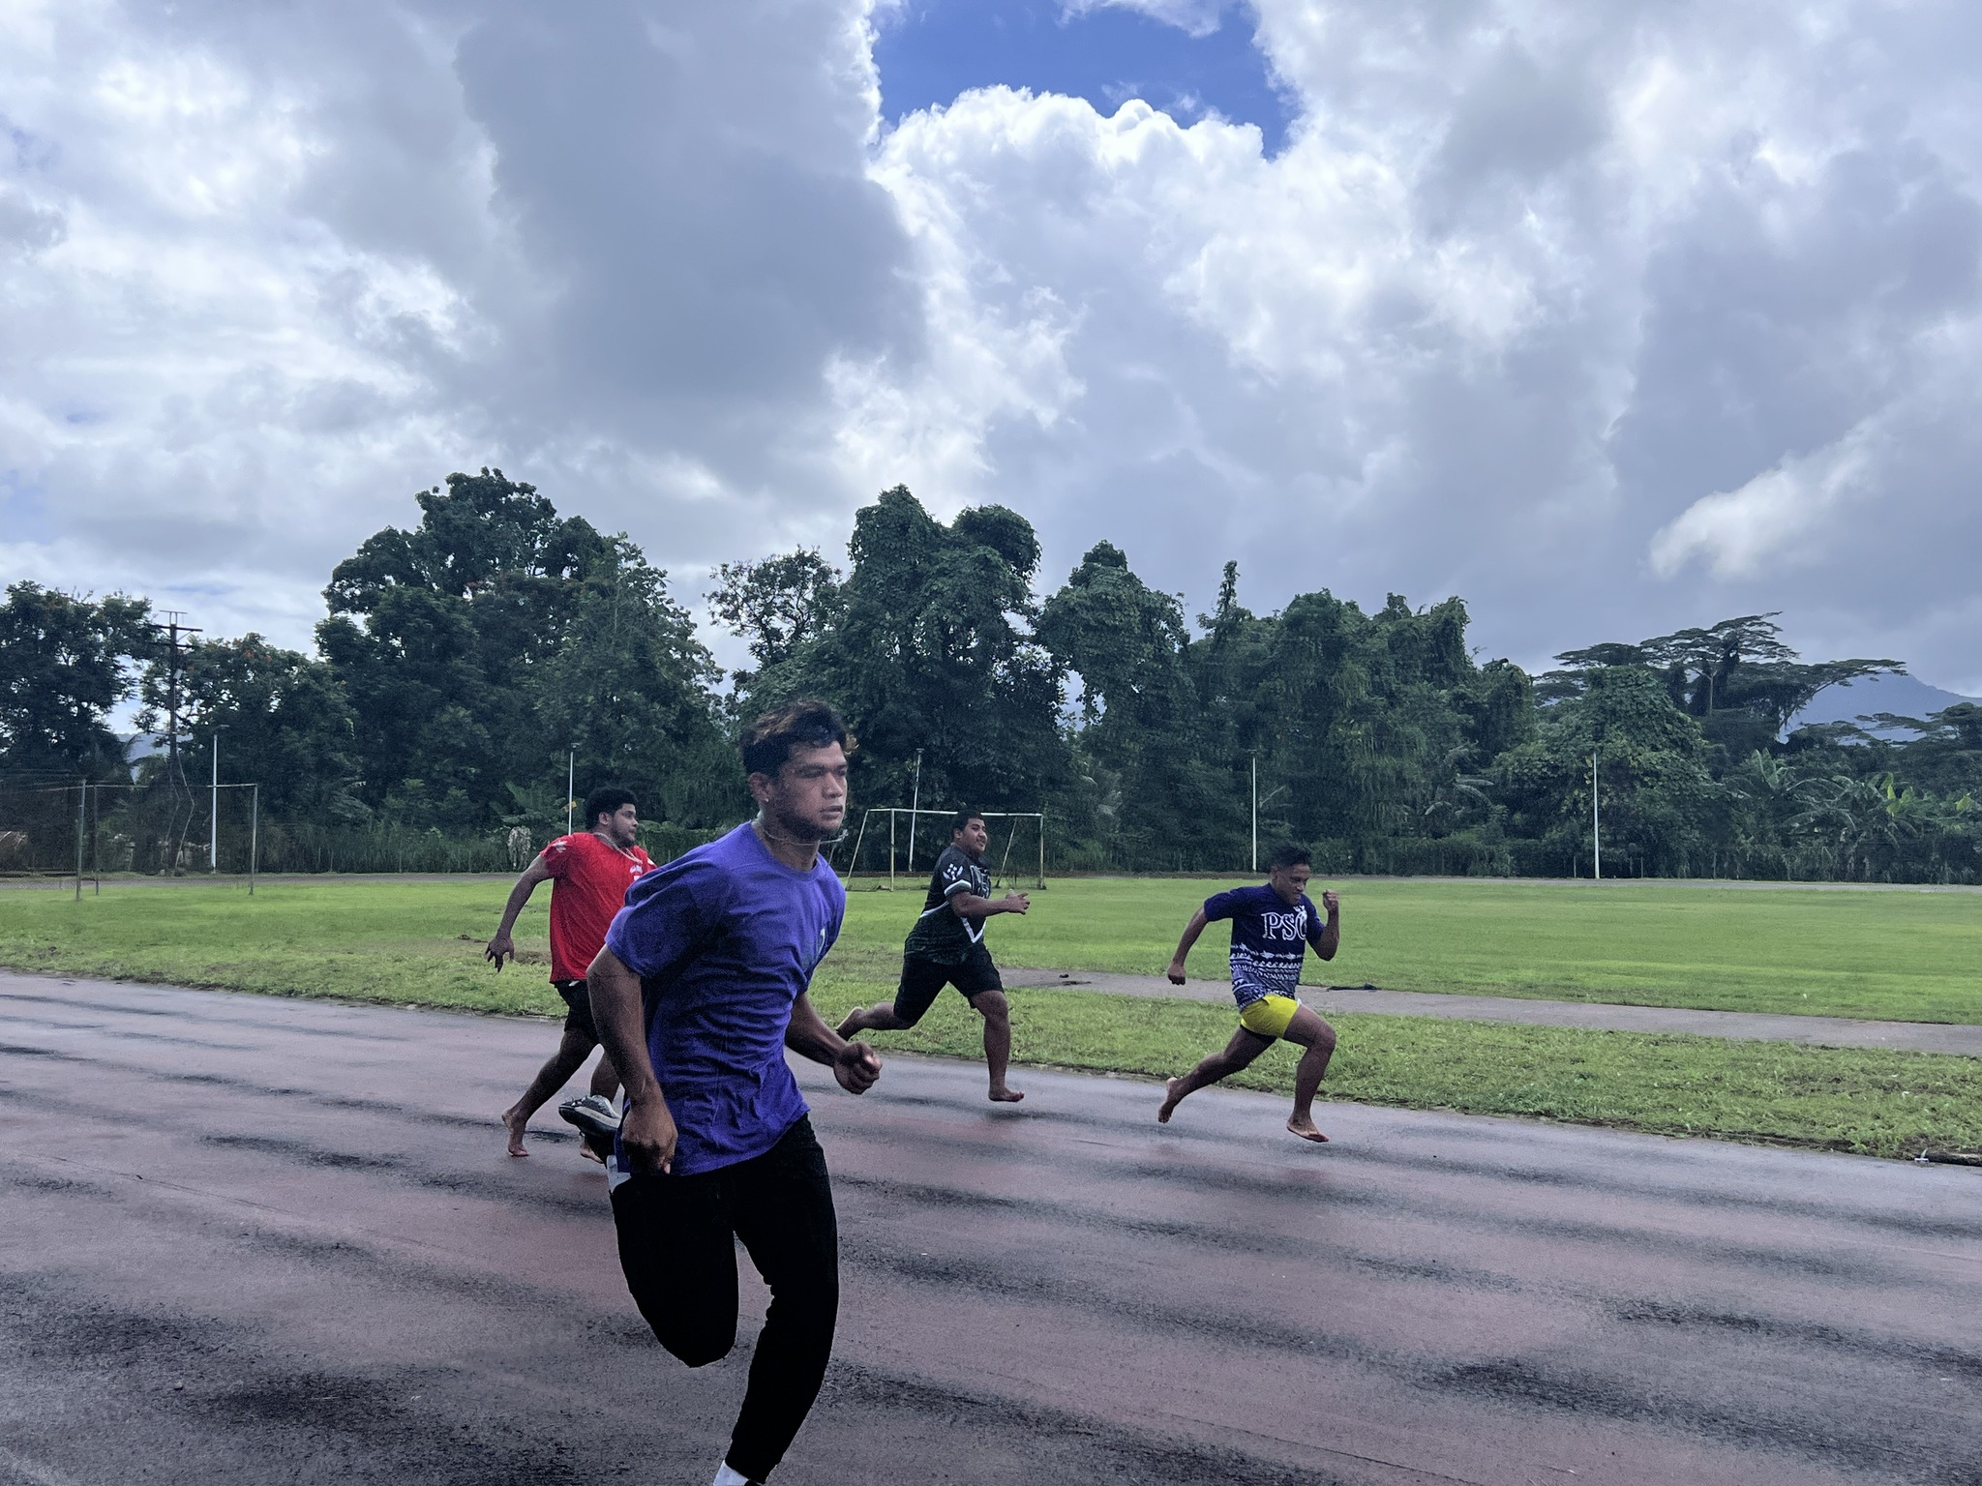
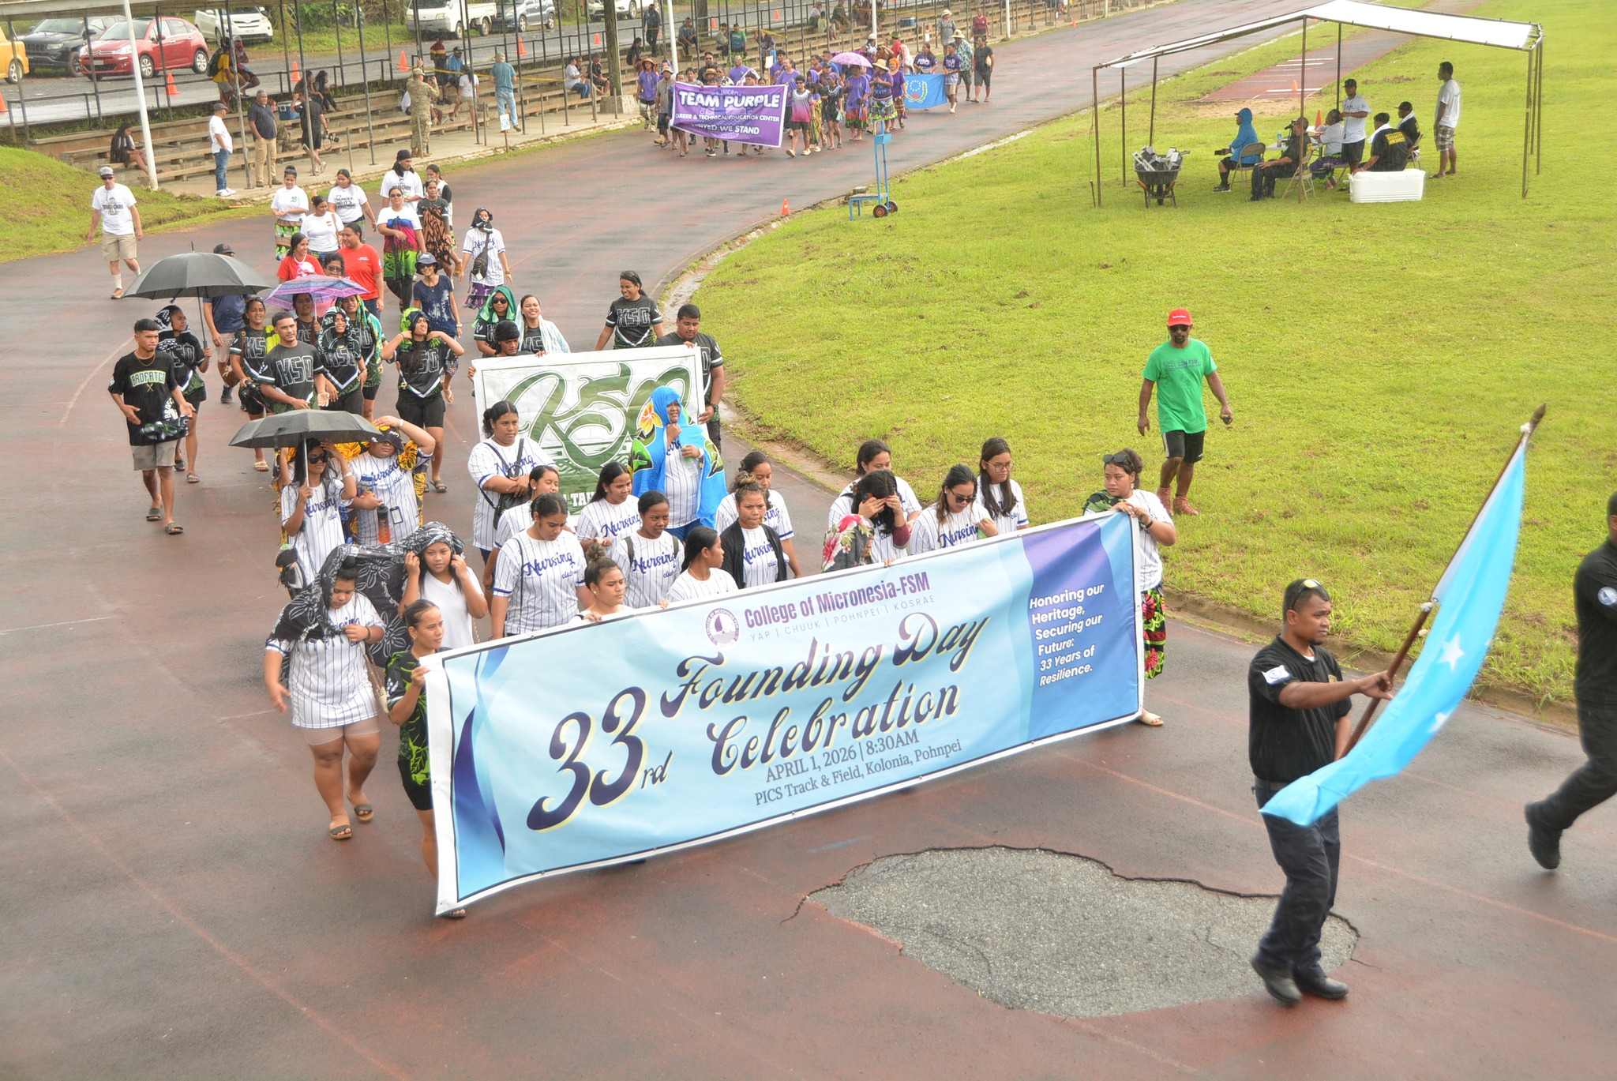
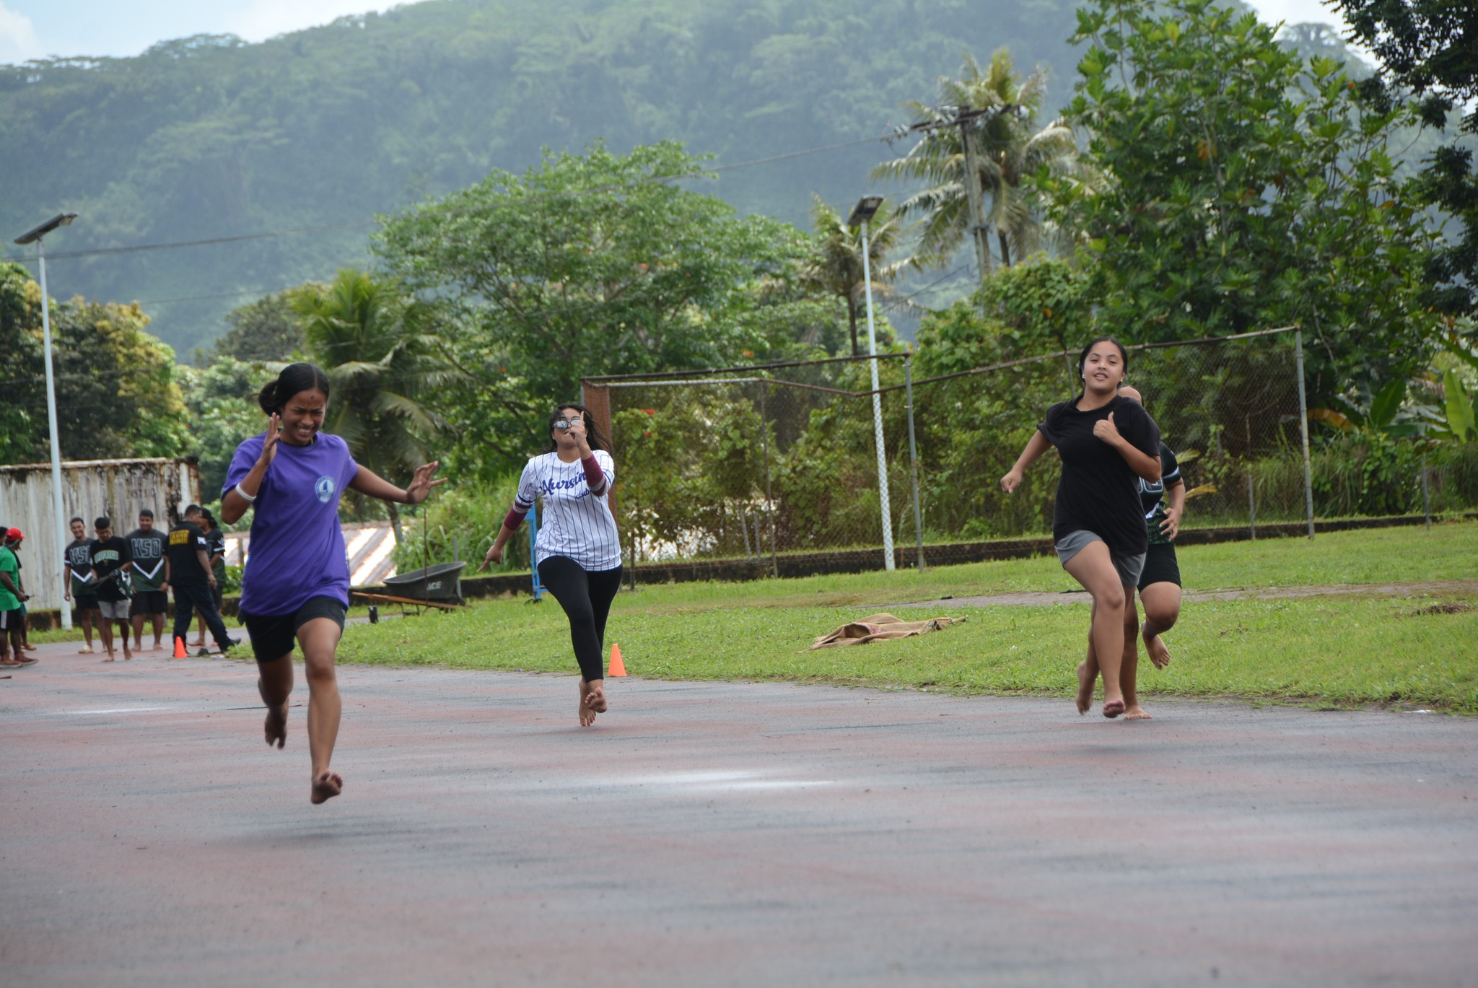
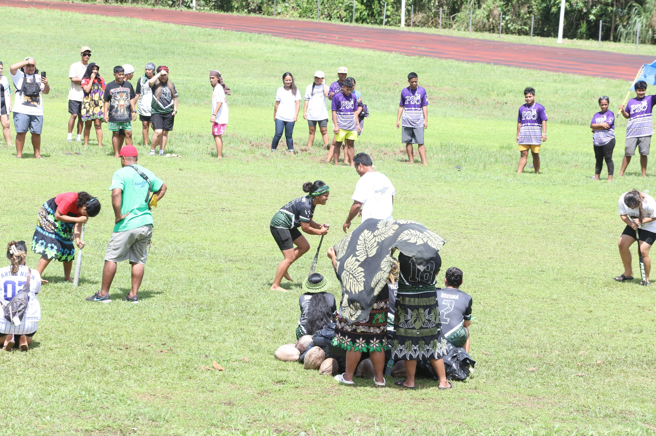
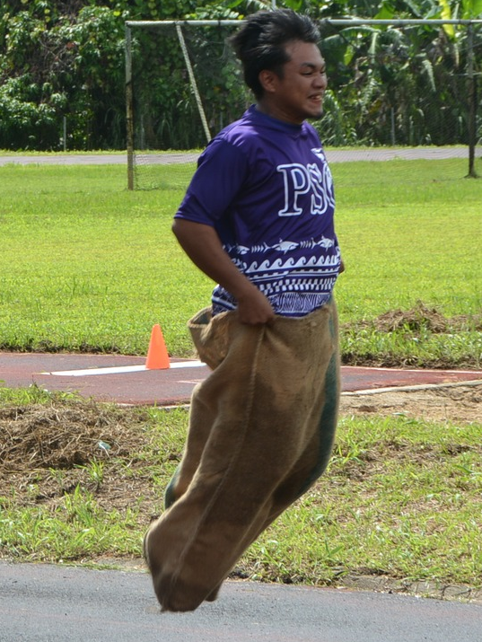
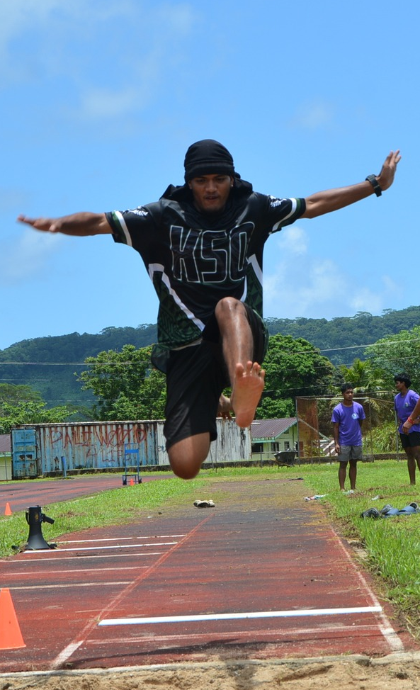
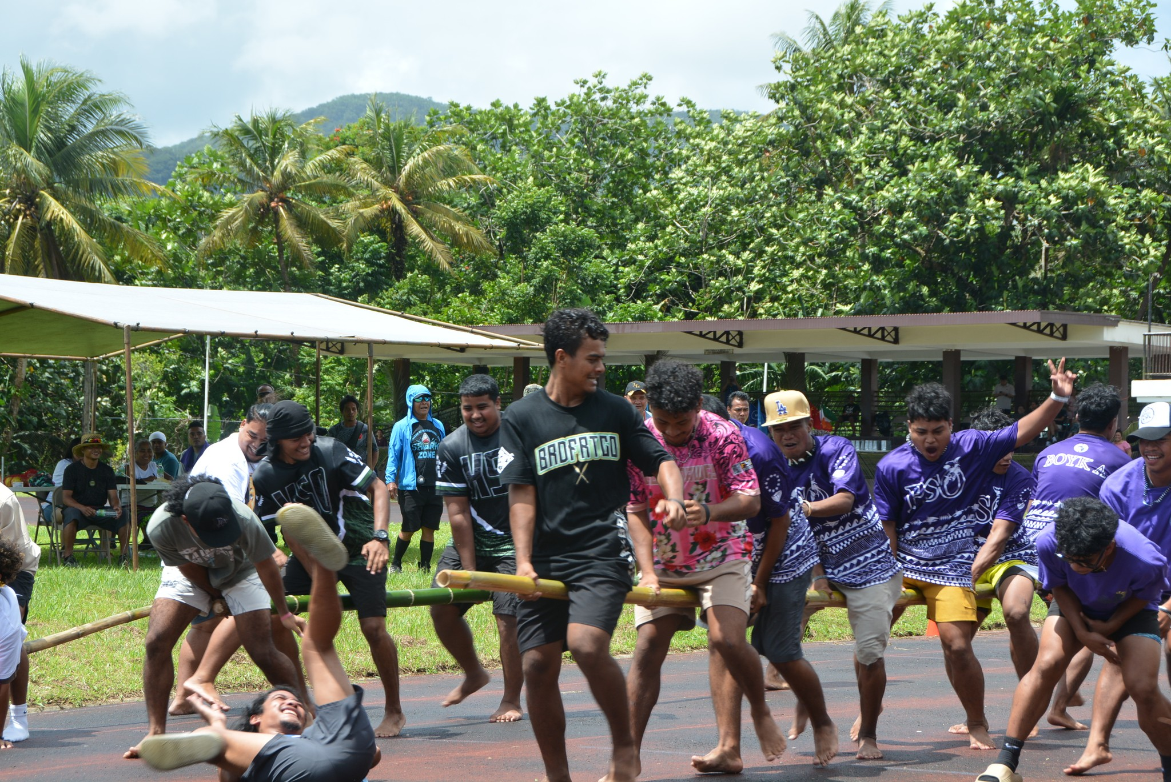
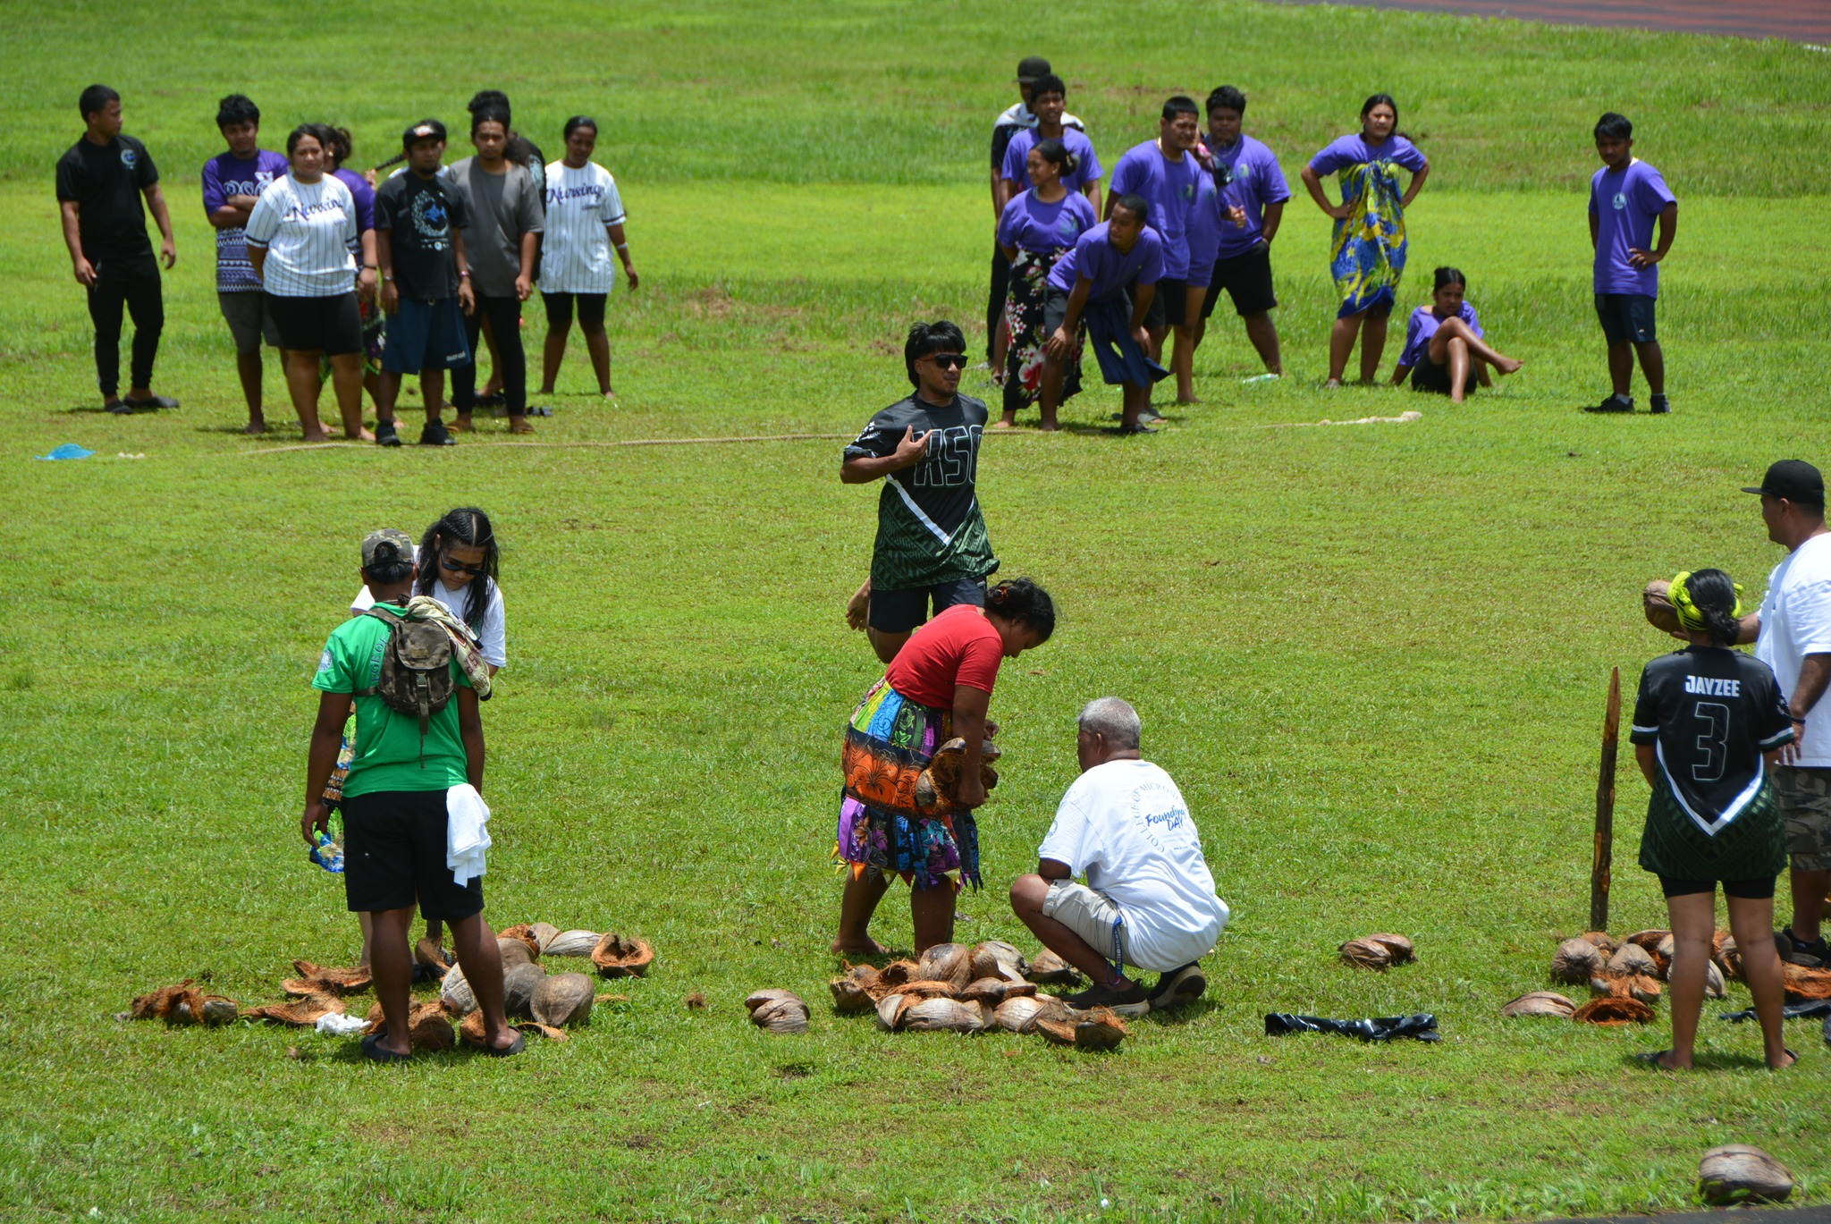
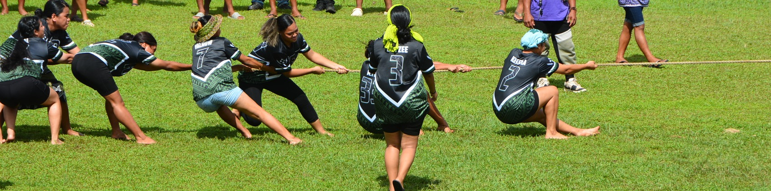
33RD FOUNDING DAY CELEBRATIONS
POHNPEI
Office of the
President
Students Today
Leaders Tomorrow

Slide 23

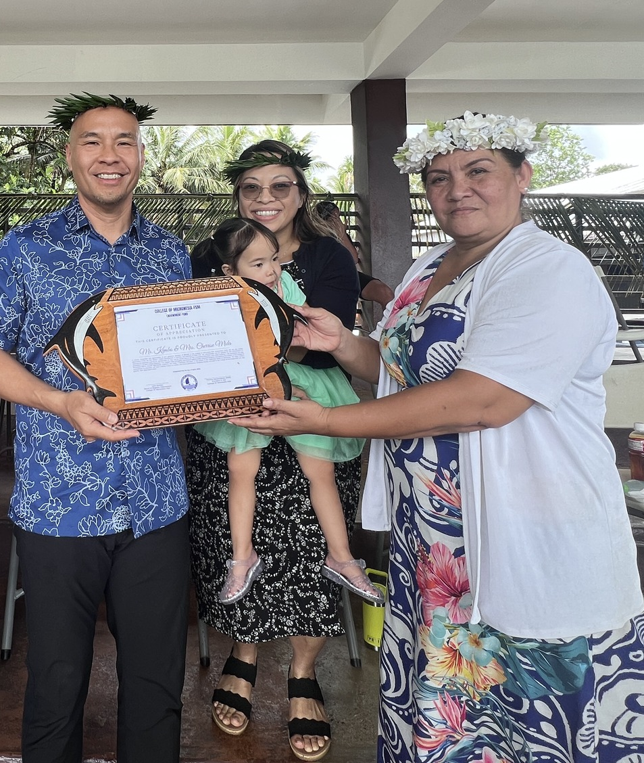






COM-FSM ENDOWMENT FUND-RAISING
2026 GOAL $100,000
DONATION: $10,000
Office of the
President
DONORS
GOVT
CONTRIBUTION
THANK YOU!!!
Students Today
Leaders Tomorrow

Slide 24
ARTIFICIAL INTELLIGENCE @ WORK @ COM-FSM
Office of the
President
https://drive.google.com/drive/folders/1quBXzVh_5zNLlBPFj-MNf867jDcBx76u
Students Today
Leaders Tomorrow

Slide 25
End of Presentation
Thank you!
College of Micronesia-FSM
Yap | Chuuk | Pohnpei | Kosrae
College of Micronesia-FSM is accredited by the Accrediting Commission for Community and Junior Colleges

Slide 26
REFERENCES
Office of the
President
Slide 4
https://www.zabala.eu/news/artificial-intelligence-and-consultancy/
https://comlandgrant.org/
Slide 8
https://www.researchgate.net/figure/The-relationship-between-Data-driven-Data-Aware-and-Data-informed-approaches-Adapted_fig2_338410352
Slide 23
https://www.dreamstime.com/illustration/raffle-prize.html
https://www.facebook.com/photo/?fbid=526769317804281&set=pb.100069327524689.-2207520000
https://www.facebook.com/StellarRichmond/posts/-city-of-richmond-auctionthe-city-of-richmond-is-currently-holding-an-online-auc/1191061589717036/
https://labyrinthinc.com/creating-a-network-of-donors/
https://online.visual-paradigm.com/infoart/templates/tickets/annual-fundraising-dinner-ticket/
Students Today
Leaders Tomorrow

