Slide 1
BOR Meeting
April 7-9, 2025
Presentation by
Gee Leong Bing, Human Resources Director/Acting VPIEQA

Slide 2
Department Structure
Vice President for Institutional Effectiveness & Quality Assurance (VPIEQA)
Director for Information Technology Office (ITO)
Office of Institutional Effectiveness & Quality Assurance (OIE&QA)
Director of Workforce Development Office (WDO)
Director of Communication & Media Office (CMO)
ITO Staff (4)
CMO Staff

Slide 3

Information Technology Office (ITO)
Lead by our IT Consultant, Mr. Dhiraj Bhartu
Assisted by 4 System Specialists
Purpose: To strengthen COM-FSM’s digital infrastructure, expand connectivity, enhance cybersecurity posture and advancing institutional systems in alignment with the 2025-2030 Strategic Plan

Slide 4
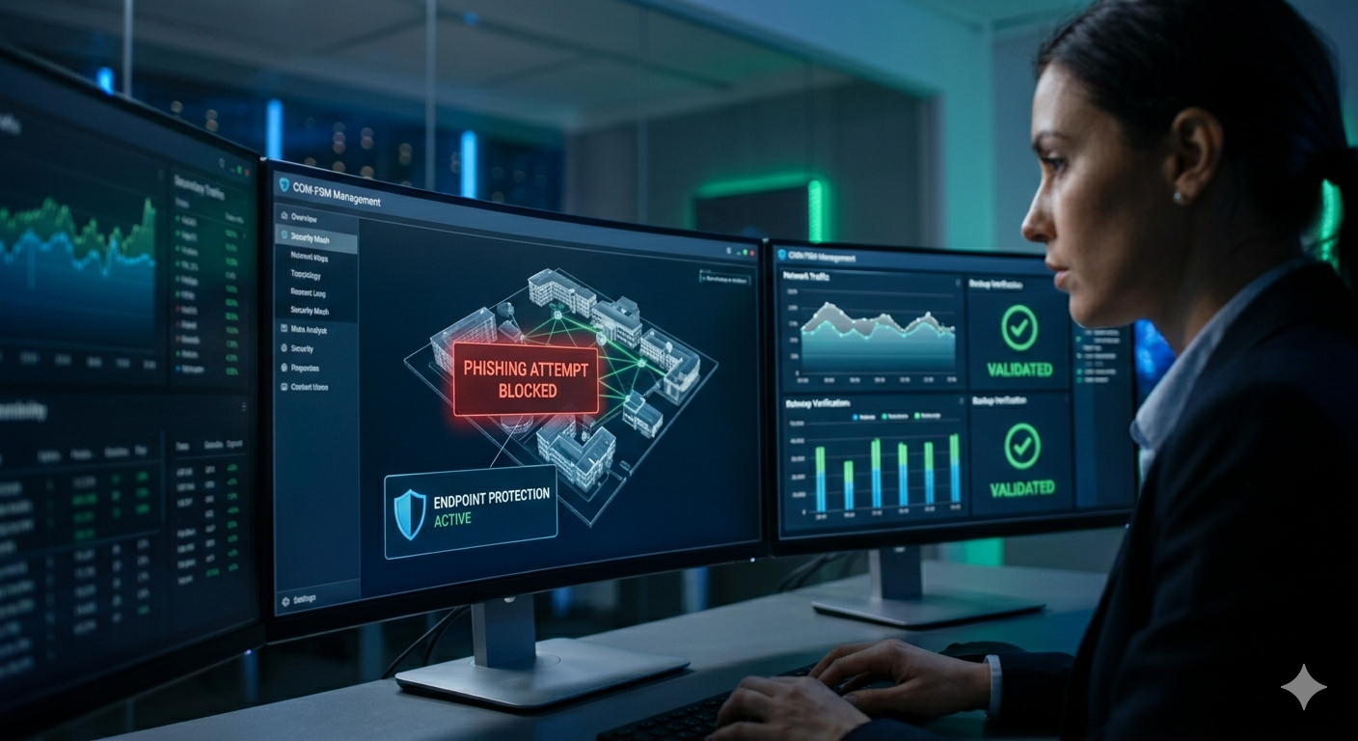
ITO Accomplishments & Future Plans
Key Accomplishments:
  Network Modernization & Infrastructure Upgrades
  Connectivity Enhancement & Starlink Deployment
  SIS, Moodle & AI
  IT Support & Service Delivery
  Cybersecurity & Compliance
Future Plans:
  Complete remaining network upgrades (switches, routers, cabling)
  Further enhance network redundancy and monitoring systems.
  Expand AI implementation.
  Continue PowerBI rollout across all departments.
  Strengthen backup, disaster recovery, and business continuity planning.
  Advance system integrations (HR, Finance, SIS).

Slide 5


Office of Institutional Effectiveness & Quality Assurance (OIE&QA)
Lead by our Institutional Researcher (Mr. Malintha Perera)
Purpose: To strengthen the College’s data driven decision-making processes through the continuous enhancement of Power BI dashboards and reporting tools. employee improvement programs

Slide 6
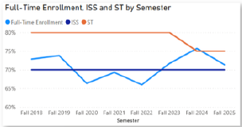

OIE&QA Accomplishments and Future Plans
Key Accomplishments:
  Provided a wide range of data requests across the college
  Successful completion and submission of the Integrated Postsecondary Education Data System (IPEDS) reports ahead of the prescribe deadline (HR, Business Office and Financial Aid)
  Submission of a project proposal to APIA Scholars for their Data Voyage 2.0 co-investigative research initiative focused on strengthening transfer pathways which was awarded late last year ($20k)
  Continue to expand public-facing Power BI dashboards. During this term, new dashboards were developed and published to display progress on key performance indicators (KPIs) and Institutional Set Standards (ISS)
Future Plans:
  Conduct other surveys to compliment the Data Voyage Project
  Develop more Power BI dashboards in the areas of HR and other offices

Slide 7

Workforce Development Office (WDO)
New Office as of 2024 lead by Director Rencelly Nelson
Purpose: To strengthen and provide training opportunities for COM-FSM employees across all campuses based on training needs and employee performance evaluations/development plans

Slide 8

WDO Accomplishments and Future Plans
Spotlight Training in:
  Moodle for staff members
  Microix Basic
  Basic Project Management
Mental Health Awareness & Suicide Prevention Training to:
  Employee groups (RH and Security Officers)
  Student groups (National and Kosrae Campus)
Future Plans
  Development of new policies that will enable the Office to function effectively and efficiently
  Aiming to set up the Office to provide training opportunities for public and private organizations
  Develop microlearning opportunities

Slide 9

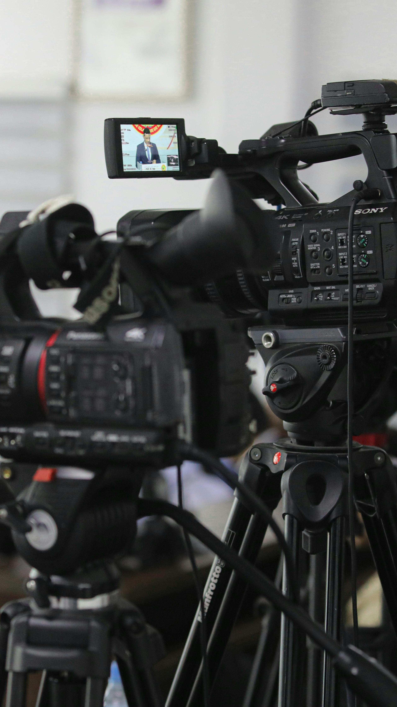

Communication & Media Office (CMO)
  A new Office as of 2025 lead by Director Juan Paulo Santos
  Assisted by a Media Technician
  Purpose: To strengthen and evolve the College’s brand identity

Slide 10
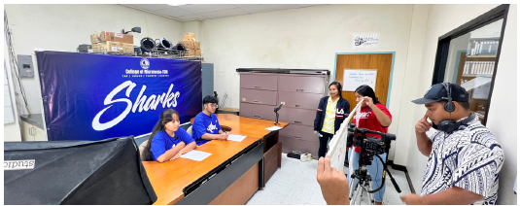
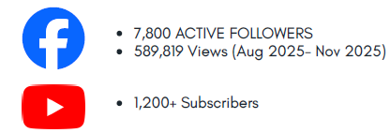
Key Accomplishments and Future Plans
Key Accomplishments:
  Revitilization of the Media Arts Club (MIC) which provides a creative platform for students to produce high quality media content including video production, photography, and graphic designs that aligns with and promotes the College’s mission
  Maintaining the Kamorale Sharks Newsletter
  Maintaining the College’s presence of Kaselehlie Press
  Maintaining the graphic designes and promotional ads for the College
Future Plans:
  Updating of Campus maps
  Improving the College’s image such as signages and other initiatives

Slide 11
Thank you!!

