Slide 1
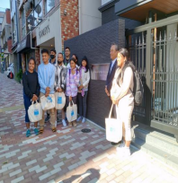

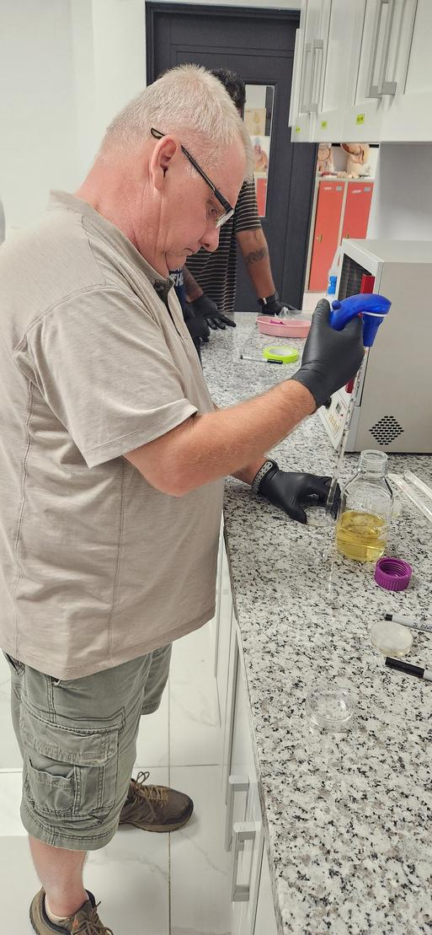
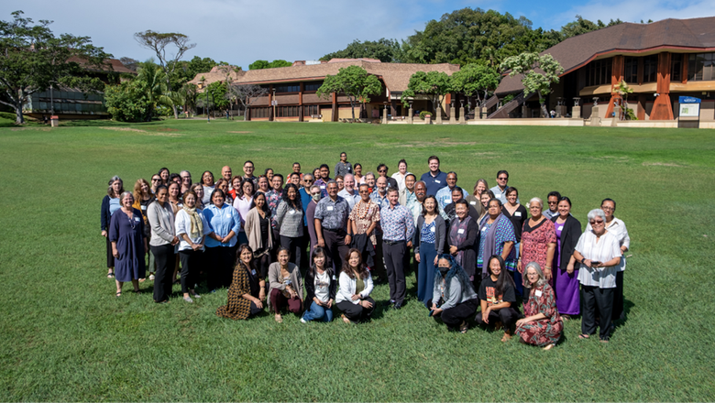
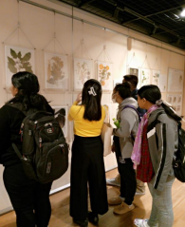
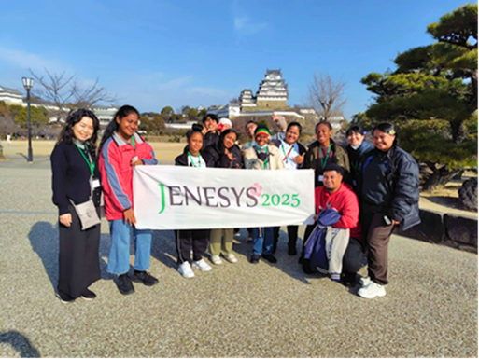
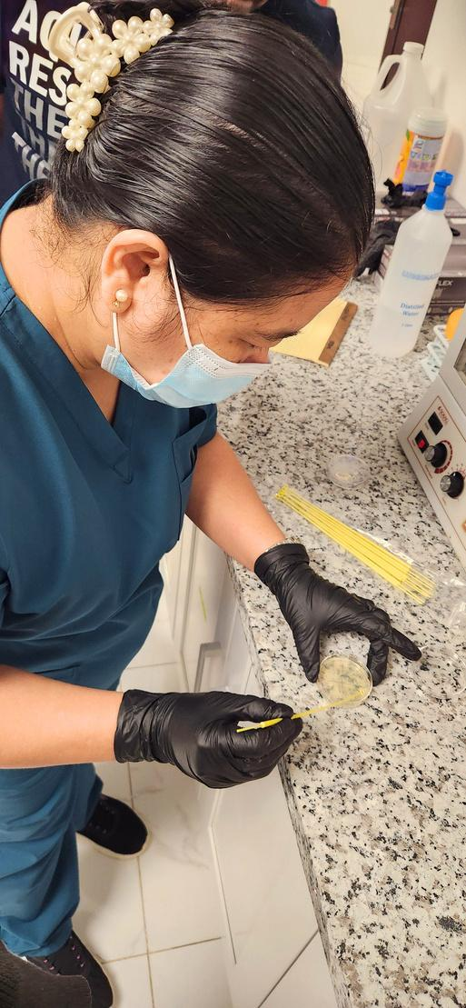
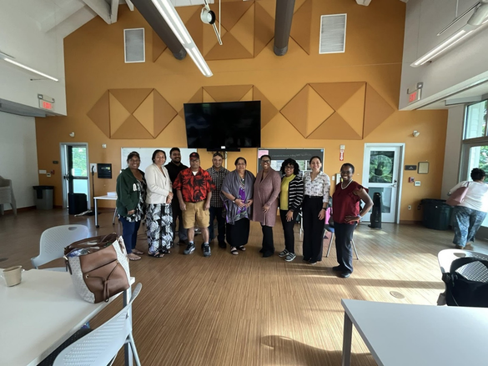
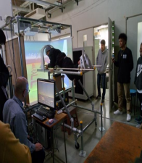
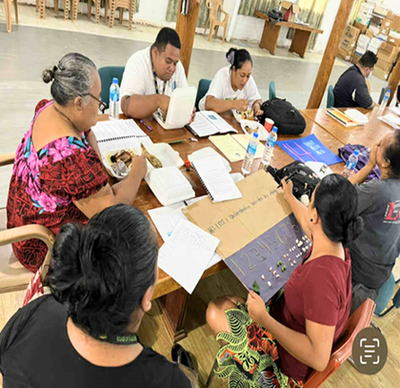
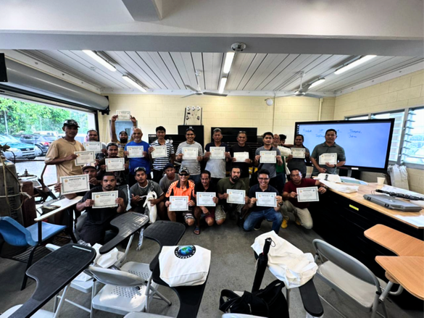
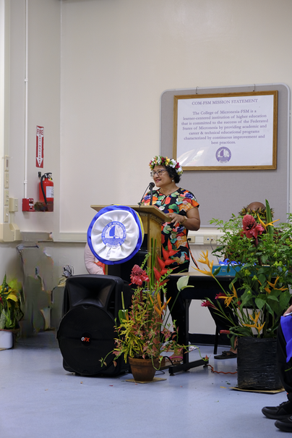
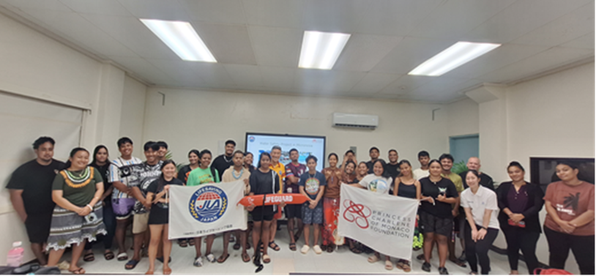
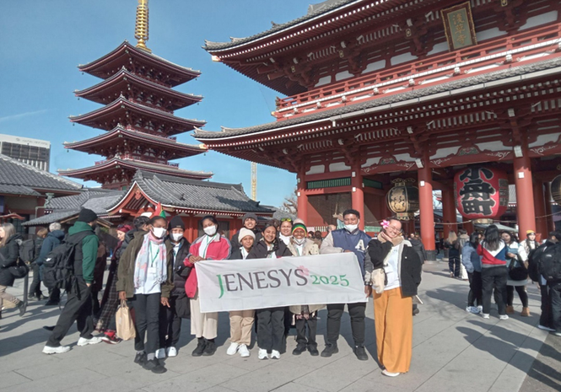




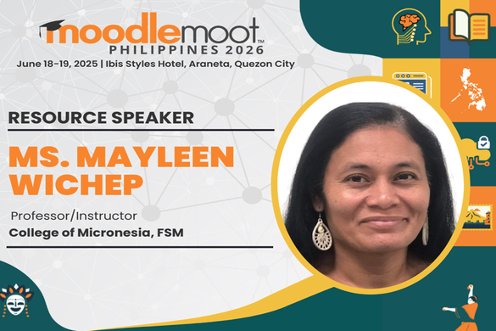
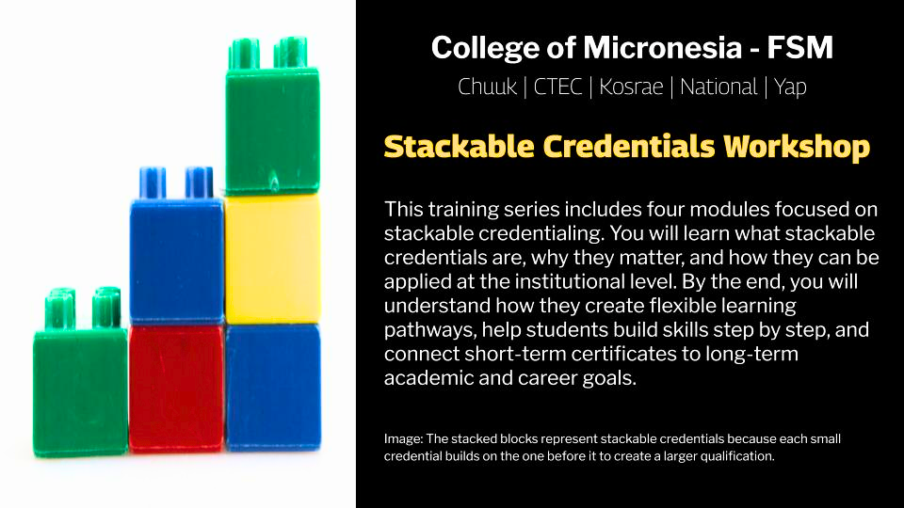
Department for Instructional Affairs
Report to the Board of Regents
2026 1ST QUARTER REPORT
Delihna Ehmes - VPIA
Office of the Campus Dean
Office of the Academic Affairs
Learning Resource Center
Instructional Coordinator

Slide 2
IA Inside Reports
Office of the Campus Dean
Office of the Academic Affairs
Learning Resource Center
Instructional Coordinator
IA_AUO_1. Provide guidance to development, delivery, and enhance quality of all instructional programs to meet high standards of quality and relevance.
IA_AUO_2. Provide support for the efficient management and development of all library resources and collections across state campus libraries to meet diverse user needs.
IA_AUO_3. Provide support for ongoing professional development to enhance instructional effectiveness and learning support services.
Strengthening Faculty
Chuuk Campus Dean Highlights
IA_AUO_4. Establish a new or strengthen existing internal and external stakeholder collaboration to enhance educational opportunities and outcomes
IA_AUO_5. Implement systematic assessment protocols in support of equitable student achievement.

Slide 3
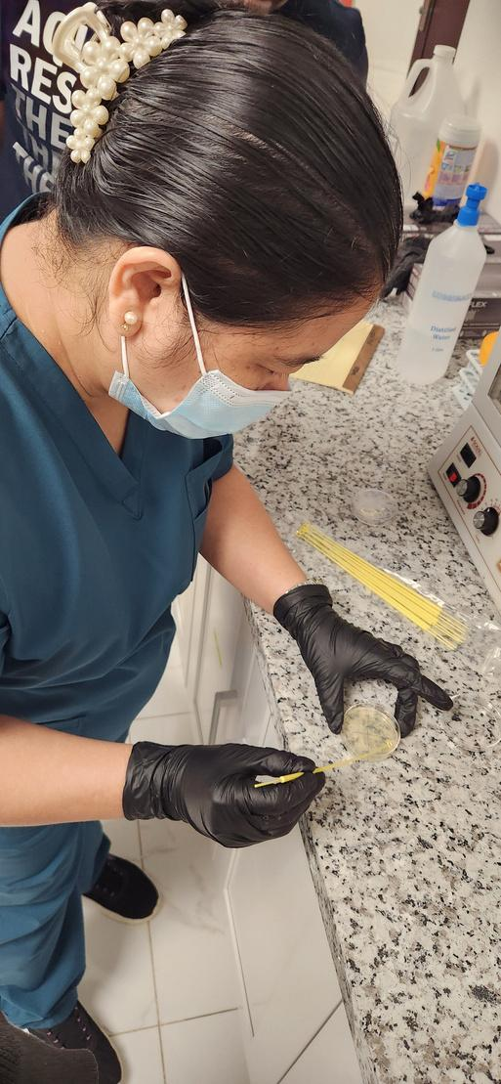
IA_AUO_1. Provide guidance to development, delivery, and enhance quality of all instructional programs to meet high standards of quality and relevance.
Part-time Instructor Pool & Course Scheduling: The VPIA office works with Deans and Institutional Research to enhance the part-time instructor pool and align course schedules with program and student needs.
STEP-UP Training: Four faculty members from the National Campus and CTEC participated in STEP-UP Training, gaining practical lab experience
Educational Technologist supported teaching through Moodle and improved course access.
UH Mentorship for DDFT Students: Three University of Hawaii medical students mentored Doctors and Dentists for Tomorrow (DDFT) students through job shadowing, enhancing the healthcare workforce pipeline.
Class 4 Master and Marine Engineering Program: The Fisheries and Maritime Institute launched its inaugural Class 4 Master and Marine Engineering Program, enrolling ten seafarers for officer-level training in navigation and marine engineering.
NSTT Workshop: COM-FSM team members attended NSTT workshops in Yap and Chuuk, contributing to teacher training, providing window for alignment to education programs..
Office of the Campus Dean
Office of the Academic Affairs
Learning Resource Center
Instructional Coordinator

Slide 4
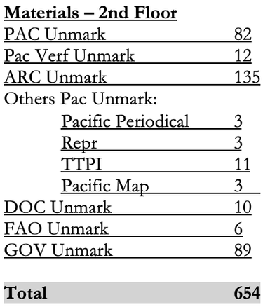
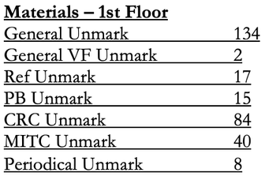
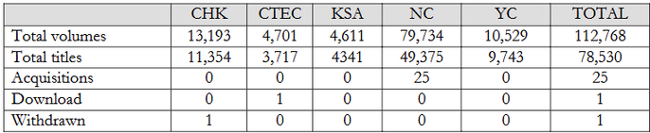
IA_AUO_2. Provide support for the efficient management and development of all library resources and collections across state campus libraries to meet diverse user needs.
Missing Materials: An inventory found gaps, and staff are working to address the challenge while reviewing subscriptions based on budget.
LRC Programs and Services: The LRC added new materials, provided student resources like headphones, and supported learning through library instruction and staff development.
Collection Development: National Campus has the largest collection, while other campuses maintain smaller collections that still meet student needs.
Inventory and Subscription Re-Evaluations: Materials and subscriptions were reviewed to ensure accuracy and support program and community needs.
Visitors: CTEC had 2 visitors, while National Campus had 36 visitors including students, staff, and peer coaches.
Campus Usage Summaries: National Campus had the highest usage, followed by Chuuk, while CTEC, Kosrae, and Yap showed moderate to lower activity across services.
Office of the Campus Dean
Office of the Academic Affairs
Learning Resource Center
Instructional Coordinator

Slide 5
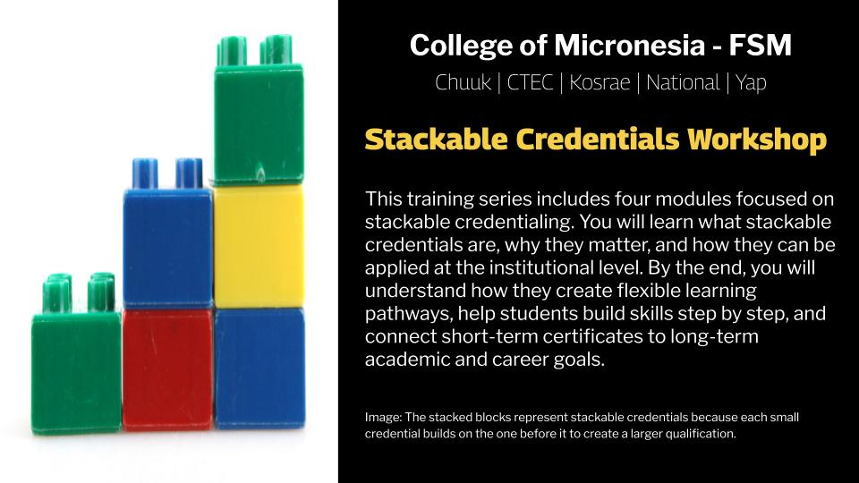
IA_AUO_3. Provide support for ongoing professional development to enhance instructional effectiveness and learning support services.
“Teaching Professor” Program: Seventeen participants (14 faculty and 3 ACE mentors) enrolled in a 10-hour program focused on integrating critical thinking into course design, assignments, assessments, and student learning.
“Stackable Credentials” Training Session: A 4-week Moodle-based training launched on March 2, 2026 engaged over 90 participants in learning and applying stackable credentials, culminating in program presentations for implementation.
Transparency, Storytelling, and Value Literacy Project: COM-FSM representatives attended an ACCJC workshop in Hawai‘i focused on using ROI data to improve student outcomes and social mobility.
Designing Workforce-Embedded Pathways: A COM-FSM team participated in a workshop on aligning academic programs with industry needs, leading to the development of the Stackable Credentials Moodle workshop page.
Training for Yap R&D Department: The Electrical Program will deliver a 5-week training starting April 13, 2026 for 20 trainees, focusing on safety, residential systems, and electrical maintenance.
EDA Health Care Group Visit: The EDA Health Care Group will collaborate with COM-FSM and Pohnpei State Health Services to provide clinical training, including BLS, oral health, and simulation activities for DDFT and Nursing students.
Office of the Campus Dean
Office of the Academic Affairs
Learning Resource Center
Instructional Coordinator

Slide 6
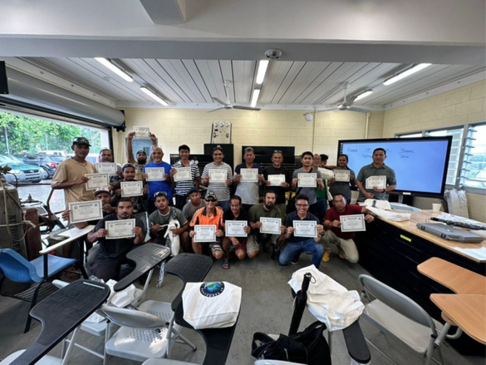
IA_AUO_4. Establish a new or strengthen existing internal and external stakeholder collaboration to enhance educational opportunities and outcomes
JENESYS Program – Two students gained experience in disaster preparedness, climate change, and cultural exchange.
Water Safety Training – Students learned basic lifesaving and first aid skills.
RAC Training – Technicians were trained to safely handle modern refrigerants.
Mono No Aware Lecture – A session highlighted Japanese culture and scholarship opportunities.
Care Training – Nursing students will receive training in maternal and neonatal care.
MoodlemootPH 2026 – A faculty member was selected as an international speaker.
Office of the Campus Dean
Office of the Academic Affairs
Learning Resource Center
Instructional Coordinator

Slide 7
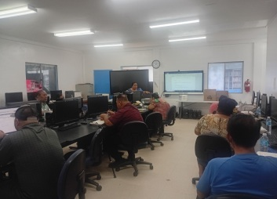
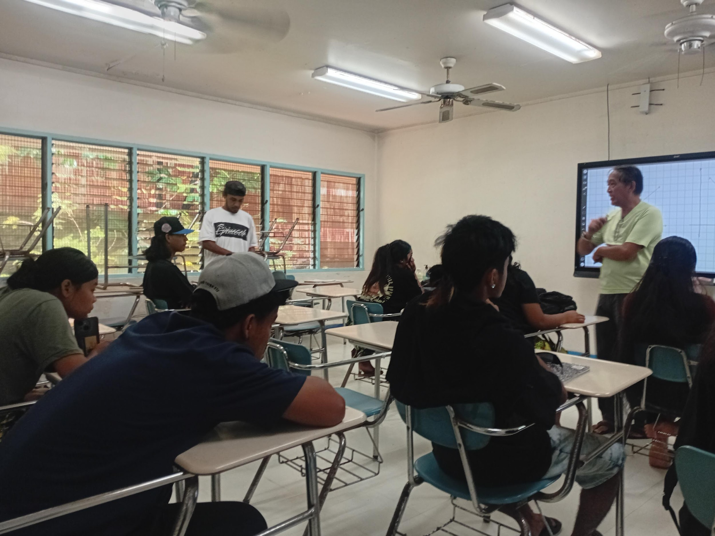
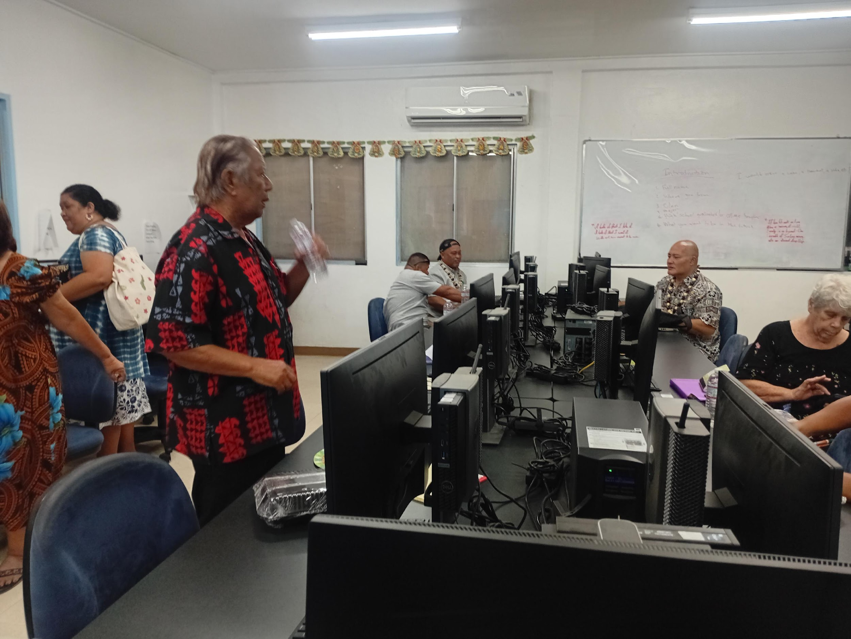
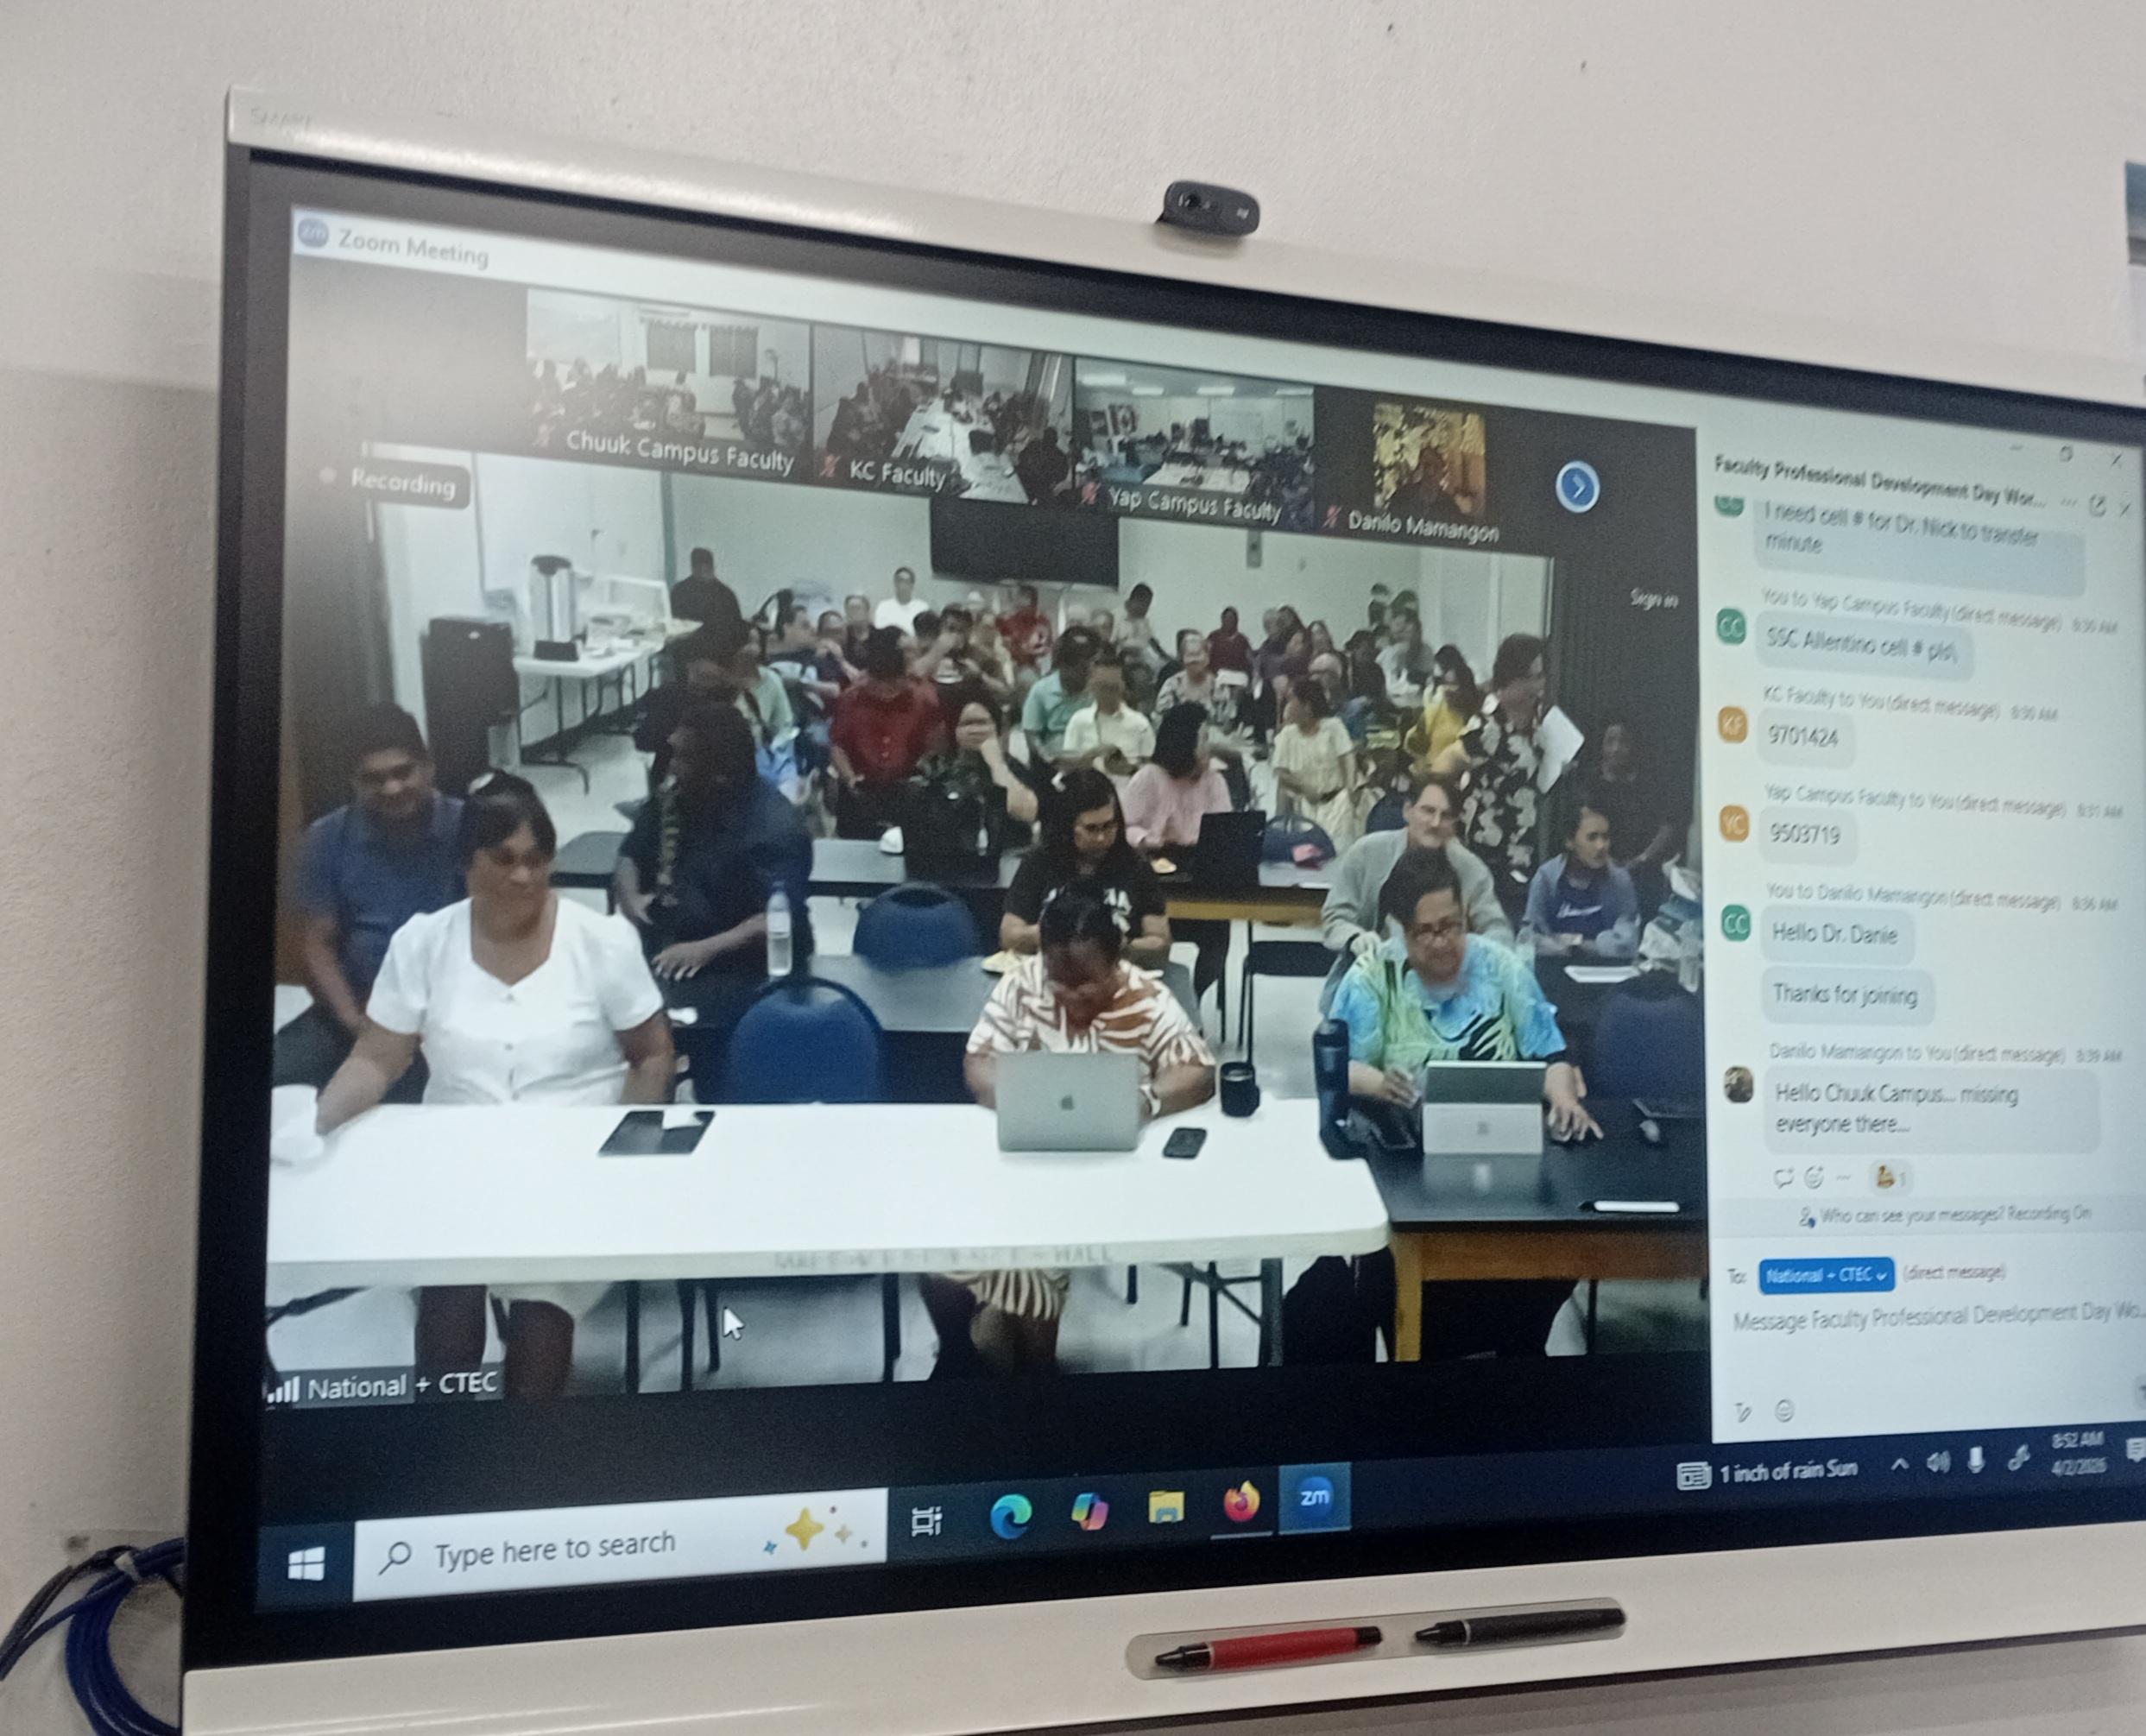
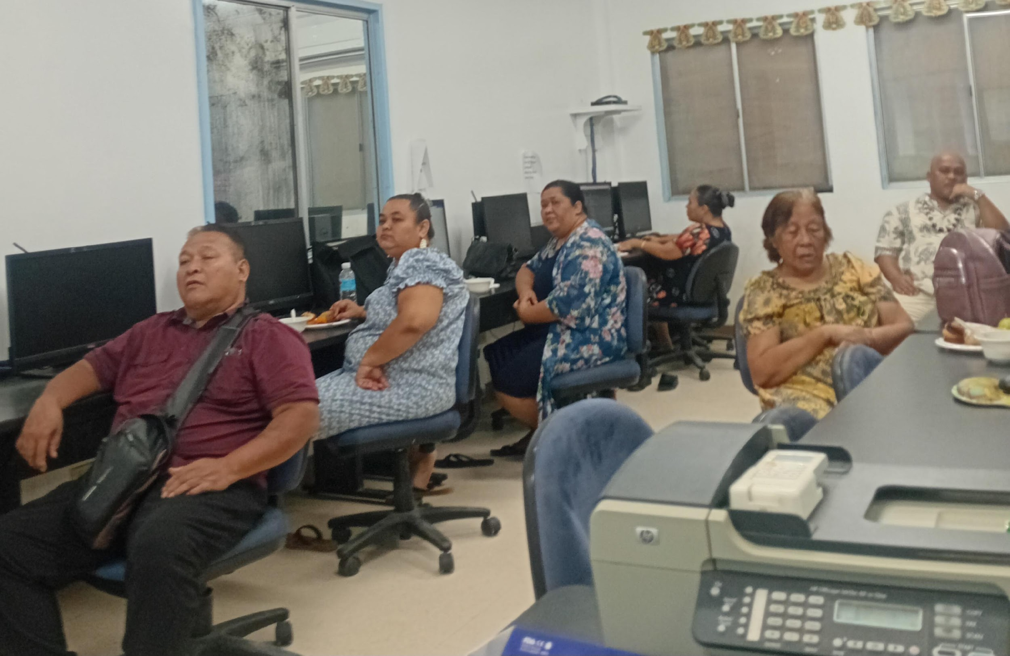
Goal 1 ( Innovation): Ensure delivery of Instructional Services for Student Achievement
Faculty Meeting ( January 21)- Organize Spring 2026 Classroom Observation, Planning of Summer 2026 and Fall 2026 Course Schedule. Track students’ performance before Early Warning Deficiency and Midterm Deficiency. Identify Students’ to be award
Faculty Classroom Observation ( February 17)- Spring 2026 Instructor pair-up with instructors from different programs to observe
Faculty Meeting ( March 25) – Encourage to take part in “Stackable Credential” training and to complete modules for each week. Presentation for Bookkeeping Program
Spring 2026 Professional Development Day ( April 2)- Chuuk Campus present Bookkeeping program
Spring 2026 Course Offer- 36 Face-to-Face and 2 online (Math Courses)
Office of the Campus Dean
Office of the Academic Affairs
Learning Resource Center
Instructional Coordinator

Slide 8
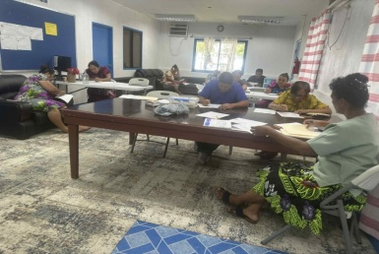
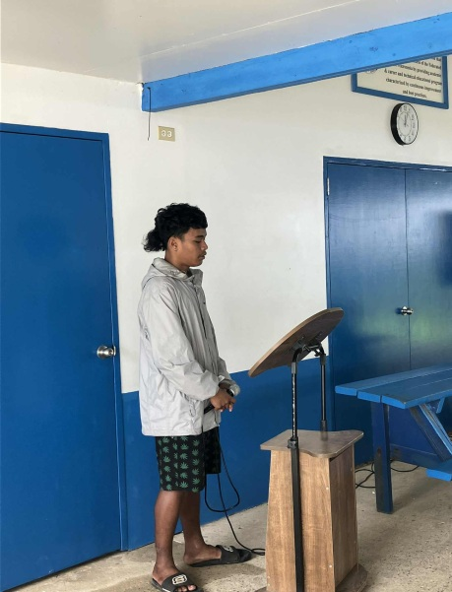
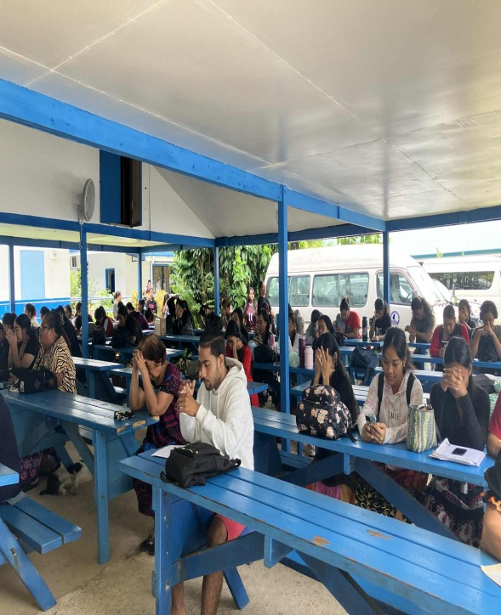
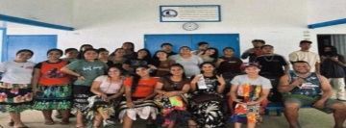
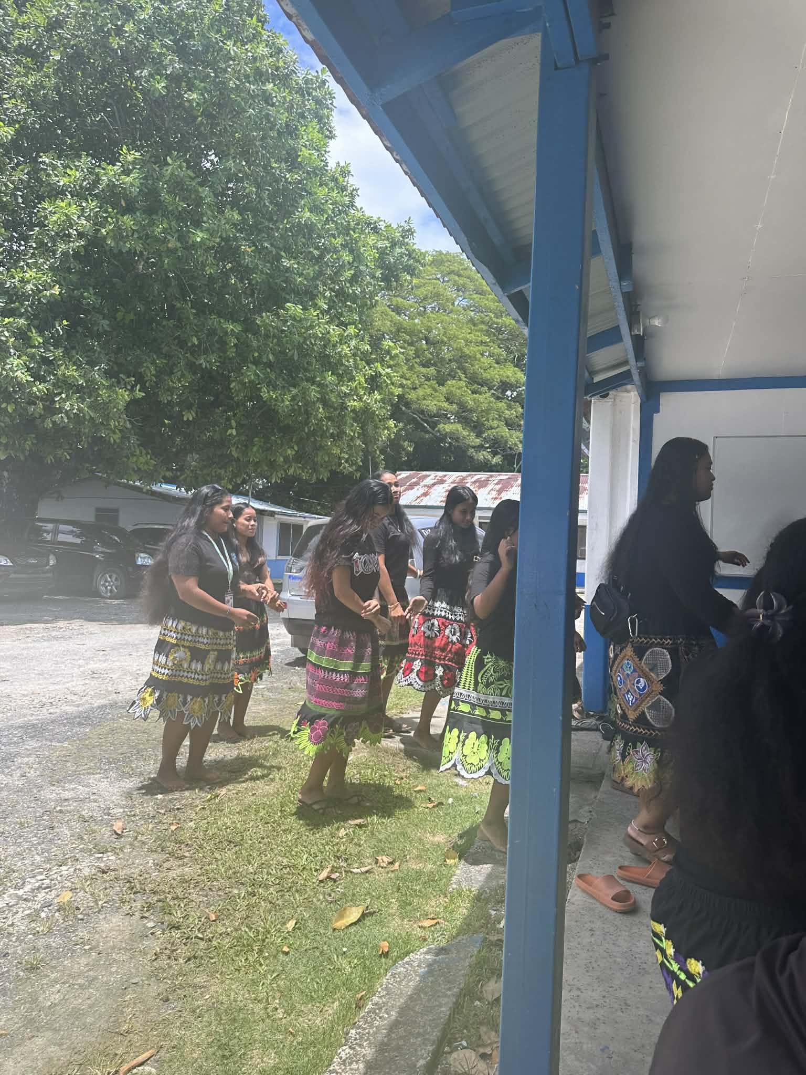
Goal 2 ( Access): Ensure provision of services that support learning and student Services
Food Processing Presentation ( January 23)- CRE EFNEP doing a presentation on food processing with employees and faculty
All-Campus Meeting ( February 4th)- Conducted by SBA Council- Vice President was the MC for the day- 22 Employees and 51 students attended this meeting.
Student Welcoming Party ( February 7th)- Spring 2026 welcoming sponsored by SBA Council for all students to celebrate beginning of the semester with collaboration of SBA Advisor, Regional Reps and Student Services Staff
Spring 2026 Tutorial Services- 3 hired tutors, tutoring in English Courses, Computer and Education Courses
Student Talent Show ( March 13)- Students performed any talent either dance, song and skit organized by SBA Council and Student Services Department

Slide 9
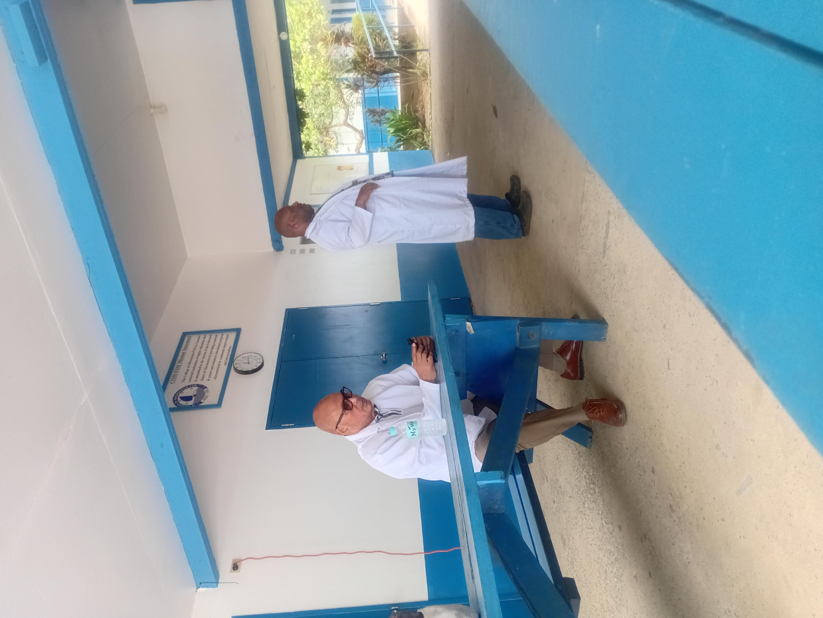
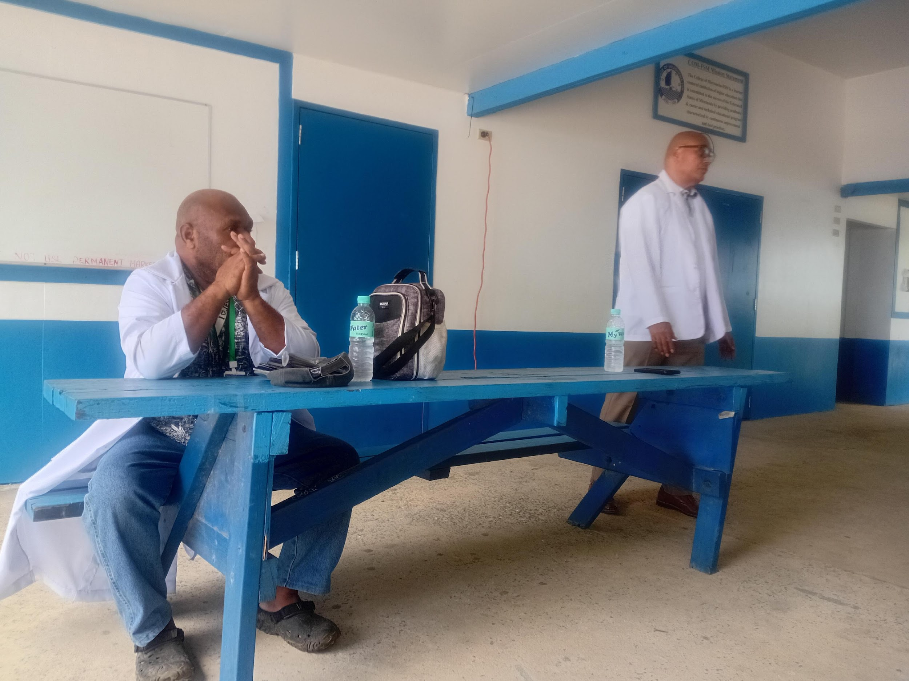
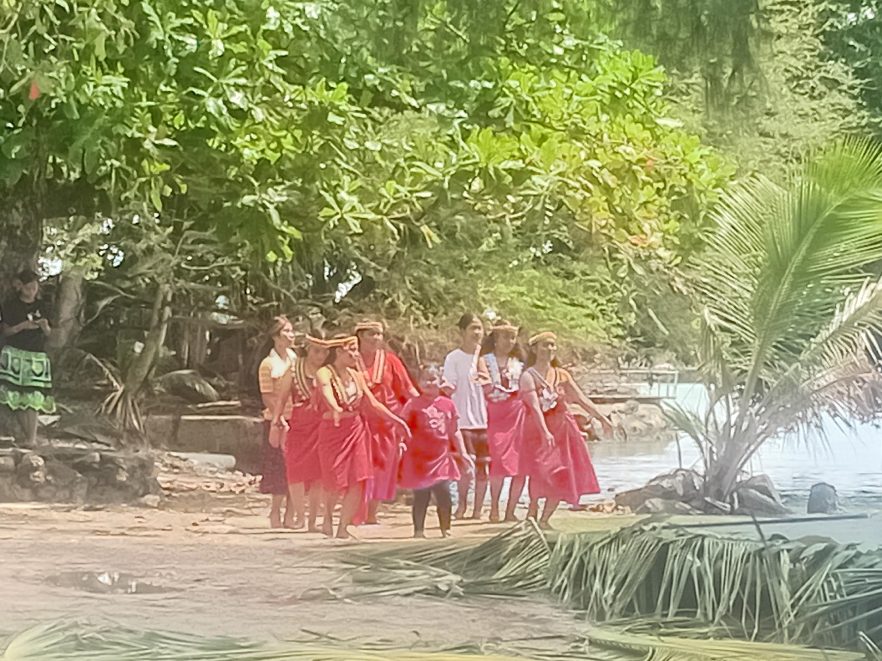
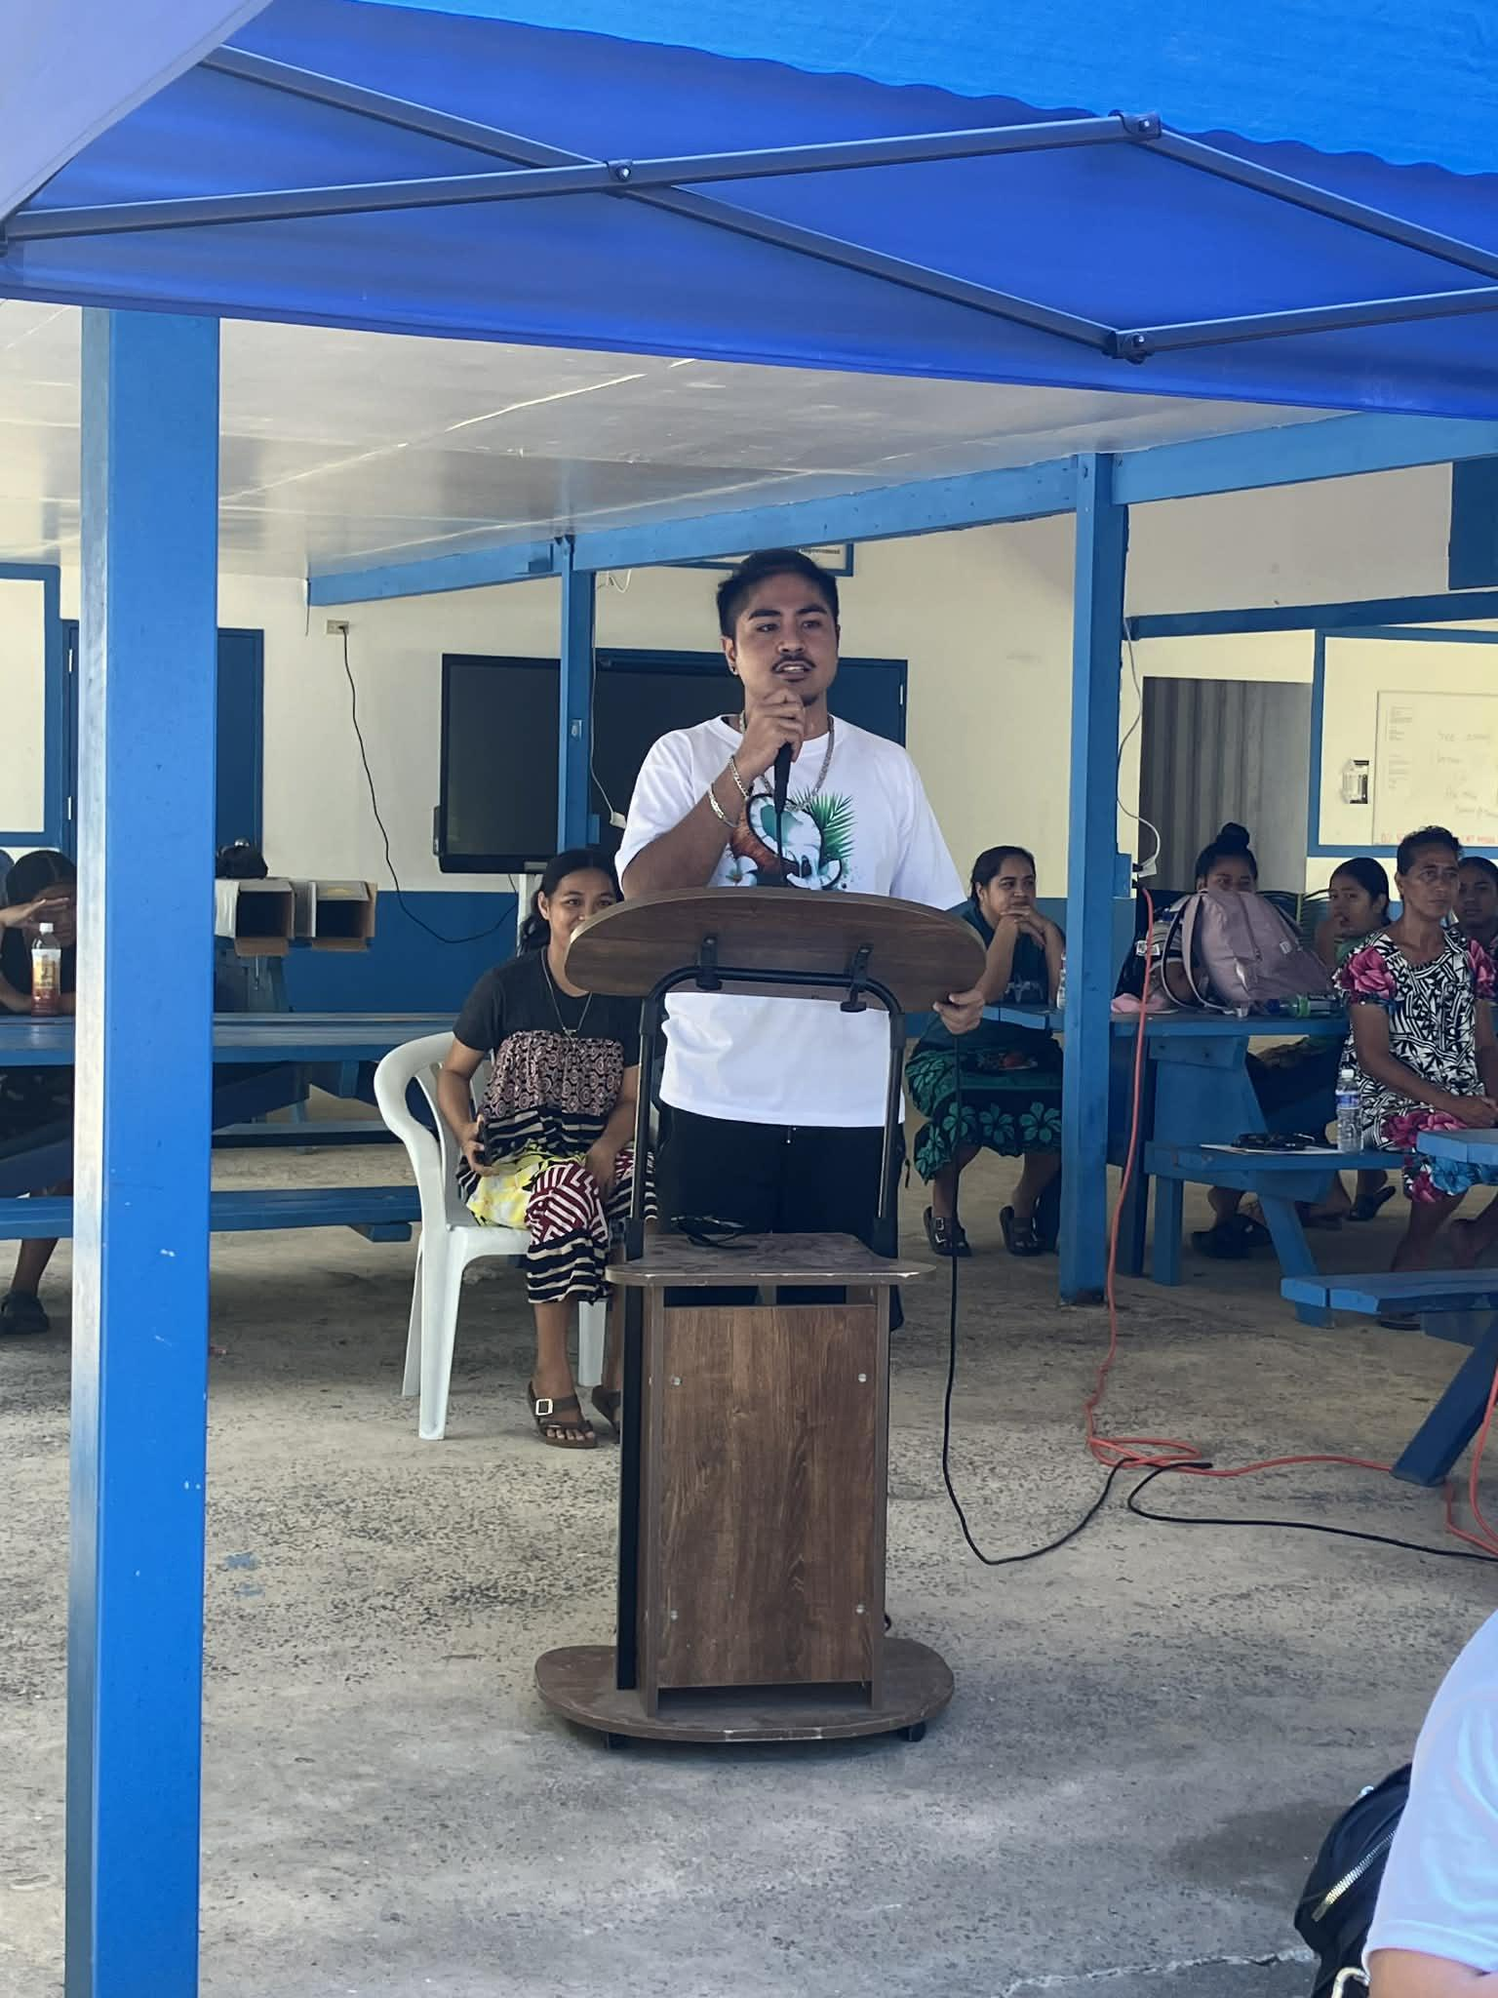
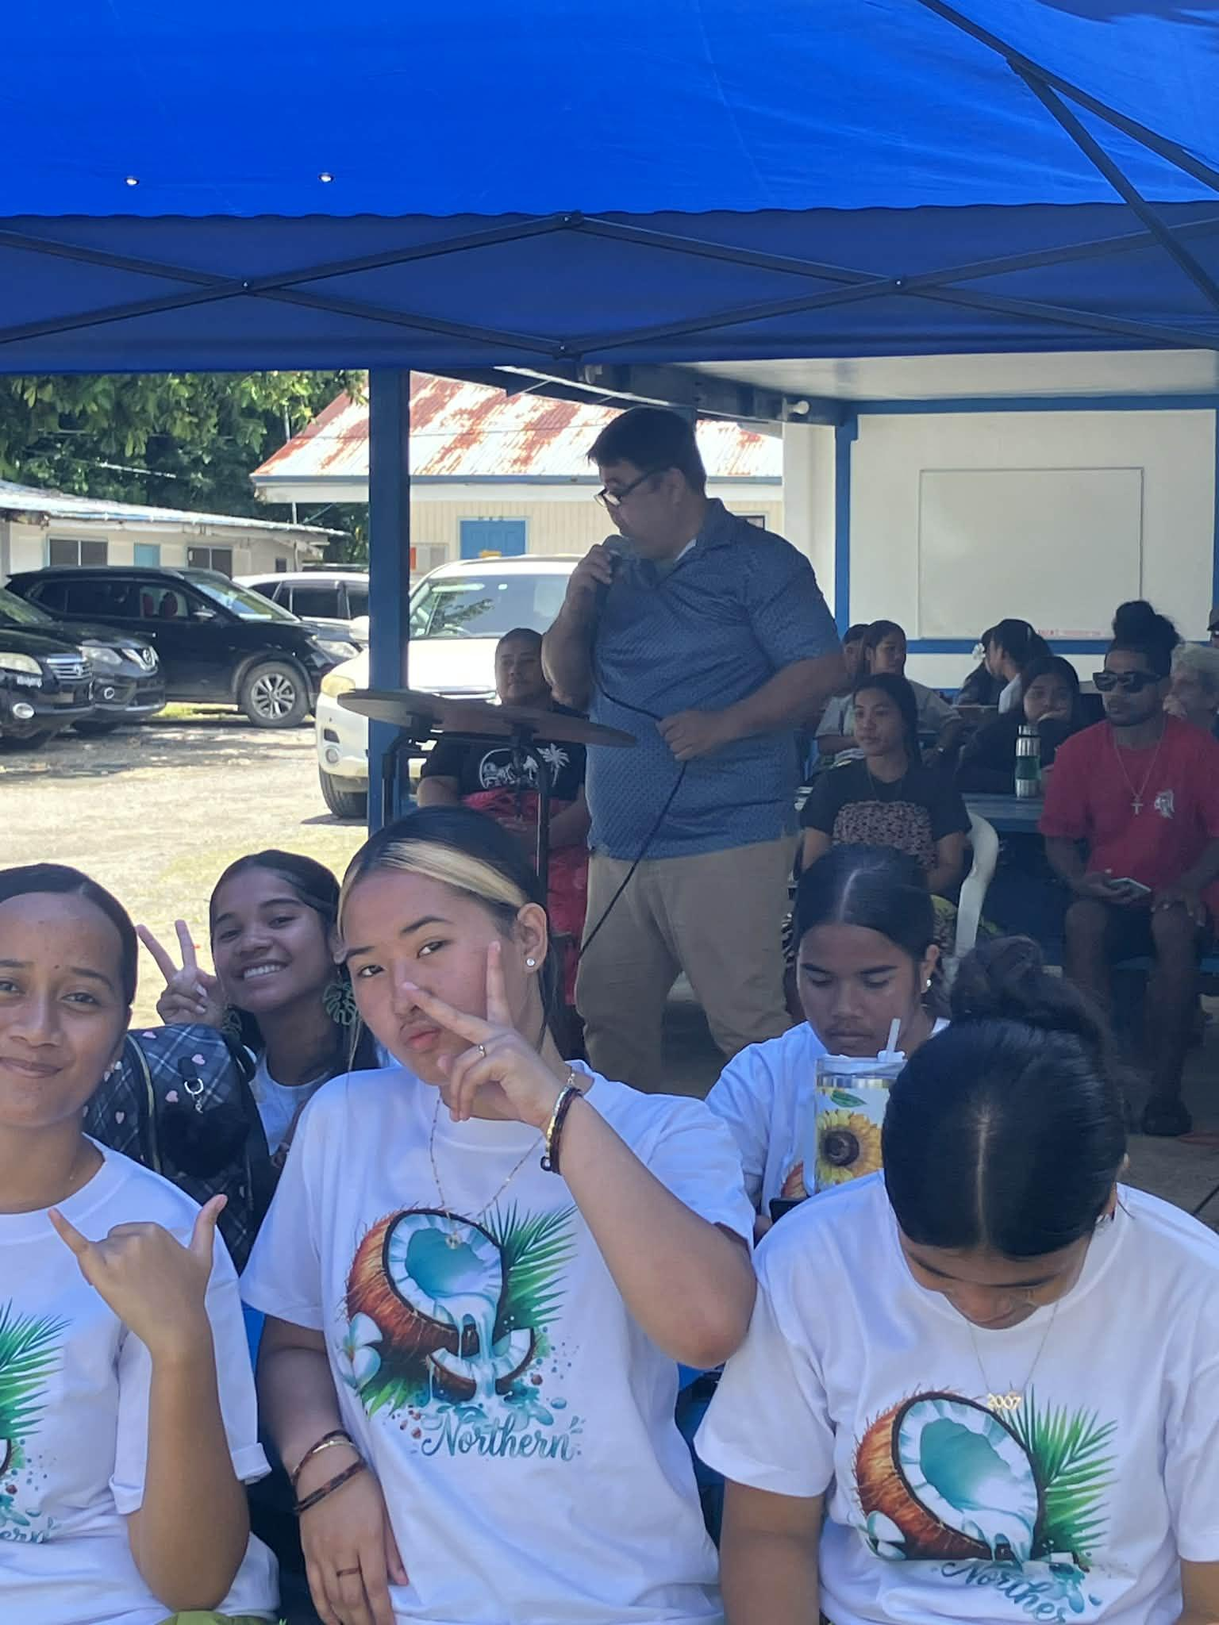
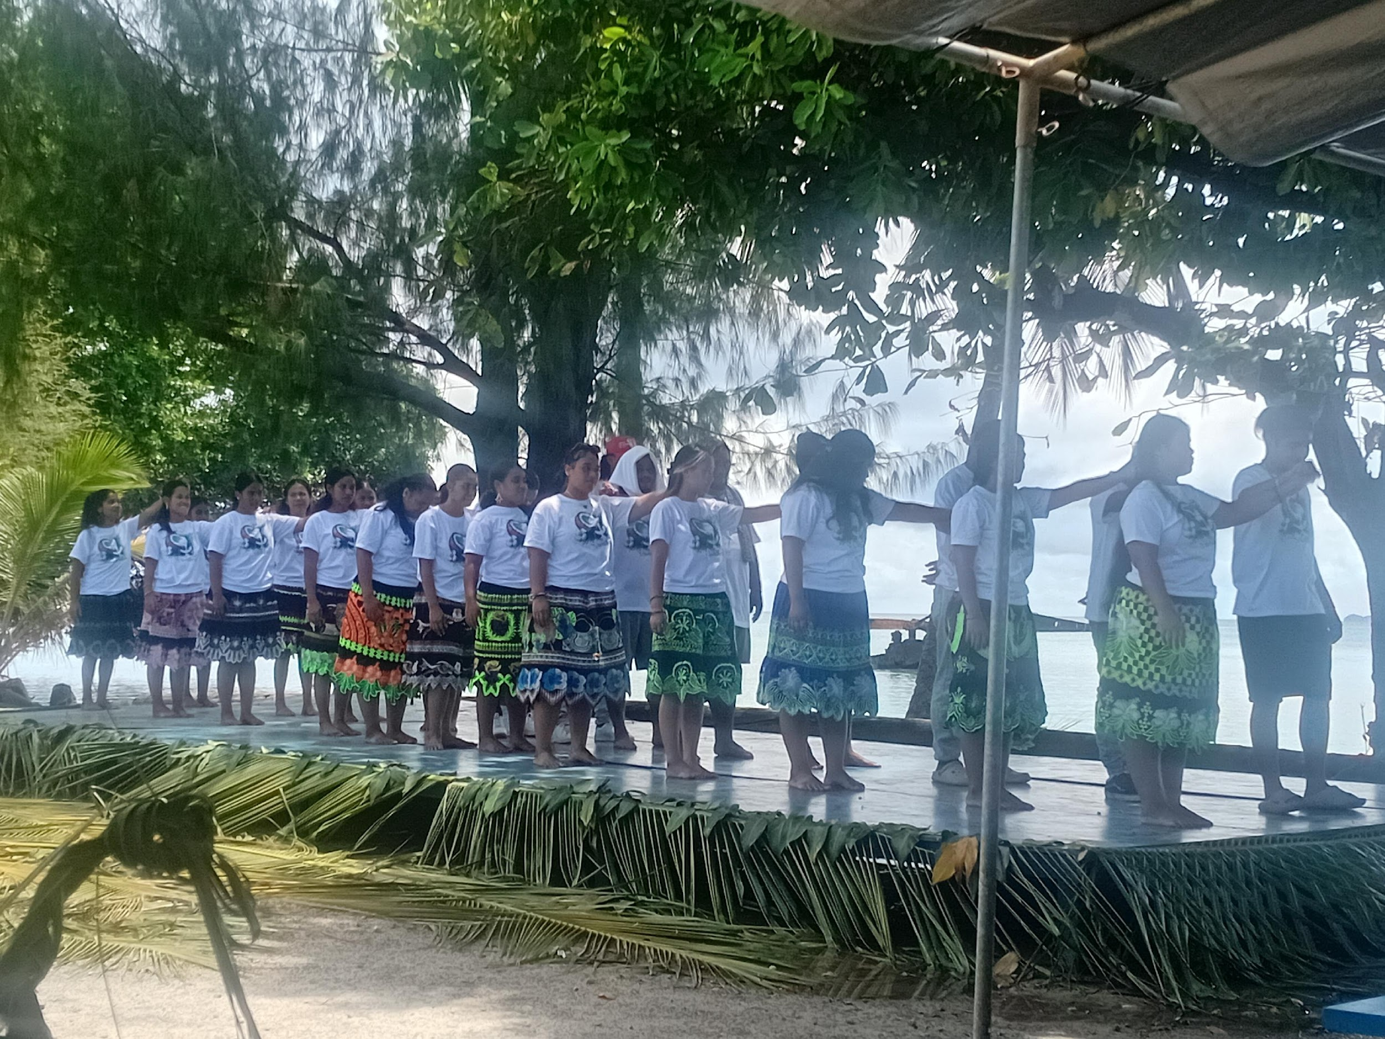
Goal 3 ( Resilience): Assure responsive and beneficial community engagement
Chuuk High School Career Day ( March 6)- Chuuk Campus was invited and 2 Faculty and 2 Support staff from Student Services represent the College
Chuuk State Health Services- Doctor’s Association ( March 30)- Meet with students to share and present the issue of “ Shortage of Doctors” and how to motivate students to further their studies by applying scholarship that can help them achieve their goals
Founding Day Celebration (April 1)- Organized by SBA Council and Regional Reps to celebrate COM-FSM Founding Day. Chuuk Campus invited New Regent Roger Arnold to celebrate this event to introduced himself to employees and student of Chuuk Campus.
Office of the Campus Dean
Office of the Academic Affairs
Learning Resource Center
Instructional Coordinator

Slide 10
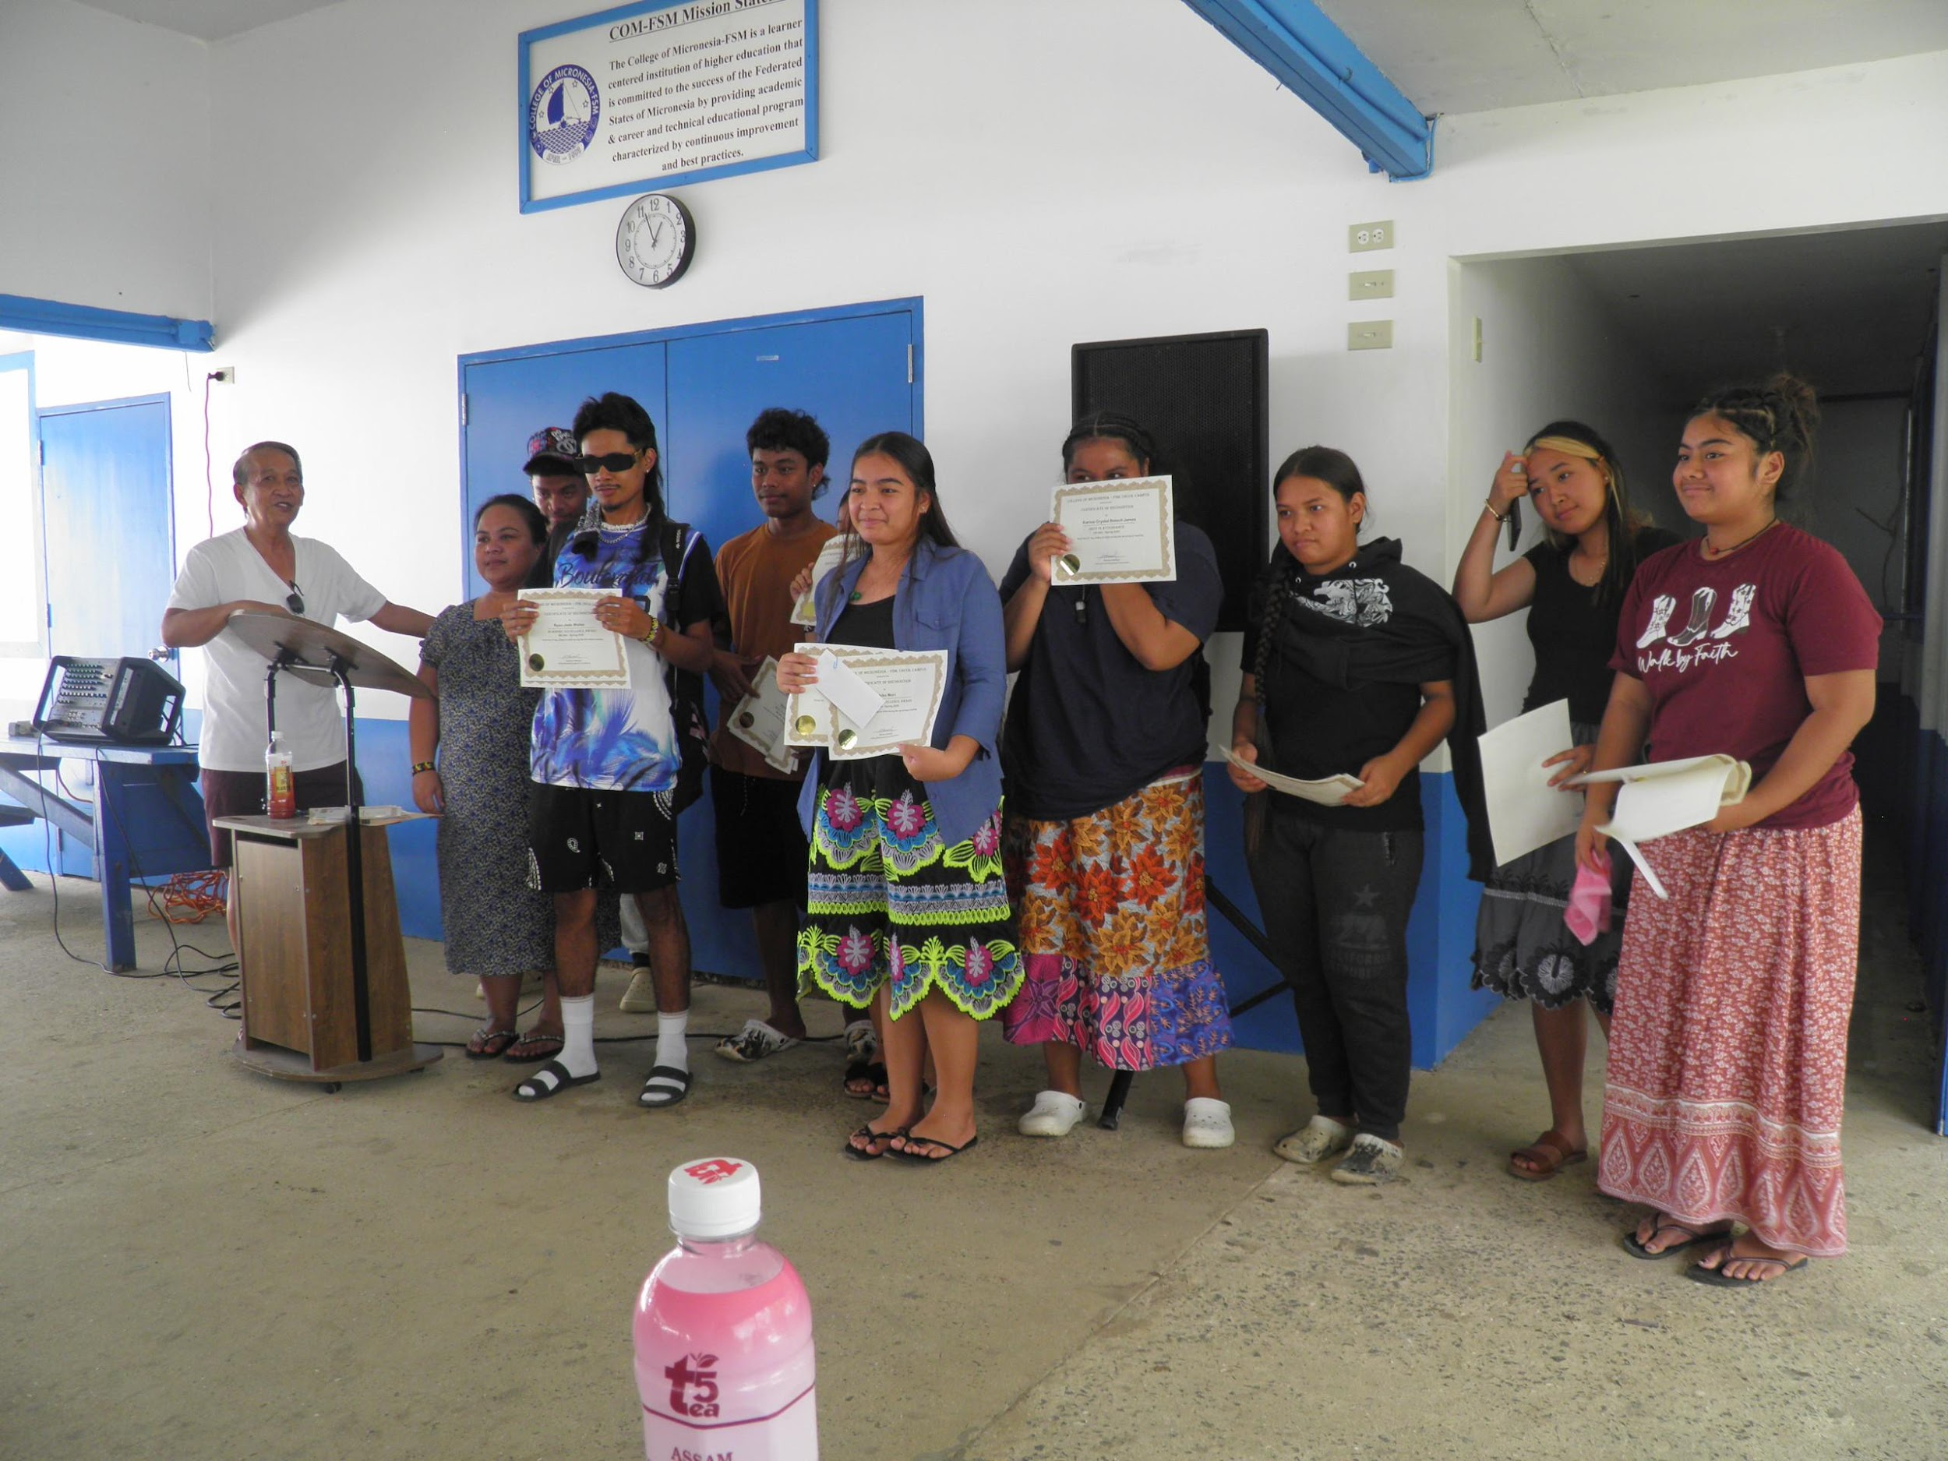
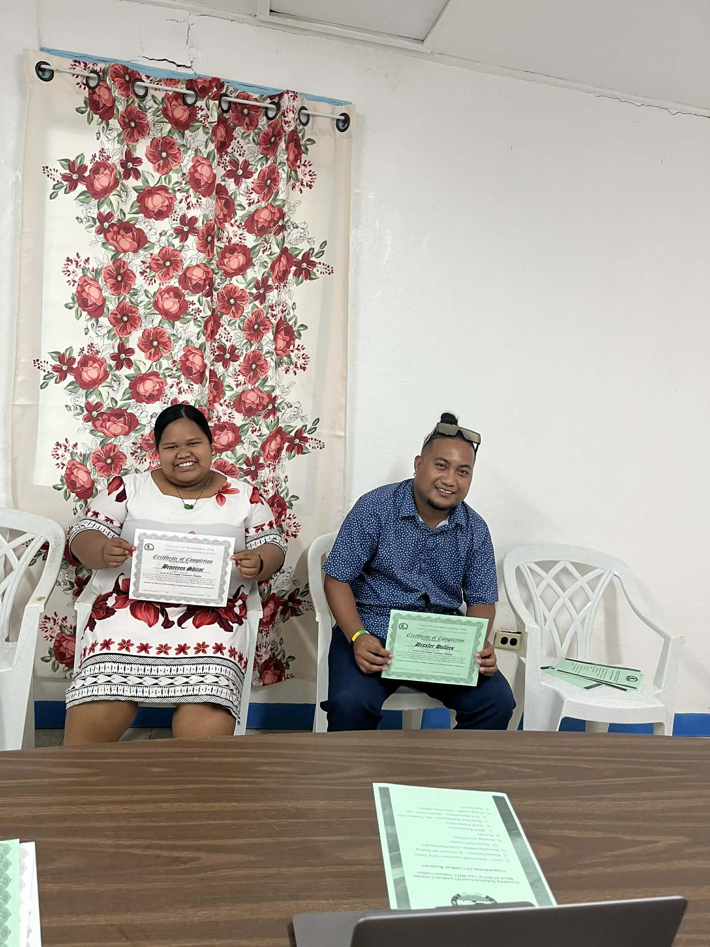
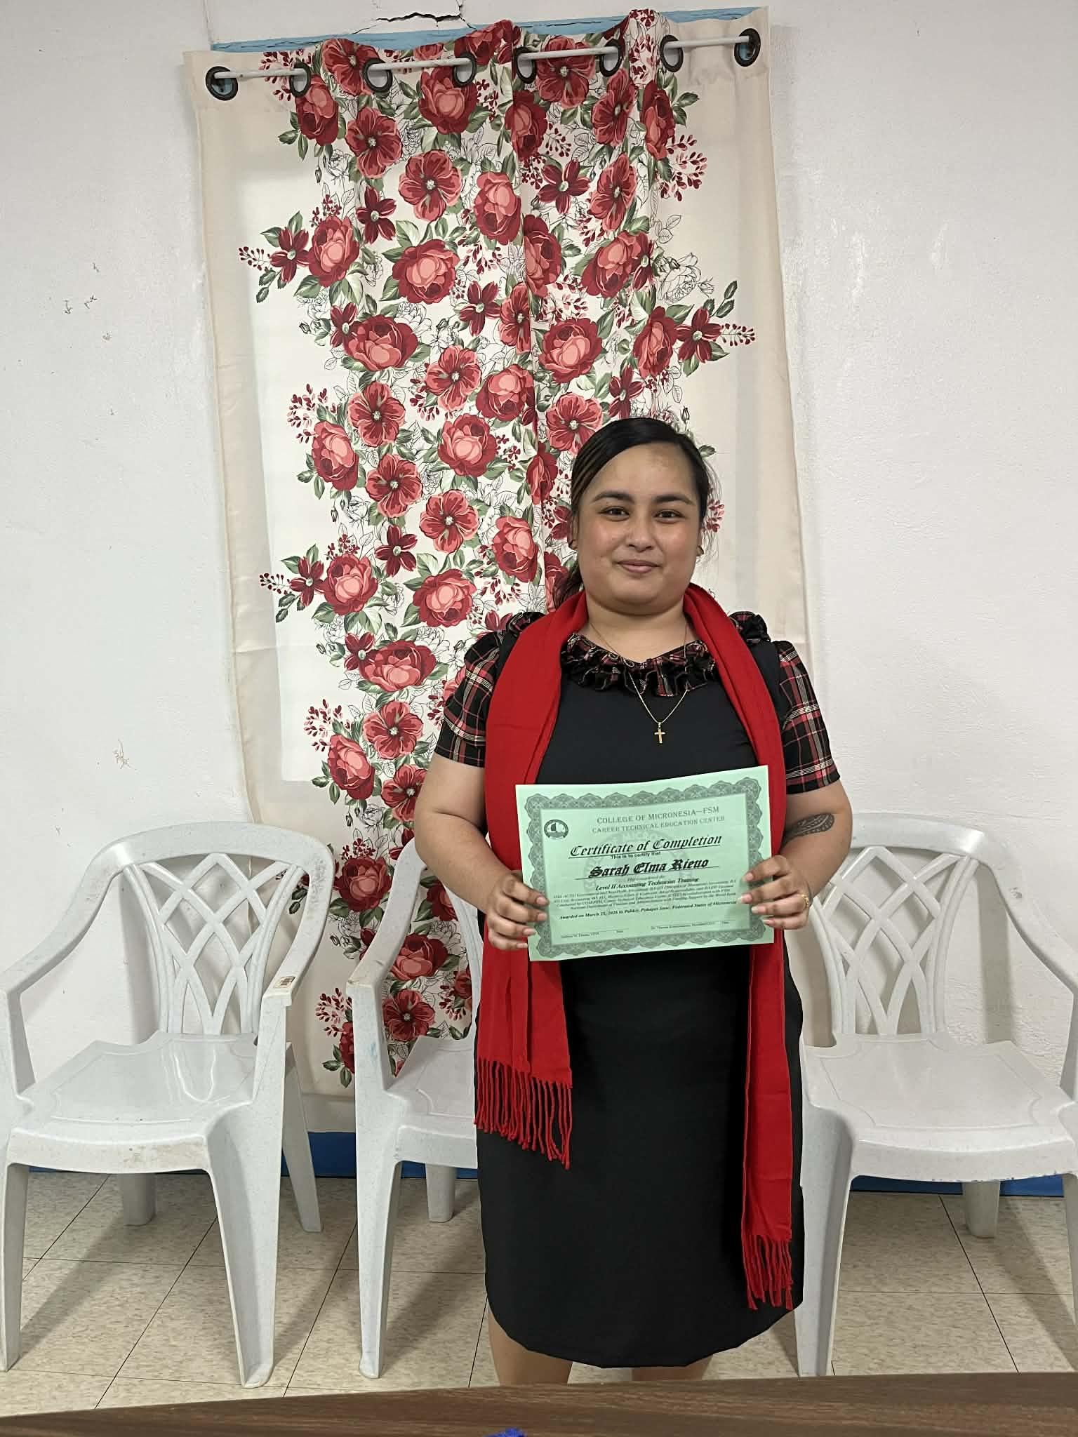
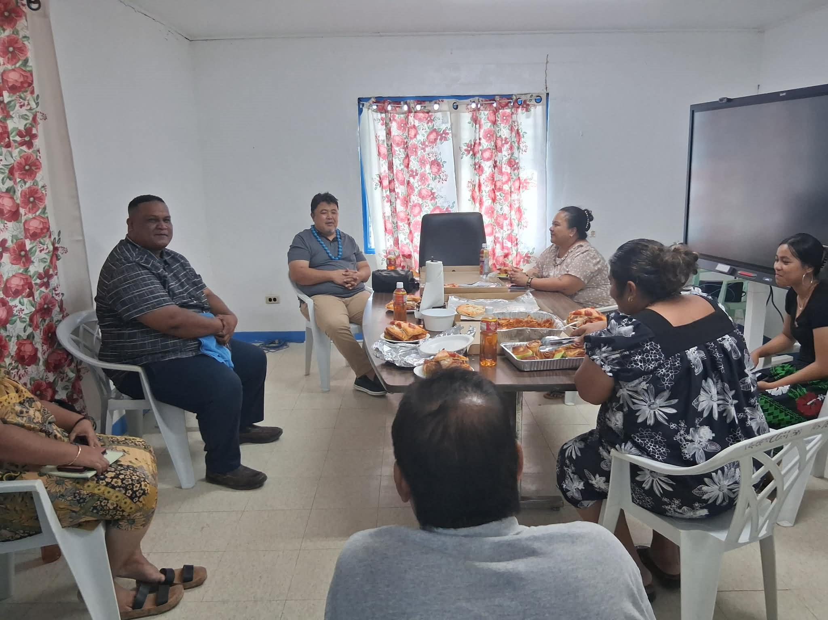
Chuuk Campus Spring 2026 Highlights
AWARD DAY ( March 4th) DOFA Online Ceremony Level 2 March 25
Regent Arnold visited Chuuk Campus on March 30
Office of the Campus Dean
Office of the Academic Affairs
Learning Resource Center
Instructional Coordinator

Slide 11
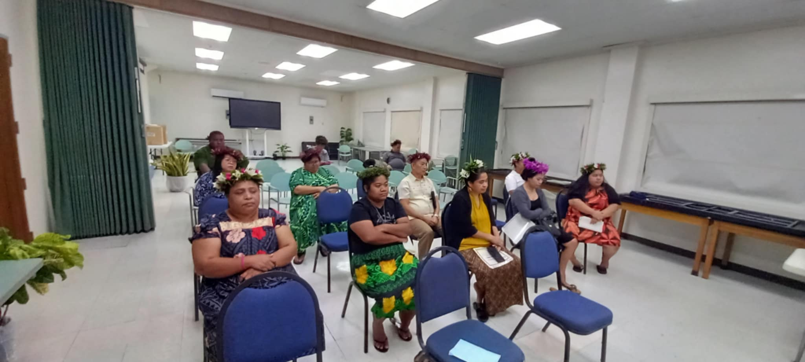
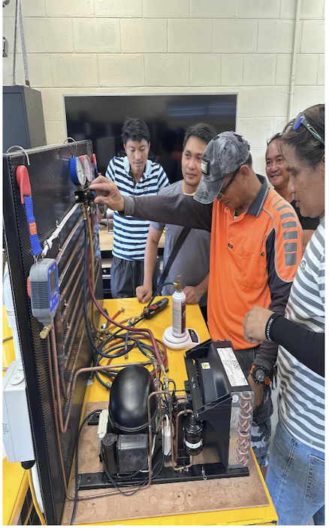
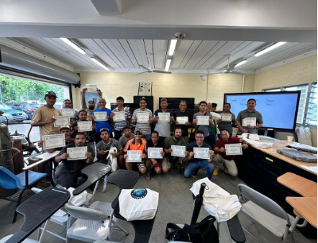
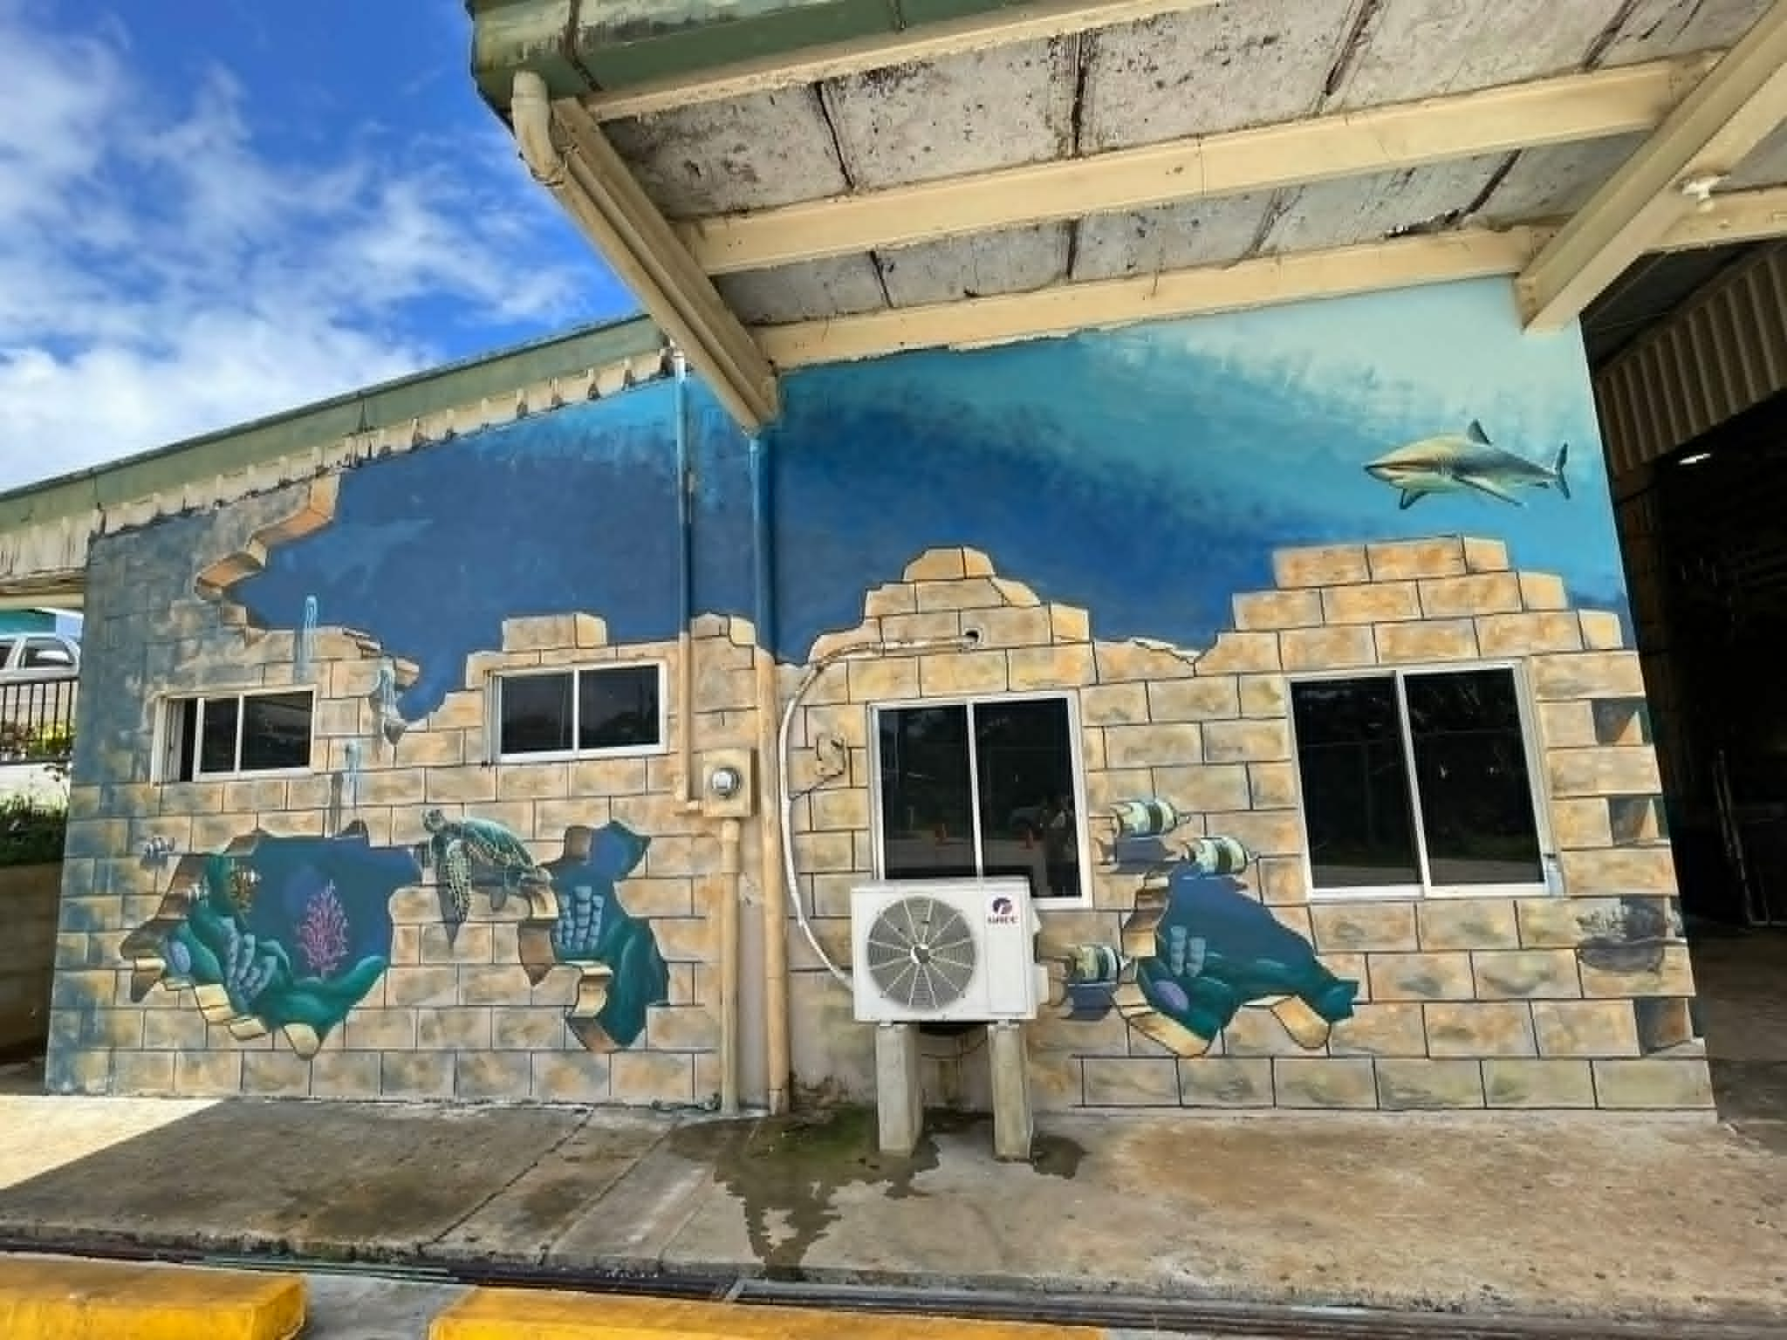
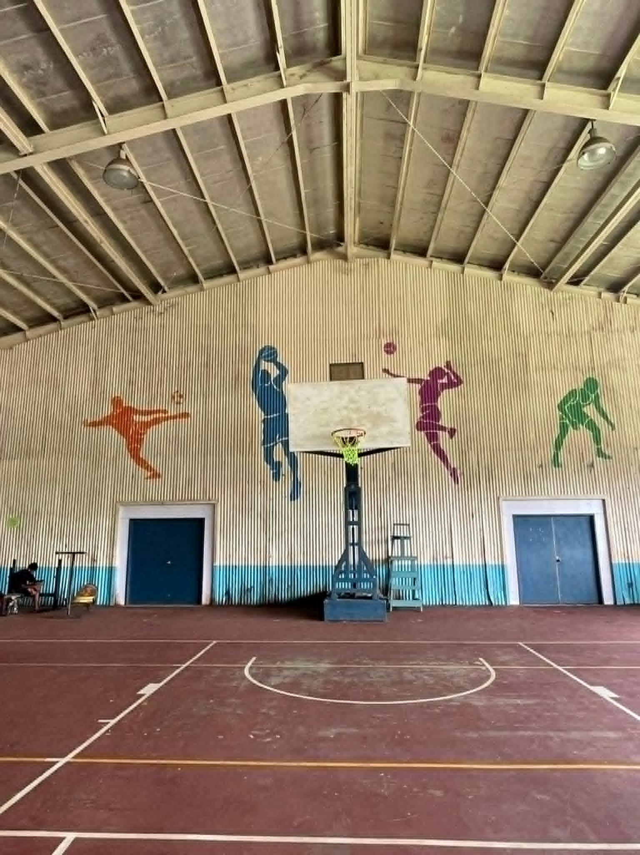
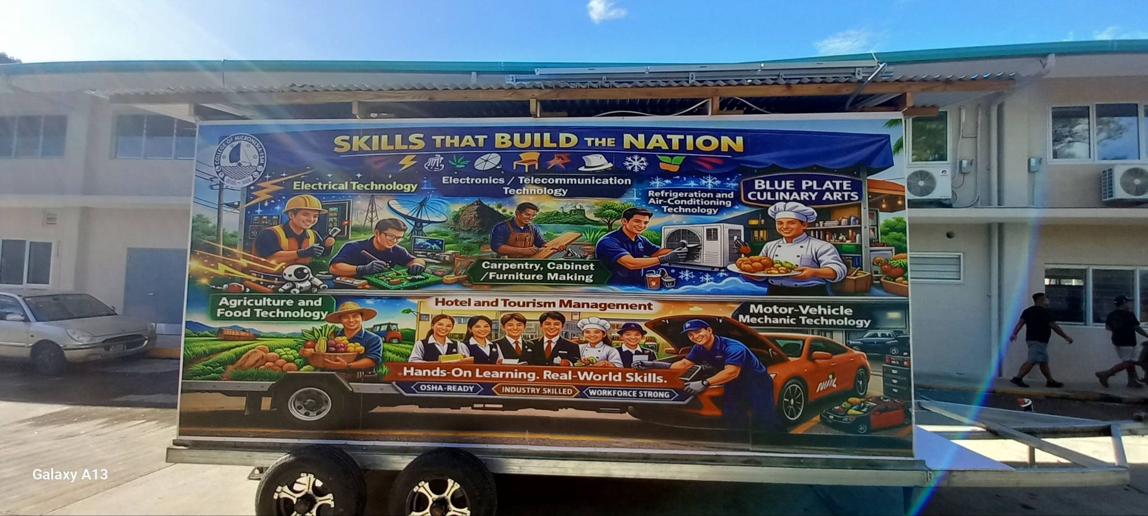
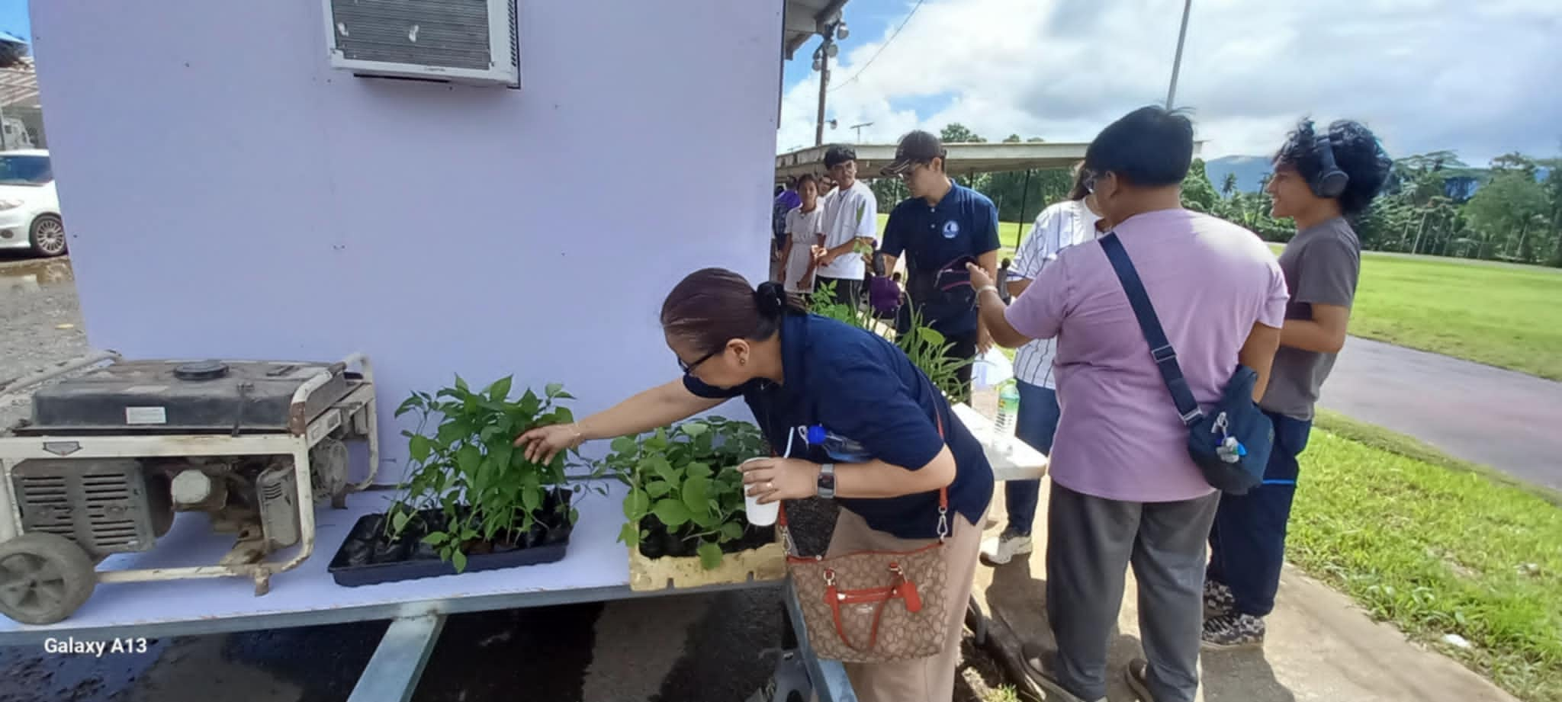
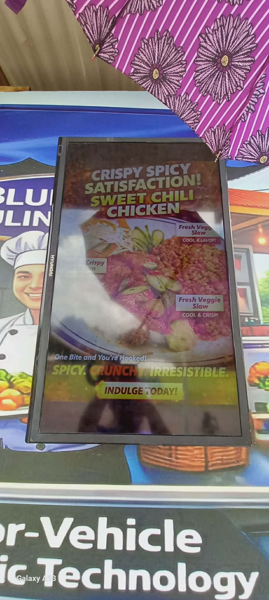
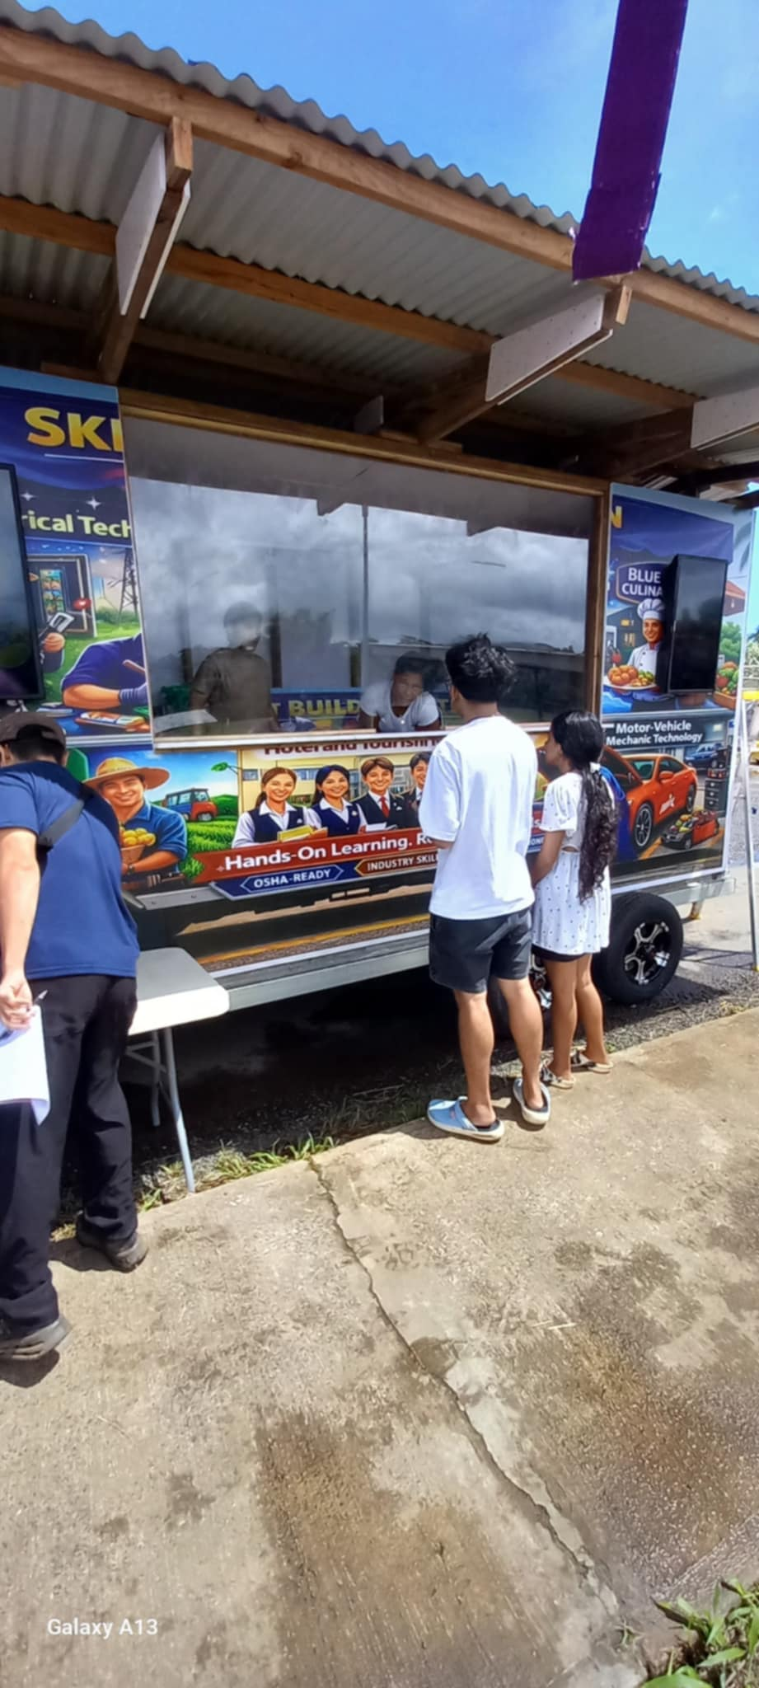


CTEC Campus Spring 2026 Highlights
Accounting Technician
3) RAC Training through DECEM
2) CTEC Murals
4) CTEC Programs on Founding Day
Office of the Campus Dean
Office of the Academic Affairs
Learning Resource Center
Instructional Coordinator

Slide 12
Kosare Campus Spring 2026 Highlights
Established a faculty-led scheduling committee to support structured and collaborative planning, under the guidance of the campus Dean and campus Instructional Coordinator. The committee utilized the college catalog, previous Summer schedules, and faculty consultation meetings to guide decision-making.
Kosrae campus expecting a new Science instructor to arrive in July 2026.
Outcomes/Impact:
Increased efforts to recruit part-time faculty to support course offerings
Expanded instructional capacity through upskilling of existing full-time faculty
Strengthened recruitment processes through committee-supported selection
Improved ability to offer planned courses despite staffing constraints
In support of this recruitment, the Dean posted announcements on Facebook regarding the Nursing and Law instructor openings and asked the IC to reach out to DOH to help solicit qualified candidates. Outcome led to 2 part-time instructors: one for Nursing and one for the Law Enforcement and Trial Counselor programs.
Office of the Campus Dean
Office of the Academic Affairs
Learning Resource Center
Instructional Coordinator

Slide 13





Slide 14
Yap Campus January-March Highlights
New Faculty recruits- English & Education Instructors
(1 from CTEC; 1 in-house transfer/promotion)
Student Support Services continues with
Moodle presentations by faculty members
Study Skills
Note taking skills
Basic computer skills
Test taking skills
Higher success rate in F2F compared to online courses.
POW WOW sessions continue
Total enrollment=131
POW WOW 1= 67 (51%) (student attendance)
POW WOW 2=73 (56%)
POW WOW 3=67 (51%)
- Need to improve the attendance of students
69% success rate of grades ABC as of midterm
Student Activities:
Bank accounts presentations by BFSM & BOG
Traditional Skills Workshop by Yap R&D Dept.
Public Health presentations on STI & Family Planning
Monthly All Campus meetings - share info, etc.
YC faculty & staff joined efforts with FMI for the FMI Handover Ceremony of the new facilities. Spirit of Team Work.
YC-FMI Choir sang the FSM National Anthem
COMET administered at all high schools in Yap State
With the help of FSM Public Auditor’s Office, COMET was administered in Woleai in March (free ride on PMA)
Accounting Level II graduate (1) - Michael Gimen
End of the Month birthday celebration- celebrating together

Slide 15




Yap Campus January - March Highlights

Slide 16
FSM FMI January-March Highlights
Enrollment Data (Spring 2026)
Program Students Notes
1st Year, Class 6 17 Navigation & Engineering
2nd Year, Class 5 17 Completing shipboard training
Class 4 10 Inaugural officer-level cohort
Total 44
Class 4 Master & Marine Engineering Program
• Officially launched January 12, 2026.
• Cohort: 10 experienced FSM-FMI seafarers (9 Yap, 1 Pohnpei).
• Streams: 6 Navigation, 4 Marine Engineering.
• Completion expected August 2026, followed by oral examinations and issuance of Certificates of Competency by FSM TC&I.
Graduates will qualify to command vessels up to 500 GRT and operate engines up to 750 kW.
The first quarter of 2026 marked historic progress at FMI.
Key achievements include:
Launch of the inaugural Class 4 Master & Marine Engineering Program – the first officer-level maritime training in FSM history.
Completion and handover of new dormitory and classroom facilities – expanding FMI’s training and accommodation capacity.
Advancement of 2nd YearCcadets toward graduation – with shipboard training underway and commencement scheduled for May 2026.
These milestones strengthen FMI’s role as the nation’s maritime training institute and position FSM as a regional center for maritime education.

Slide 17
FSM FMI January-March Highlights
• Four FMI faculty appointed as Oral Examiners by the FSM Department of TC&I:
o Pine Timoteo (Class 1 Master)
o Alvin Sinem (Class 4 Master)
o Telava Tofinga (Class 3 Engineer)
o Michael Mailuw (Class 4 Engineer)
• Collaboration with TC&I Consultant Tom Kostka to update FSM STCW standards in alignment with IMO STCW. It is currently with the FSM TC&I for review and adoption.
Opportunities & Next Steps:
1. Secure national approval for updated FSM STCW standards.
2. Develop national seafarer database in collaboration with FSM TC&I.
3. Develop & launch Port Pilot Training program- FSM States’ needs.
4. Deliver Basic Safety Training across FSM States.
5. Expand recruitment efforts to Palau & Marshall Islands.
6. Further develop a fisheries program at FMI
7. Faculty upgrades:
o Navigation: 1 Class 4 Master, 3 Class 5 Masters
o Marine Engineering: 1 Class 3 Engineer, 2 Class 4 Engineers, 1 Class 5 Engineer
o Goal: Upgrade faculty to Class 4 & 3 for stronger program delivery.
8. New Pacific Colleges of Fisheries & Maritime Association - purpose is to collaborate, share resources 3 key objectives for maritime and fisheries workforce development, including
promoting cooperation among member institutions,
harmonizing education standards with international requirements, and
building capacity for skilled workforce development.
Other Projects & Technical Support:
JICA Project - installation of Radar Simulator & fire fighting equipment in July/August 2026.
Replacement/installation of the Bridge Simulator system, a donation from the Nippon Foundation of Japan.
Fisheries Research & Training Vessel (Japan Grant Aid, 2023).
Design finalization visit scheduled on April 22–24, 2026.
Completion expected - November 2028.

Slide 18






FSM FMI Highlights

Slide 19
IA Sub-Units
Office of the Campus Deans
Office of the Academic Programs
Learning Resource Center
Instructional Coordinator

Slide 20
Department for Instructional Affairs
Thank You!
2026 1ST QUARTER REPORT
Delihna Ehmes - VPIA
Office of the Campus Dean
Office of the Academic Affairs
Learning Resource Center
Instructional Coordinator

