Slide 1
College of Micronesia-FSM 2017 Budget Development
FY 2017 REVENUE PROJECTIONS

Slide 2
ASSUMPTIONS

Slide 3
Number of Students(Based on actual 2015)

Slide 4
AVERAGE CREDIT PER FY2015

Slide 5
NUMBER OF CREDITS(Based on Averge Credit per FY2015)

Slide 6
TUITION (Based at $135 per credit)

Slide 7
TUITION, net of 7.5% D/A and Tuition Remission

Slide 8
STUDENT/HEALTH/REGISTRATION FEES

Slide 9
FACILITY FEE

Slide 10
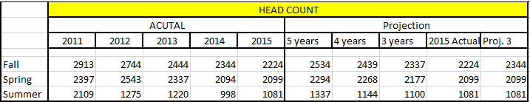
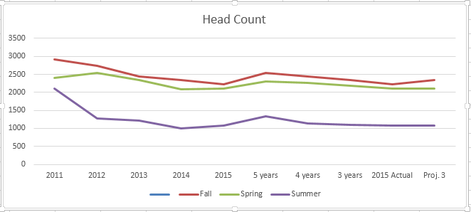
Revenue Factor : Headcount

Slide 11
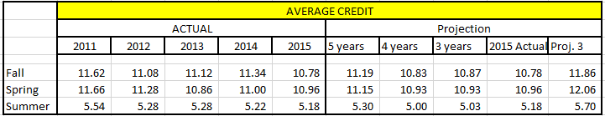
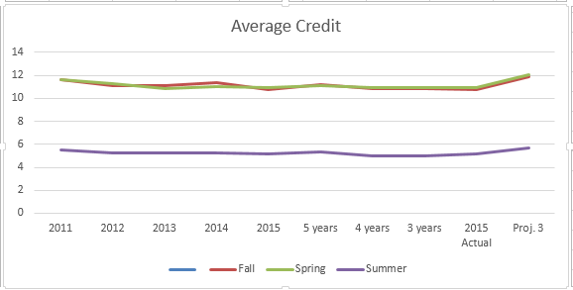
Revenue Factor: Average Credit

