Slide 1

College of Micronesia – FSM
Digital Transformation Status
Report
Digital transformation is the integration of digital technology into all areas of COM-FSM’s DNA, fundamentally changing how it operates and delivers the best learner-centered experience that is committed to the success of the Federated States of Micronesia by providing academic and career & technical educational programs characterized by continuous improvement and best practices.
Digital Transformation

Slide 2
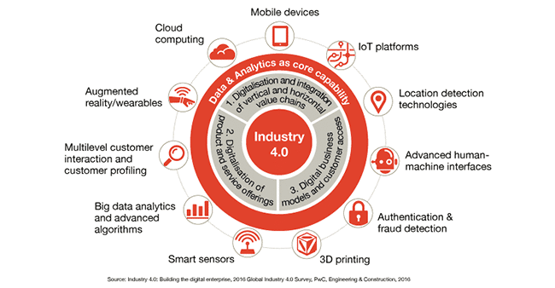
The Need for Digital Transformation
In today’s educational landscape, digital transformation is essential for COM-FSM to remain competitive, innovate, and meet the ever-changing expectations of our students.

Slide 3
Components of a Successful Digital Transformation Strategy
1
Leadership Commitment
2
Student-Centric Approach
A dedicated and supportive leadership team that drives change and fosters a digital-first culture.
Understanding student needs and delivering personalized experiences through digital channels.
3
Agile Operations
4
Talent Development
Adopting agile methodologies to accelerate innovation, streamline processes, and respond quickly to market changes.
Equipping employees with the necessary digital skills and creating a culture of continuous learning.

Slide 4



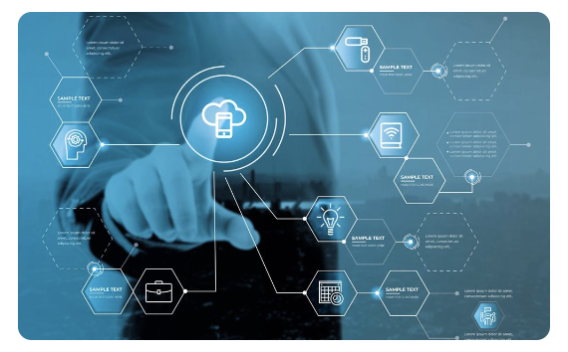
Current Challenges at COM-FSM with its Digital Infrastructure
Development Needs
Data-driven Analytics
Infrastructure
Emphasis on continuous training for IT staff.
Emphasis on continuous training for instructors and support staff when new technologies are introduced.
Emphasis on implementing analytics systems to harness current data and future trend prediction for data-driven decision-making.
Legacy systems and ageing digital infrastructure.
Lack of proper software system for IT equipment inventory.
Need to enhance wireless network infrastructure.
Deeper focus on data security.

Slide 5
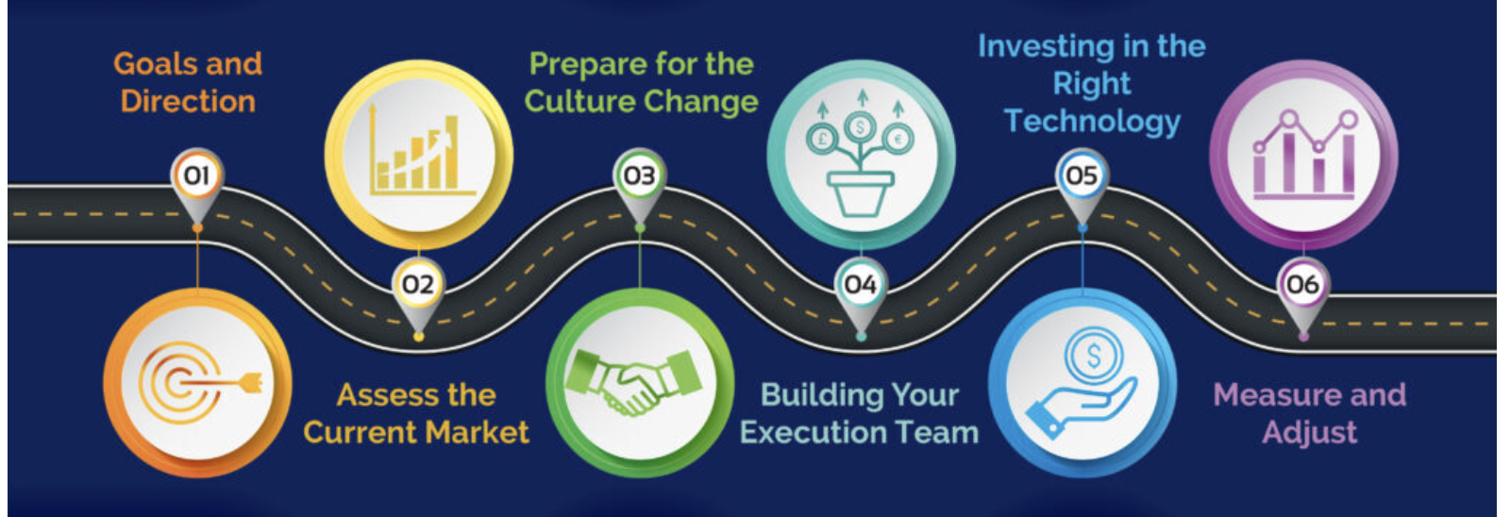
Key 2024 Action Plan To Drive Digital Transformation
Digital Infrastructure Upgrade for Kosrae Campus
Digital Infrastructure Upgrade for Chuuk Campus
Digital Infrastructure Upgrade for Yap & FMI Campus
Digital Infrastructure Upgrade for National & CTEC Campus
Implementation of mobile-first strategy where applicable.
Becoming members of international best practice bodies such as EDUCAUSE and ICDE.
Revamp of COM-FSM website
Launch of COM-FSM online recruitment & staff development portal

Slide 6
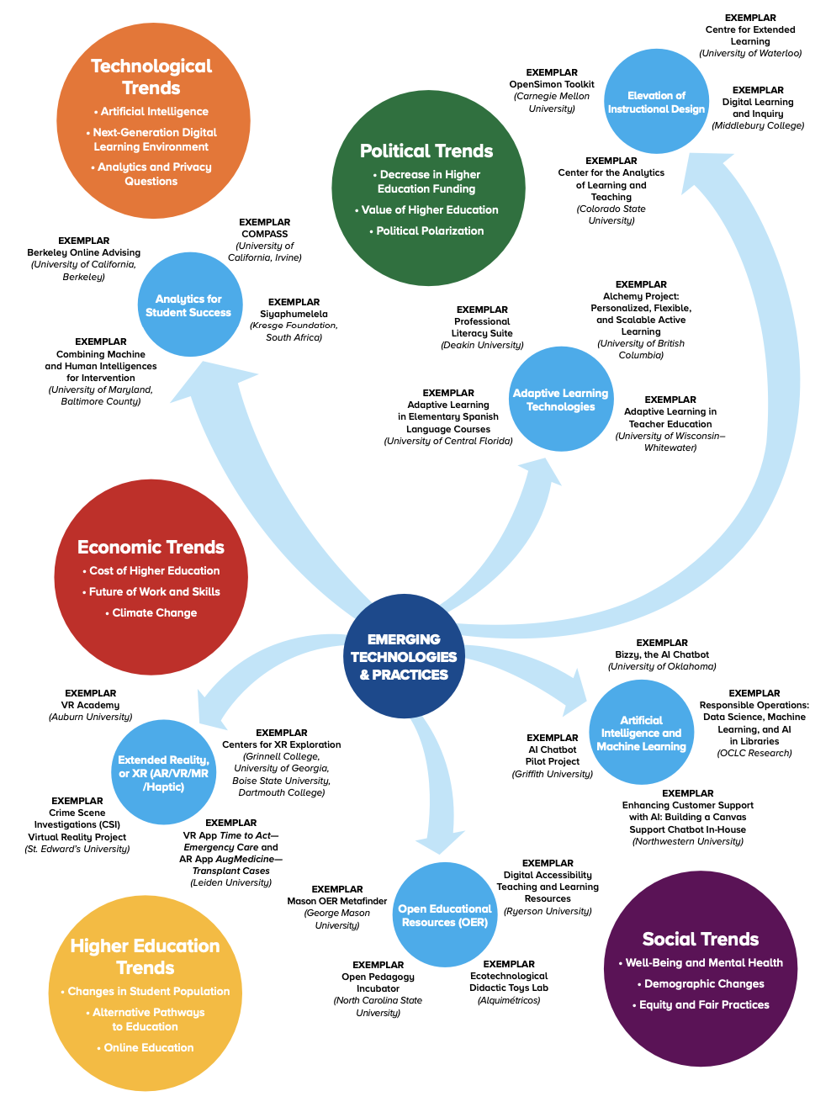
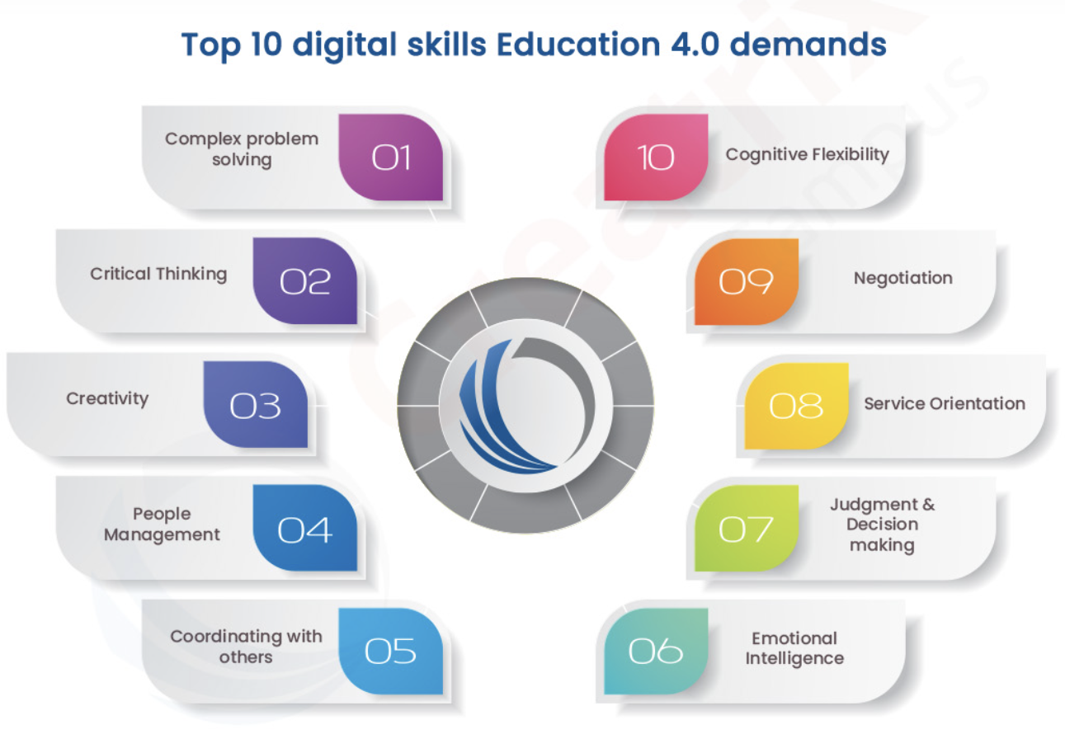
Embracing change is not just a necessity; it is an opportunity to redefine our success and 'Embracing Tomorrow.'

