Slide 1
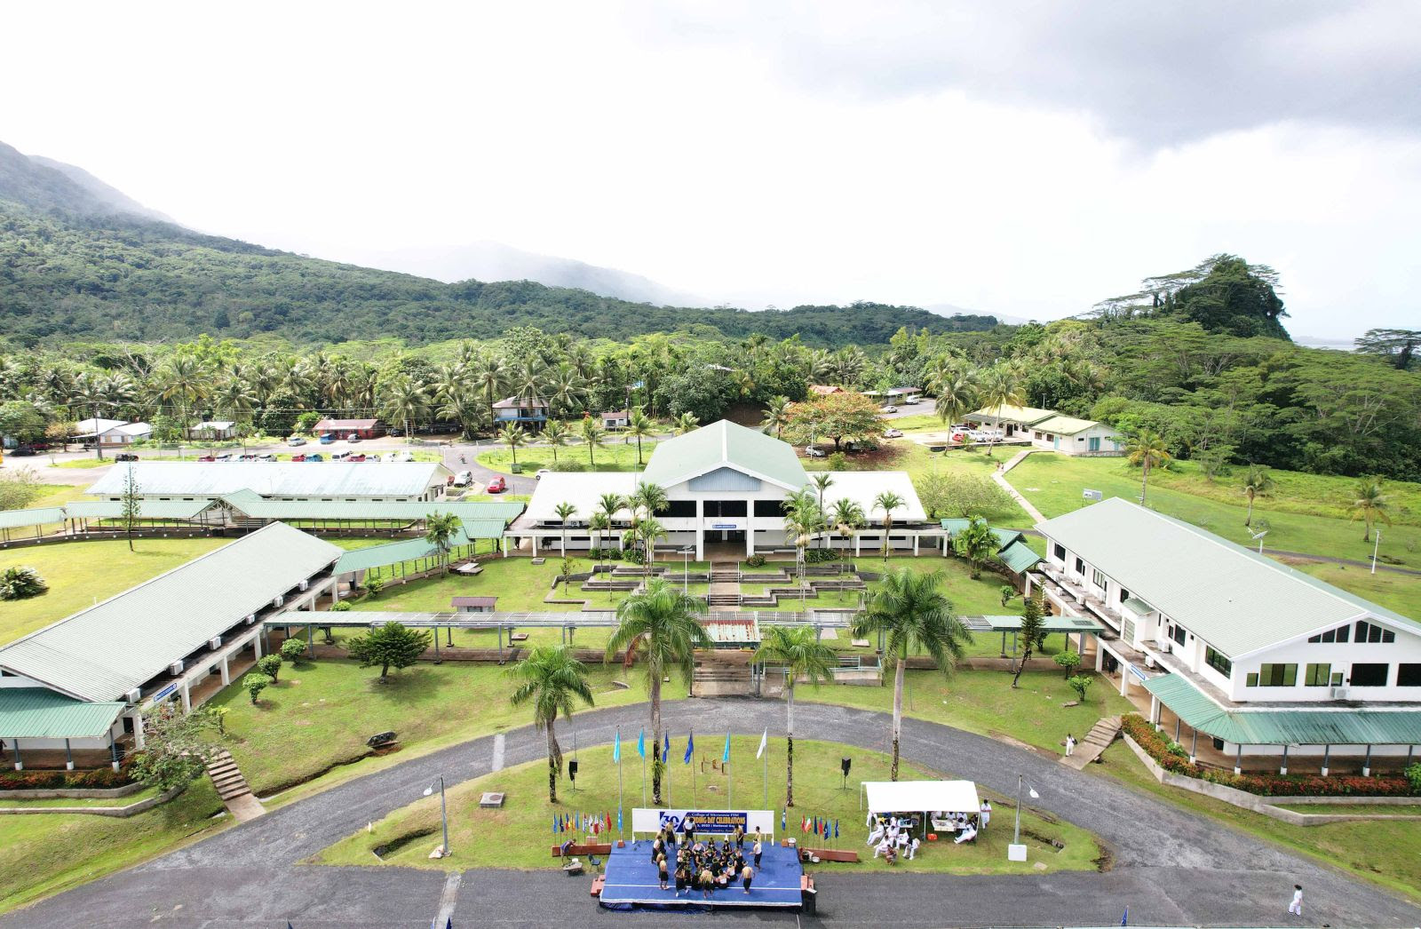
SBA reports to the Board of Regents: Fostering Excellence and Equity for All Students
Student Body Association (SBA) Report to the Board of Regents: Fostering Excellence and Equity for All Students
“Standing up for student rights and welfare, whether it’s academic policies, campus facilities, or social issues.”
December 4-5, 2025, Colonia, Yap, Federated States of Micronesia
Highlights
Improvement
Challenges

Slide 2
Mission statement
“The College of Micronesia-FSM is a learner-centered institution of higher education that is committed to the success of the Federated States of Micronesia by providing academic and career & technical educational programs characterized by continuous improvement and best practices”

Slide 3
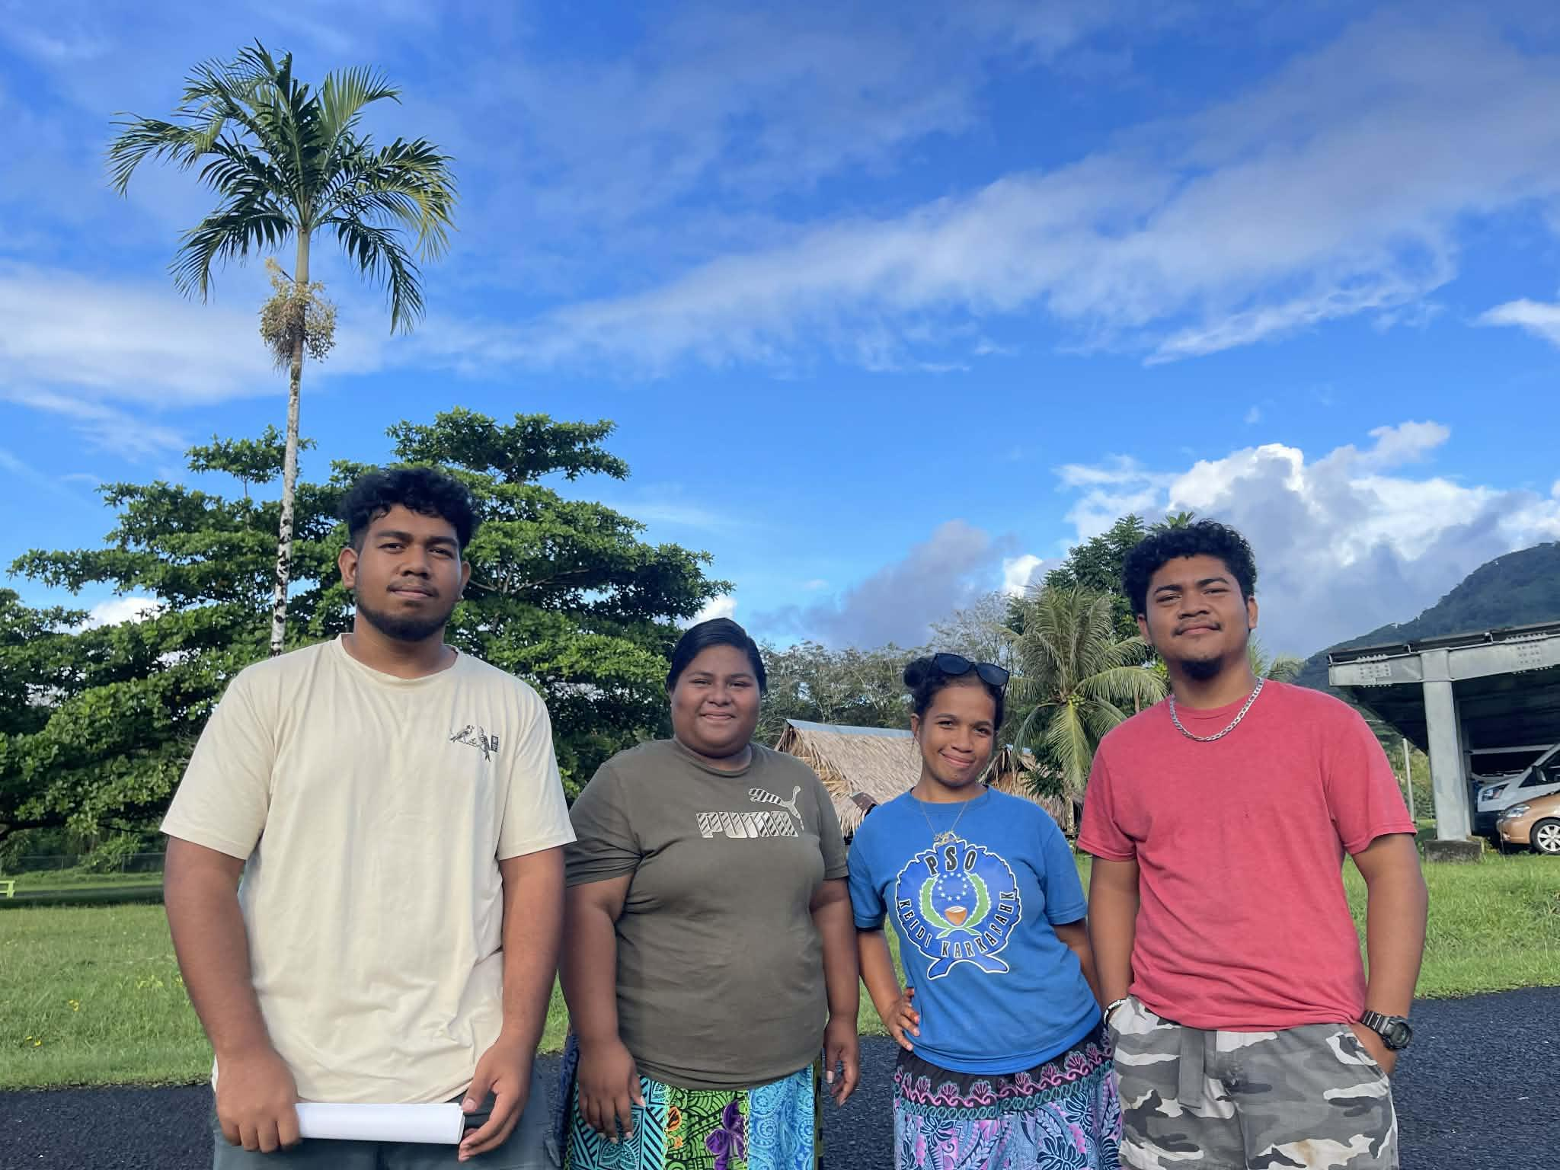
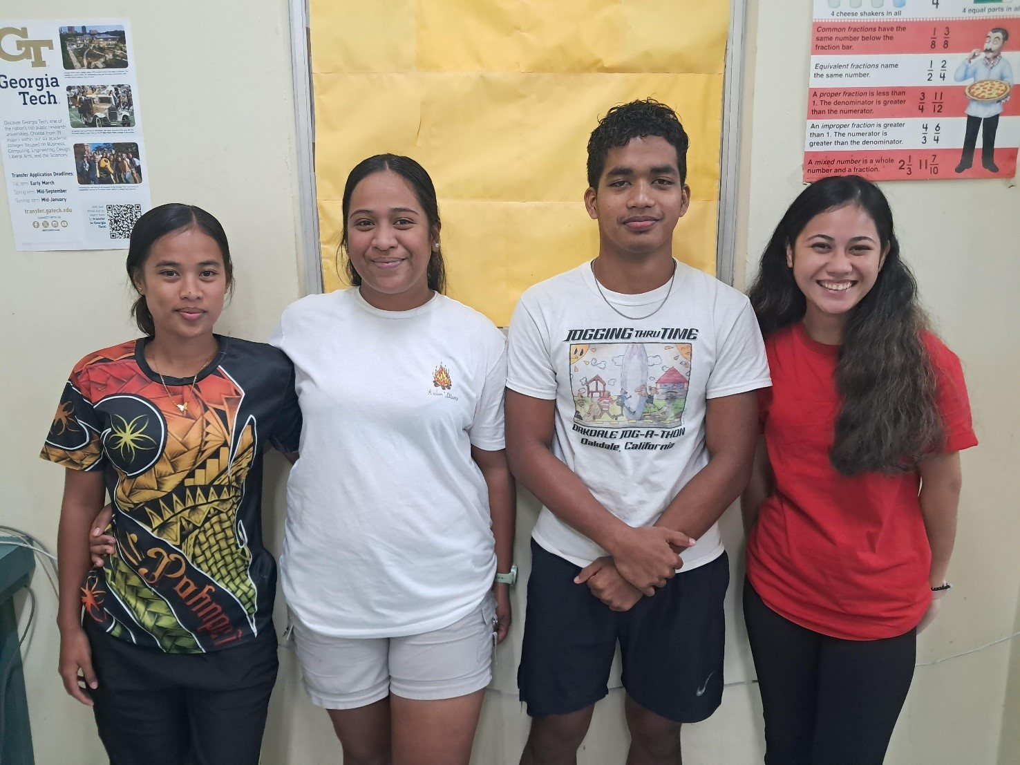
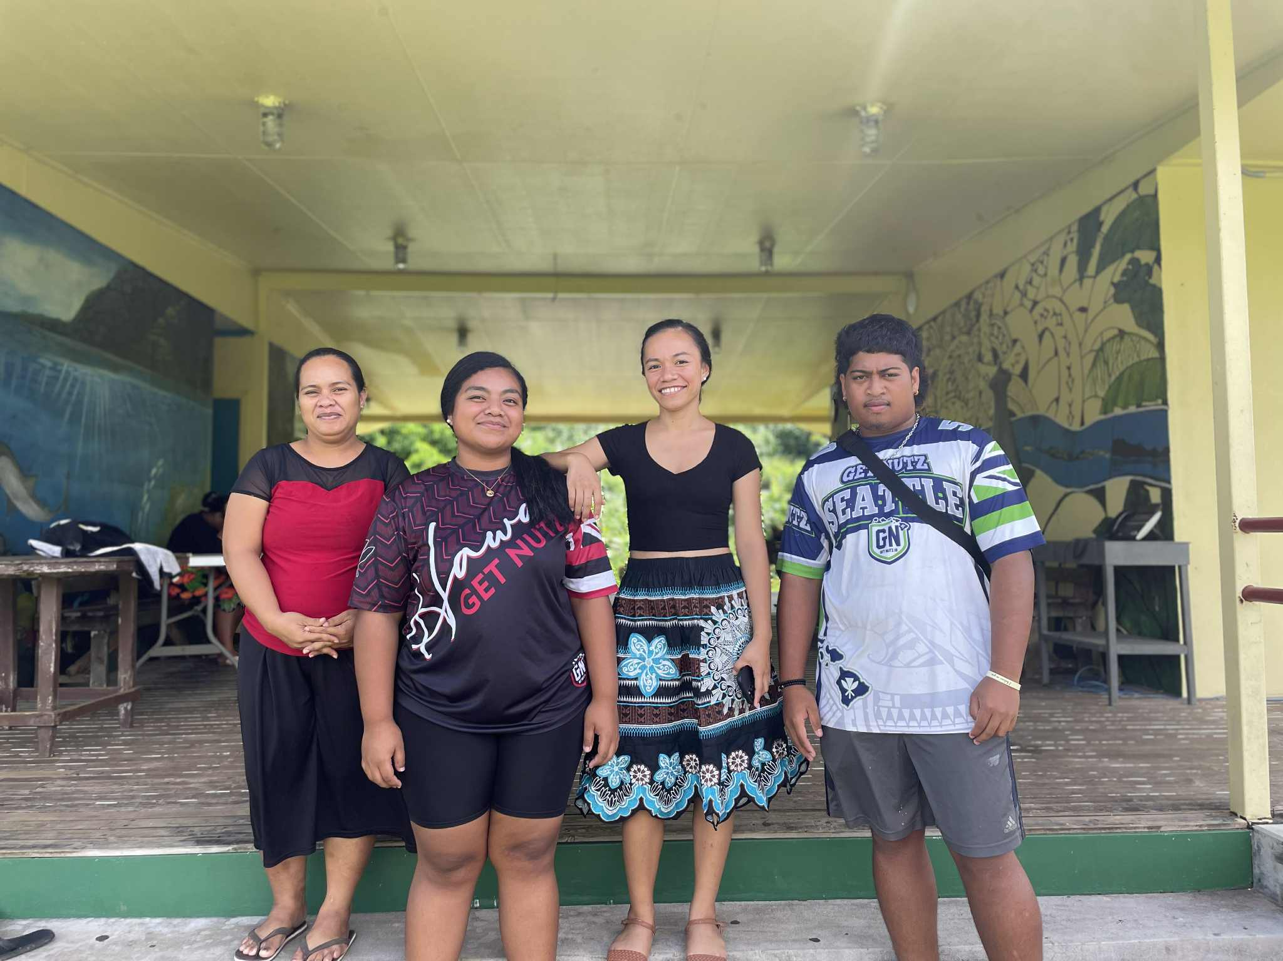
Student Body Association officers
National From left to right. Deshawn S. Skilling, Milain Soar, Kalain Padahk, Stephen JR. mara
CTEC From left to right. Lilly jean Alex, Amayalynn Shoniber, Iberson Barnabas, Hafsha Edward
Kosrae From Left to Right- Mia B. Neth , Adyna Sepe Shrew, Arlyn Zoya H. Nena, Lyndon Dwayne G. Esau

Slide 4
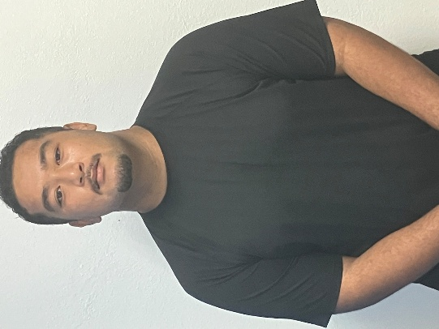
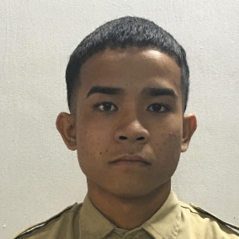

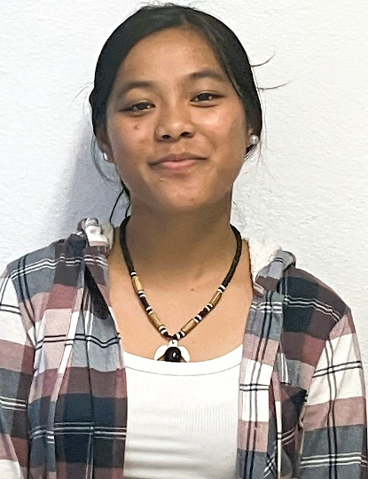
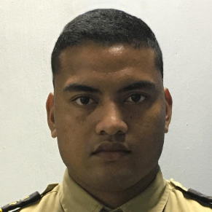

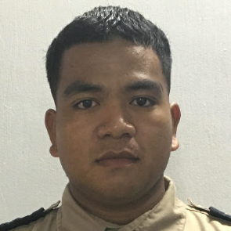

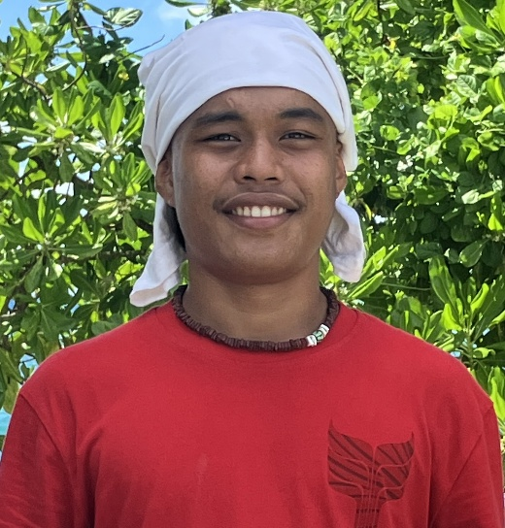
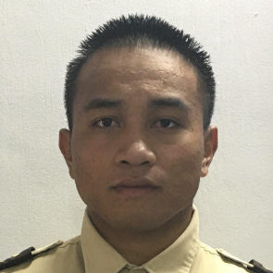

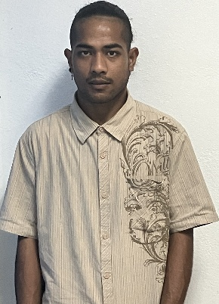
Student Body Association officers
Fisheries Maritime institute
YAP
Chuuk
Zinaida hazel
David Welle
Jeffrey Ray Sigrah
Micah Marelmathaw
Alissa Sandiago
Tinus Martinus Alokoa
Alik Alik Taulung
Alpha Leyangerwel
Deshawn Ka
Joannista Berngun
Hectar David
Noel Ratimang

Slide 5
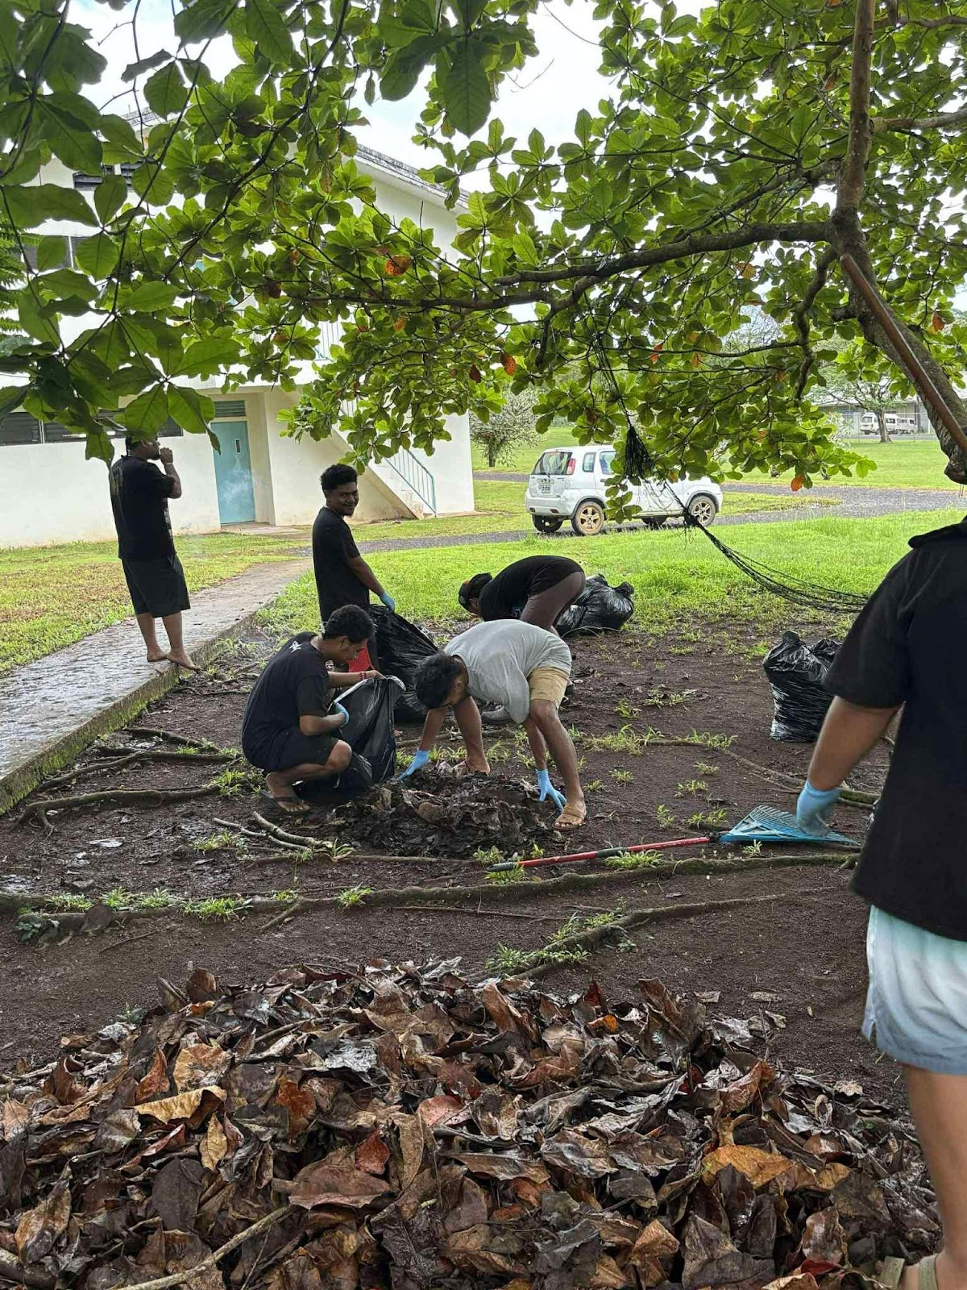
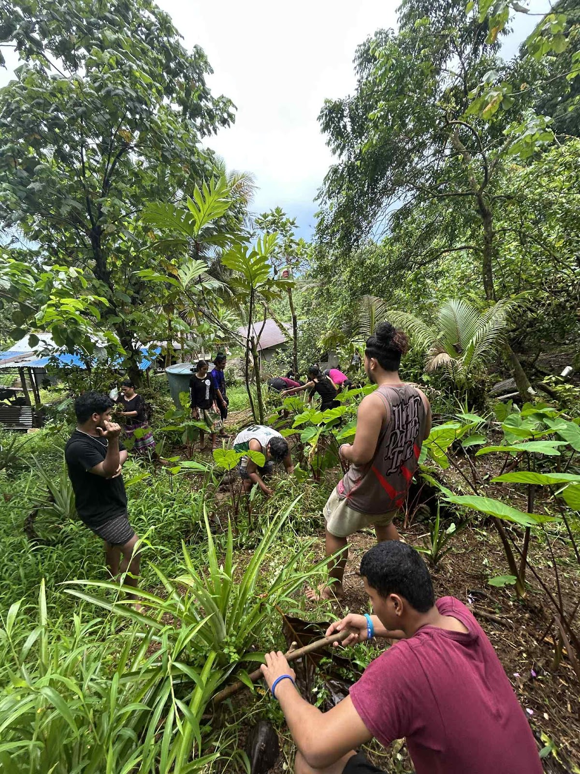
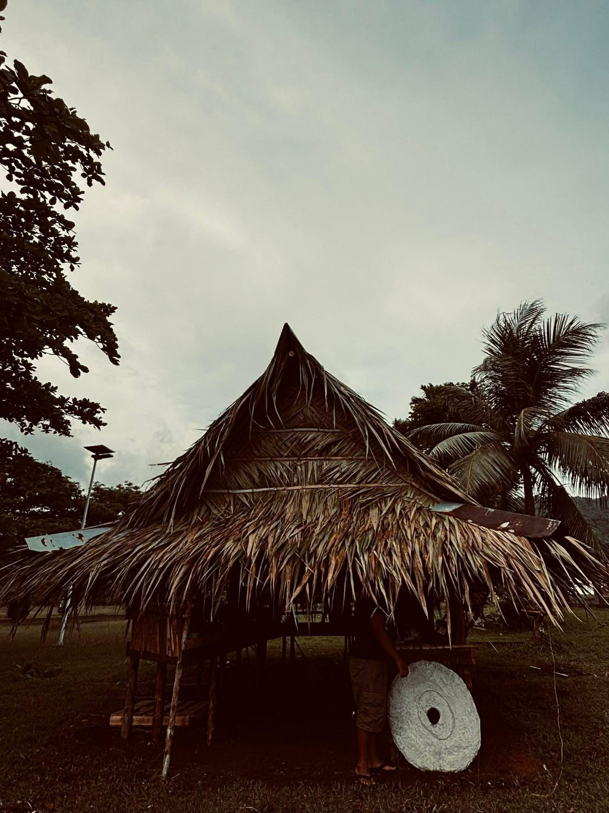
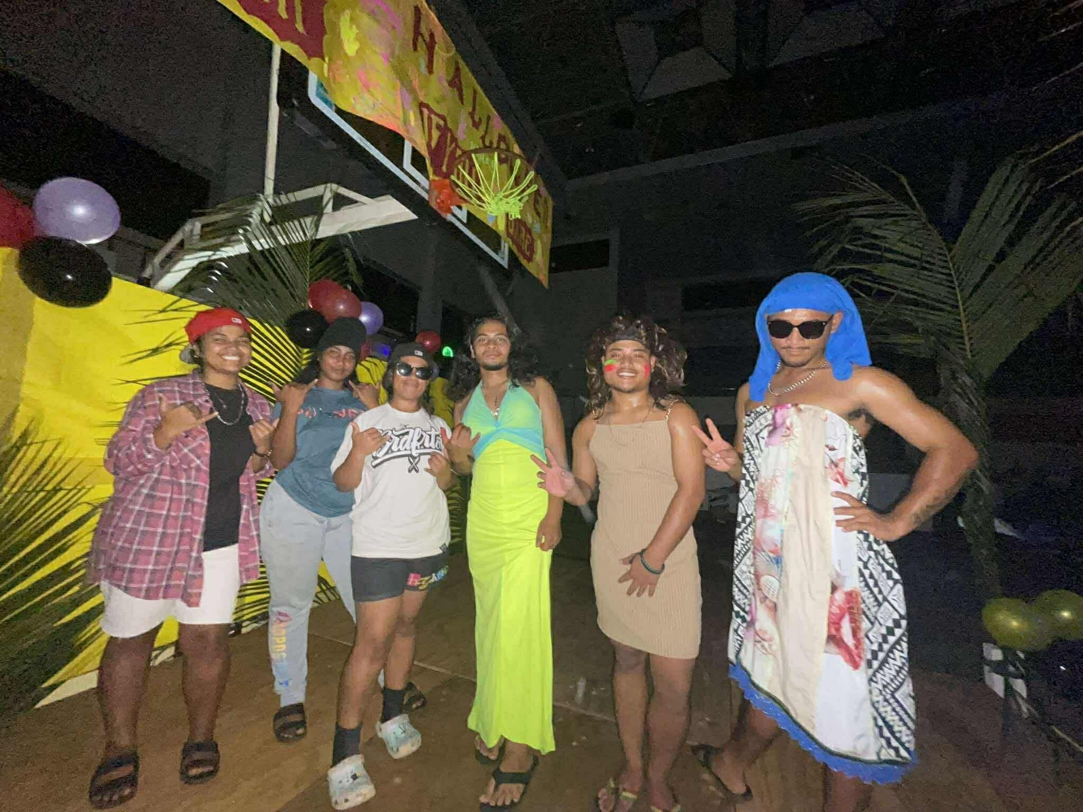
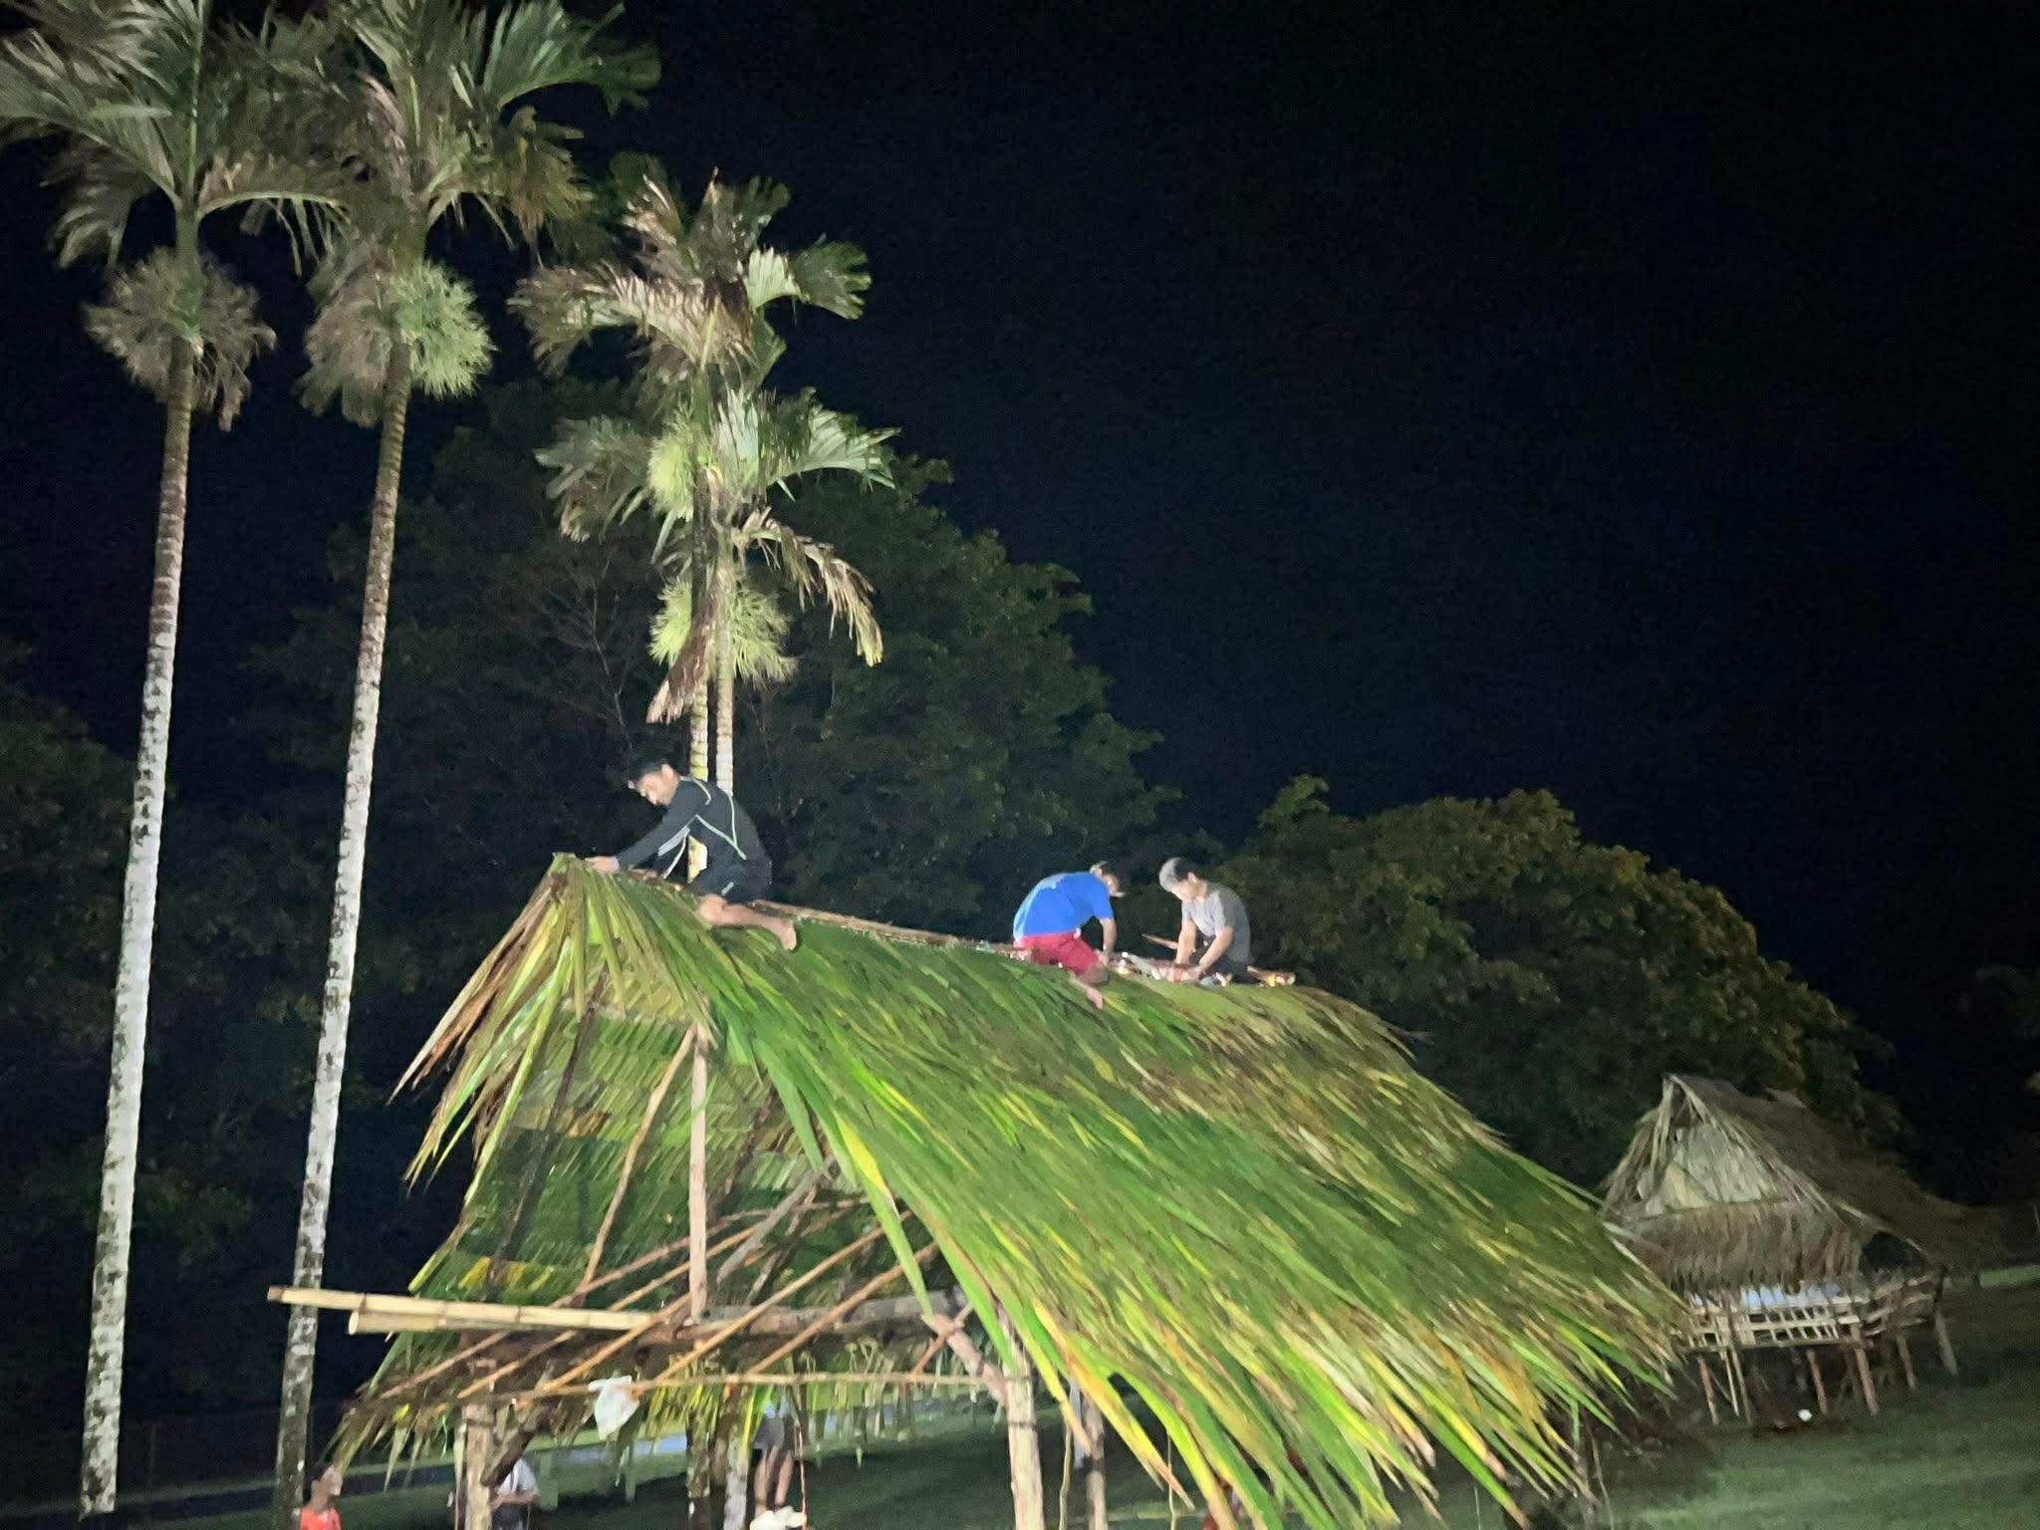
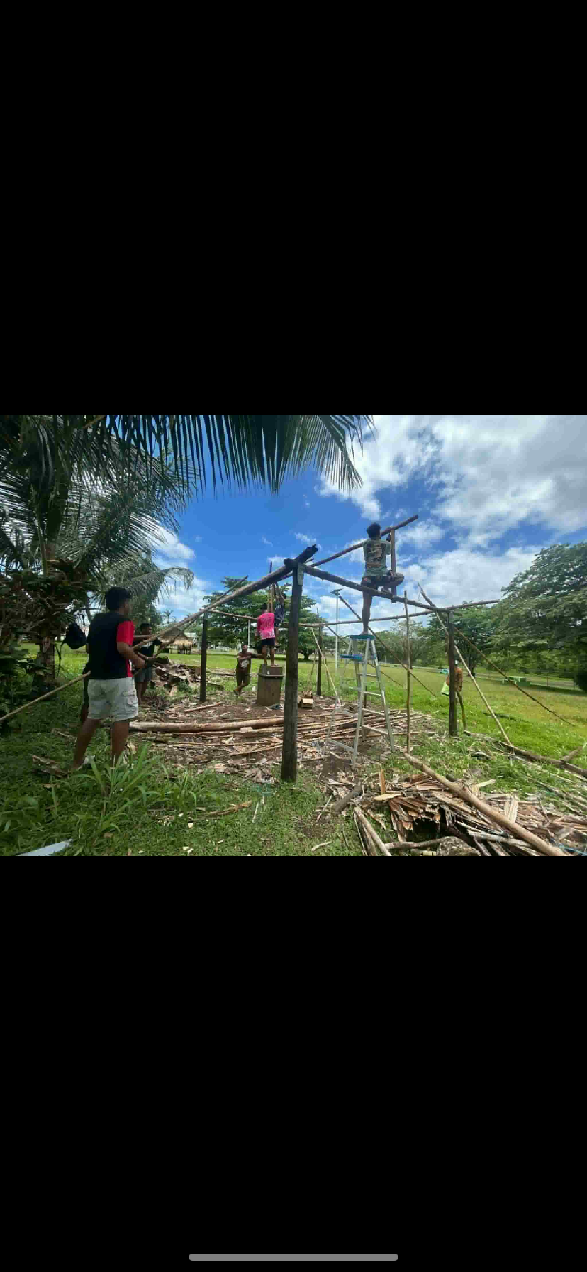
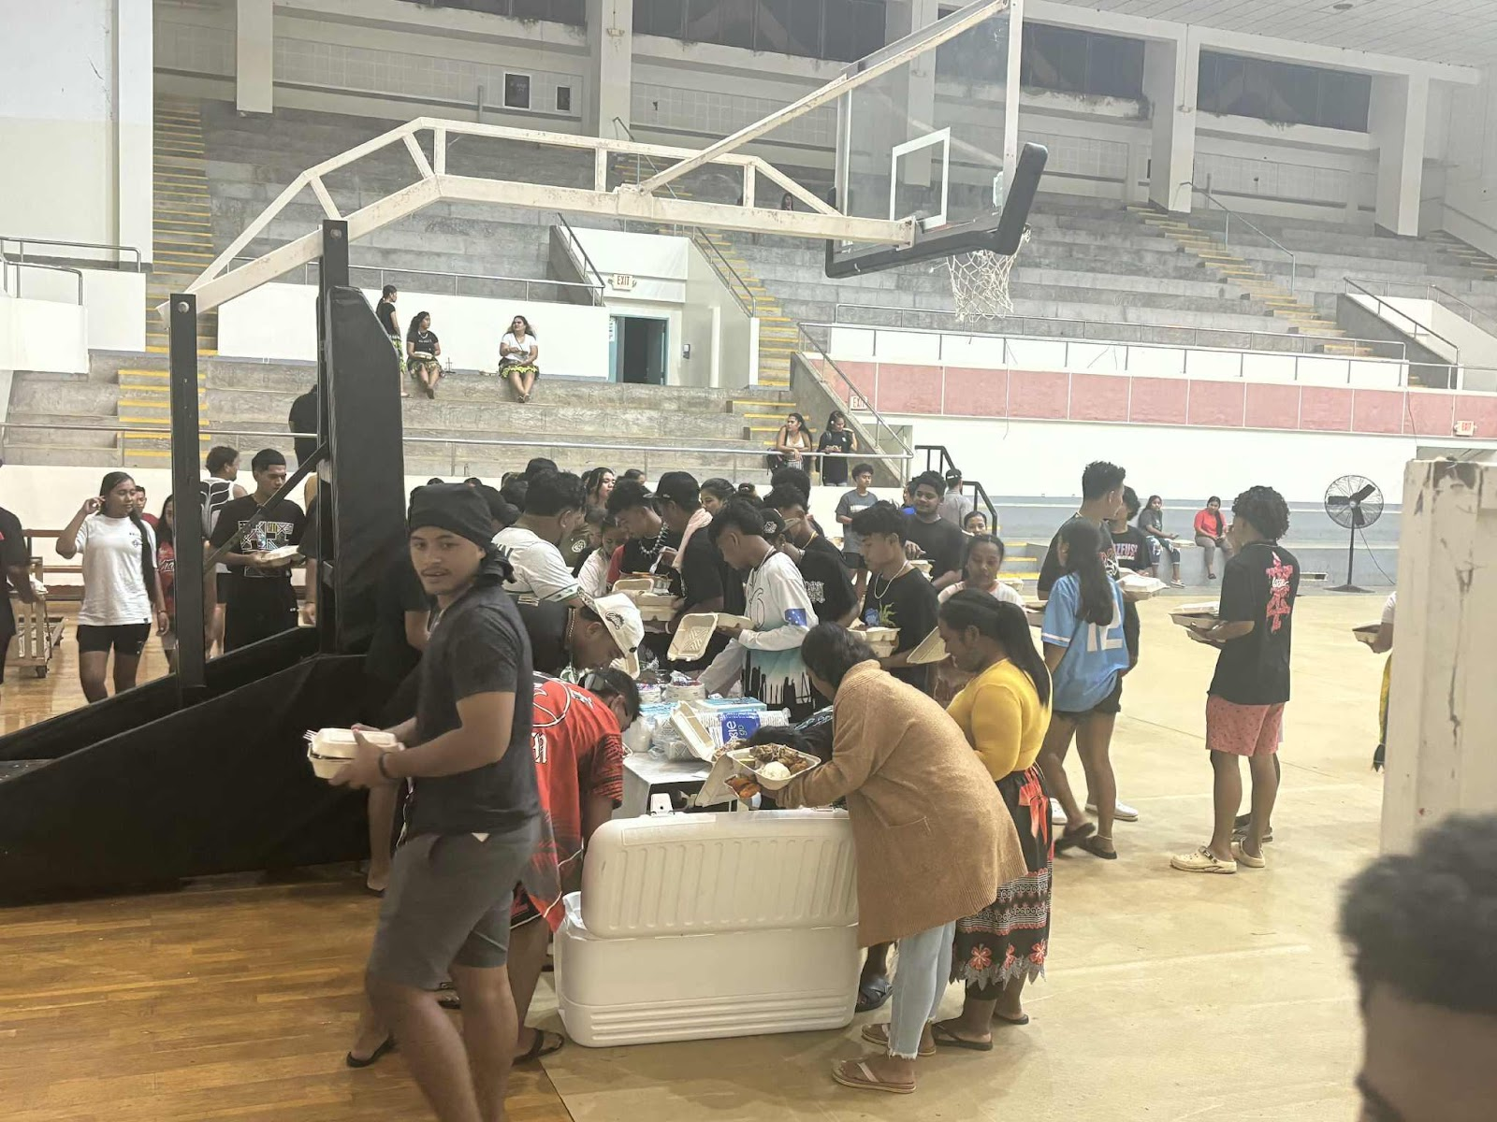
National Campus
Welcome party and completion of the cultural huts
Halloween party
Community Service

Slide 6
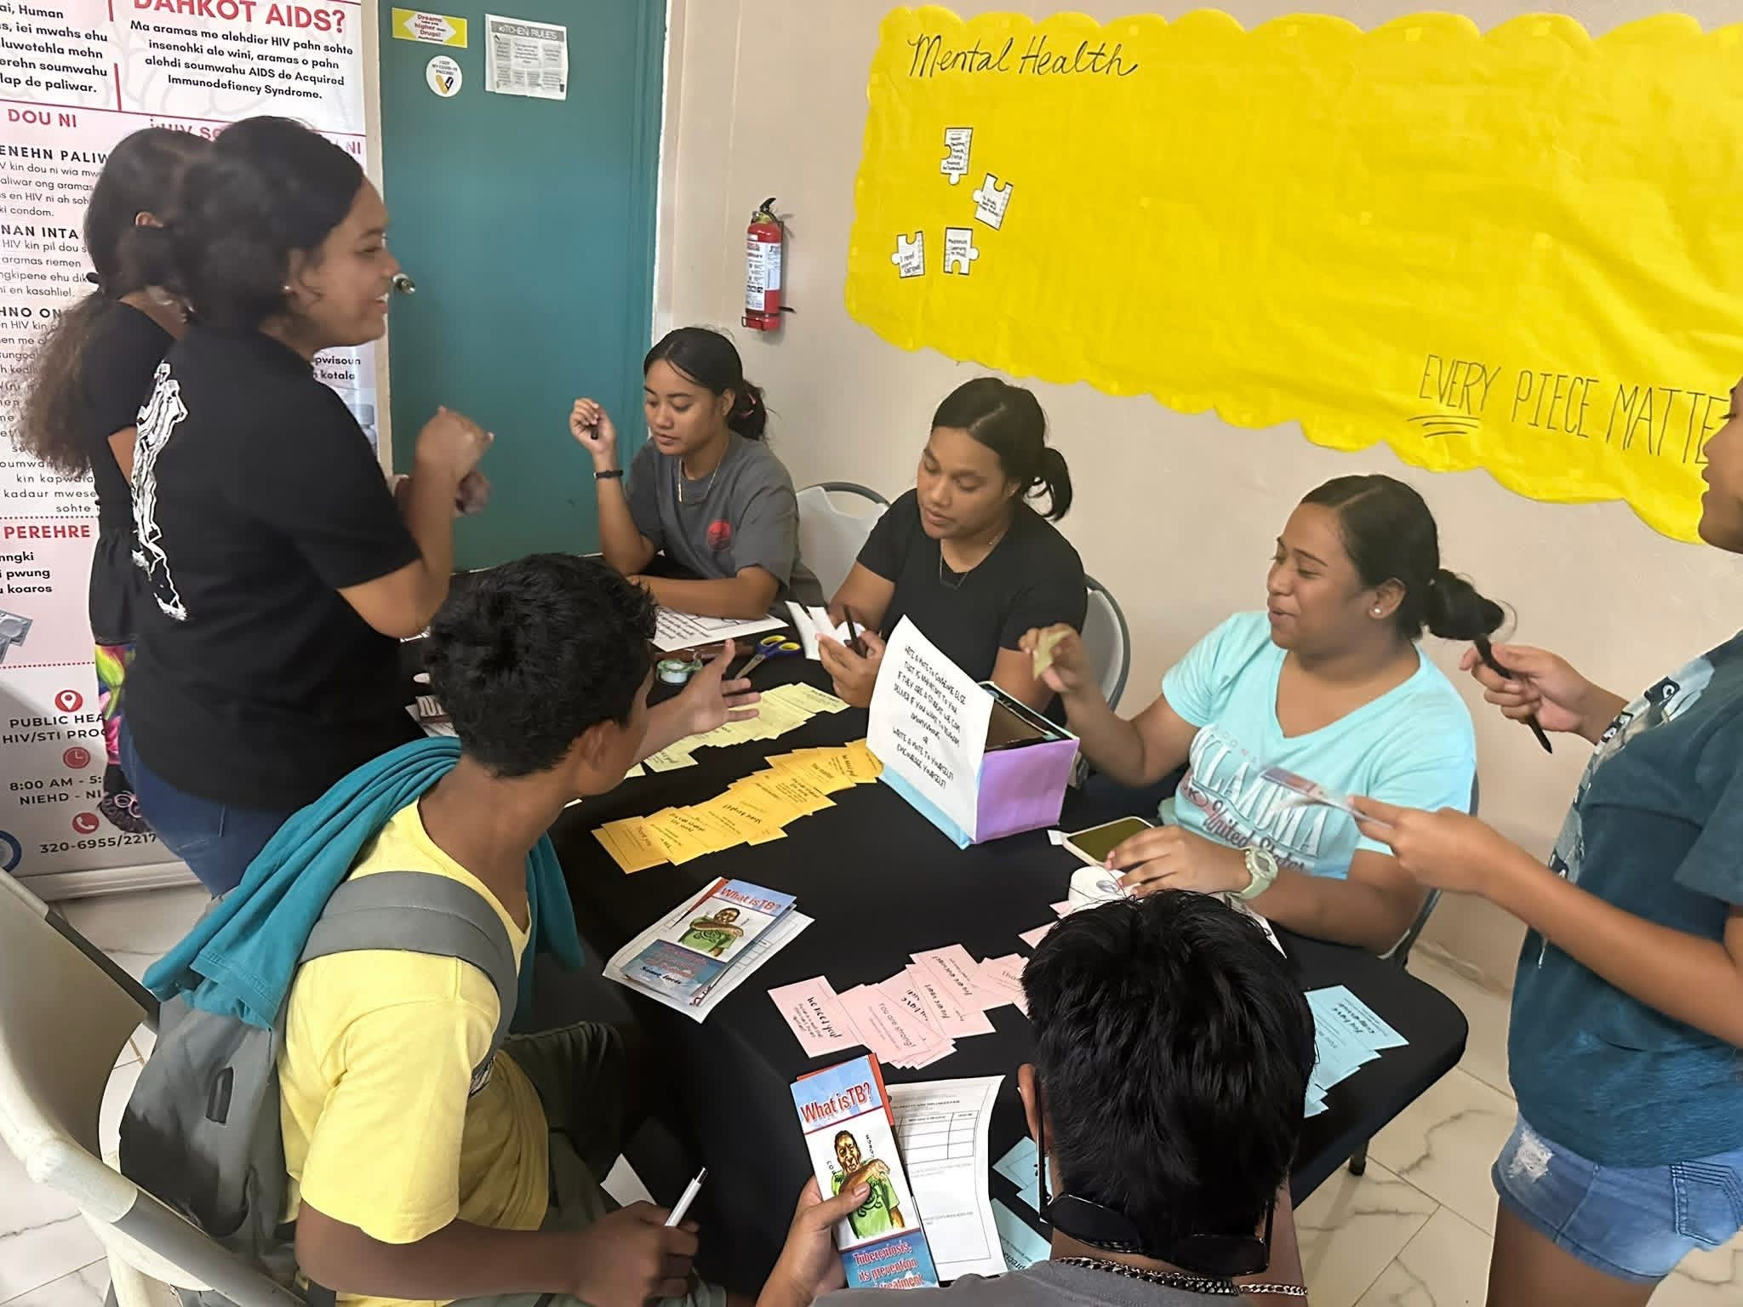
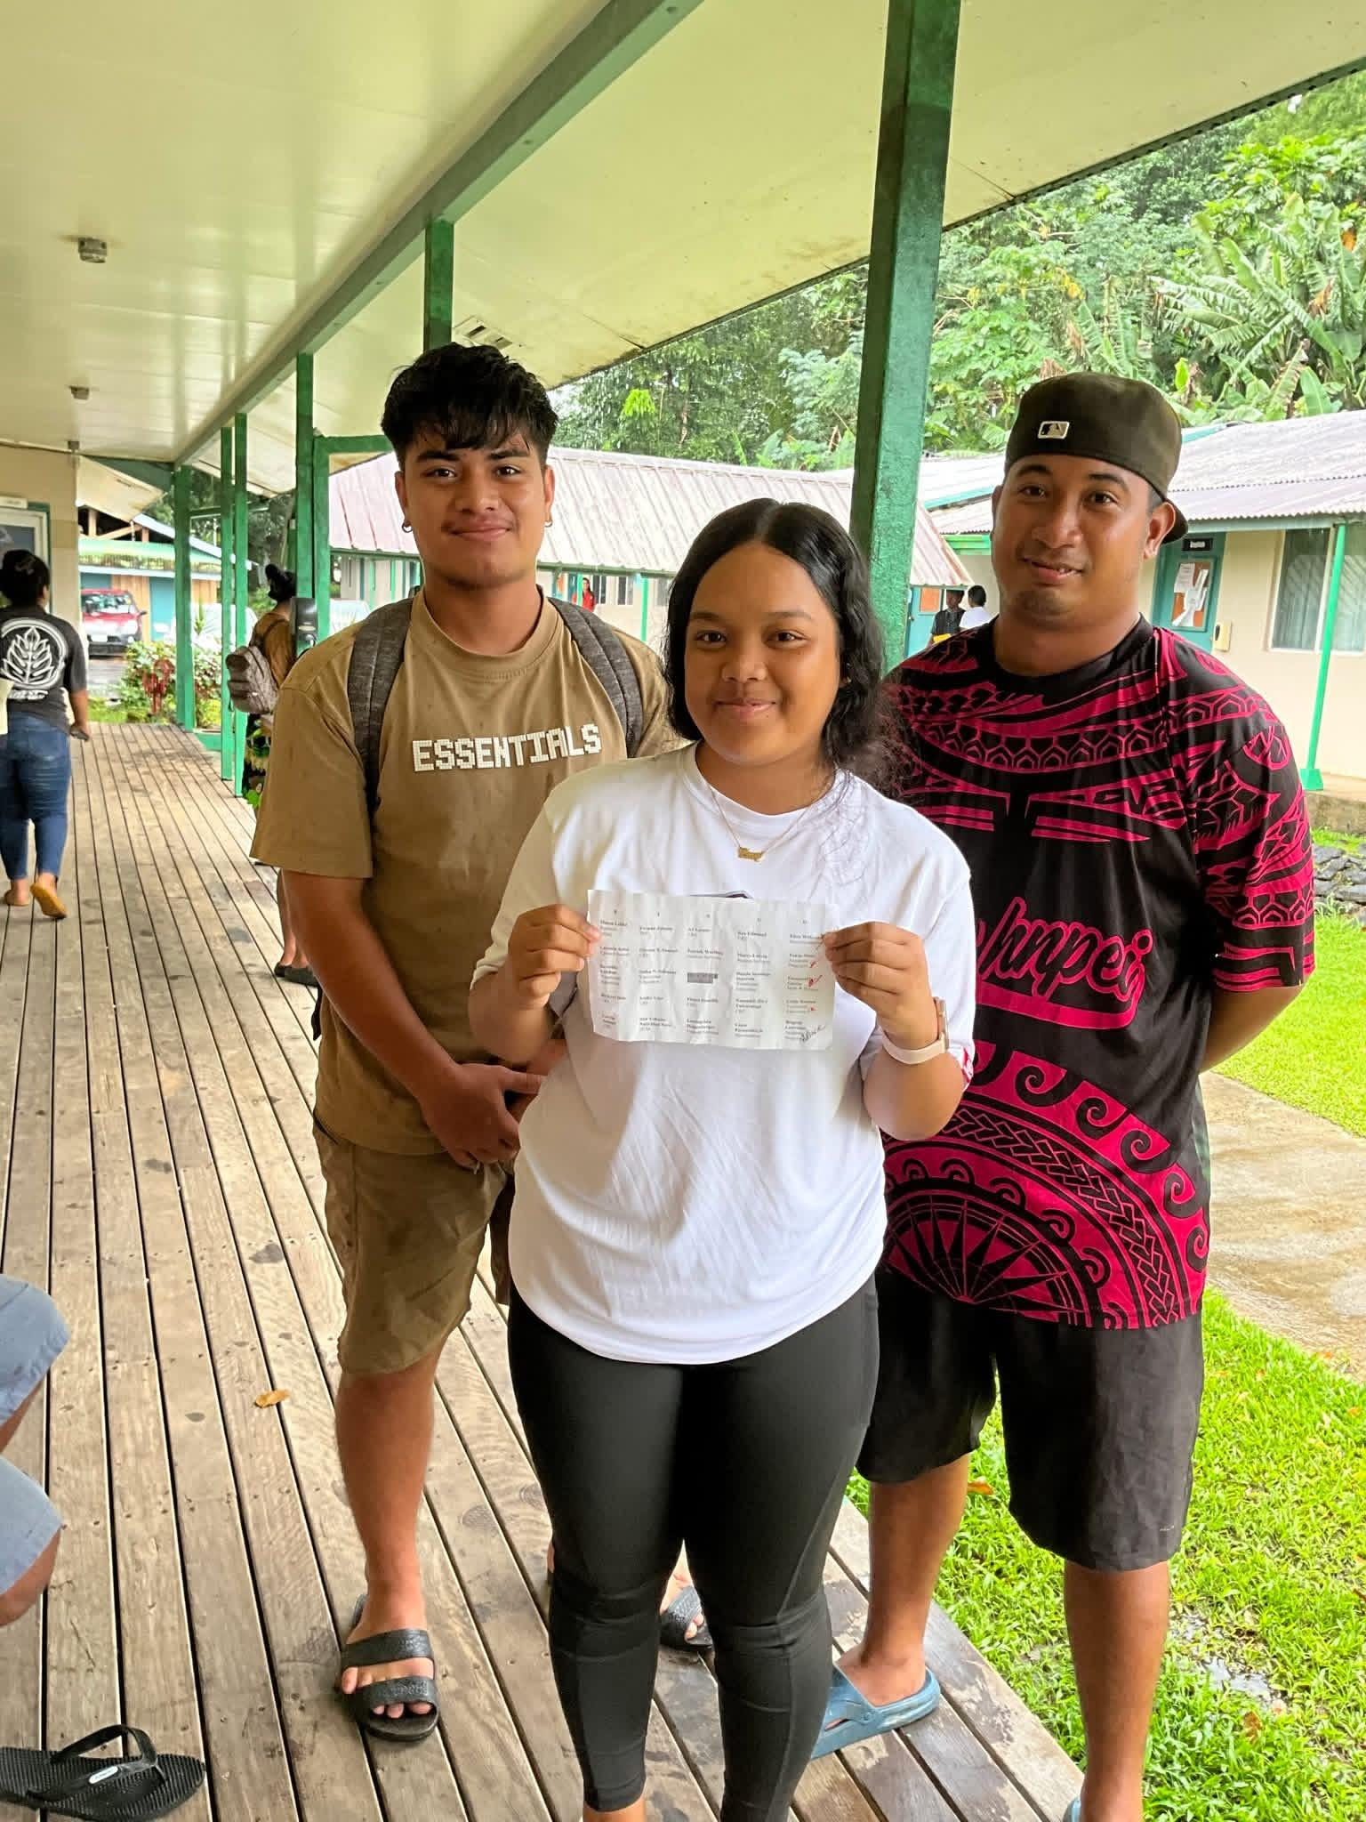
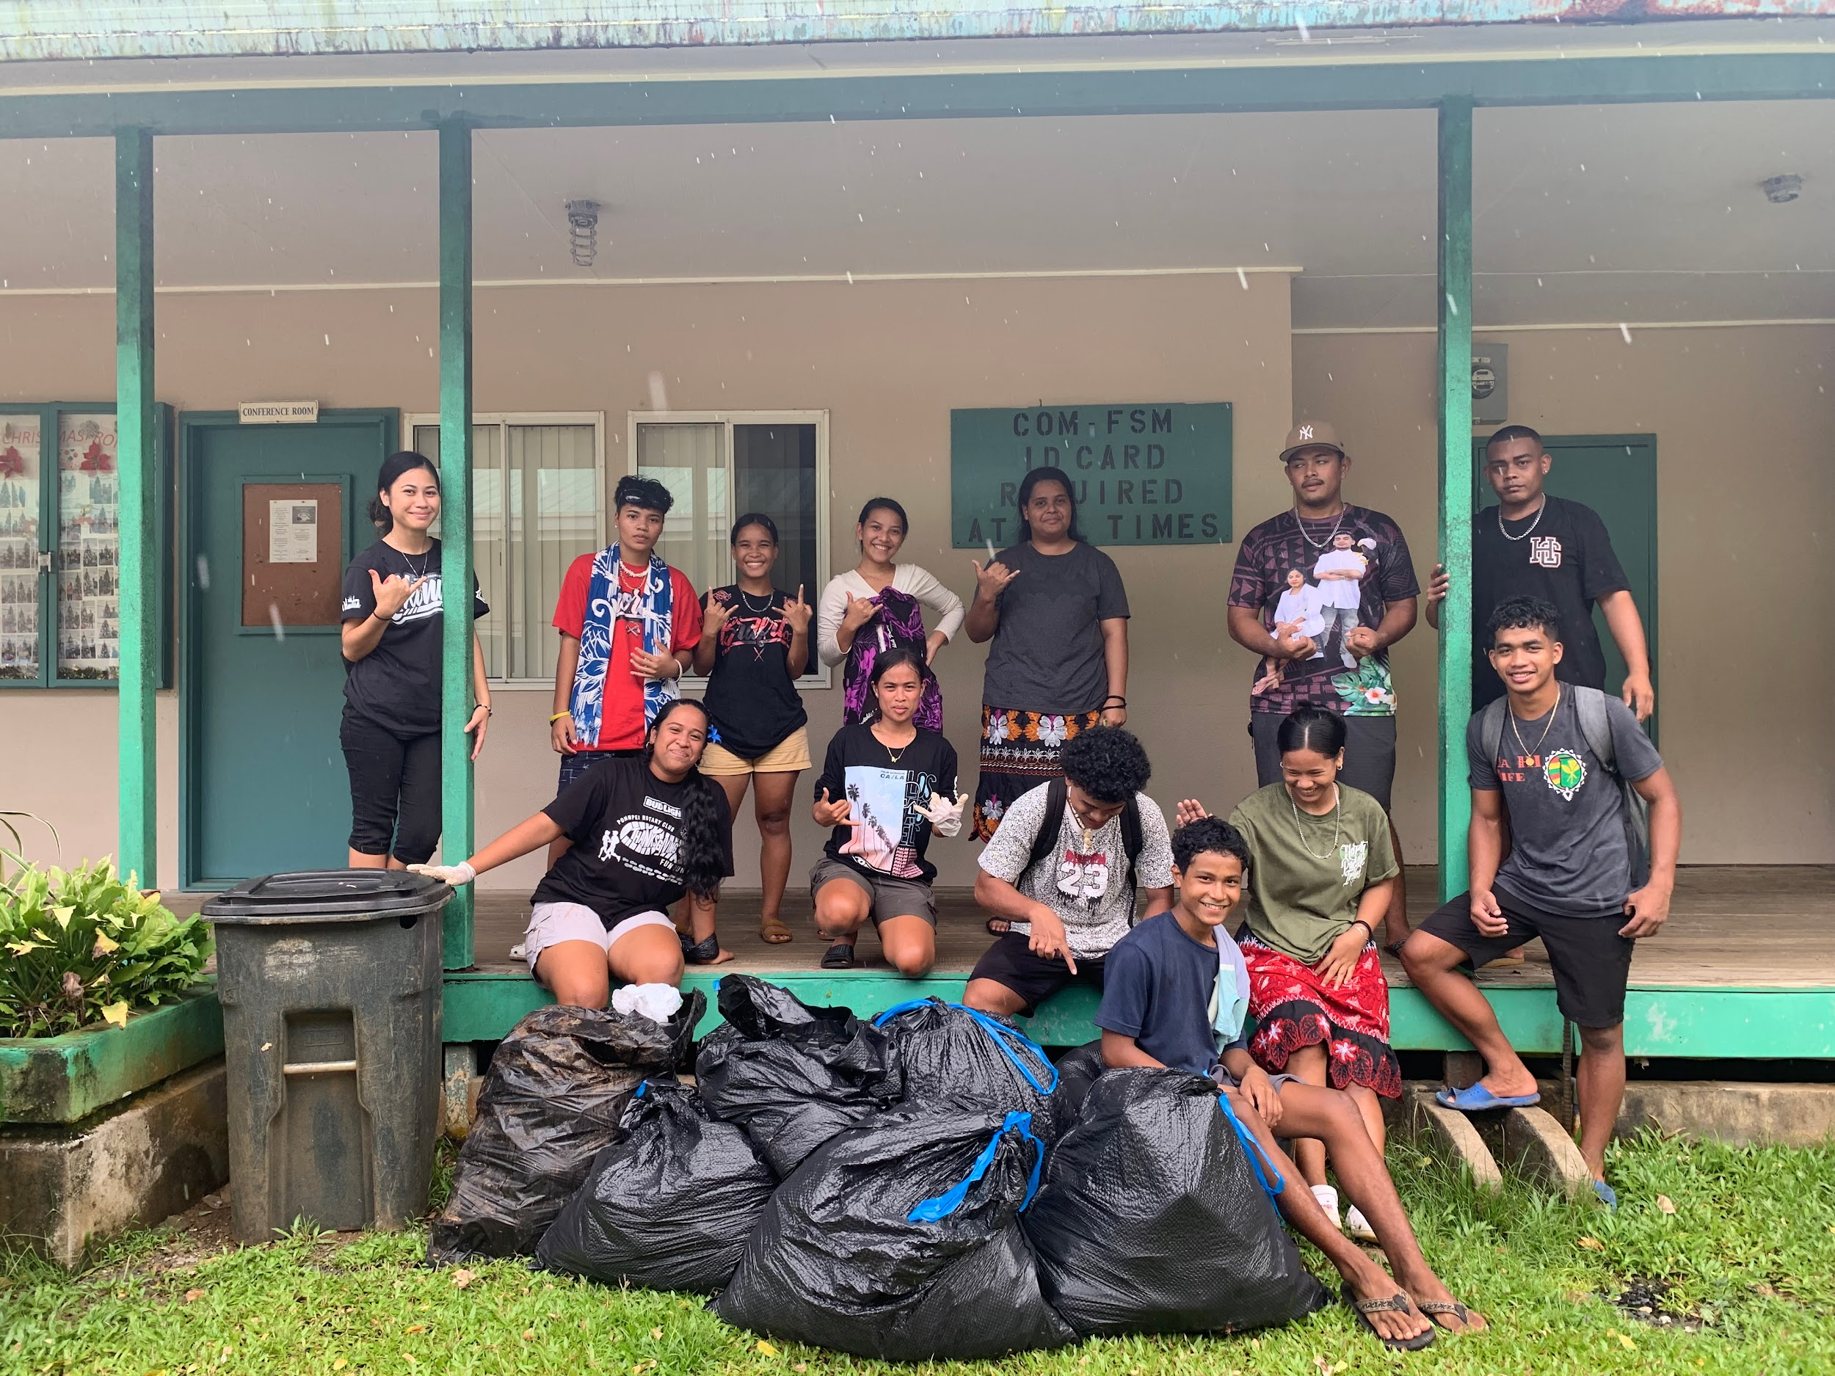
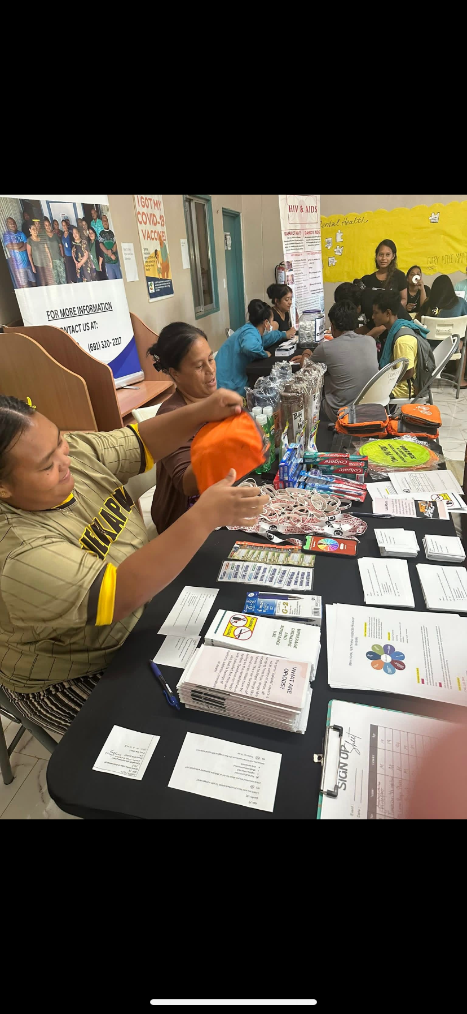
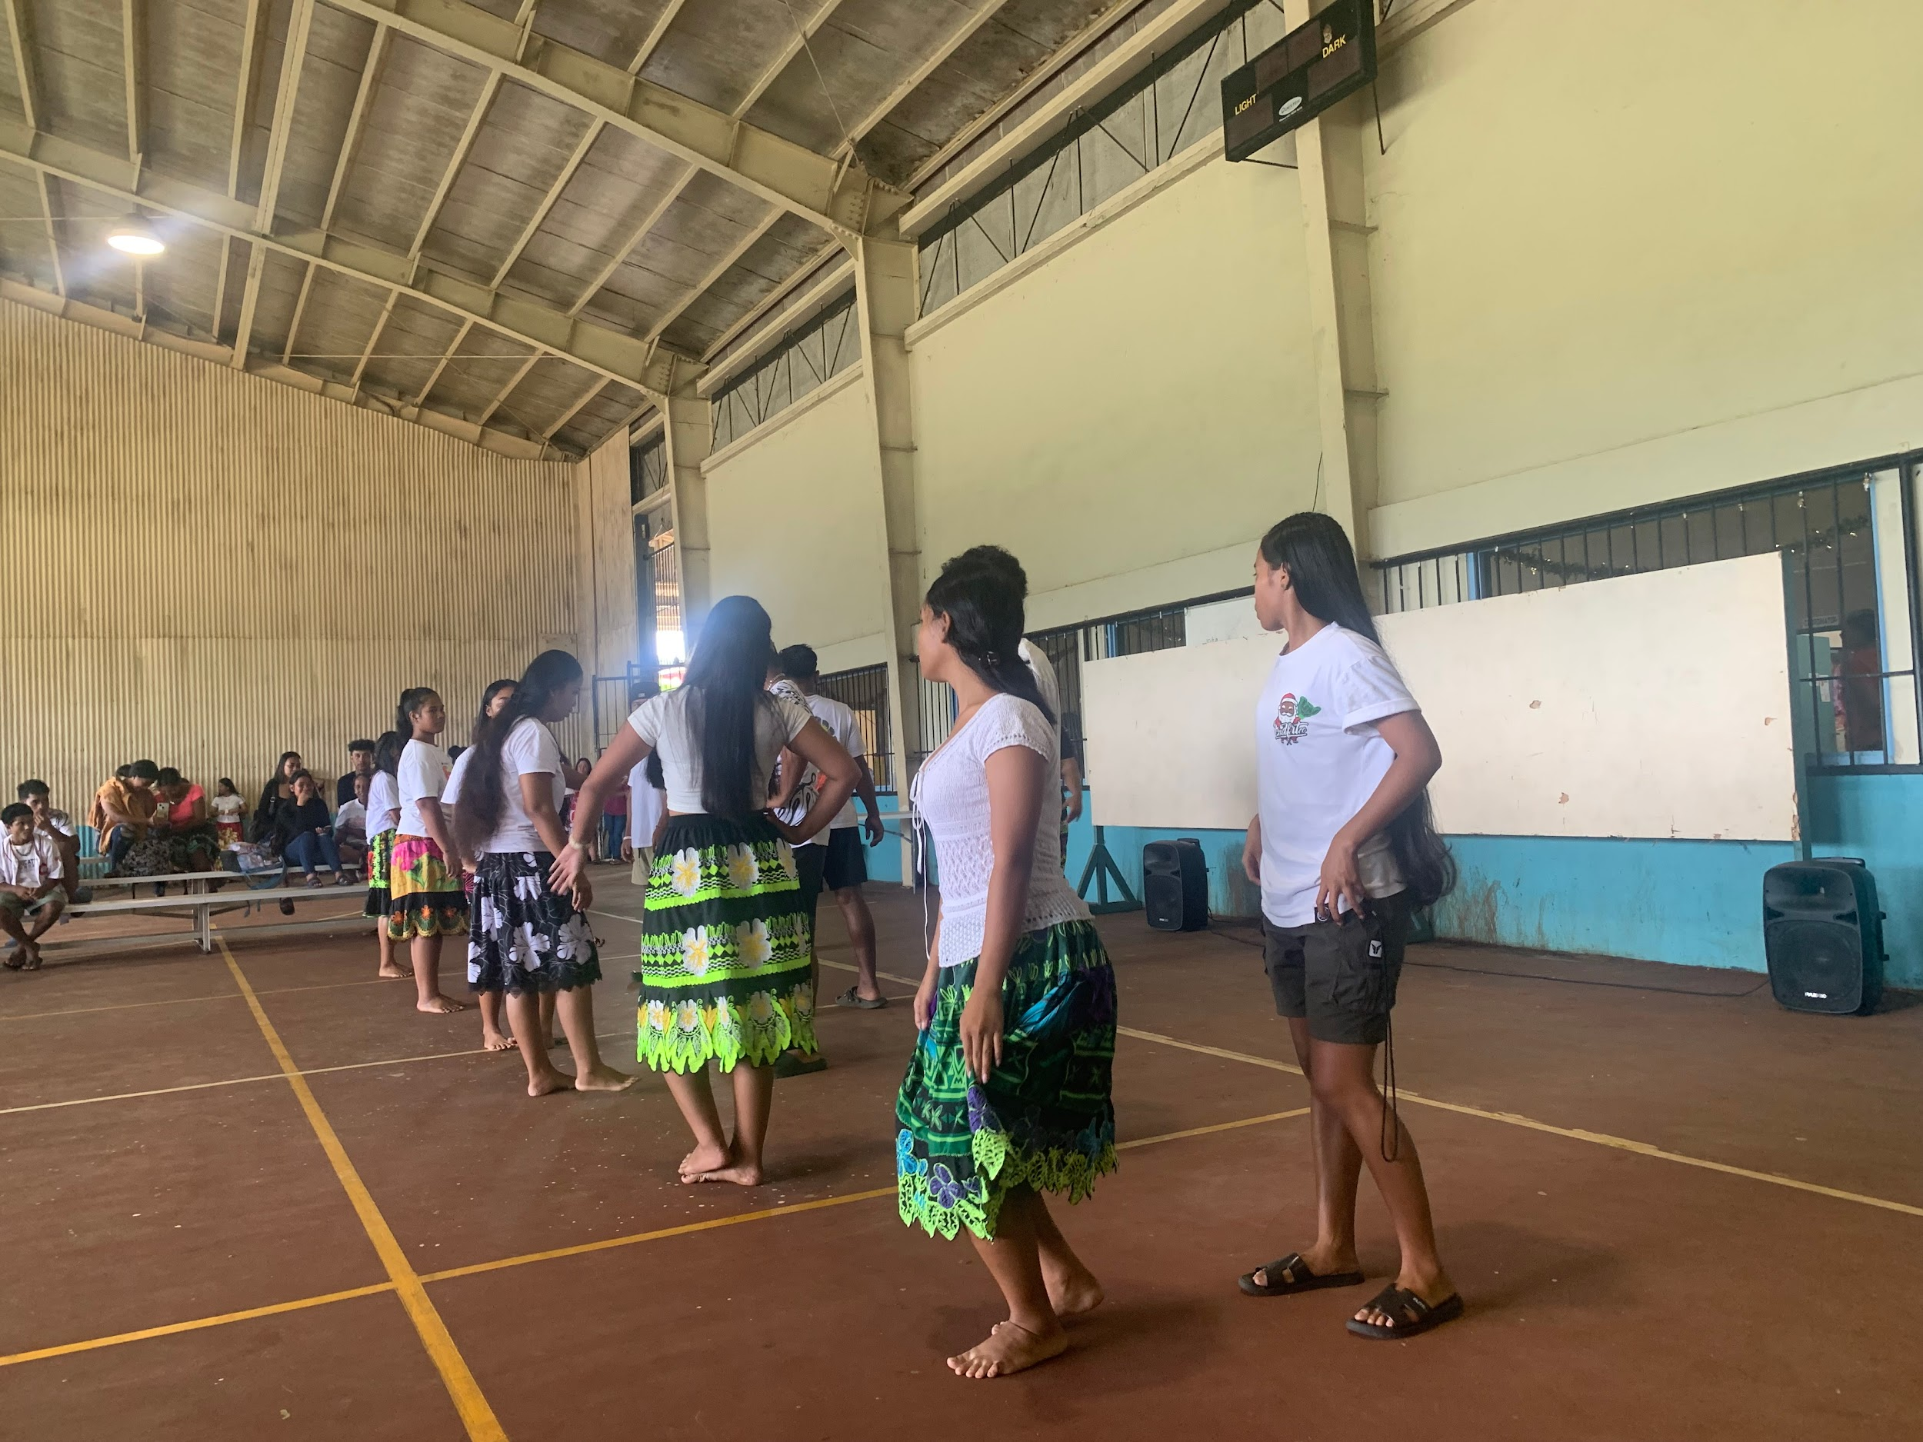
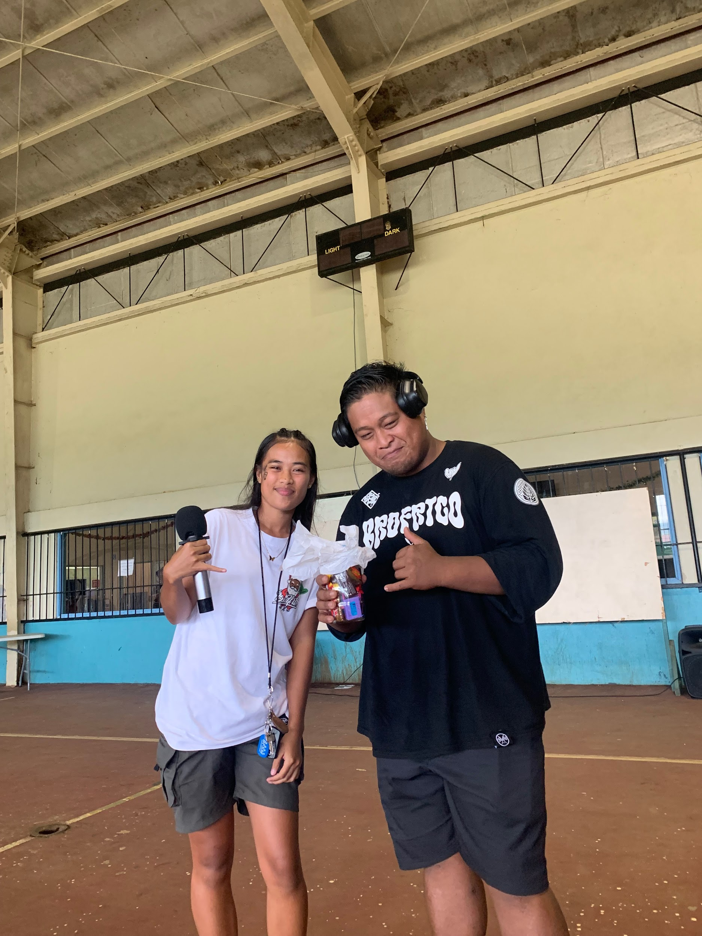
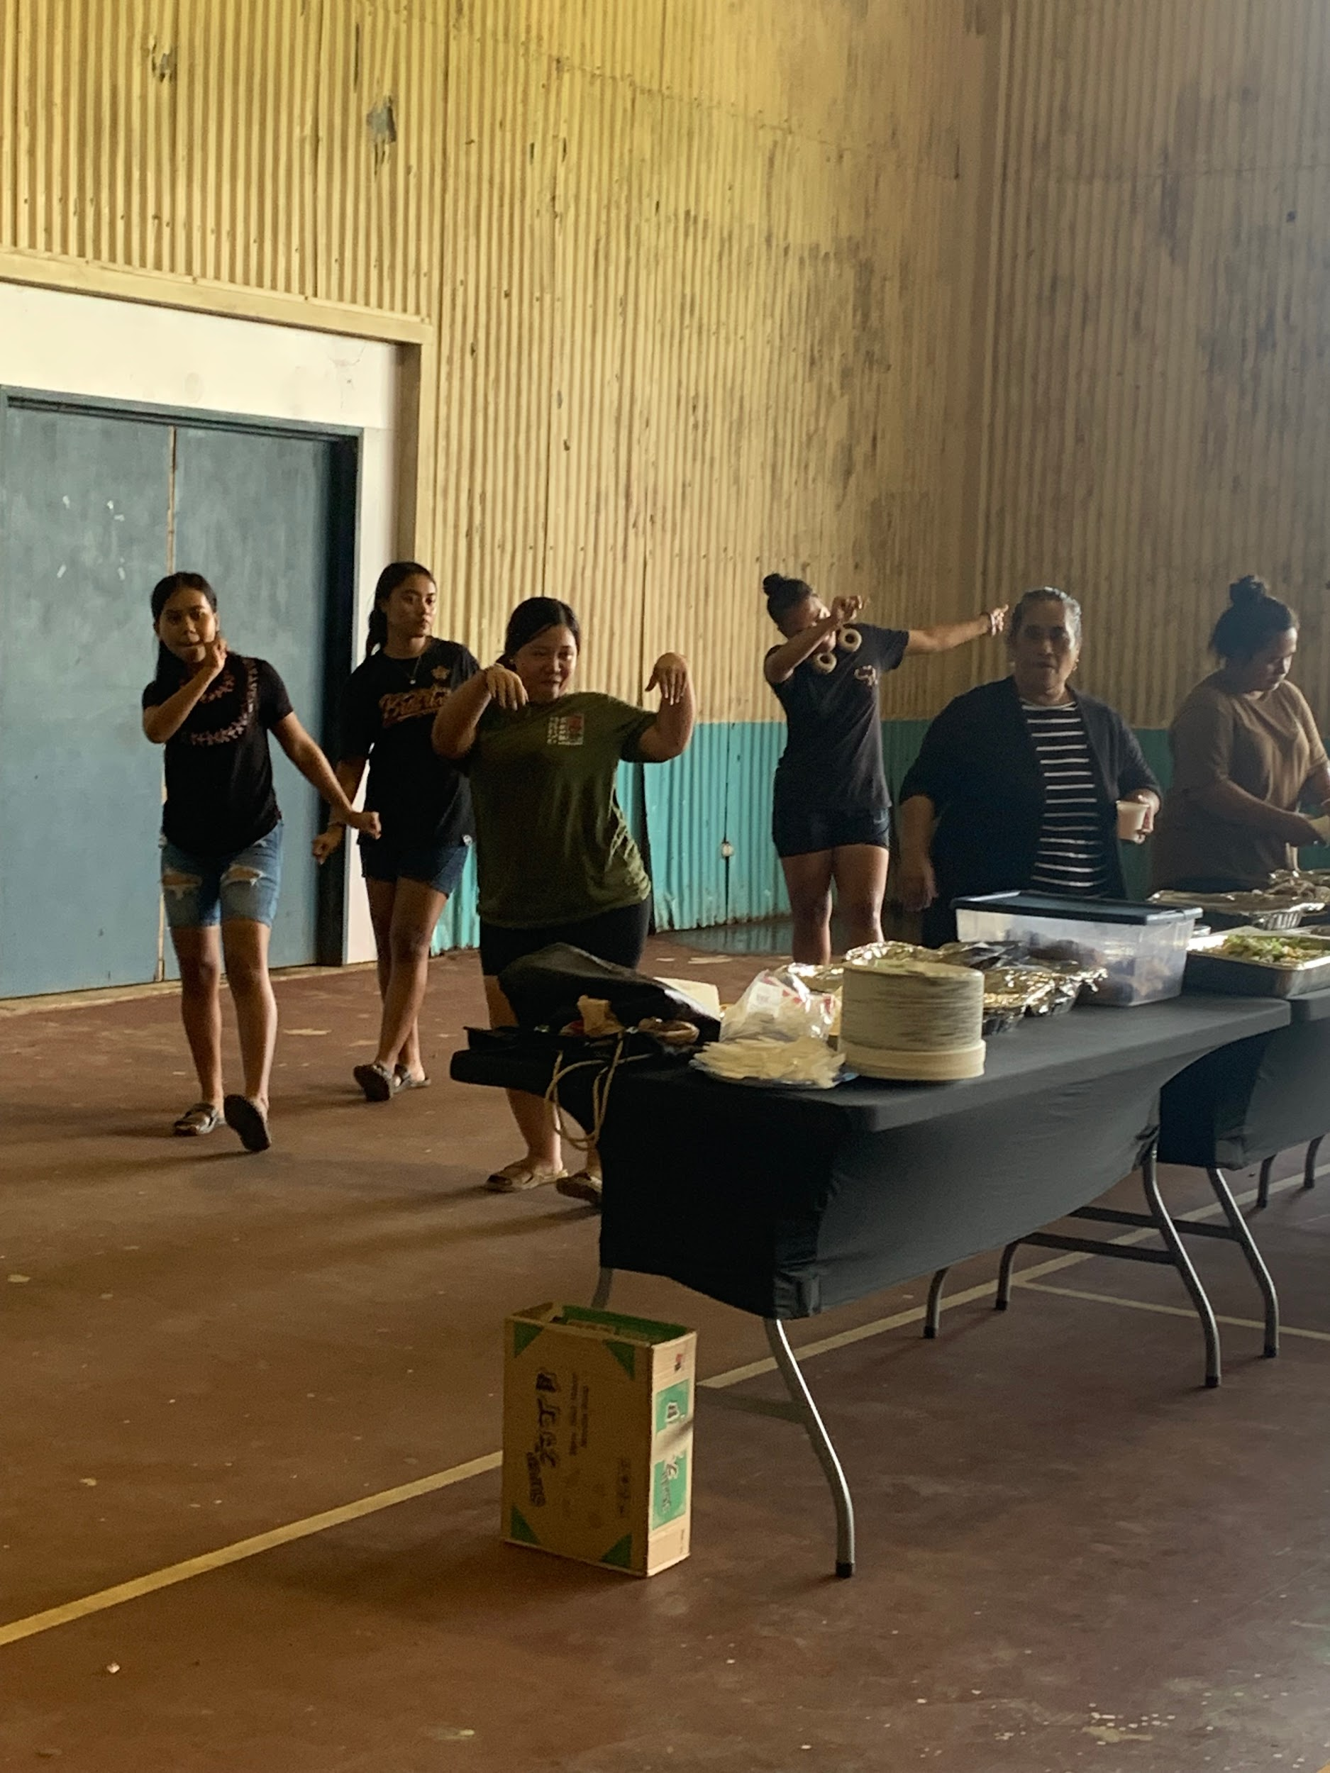
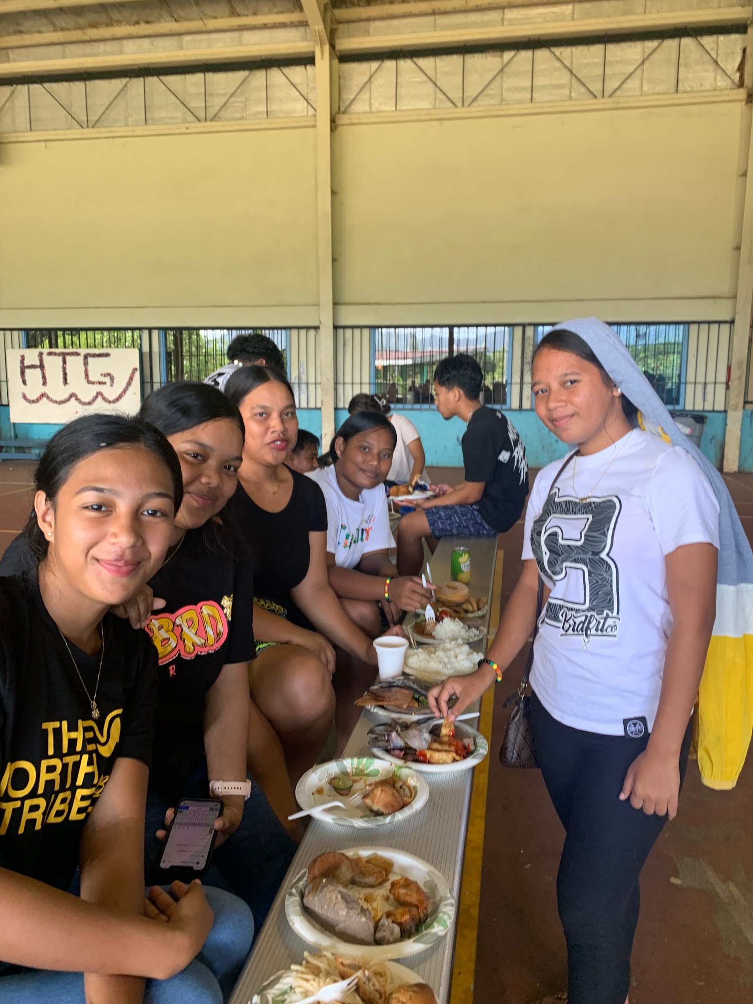
Career and Technical Education (CTEC)
Fun Monday
Community service
Mental health
Halloween
Thanksgiving/christmas

Slide 7
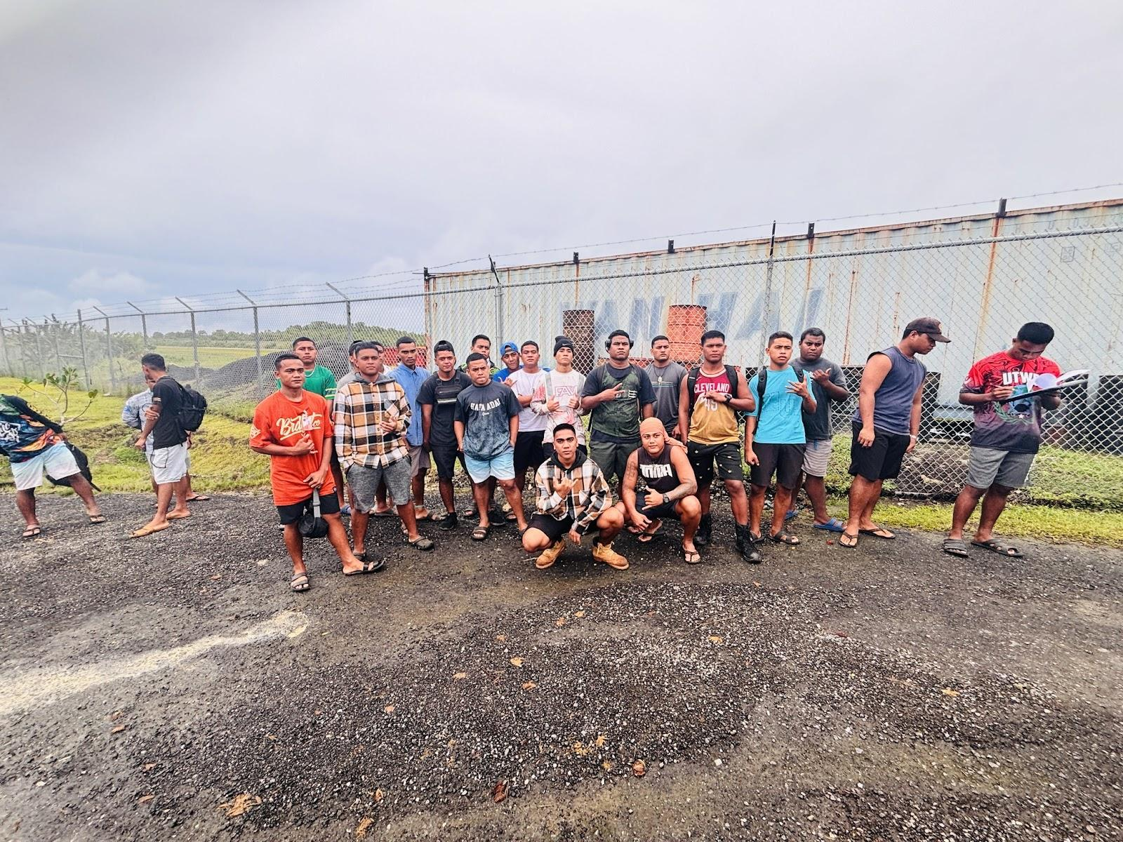
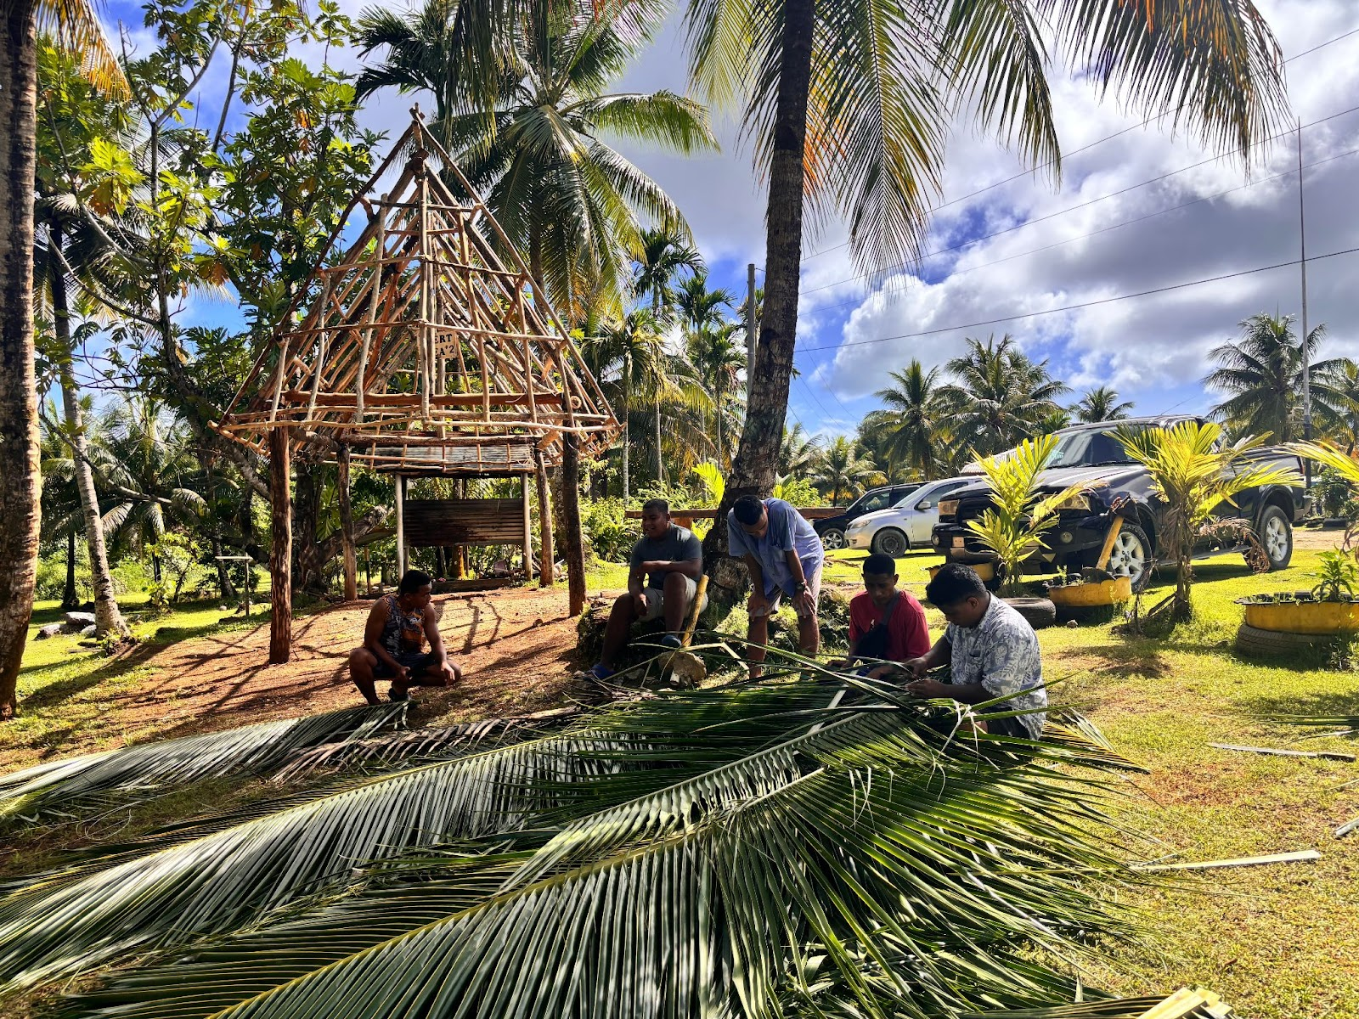
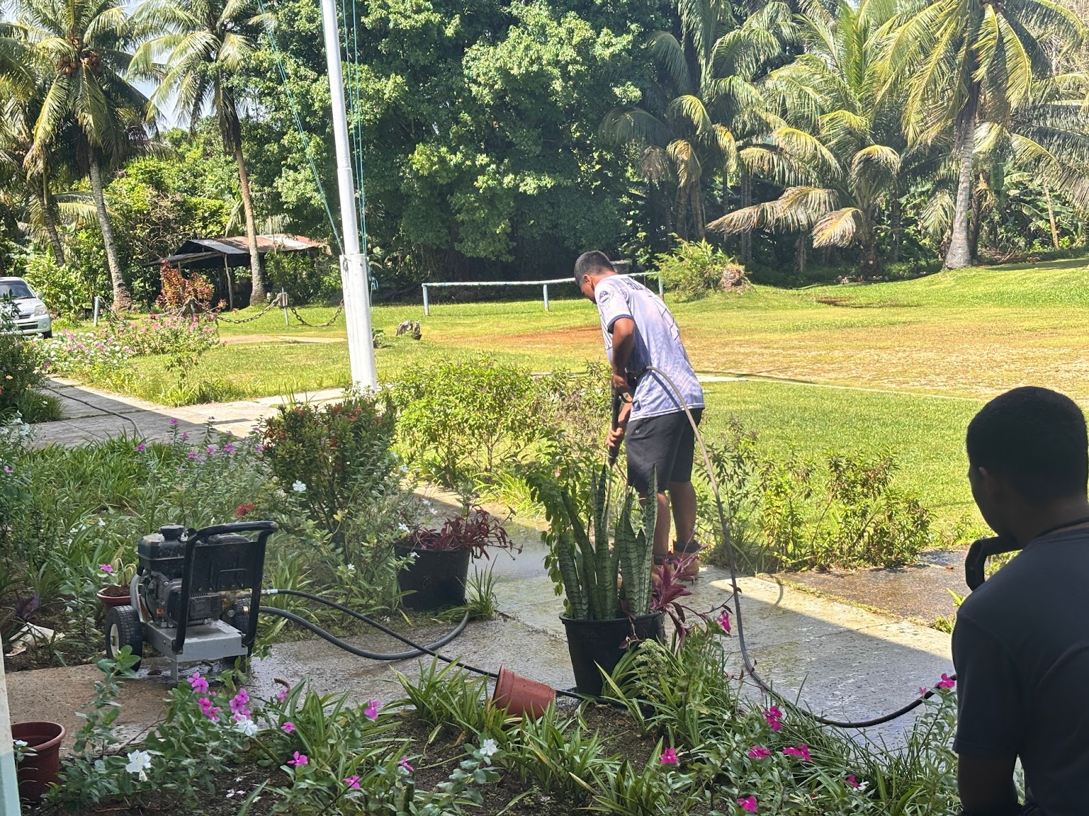
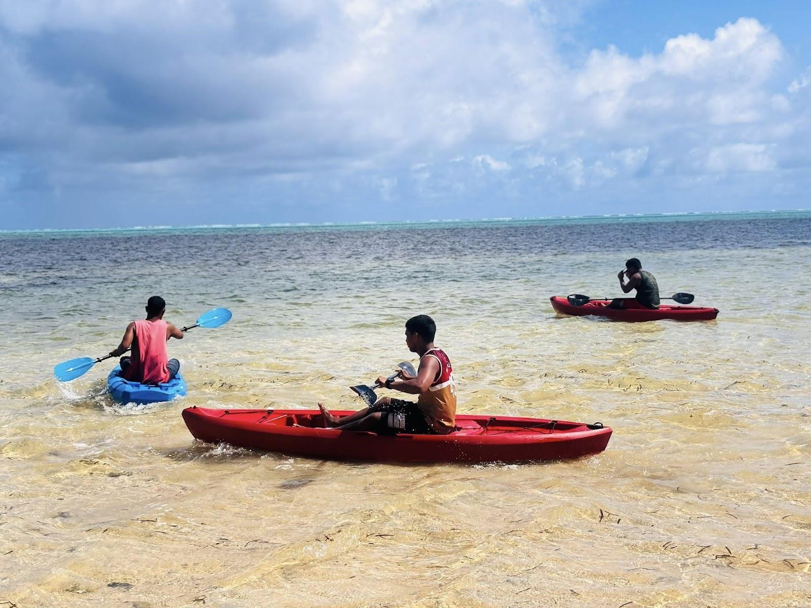
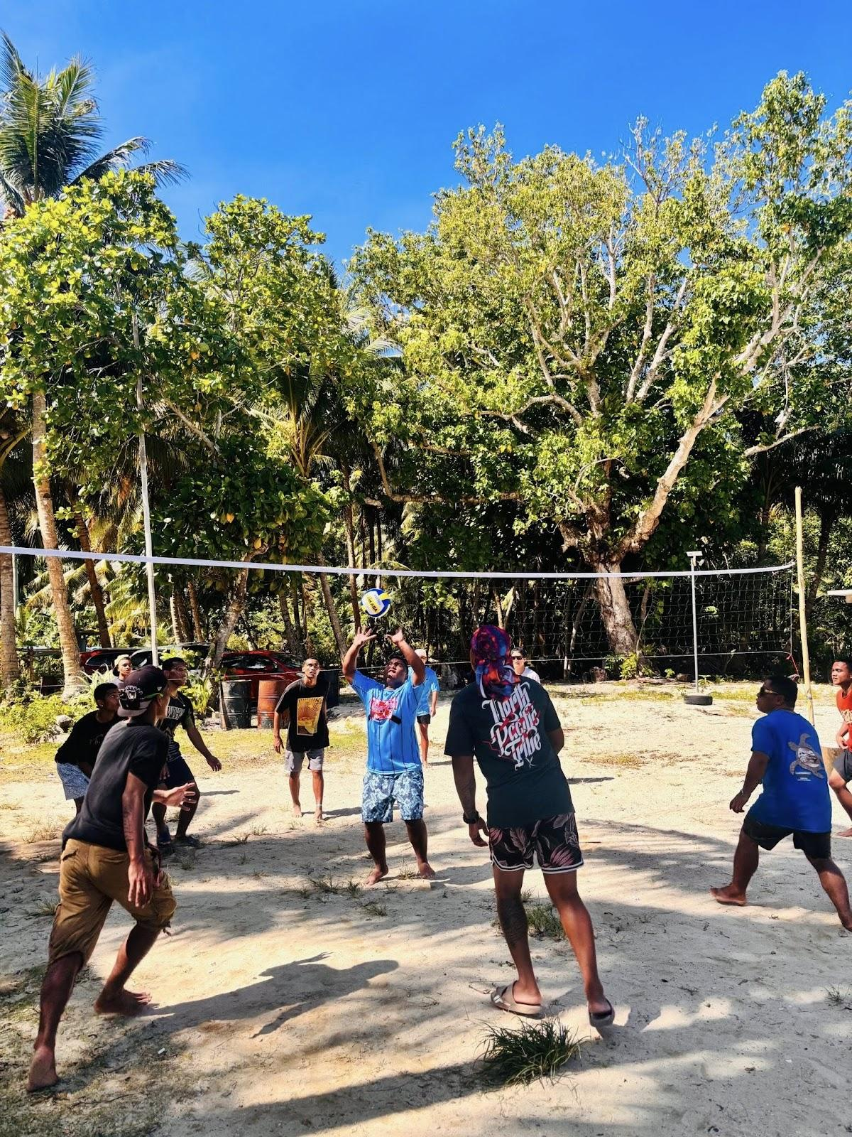
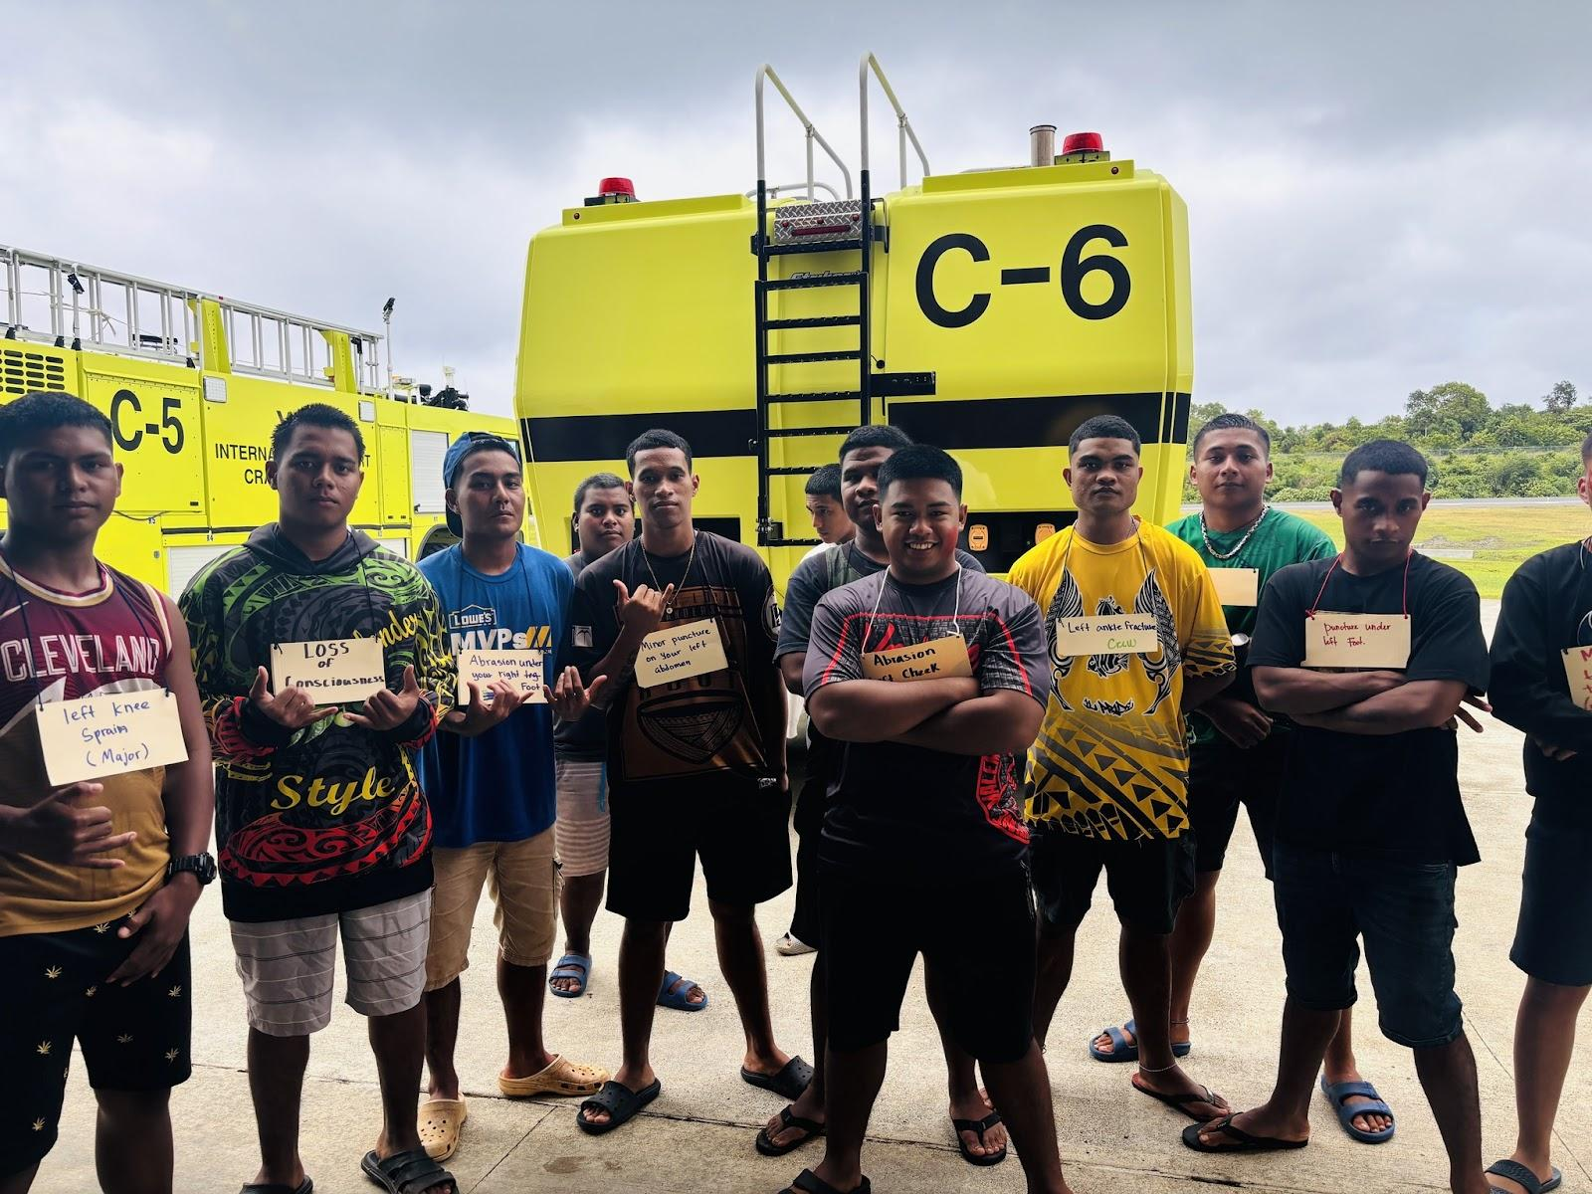
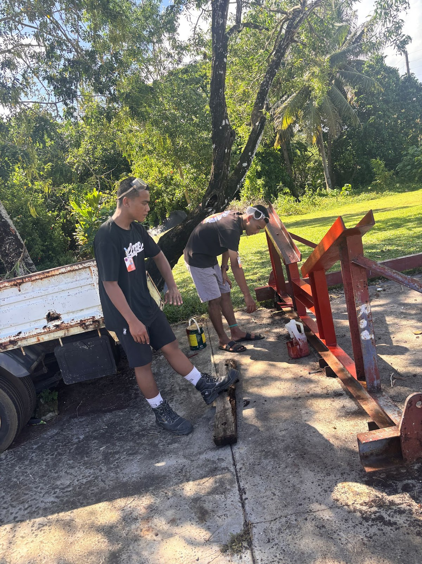
Fisheries and Maritime institute (FMI)
Helping campus running smoothly
Cadet activities
Emergency exercise

Slide 8
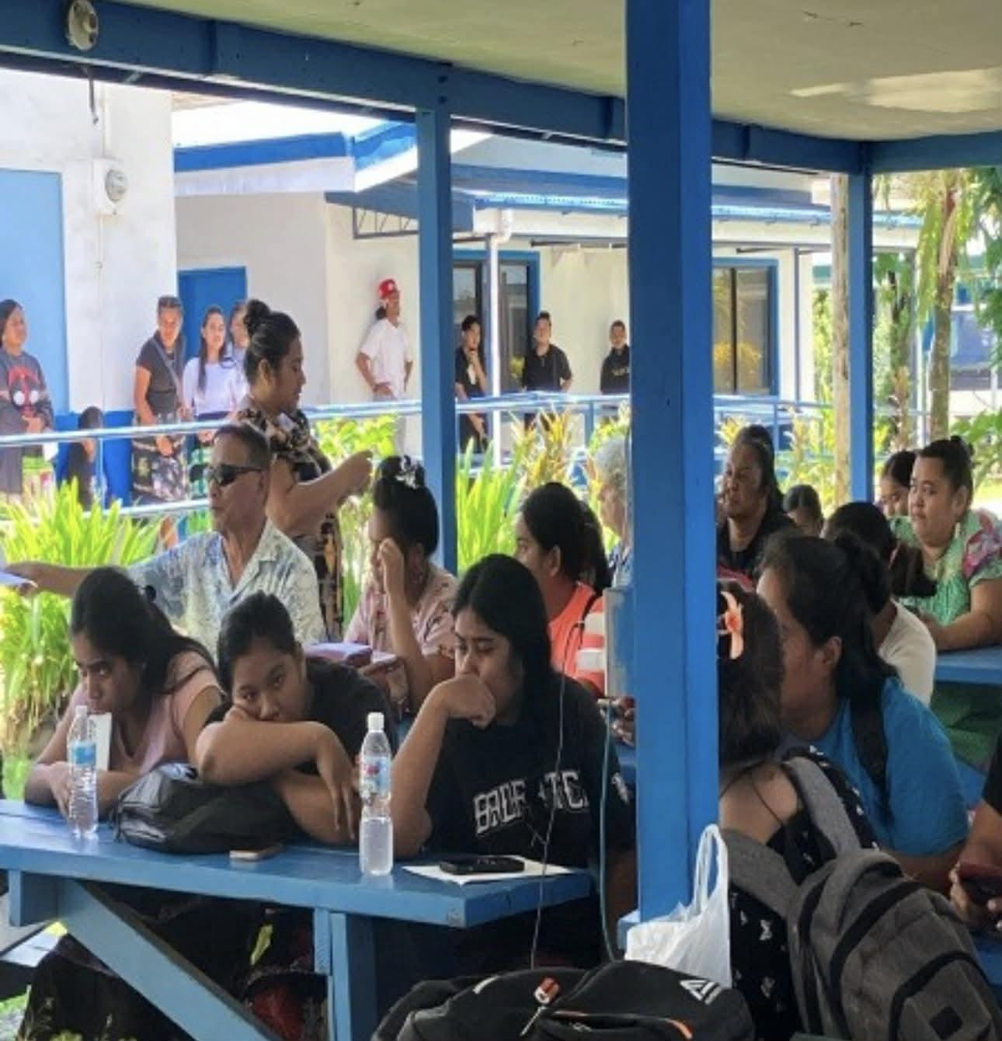
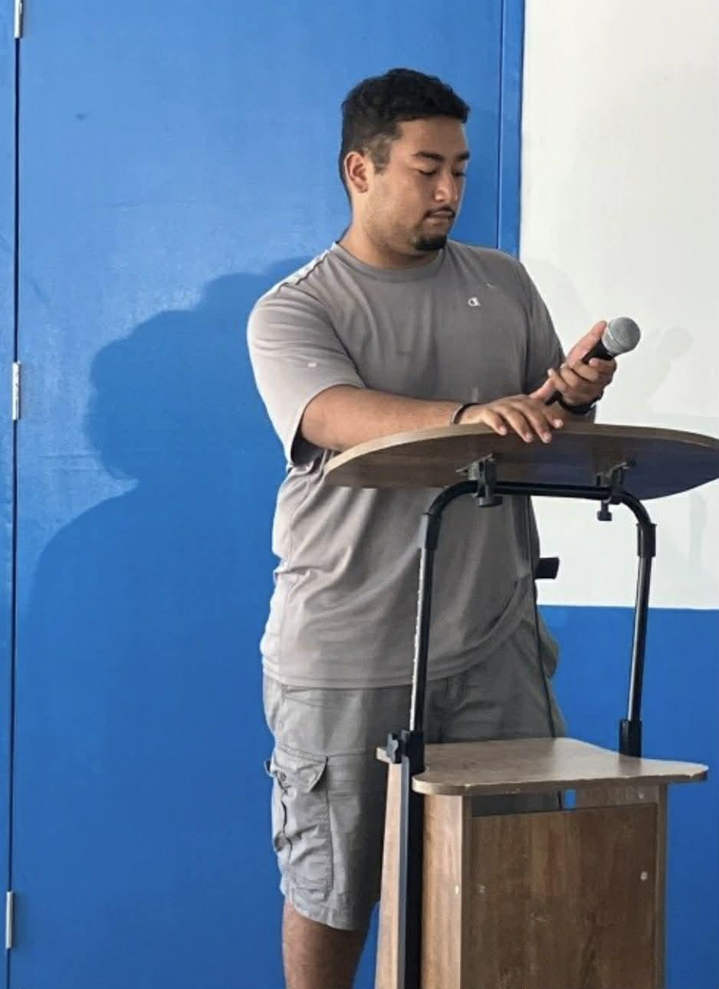
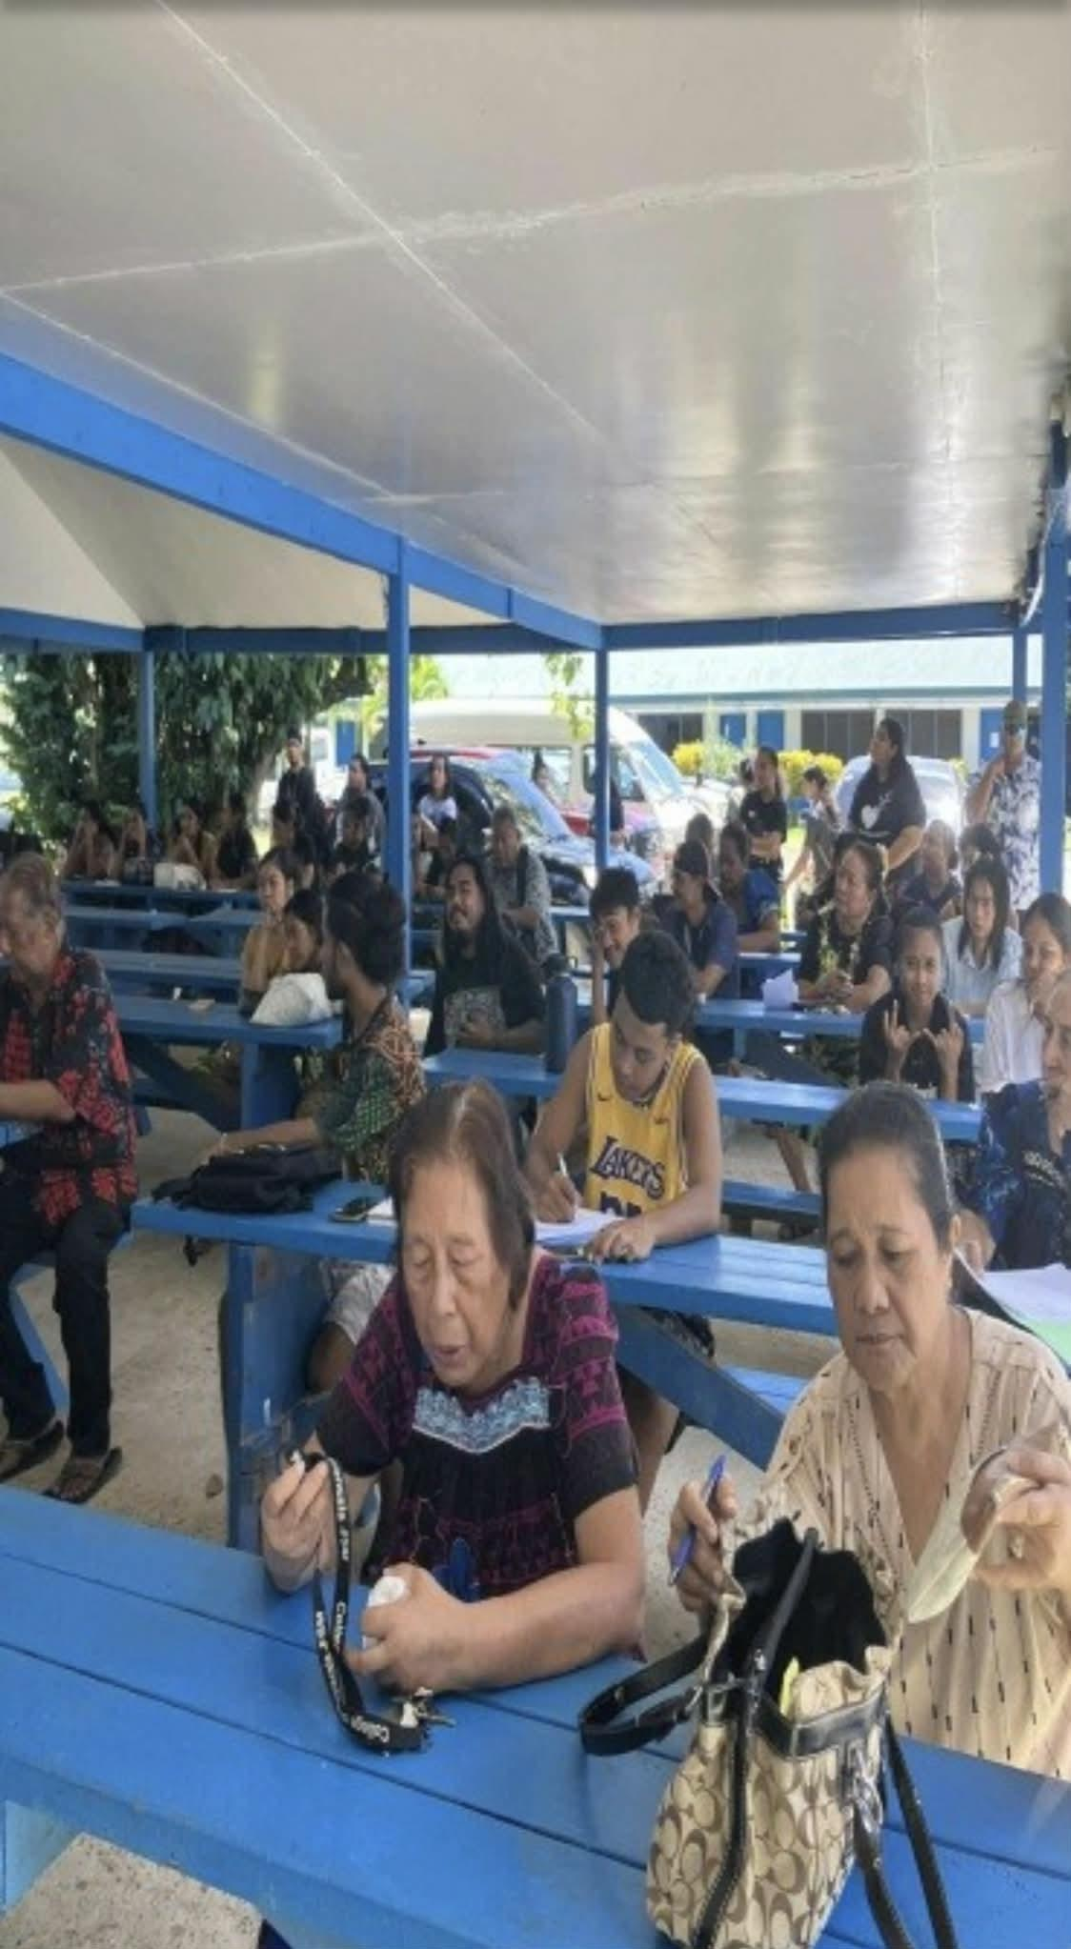
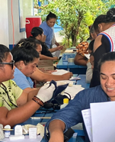
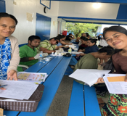
Chuuk Campus
SBA sponsor November all Campus Meeting
World diabetic day a collaboration day with health services

Slide 9
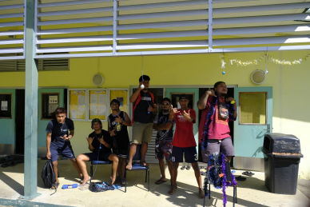
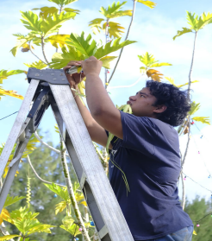
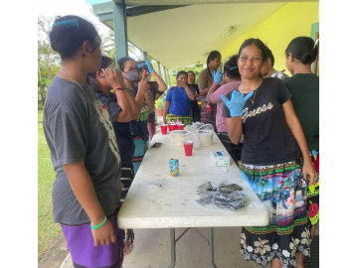
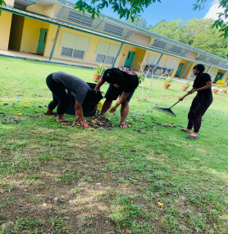
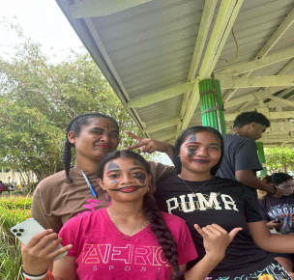
Yap Campus
Regular Friday cleanup
Halloween Fun
Christmas decoration competitors

Slide 10
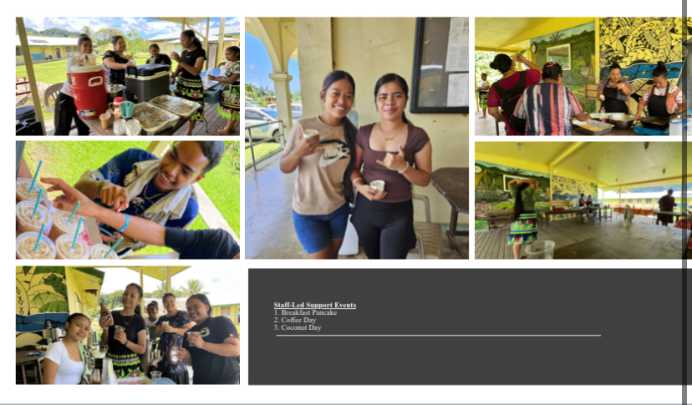


Kosrae Campus
Spirit Week
Fundraiser
Staff-Led Support Event
Kick off

Slide 11
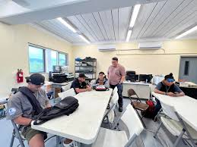
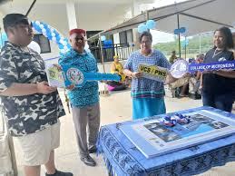
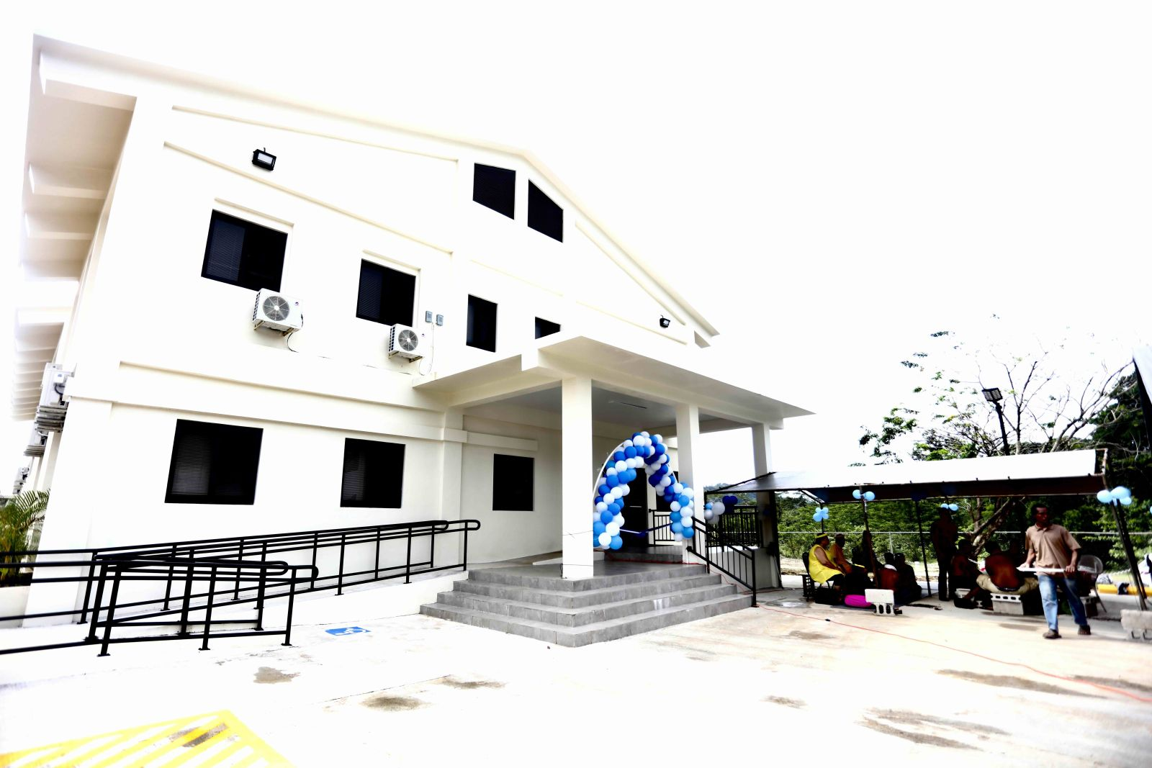
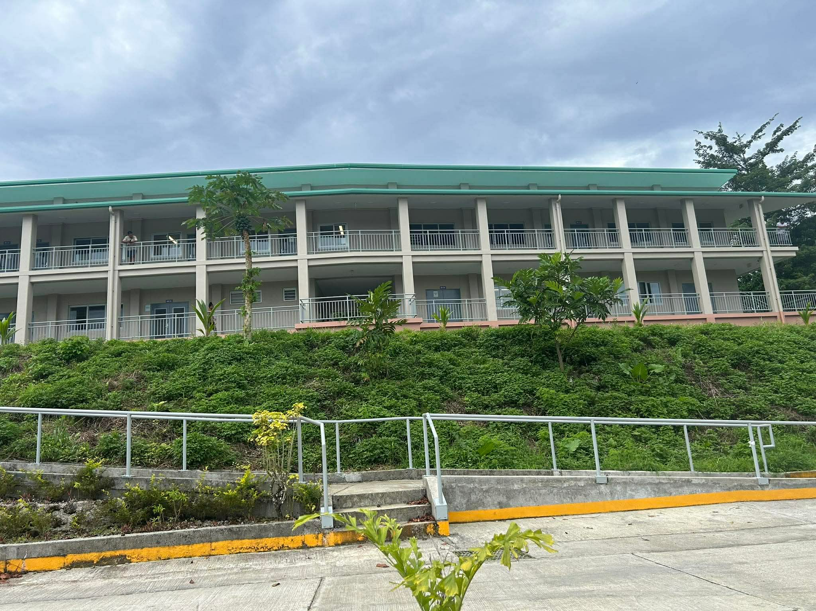
Improvement
Buildings for Nursing and Trades and Technology Programs

Slide 12
Challenges
Need for new or improved campus facilities (Chuuk)
No work study (FMI)

Slide 13
Conclusion
This year brought important achievements and meaningful steps toward improvement. Each area has helped shape a stronger path forward for our college. With continued support and collaboration, we are confident in our ability to build on our progress and address what still needs work. Thank you for your time and continued support.

