Slide 1
Financial Report
As of October 31, 2025

Slide 2
I. Overview
This report summarizes the overall financial health of the College of Micronesia-FSM.
Compares budgeted amounts vs actual expenditures, budget proposal for FY2027
Highlights opportunities for strategic fund allocation and monitoring.
Audit Status

Slide 3
II. Budget A. FY2025 Approved Budget
FY2025 Budget | Summited to the FSM Govt. | Approved by the FSM Govt.
Tuition | $7,377,049 | $7,377,049
Student Activity/ Health/ Registration | 272,487 | 272,487
Total Cost of Ownership (Facility) | 686,879 | 686,879
RH/Others | 192,861 | 192,861
FSM (ESG) | 1,000,000 | 4,018,539
FSM (General Fund) | 7,058,451 | 0
Total | $16,587,727 | $12,547,815

Slide 4
B. FY2025 Actual Expenses as of October 31, 2025
Campus | Budget | Actual | Balance
National | 7,356,926.84 | 7,146,659.24 | 210,267.60 | 3%
CTEC | 2,062,540.00 | 1,530,768.28 | 531,771.72 | 26%
Chuuk | 1,394,992.21 | 1,152,031.70 | 242,960.51 | 17%
Kosrae | 879,485.00 | 641,343.75 | 238,141.25 | 27%
Yap | 853,870.95 | 626,423.78 | 227,447.17 | 27%
Total | 12,547,815.00 | 11,097,226.75 | 1,450,588.25 | 12%
 |  | 0.88 | 12%

Slide 5
C. FY2026 Approved Budget
 | FY2026 Budget Submitted to BOR | Summited to the FSM Govt. | Approved by the FSM Govt. | Budget used for FY2026
Tuition | 6,538,130 | $7,377,049 | $7,377,049 | 6,538,130
Student Activity/ Health/ Registration | 229,898 | 272,487 | 272,487 | 229,898
Total Cost of Ownership (Facility) | 613,922 | 686,879 | 686,879 | 613,922
RH/Others | 217,898 | 192,861 | 192,861 | 217,898
FSM (ESG) | 4,018,539 | 1,000,000 | 5,018,539 | 5,018,539
FSM (General Fund) | 0 | 7,058,451 | 0 | 0
Total | 11,618,387 | $16,587,727 | $13,547,815 | 12,618,387

Slide 6
D. Proposed Budget for FY2027
 | FY2027 Budget Submitted to BOR | Summited to the FSM Govt.
Tuition | 6,154,742 | 7,657,116
Student Activity/ Health/ Registration | 218,100 | 272,487
Total Cost of Ownership (Facility) | 582,585 | 585,585
RH/Others | 125,406 | 125,406
FSM (ESG) | 5,018,539 | 7,018,539
FSM (General Fund) | 0 | 1,000,000
Total | 12,099,372 | 16,656,133

Slide 7
III. Cash Status
Bank of FSM - $833,350.26
Bank of Guam - 223,995.58 Total $1,057,345.84

Slide 8
IV. Investment Balance as of October 31, 2025 A. Cash Reserves Fund
Balance as of October 31, 2025- $3,025,142.45
Unrealized gain in FY2026 - $7,490.54

Slide 9
B. Endowment Fund
Balance as of October 31, 2025- $14,521,449.43
Unrealized gain in FY2026 - $48,589.45

Slide 10
B. Total Investment Fund
Balance as of October 31, 2025- $17,546,591.88
Unrealized gain in FY2026 - $56,079.99

Slide 11
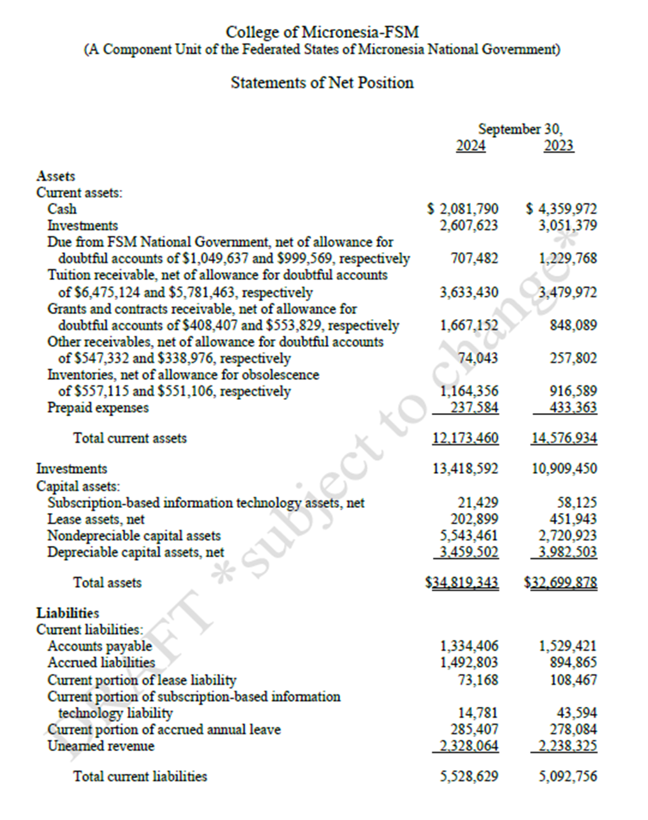
V- FY 2024 Audit Status

Slide 12
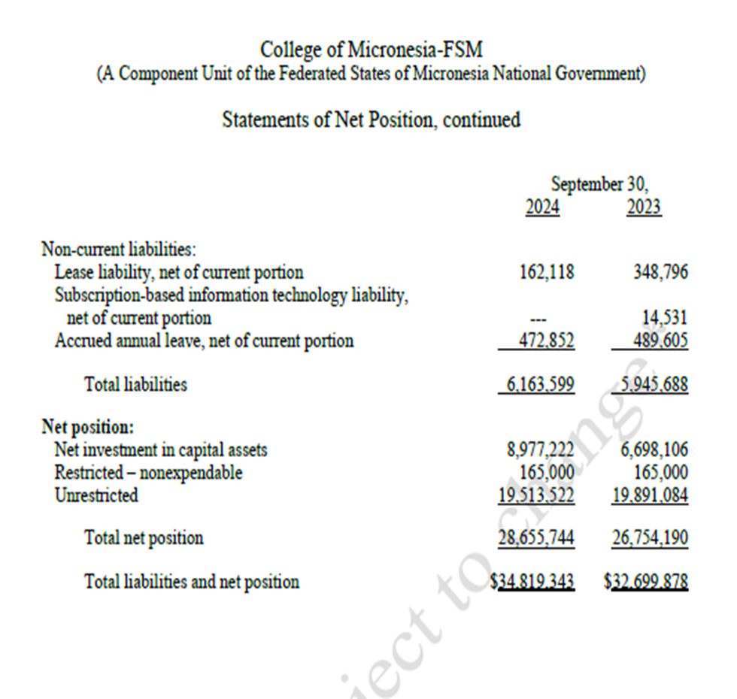

Slide 13
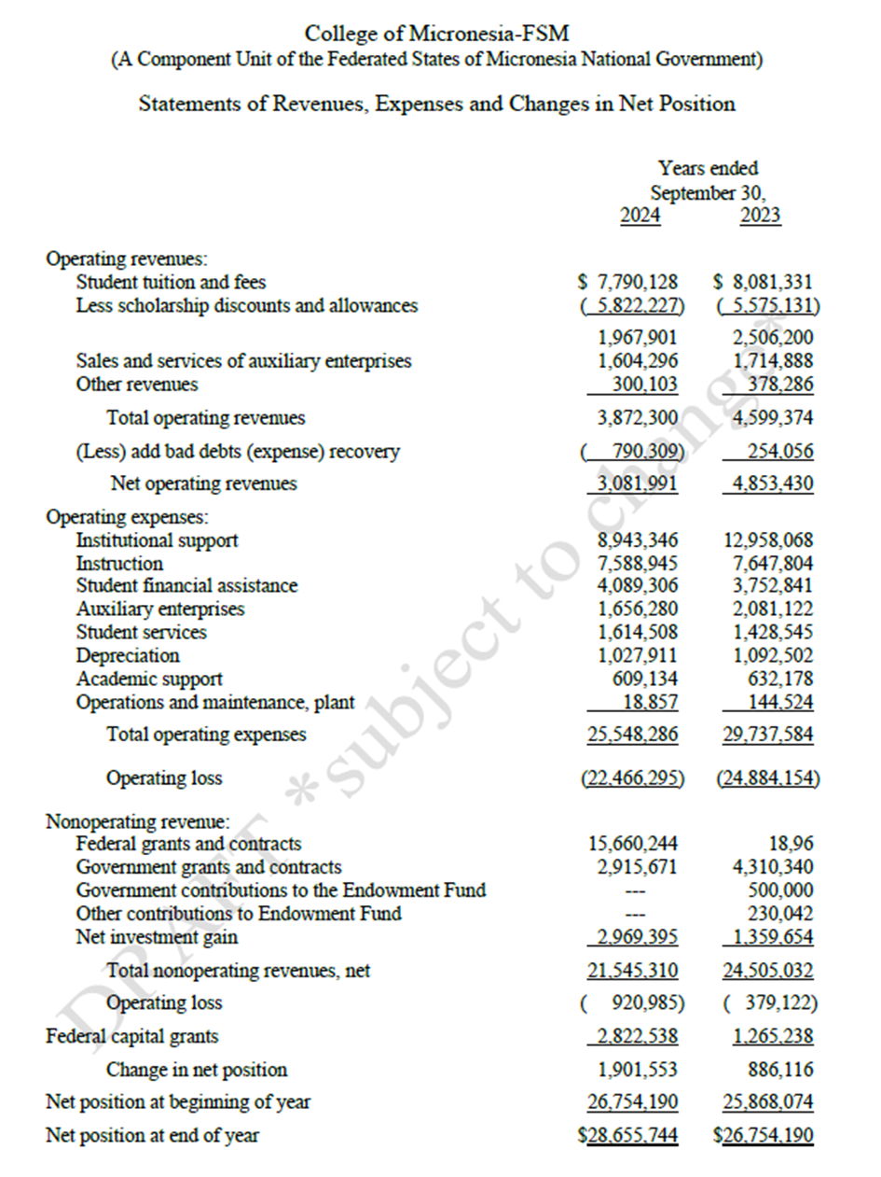

Slide 14
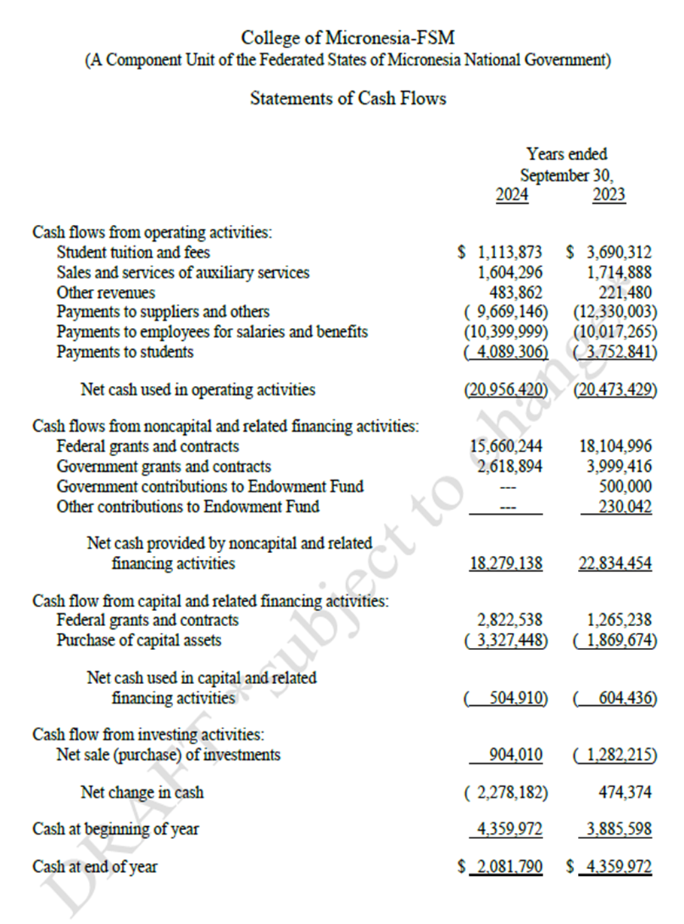

Slide 15
Summary of Audit Findings
Audit Findings | FY2023 | FY2024
2023-01 | Finding 2023-01 - Application of GASB Cod. N50, Nonexchange Transactions and GASB Cod. 2200, Annual Comprehensive Financial Report | -
2023-02 | Interfund payables/receivables | -
2023-03 | Grants and contracts receivables subsidiary ledgers | 2024-02(pending resolution)
2023-04 | Reporting | 2024-03
2023-05 | Special Tests and Provisions: Verification | 2024-04
2023-06 | Special Tests and Provisions: Gramm-Leach-Bliley Act–Student Information Security | 2024-05
2023-07 | Special Tests and Provisions: Disbursements to or on Behalf of Students | 2024-06
2023-08 | Special Tests and Provisions: Disbursements to or on Behalf of Students | 2024-07
2023-09 | Procurement, Suspension, and Debarment | -
2024-01 |  | Financial statement close process to effectively meet the external financial reporting objectives (pending resolution)

Slide 16
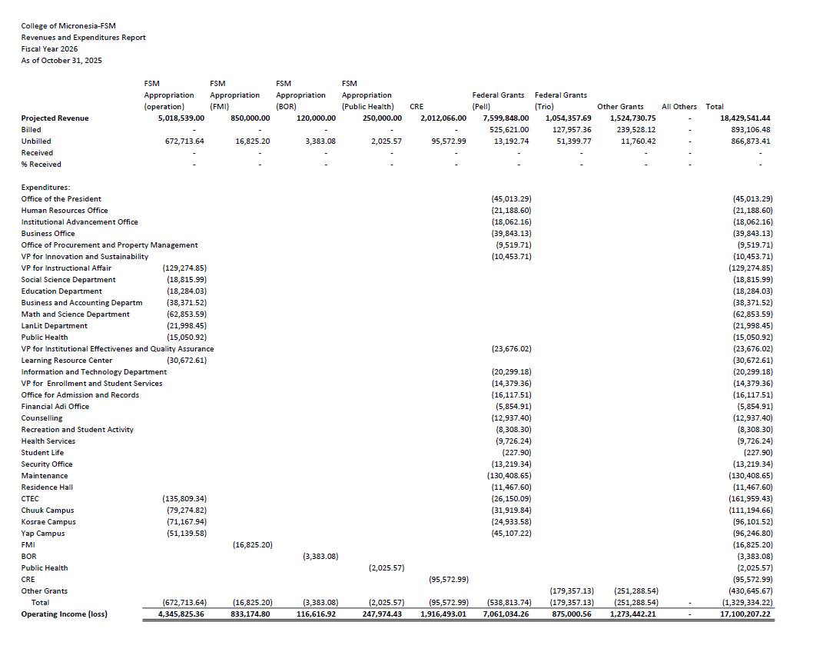
VI. Statement of Revenue and Expenditure

