Slide 1

College of Micronesia-FSM
Yap | Chuuk | Pohnpei | Kosrae
College of Micronesia-FSM is accredited by the Accrediting Commission for Community and Junior Colleges
Office of the President
Charting transformational journeys at COMFSM
BOR Meeting Presentation by President Theresa Koroivulaono (Ph. D): December 3-6, 2025

Slide 2




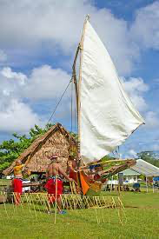

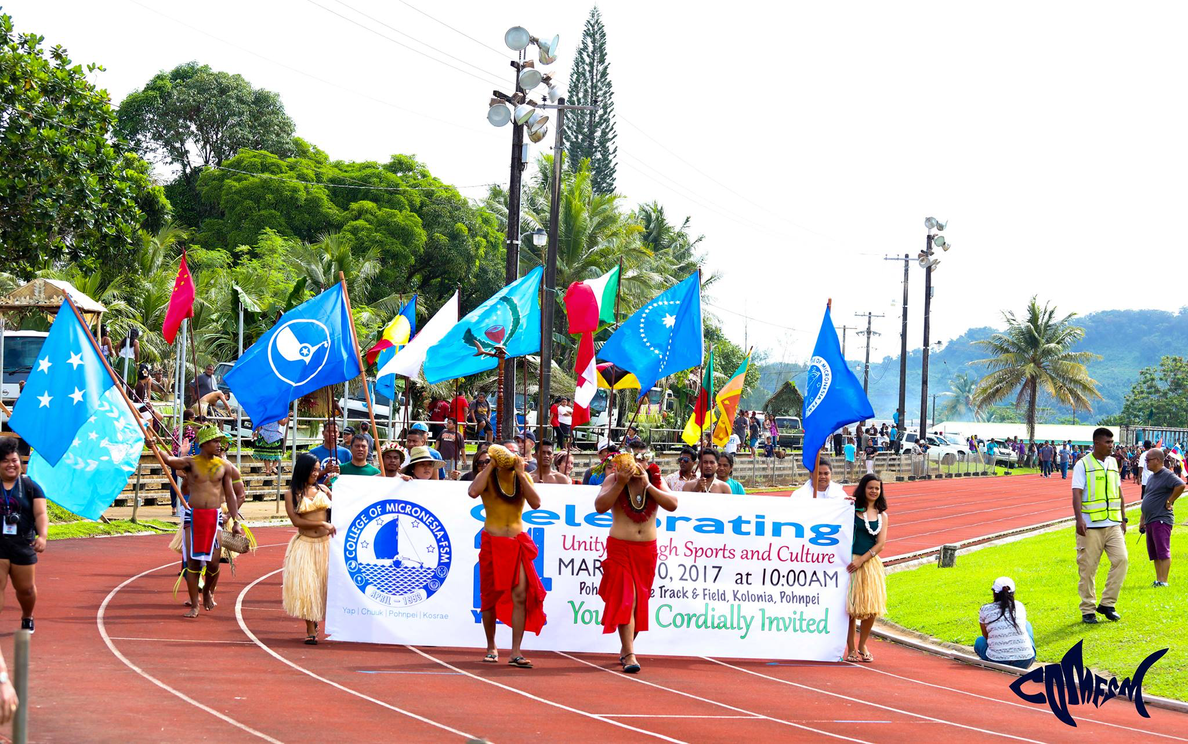



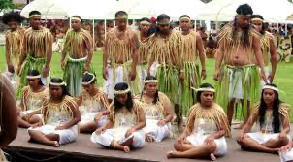
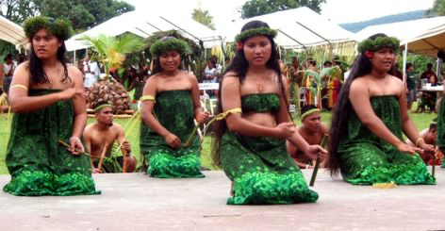

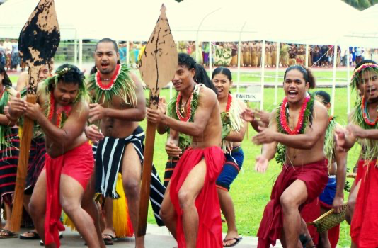


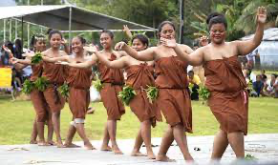
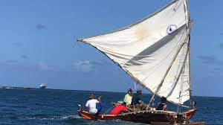



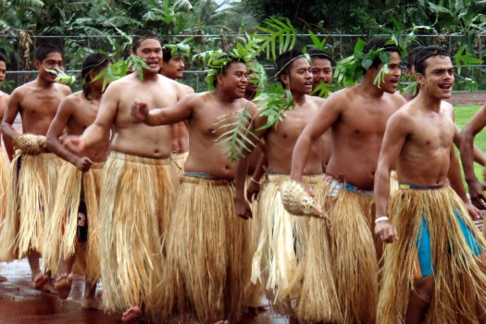
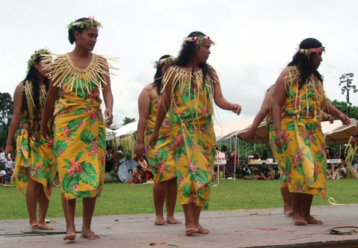
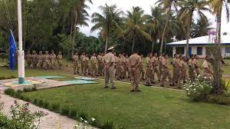
Office of the President
EDUCATIONAL MISSION
Office of the
President
The College of Micronesia-FSM is a learner-centered institution of higher education that is committed to the success of the Federated States of Micronesia by providing academic and career & technical educational programs characterized by continuous improvement and best practices.
INSTITUTIONAL VISION
We provide quality education today for a successful tomorrow.
INSTITUTIONAL CORE VALUES
Commitment
Excellence
Learner-Centeredness
Professionalism
Teamwork
Respect
Students Today
Leaders Tomorrow

Slide 3

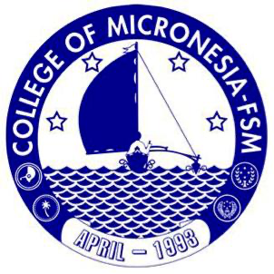
4 States, 6 Campuses, 1,000,000+ sq. miles of ocean
National Campus
P.O. Box 159, Palikir, Pohnpei FM 96941
Phone: (691) 320-2480 | Fax: (691) 320-2479 | E-Mail: national@comfsm.fm
Career & Technical Education Center
P.O. Box 614, Kolonia, Pohnpei FM 96941
Phone: (691) 320-3795 | Fax: (691) 320-3799 | E-Mail: pnisite@comfsm.fm
Chuuk Campus
P.O. Box 879, Went, Chuuk FM 96942
Phone: (691) 330-3689 | Fax: (691) 330-2740 | E-Mail: chksite@comfsm.fm
Yap Campus
P.O. Box 286, Colonia, Yap FM 96943
Phone: (691) 350-2296 | Fax: (691) 350-5150 | E-Mail: yapsite@comfsm.fm
Kosrae Campus
P.O. Box 37, Tofol, Kosrae FM 96944
Phone: (691) 370-3191| Fax: (691) 370-3193 | E-Mail: ksasite@comfsm.fm
FSM Fisheries & Maritime Institute
P.O. Box 1056, Colonia, Yap FM 96943
Phone: (691) 350-3544 | Fax: (691) 350-3545 | E-Mail: fmi@comfsm.fm
College of Micronesia-FSM is accredited by the Accrediting Commission for Community and Junior Colleges, Western Association of Schools and Colleges, 331 J Street Suite 200 Sacramento, CA 95814,(415) 506-0234, an institutional accrediting body recognized by the Council for Higher Education Accreditation and the U.S. Department of Education.

Slide 4
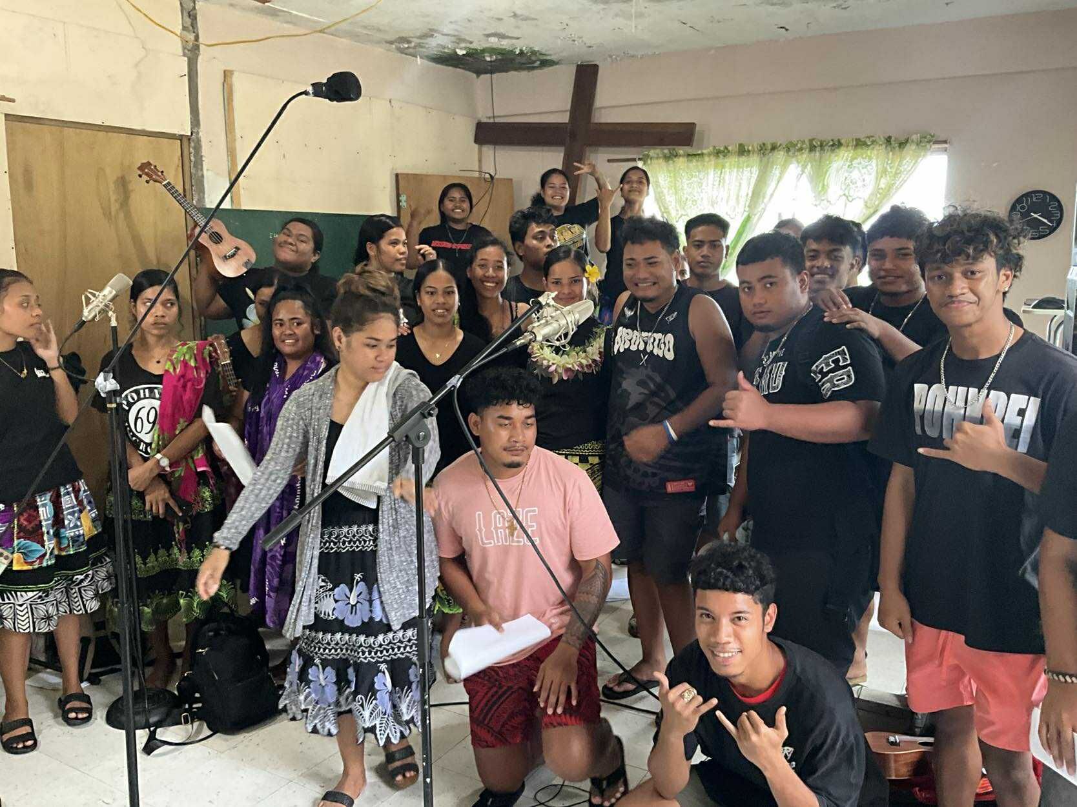
OVERVIEW
Office of the
President
OTP Vision
Transformation at COMFSM
      COMFSM:COLLEGE OF THE FUTURE
      Inherited education system
      Mainstreaming indigenous ways of learning
Students Today
Leaders Tomorrow

Slide 5
WORLD BANK PROJECT APPRAISAL
2022
Office of the
President
FSM’s economy is largely driven by the public sector, agriculture, and fisheries. In 2019, FSM’s gross domestic product (GDP) is estimated to have grown by 1.2 percent, equivalent to US$3,585 per capita.6 The public sector is a major part of the FSM economy, accounting for around 32 percent of GDP and 48 percent of formal sector employment. Outside of the public sector, agriculture and fisheries are the main economic activities, contributing around 23 percent of GDP. Small‐scale service industries, such as inbound tourism and wholesale and retail trade, make up the remainder of the economy. Most goods are imported and there are few exports. During FY20, FSM had a trade deficit (goods and services), with the total value of exports estimated at around US$98 million and the total value of imports at around US$271 million. Fiscal policy is highly dependent on foreign aid and fiscal transfers, primarily from the US via the Compact, typically for public investments, and service provision in education and health. Foreign grants have averaged 35 percent of GDP over the past decade.
The FSM labor market is characterized by relatively low formal employment, high unemployment, and a high share of outward migration.While there are no recent labor market data available, the 2010 census suggested that around half of the FSM’s labor force was in formal employment while a quarter was engaged in subsistence, with the remainder unemployed. Of those engaged in the formal sector, around half were engaged by the private sector. In the 2013 Household Income and Expenditure Survey (HIES) among adults of age 25 years and older, higher education attainment was associated with a higher likelihood of being engaged in paid employment, and among adults who completed high school or an associate degree, paid employment was 15 percentage points higher than among those who completed elementary school only. Half and three‐quarters of those with college and postgraduate degrees, respectively, were likely to be engaged in paid employment. The Organisation for Economic Co‐operation and Development migration database reports that as of 2017 (latest available data), over 31,000 Micronesians are living in the United States. More than 60 percent of the migrants to the US mainland were most likely to be in paid employment, and the ratio of private‐to‐public sector jobs is high. Wages for paid migrant workers suggest that the majority are in labor‐intensive industries.
Students Today
Leaders Tomorrow
https://documents1.worldbank.org/curated/en/159891651843033906/pdf/Micronesia-FSM-Skills-and-Employability-Enhancement-Project.pdf

Slide 6
WORKFORCE NEEDS ASSESSMENT
Office of the
President
Desktop research
Partnerships
Unifying themes
Need up-to-date FSM data
National + State + the College
Culture
Artificial Intelligence
Students Today
Leaders Tomorrow

Slide 7
CURRICULUM REVIEW: INITIAL FINDINGS
Office of the
President
Some emerging trends from the review:
Associate and Bachelor’s programs with increasing and decreasing enrollments;
Certificate programs show an increasing enrollment trend with the newer technologies and decreases in the older programs;
Some evidence is available that point to decreasing enrollments in some areas which are requested as high priority by the 4 States;
Graduation numbers show annual fluctuations but are generally trending upward;
Less than 50% of students are enrolled in online courses;
Our learning resources, for example text books will need further review for relevance and updating;
Thus far, none of the reviewed courses have incorporated AI;
7% of reviewed courses included SLOs related to Indigenous Micronesian skills, knowledge, cultures, and languages.
12% of reviewed courses included content related to Indigenous Micronesian skills, knowledge, cultures, and languages.
9% of reviewed courses included strategies to support and engage with multilingual English learners.
61% of reviewed courses include some kind of learning technologies.
Students Today
Leaders Tomorrow

Slide 8
CURRICULUM REVIEW FOR TRANSFORMATION
Office of the
President
Enrollment (programs)
Syllabi, Course & Program Reviews
Surveys & Focus Groups
Fluctuating Enrollment Trends
Basis for Transformation
Informed Transformation
Students Today
Leaders Tomorrow

Slide 9
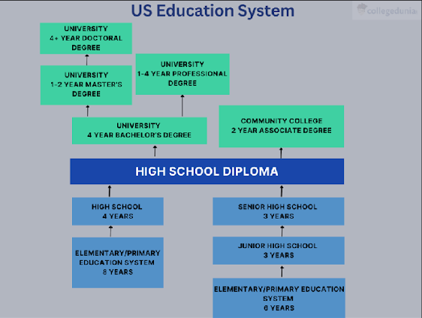
INHERITED EDUCATION SYSTEM
Office of the
President
Students Today
Leaders Tomorrow

Slide 10
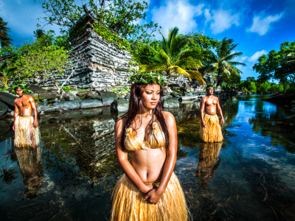
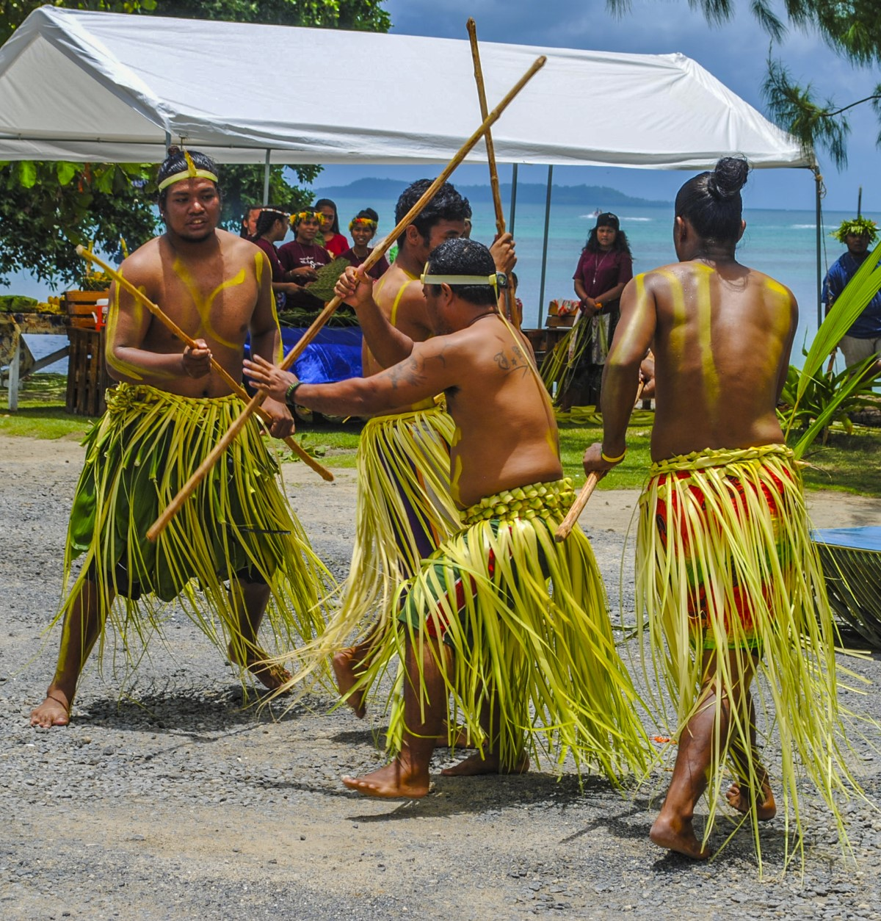
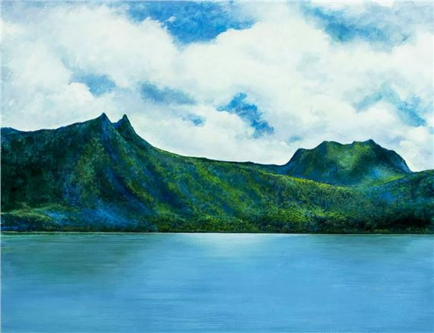
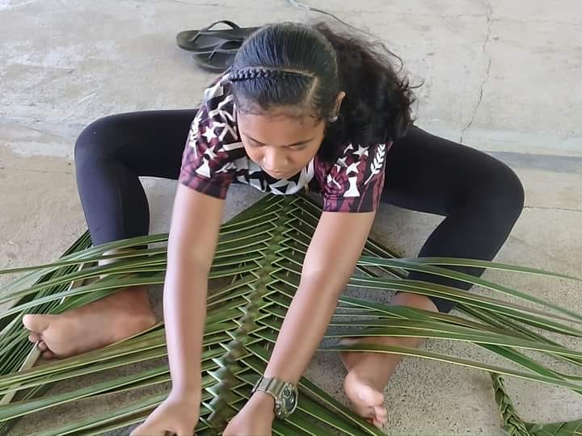
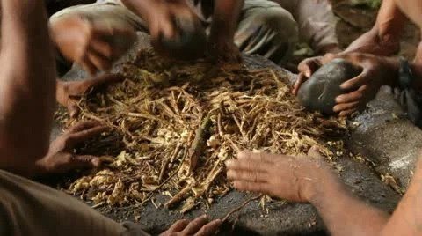
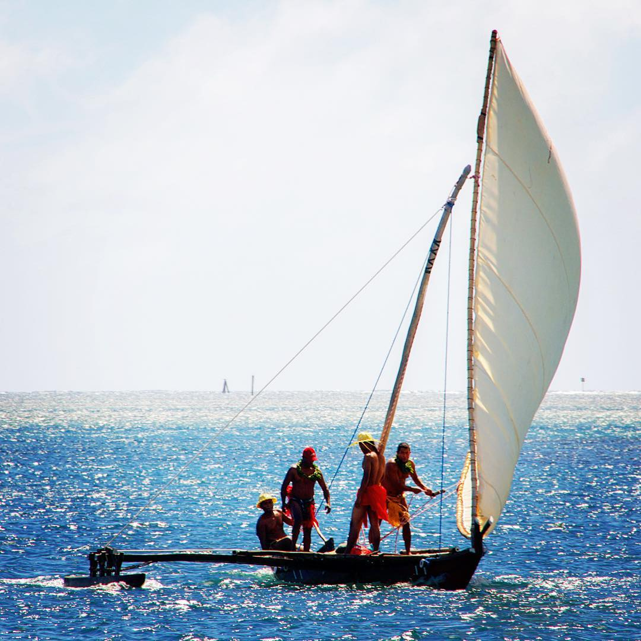
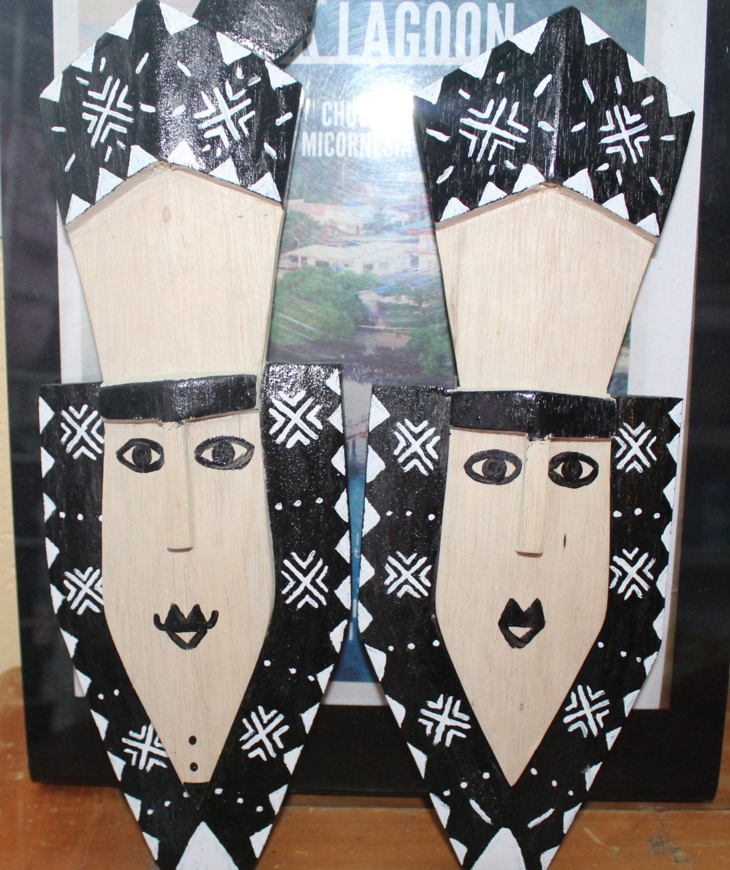
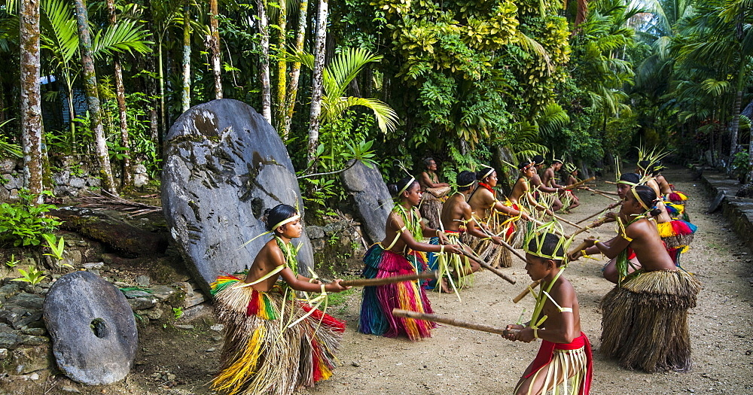
OUR INDIGENOUS WAYS OF KNOWING
Office of the
President
Students Today
Leaders Tomorrow

Slide 11
MAINSTREAM INDIGENOUS WAYS OF KNOWING
Office of the
President
2.0. Traditional Navigation
2.1 Practical Traditional Navigation Exercises: Have students navigate a predetermined course using traditional navigation methods. Assess their ability to accurately determine their position, course, and speed depending on the ocean, the winds and signs from wayfinding knowledge presented by the master navigator.
ASSESSING:
2.2. students’ ability to name the stars, star pairings, star-island pairing, and other methods of wayfinding as taught by the traditional master navigator.
2.3. student’s ability to PAFIUSIU, demonstrate proficiency and mastery in the
knowledge of star naming and identification. (PAFIUSIU).
2.4. student’s oral demonstration of their proficiency in naming bearings and reciprocal bearings of navigational stars and constellations. (GASHOUMWU).
2.5. student’s proficiency in demonstrating his/her knowledge when naming bearings of navigational stars and constellations in the celestial sphere in connection with the longitudinal and athwart directions of a canoe. (GEMAT).
2.6. student’s demonstration of their proficiency through oral presentations in the knowledge of naming the bearings of islands within the Micronesian region. (WOFALIUWE).
2.7. student’s mastery through oral demonstration proficiency in the knowledge of bearings of birds and flocks of birds, fish and groups of fish, sea creatures, insects, submerged reefs and other phenomena on the sea, from a reference point or an island. (BUGOFFI).
  Oral Knowledge Sharing & Storytelling:
  Assignment for students: Ask the students to create a 1.5 minutes video interviewing an elder in their family and to ask about tales of origin on their island.
ASSESSING
The students must do the following tasks:
Create a consent form to formalize the consent of their interviewees.
Demonstrate that they completed/performed any required rituals or customs in the process of asking their elders if they can be interviewed.
Prepare 3 questions for the interview.
Only use mobile smart phones.
Use cutaways to relevant footage/objects (e.g. canoes, plants, fish, etc.) to illustrate the narrative at selected intervals while an interviewee is talking on camera.
If there are any soundtracks used in the video production, provide acknowledgements of the intellectual property owner.
Be prepared to present your video to the class with a short summary (before showing the video) about the process you followed and then answer questions at the conclusion.
4 main languages:
KOSRAEN, POHNPEIAN, CHUUKESE YAPESE
ALL LIVING ORAL CULTURES
1 language of instruction:
ENGLISH
LITERATE CULTURE
Students Today
Leaders Tomorrow

Slide 12
EDUCATION-DRIVEN TECHNOLOGY AT COMFSM
Office of the
President
Storytelling techniques
  Clarity
  Coherence
  Non-verbal communication
  Creativity
  Engagement
  Accuracy of content
Assessment
  Culturally appropriate
  Oral language proficiency
The Spoken Word
Artefacts of Learning
Interactive Oral Quizzes: LMS, Flipgrid, Padlet, Podcasts etc.
Audio recordings
Talking story/Audio notes/Pronunciation & Fluency
Live oral exams
Videos
Dynamic environment; directly applicable to oral culture discourse
Zoom, Big Blue Button, Microsoft Teams Rooms etc.
Song & Dance performances/Non-verbal cues/Ceremonial oral presentations
Digital storytelling
Students Today
Leaders Tomorrow
Voice, images, music & text = multimedia story; 'a picture paints a thousand words'

Slide 13
LEVERAGING AI FOR TRANSFORMATION
Office of the
President
COMMITMENT TO CULTURAL & INSTITUTIONAL VALUES
Foundation
- Strategic alignment
- Scope
- Ethical principles for use
- Acceptable ways to use AI
Monitoring & Review
- Unacceptable uses
- Enforcement & sanctions
Stanford University’s Institute for Human-Centered AI, MIT’s Responsible AI guidelines, UNESCO’s Recommendation on the Ethics of Artificial Intelligence, OECD’s AI Principles, EDUCAUSE AI Guidance for Higher Education, Ethical principles from OpenAI, and Google, Palau Community College.
Students Today
Leaders Tomorrow

Slide 14
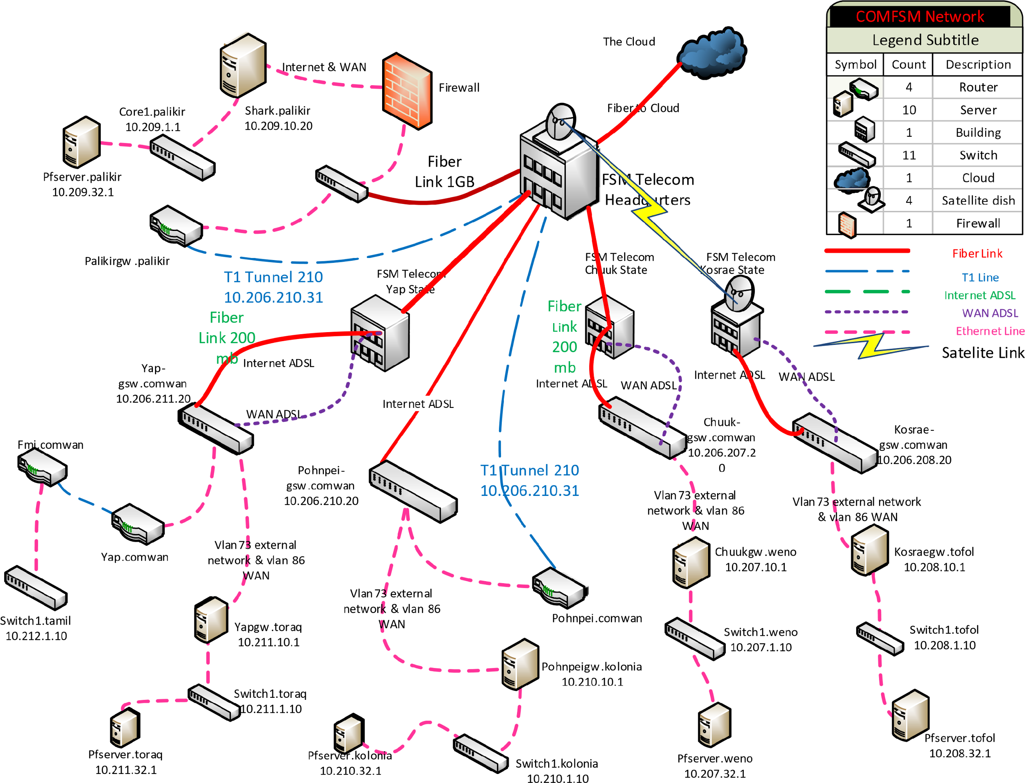
CURRENT IT INFRASTRUCTURE
Office of the
President
10 physical servers: multiple systems & backups
YAP,CHUUK, KOSRAE & CTEC campuses: 1 gateway server each supporting local services & acts as a secure network hub; 1 packet-fence server each serving as the WiFi system
Old equipment
Limited sandbox environments.
Students Today
Leaders Tomorrow

Slide 15
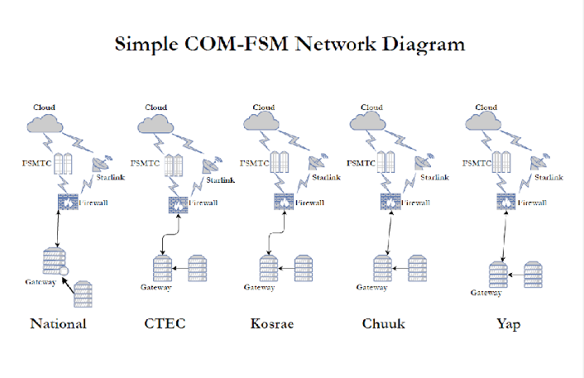
TRANSFORMING OUR IT INFRASTRUCTURE
Office of the
President
Create ‘SharkNet’
Expand visualization clusters at the National Campus to support student lab simulations: e. g. IT, cybersecurity, science modelling, simulated learning environments
The Nursing program is currently testing VR/AR for immersive learning
AI integration with Moodle & SIS
Students Today
Leaders Tomorrow

Slide 16
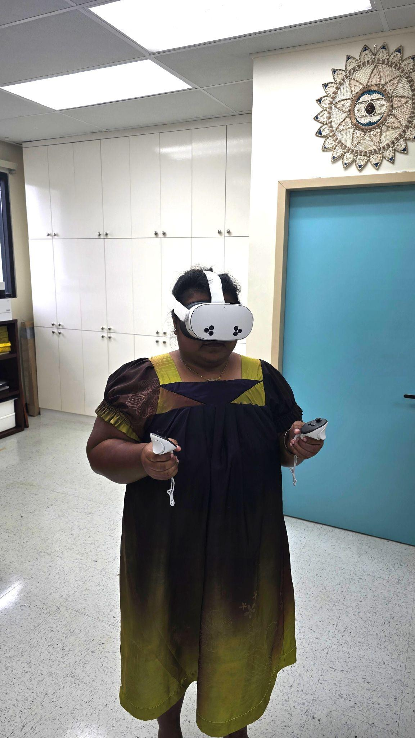
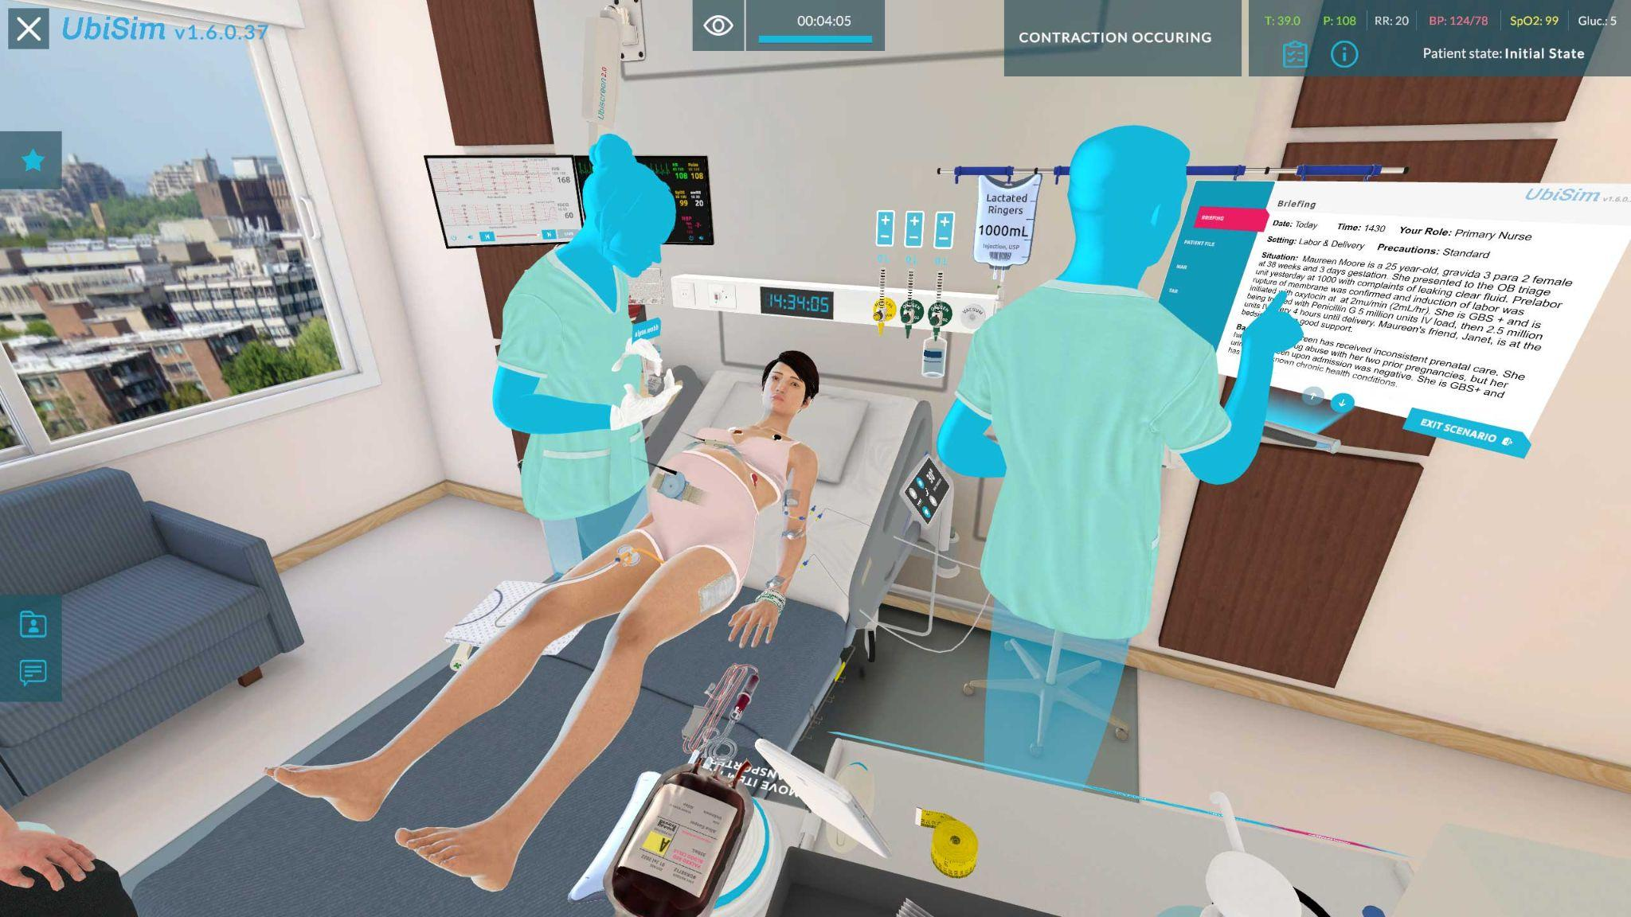
NURSING METAVR
Office of the
President
Students Today
Leaders Tomorrow
https://www.ubisimvr.com/research/what-the-data-tell-us-about-ubisim
Notes:
This increases to $1,037.37 in FY2025.

Slide 17

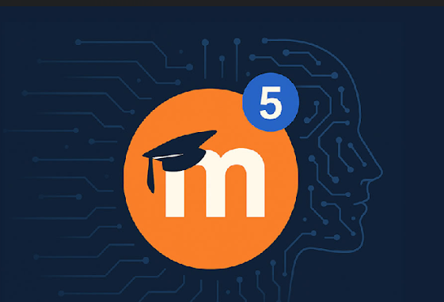
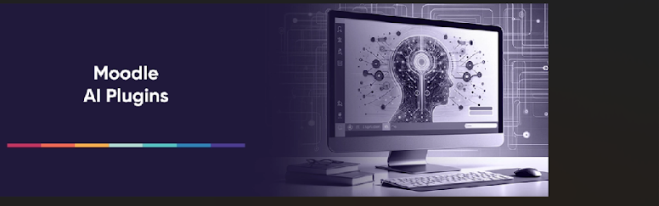
TRANSFORMING LEARNING
Office of the
President
Moodle AI to be piloted by the start of Spring 2026
COMFSM’s Moodle site will be upgraded to Moodle 5.0 by the end of Fall 2025
Focus on the use of H5P to increase ‘engaging learning experiences’
Establish a Virtual Campus
Students Today
Leaders Tomorrow

Slide 18
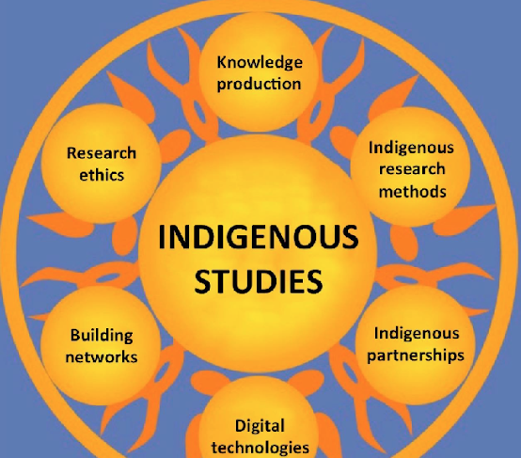
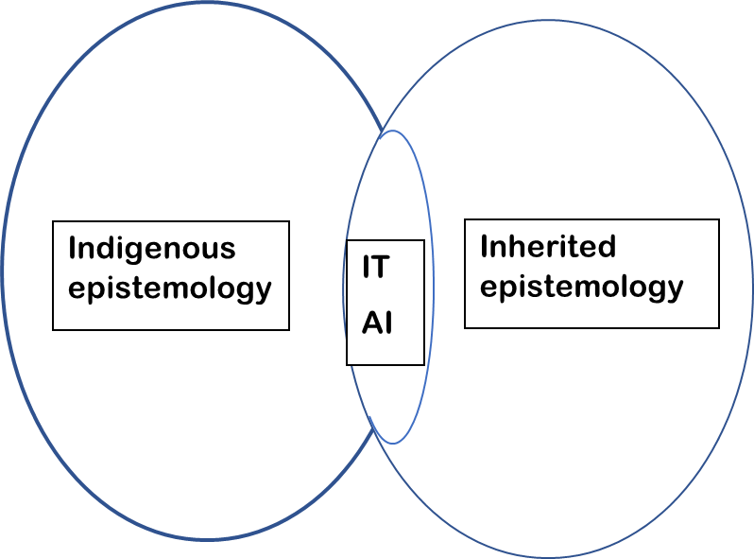

DIGITIZING INDIGENOUS WAYS OF LEARNING

Slide 19

THE College of the Future in the FSM for the FSM & Beyond
STRATEGIC
PLAN
2025
-
2030
MISSION
Office of the
President
Integrated Education Master Plan
2024 - 2034
VIRTUAL COLLEGE
Strategic Plan 2025-2030
ACCESS INNOVATION RESILIENCE
ENTREPRENEUR OCEAN & LAND MANAGERS
GREEN ECONOMIES
Actionable Implementation Plans
OTP, IA, EMSS, IEQA, AS, CRE
Students Today
Leaders Tomorrow
Key Performance Indicators

Slide 20
End of Presentation
Thank you!
College of Micronesia-FSM
Yap | Chuuk | Pohnpei | Kosrae
College of Micronesia-FSM is accredited by the Accrediting Commission for Community and Junior Colleges

Slide 21
REFERENCES
Office of the
President
Slide 9
https://www.ed.gov/about/ed-overview/mission-of-the-us-department-of-education#:~:text=ED's%20mission%20is%20to%20promote,%2D88%20of%20October%201979
Slide 10
https://southpacificislands.travel/welcome-to-the-federated-states-of-micronesia-fsm/
https://visit-micronesia.fm/traditional-culture/
https://www.facebook.com/KosraeIsland/posts/this-7th-grade-student-in-kosrae-is-sharing-her-weaving-skills-on-how-to-make-ti/960934049367484/
https://www.mutualart.com/Artwork/Landscape-Micronesia--Kosrae---Sleeping-/8A642B80339A3ABE242E019490BC5911
Students Today
Leaders Tomorrow

